Slide 1
Federal-Aid Project Delivery: General Overview for Locally Administered Projects
March 2022

Slide 2
Locally Administered Projects Overview
Federal-Aid Project Delivery
What you will learn from this Presentation:
Major Steps of administering a federal-aid project by a local government agency
Resources available for local government agencies
EBS Portal – managing your project online

Slide 3
Basic Requirements for Federal-aid Projects
Federal-Aid Project Delivery
Federal-aid funding is cost-reimbursement
Funding Authorization is required prior to each phase of work
Local Government Agency (LGA) has the responsibility to deliver the project
NCDOT has the responsibility to provide oversight to LGAs and ensure appropriate use of funds
Notes:
This is not a grant; we don’t cut you a check up front; you do the work, you pay 100% for the work, and we reimburse the agreed upon share, which is generally 80%, but it could be less depending on whether the LGA has committed a larger local match.
FHWA must authorize funds for each phase of the project before work on that phase can begin.
Locally administered projects mean that the local municipalities and governments implement the project – you develop plans, you acquire right of way, you let and enter into a construction contract to build the project
NCDOT’s role is to provide guidance, oversight, and reimbursement. On occasion, the Department will provide a phase of work, for example, the construction engineering and inspection and/or contract administration. If the Department provides this work, then we will charge to the project, using federal funds + local match.

Slide 4
PROJECT DELIVERY – MAJOR STEPS

Slide 5
Pre-Construction “Mountain”
Federal-Aid Project Delivery
Right of Way/Utility/RR Certification
Right of Way Acquisition (and Utility Relocation)
Environmental Document
Agreement
Programming (includes Schedule)
Procuring Professional Services
Right of Way Plans
Final Plans, Specifications, and Estimate
Right of Way (ROW) Authorization
Preliminary Engineering (PE) Authorization
Notes:
Start at the bottom of the “mountain:
Items in BOLD are deliverables and are required to be completed before moving to the next AUTHORIZATION phase.
Items after the arrows cannot be started until the funding authorization is obtained.

Slide 6
Construction “Mountain”
Federal-Aid Project Delivery
Final Voucher Date
Final Inspection and Project Acceptance
Construction
Bidding, Letting, and Awarding Construction Contract
Construction Engineering and Inspection
Maintenance
Final Reimbursement
Construction (CON) Authorization
Notes:
Start at the bottom of the “mountain:
Items in BOLD are deliverables and are required to be completed before moving to the next AUTHORIZATION phase.
Items after the arrows cannot be started until the funding authorization is obtained.

Slide 7
Agreement
Federal-Aid Project Delivery
Requested by the LGA through the EBS Portal
Executed between NCDOT and the Local Governmental Agency
Includes provisions that LGA must comply with in order to receive reimbursement
Includes funding, time frames, scope of work, and responsibilities
Funding Authorizations cannot occur until a fully executed agreement is in place.
Notes:
An agreement can be requested once a project is programmed in the STIP (State Transportation Improvement Program). The funding program (in this case the MPO) should notify the LGA when the Project is programmed and an agreement can be requested through our Local Projects Management System (EBS Portal).
The Agreement is the tool that enables NCDOT to reimburse the LGA for the scope of work. Without the agreement, we cannot reimburse the LGA. The Agreement runs on DOT’s Board Agenda and DOT can sign after the LGA has approved and signed.
It can take 3-4 months to get an agreement fully executed, but the Department is using DocuSign, which can cut down on the transit time.

Slide 8
Agreement
Federal-Aid Project Delivery
Federal Funding Accountability and Transparency Act (FFATA)
FFATA Subrecipient Form – is required to be completed once each state fiscal year or each time contact or officer information changes, until the project is completed
The NCDOT requires that Subrecipient data be provided by each Local Agency Subrecipient working on federally funded projects of $30,000 or greater.
It is only required for Subrecipients that use Federal funds for locally administered Transportation and Infrastructure projects.
The form can be found in the Forms & Templates column at https://connect.ncdot.gov/municipalities/Funding/Pages/default.aspx
Form needs to be submitted to the NCDOT Fiscal Management Division, Kelly Blackwood (ffata@ncdot.gov).
Notes:
This form is only required for Subrecipients that use Federal funds for locally administered Transportation and Infrastructure projects. The form is required to be completed once each state fiscal year or each time contact or officer information changes.

Slide 9
Funding Authorizations
Federal-Aid Project Delivery
For every phase that is eligible for reimbursement, the LGA must request funding authorization through the EBS
PE: Preliminary Engineering – pays for professional engineering services, and other pre-construction activities
ROW: Right of Way and Utility Relocation – pays for costs of acquiring ROW, relocating utilities, appraisals and other ROW associated costs
CON: Construction – pays for the construction contract, construction engineering and inspection (CEI), and contract administration.
Notes:
Funding Authorization is the method by which the Federal Government allows the initiation of work to occur for that phase. So no work can occur on the phase on which you want reimbursement, unless you have authorization. There are certain deliverables that are required in order to authorize funds for each phase – refer to your Pre-Construction and Construction Steps - “mountains”.

Slide 10
Funding Authorizations
Federal-Aid Project Delivery
Note deliverables (from the steps) that are needed prior to requesting funding authorization
Funding authorization starts the clock with FHWA
Funding authorization still requires reviews of proposed costs with NCDOT prior to LGA incurring costs
NCDOT will use your funding
Notes:
Once FHWA Authorizes funds, they can only see activity if they are reimbursing funds. When an LGA incurs costs, you pay for the work, then turn around and bill NCDOT. We review and reimburse you, then we turn around and bill FHWA. Until FHWA pays NCDOT, they do not see any activity on the projects. FHWA is running reports at six months to see which projects have had no activity (or billing). Make sure when funds are authorized you are ready to proceed with work so that project does not become inactive.
Ensure that NCDOT reviews proposed costs (consultant contracts, ROW acquisition, construction awards) prior to entering into contracts so that we can document to auditors that we have provided appropriate review and approval of those anticipated costs.
As NCDOT provides oversight, the Department will charge directly to your project so that our costs will go against your awarded funding. The LGA is responsible for the non-federal funding for any Federal funding used – whether those funds are used by a third-party consultant/vendor/contractor or NCDOT.

Slide 11
Professional Services
Federal-Aid Project Delivery
LGA is responsible for soliciting and selecting consultants in accordance with federal regulations, state statutes, and NCDOT policy
NCDOT provides a standard template that can adapted for either Design or CEI work as needed
LGA must follow a qualifications-based selection process; NCDOT will review and concur with the selection of a consultant and the negotiated amount of the contract
Notes:
Federal Regulations require qualifications-based selection process. The state general statute and NCDOT’s policy for consultant selection basically mirrors this process. This process usually includes advertisement, a review of proposals based on qualifications, a selection process that is documented by the LGA, then negotiation of a contract, and review by DOT.

Slide 12
Environmental Documentation
Federal-Aid Project Delivery
Must be in conformance with NEPA – National Environmental Policy Act
Must also comply with other Federal environmental laws
Most projects qualify as a Categorical Exclusion (CE) Document
In order to authorize either ROW funds or Construction funds, we must have a completed environmental document.

Slide 13
Design
Federal-Aid Project Delivery
Follow NCDOT Design Standards for Roadways and Structures
Use NCDOT details, for example wheelchair ramps, curb and gutter, etc.
Work with Division on when plans should be submitted for review; complex projects may need an earlier review than simpler projects
Review may occur solely at the Division or certain reviews may occur in Raleigh

Slide 14
Right of Way
Federal-Aid Project Delivery
Any kind of ROW, whether it’s acquisition in fee simple, or you’re entering into an easement (temporary or permanent), or an encroachment, must be properly documented and then certified
All acquisition must be in conformance with the “Uniform Act,” whether ROW Acquisition is being reimbursed with Federal funds or not
Appraisals must be reviewed by NCDOT, even if ROW is not an eligible expense; NCODT will provide a concurrence in “just compensation”
If ROW is an eligible phase, ROW Funding must be authorized prior to acquiring ROW
Notes:
Be aware of lack of records on right of way and the potential need to acquire multiple small amounts of ROW or easements, particularly for linear projects.

Slide 15
Utility Relocation
Federal-Aid Project Delivery
All utilities should be cleared from the Project Area, prior to moving into construction
Costs for third-party utility providers to relocate utilities must be reviewed by NCDOT before LGA enters into contract.
Notes:
Be mindful of multiple utilities and the time it takes to relocate – you are often at the mercy of the utility owners’ schedule.

Slide 16
Right of Way / Utility / RR Certification
Federal-Aid Project Delivery
Certification ensures that LGA has control of all ROW needed for project and the ROW is clear from all obstructions
Either the LGA owns outright or has a lease, easement, or other legal document to control ROW
Certification should also address any utility or railroad conflicts:
Utilities should be relocated out of the project area; or,
Utility relocation should be included in the construction contract; and,
Any RR conflicts must be documented with agreements/approval from RR to encroach on their property
Notes:
The third piece is the ROW Certification – the Division ROW Agent reviews your acquisition process, your property – they usually need a final set of plans and any documentation that shows your “control” of the property – through deeds, lease, easements. We have some forms on our website that help you compile your information.

Slide 17
Contract Proposal and Estimate
Federal-Aid Project Delivery
Contract Proposal is prepared in accordance with the 2018 North Carolina Standard Specifications for Roads and Structures
Proposal will include federal provisions that will be part of the contract
The engineer’s estimate is a line-item estimate that references the Spec Book or special provisions
The engineer’s estimate is also used to set a goal for Disadvantaged Business Enterprise firms
Notes:
Refer to this website when putting together contract proposals - https://connect.ncdot.gov/municipalities/Pages/Bid-Proposals-for-LGA.aspx
Most proposals and estimates can be reviewed at the Division Office – for larger (esp. over $2 million) or for more complex projects, the review may occur in Raleigh.
Some of the common federal provisions: Disadvantaged Business enterprise goal (will not use state women/minority business goals), Buy America (iron/steel permanently incorporated), proprietary items – cannot specify make/brand/model – must write provision to describe the item you want, or there’s a process for requesting an exemption in the event of synchronicity.

Slide 18
Construction Procurement
Federal-Aid Project Delivery
Advertising and Letting a Construction Contract can only occur after Construction funds are authorized
NCDOT must review and concur in the LGA’s proposal to award a construction contract
We have template letters and forms to use when requesting concurrence
Notes:
Construction Procurement – also known as bidding, letting and awarding a construction contract. In the DOT world, let date is the date you open bids.
NCDOT will provide a notice to proceed when funding is authorized and you are approved to advertise.
LGA must select the lowest responsive, responsible, ensure they have met the DBE goal and are pre-qualified by the Department to do the work.

Slide 19
Construction
Federal-Aid Project Delivery
Contract Administration and Construction Engineering & Inspection (CEI) is accomplished by the LGA in accordance with the NCDOT Construction Manual
LGA should hire a professional engineering firm to provide these services – follow Professional Services guidance
NCDOT will provide oversight through the Division Office or the Resident Engineer’s Office
NCDOT must concur with the LGA’s acceptance of the project before final reimbursement can be made

Slide 20
Reimbursement
Federal-Aid Project Delivery
Can occur throughout the project as costs are incurred
LGA pays full invoice; NCDOT reimburses 80% of eligible costs up to amount in agreement
Final Reimbursement will not occur until project is complete, accepted by NCDOT, and all reporting and other requirements have been accomplished
Notes:
LGA will submit reimbursement requests through the on-line project management system.

Slide 21
Close-Out and Final Voucher Date
Federal-Aid Project Delivery
Department will process several items related to closing out the LGA project:
Ensuring that LGA has all appropriate records
Calculating any costs that the LGA owes the Department
Certifying materials permanently incorporated in the Project
Once these items are accomplished, NCDOT will request FHWA close the project and issue a Final Voucher Date
Final Voucher date will start retention of records period

Slide 22
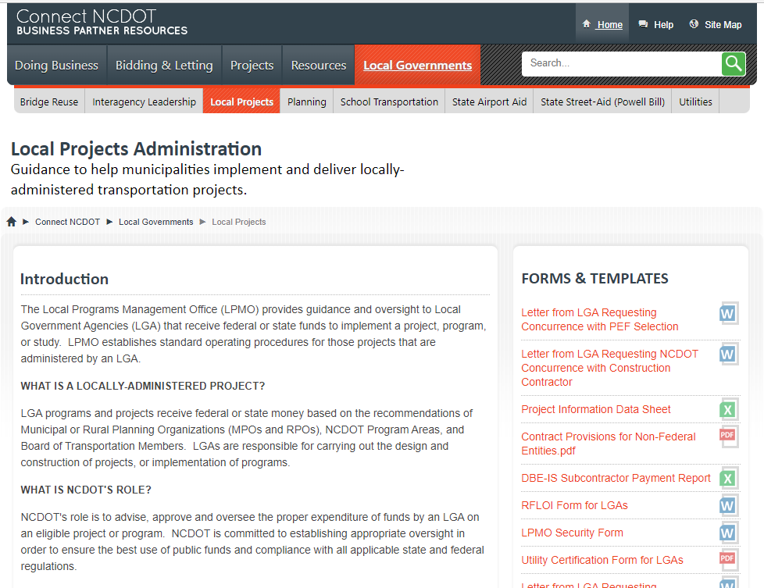
RESOURCES
Federal-Aid Project Delivery
https://connect.ncdot.gov/municipalities/Funding/Pages/default.aspx

Slide 23
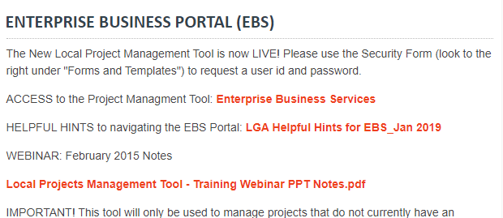
RESOURCES
Federal-Aid Project Delivery

Slide 24
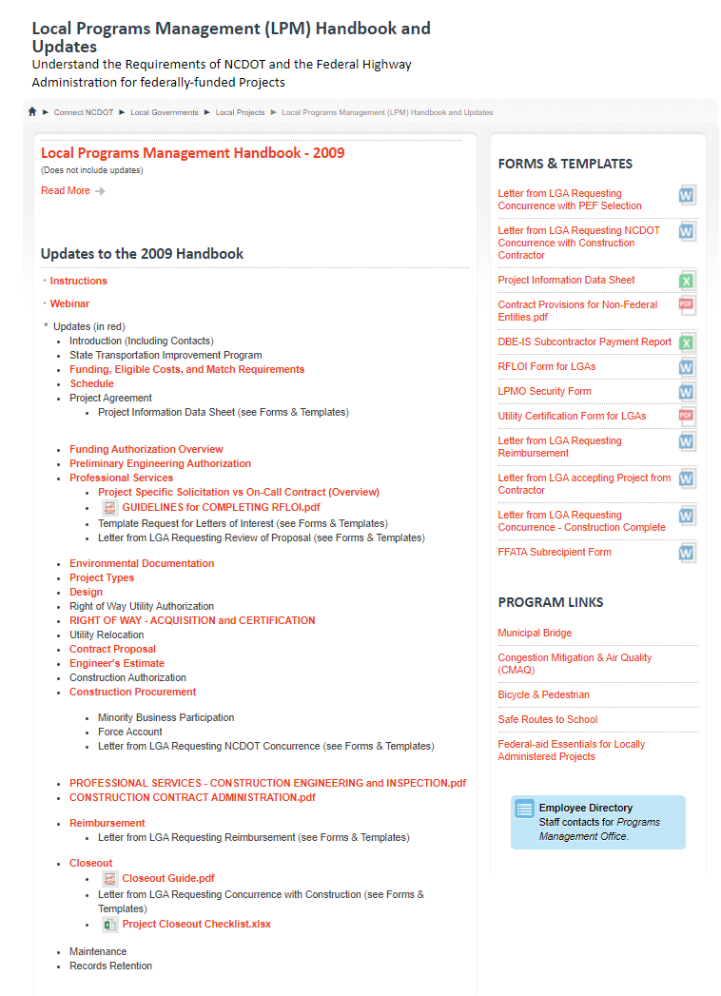
RESOURCES
Federal-Aid Project Delivery

Slide 25
Local Project Management Tool
The Project Management Tool on the EBS Portal will be used to:
Request New Agreements and Supplemental Agreements
Submit Documents for review by the Department
Request Funding Authorizations for each phase of work
Submit Reimbursement Requests for work performed
Notes:
The Local Project Management Tool is our way of managing the paper process of administering your project. While we will still use e-mails and phone and letters to document steps and questions, the Project Management Tool will be the electronic file cabinet for all documents pertaining to the project.

Slide 26
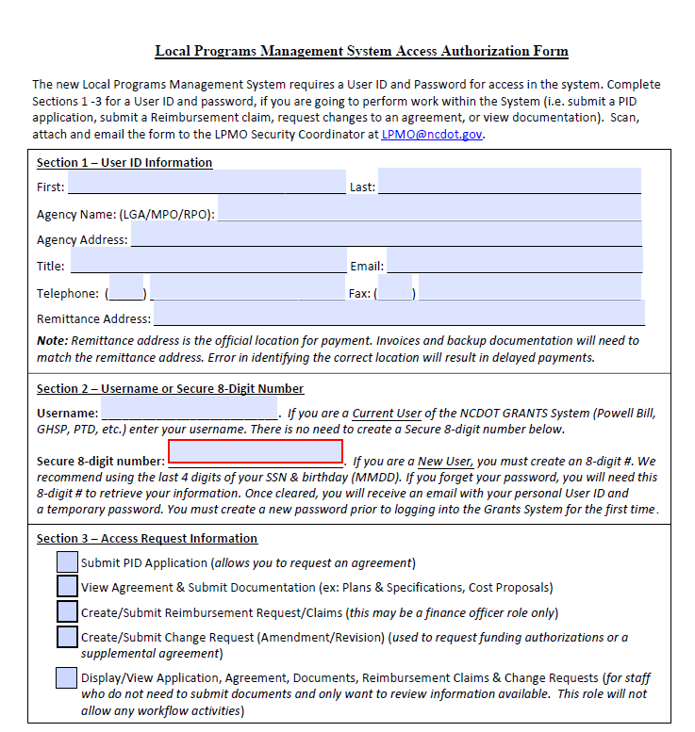
LPMO Security Form
LPMO Security Form
Must have a user id and password to access the EBS portal and Local Projects.
Form is on the Connect website.
If you already have access to EBS portal, then indicate that in Section 2 of the form.
Notes:
You must have a user id and password to log into the EBS portal and access the Local Projects System. Download the form from the Connect website, complete it and e-mail to the address indicated. If you already have access to the EBS portal, for example for Powell Bill or Public Transportation, you must indicate that on the form. You will use your same login, but NCDOT will need to update your role to allow you access to the Local Projects System.

Slide 27
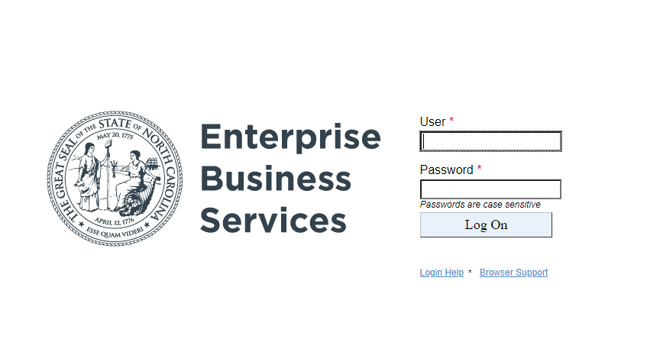
Local Project Management Tool
https://www.ebs.nc.gov/irj/portal

Slide 28
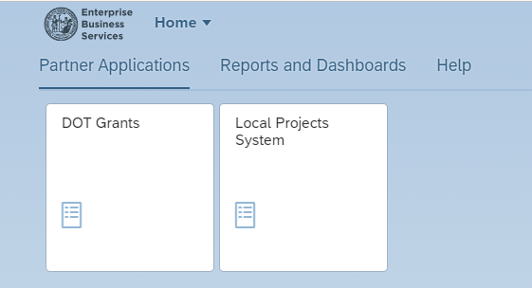
Local Project Management Tool

Slide 29
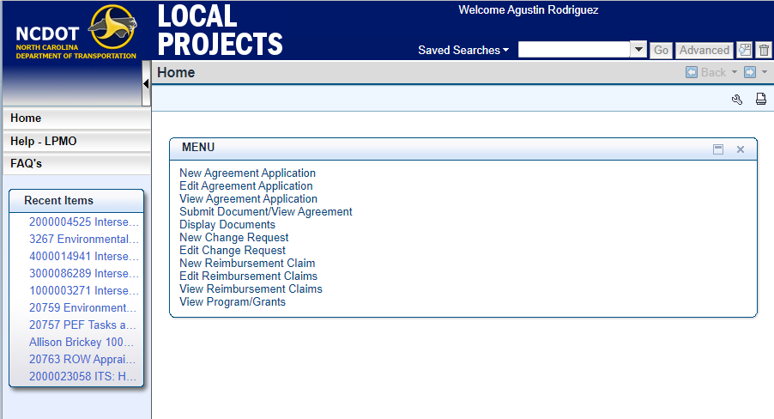
Application Process – Agreement Request
Notes:
This is a screen shot of the main menu when you access your project – This system was developed to help LGAs follow a consistent path when administering a local project. LGAs will use this system to request an agreement, upload documents for review, request funding authorization, and request reimbursement. The system will contain all the documentation related to a project and the advantage to the LGAs will be that you don’t have to figure out who needs to see what. We’ll coordinate that internally.
And, as a reminder, this system doesn’t change any of the requirements for federal-aid project delivery; it’s designed to simplify the logistics of going through the process. It also gives more control to the LGA to initiate requests and manage the delivery of the project.

Slide 30
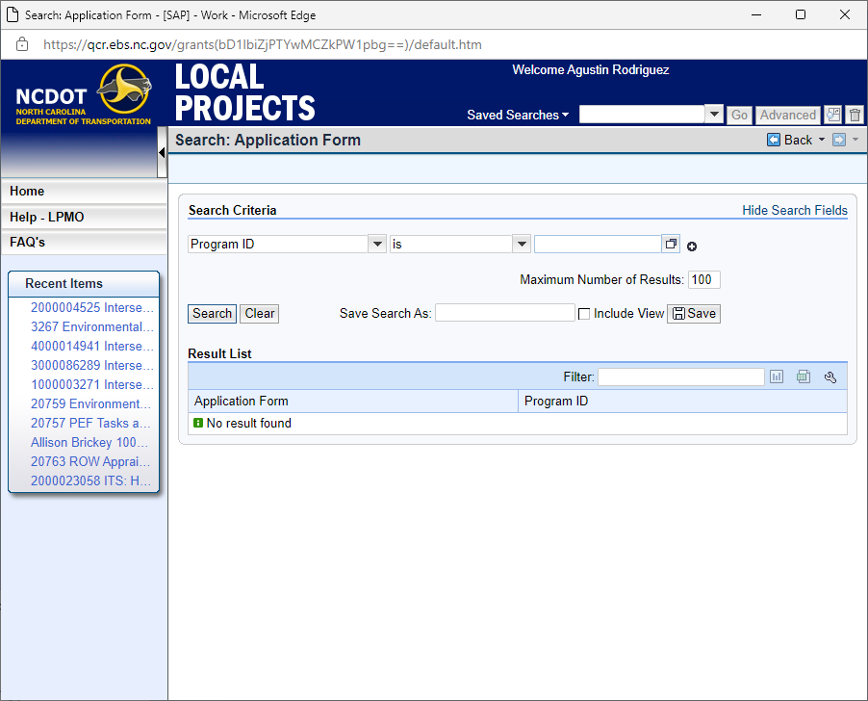
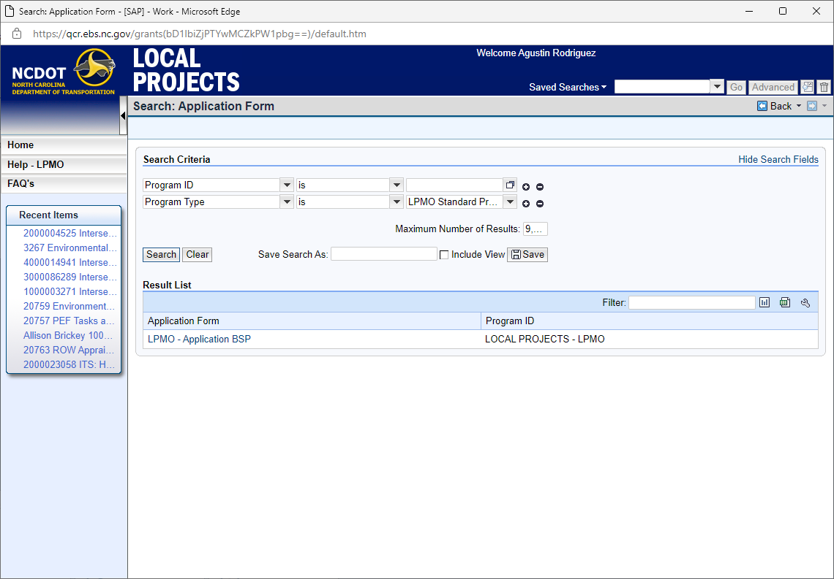
Application Process – Agreement Request

Slide 31
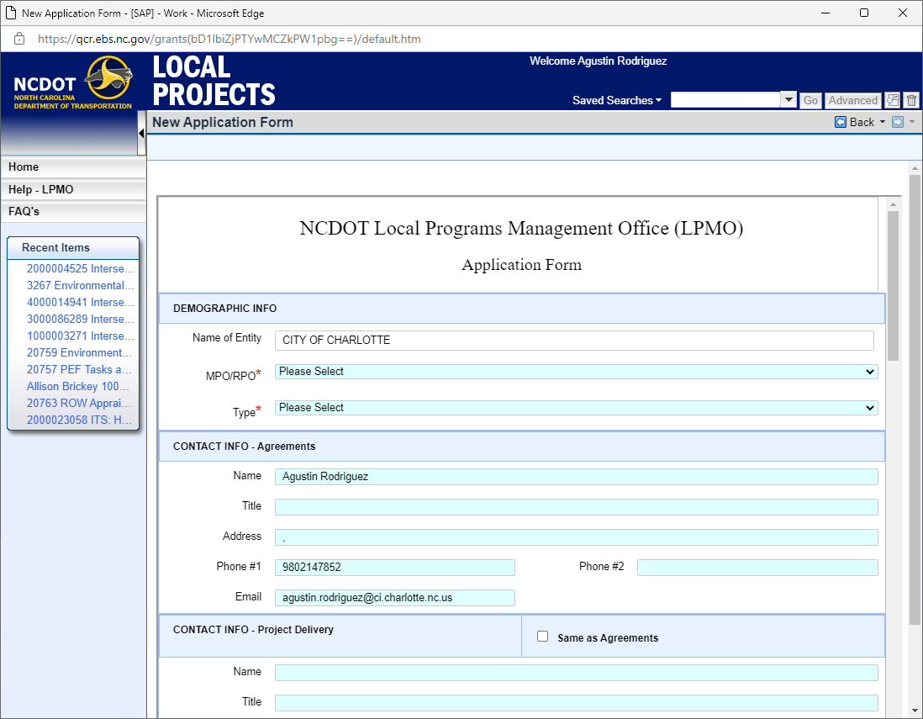
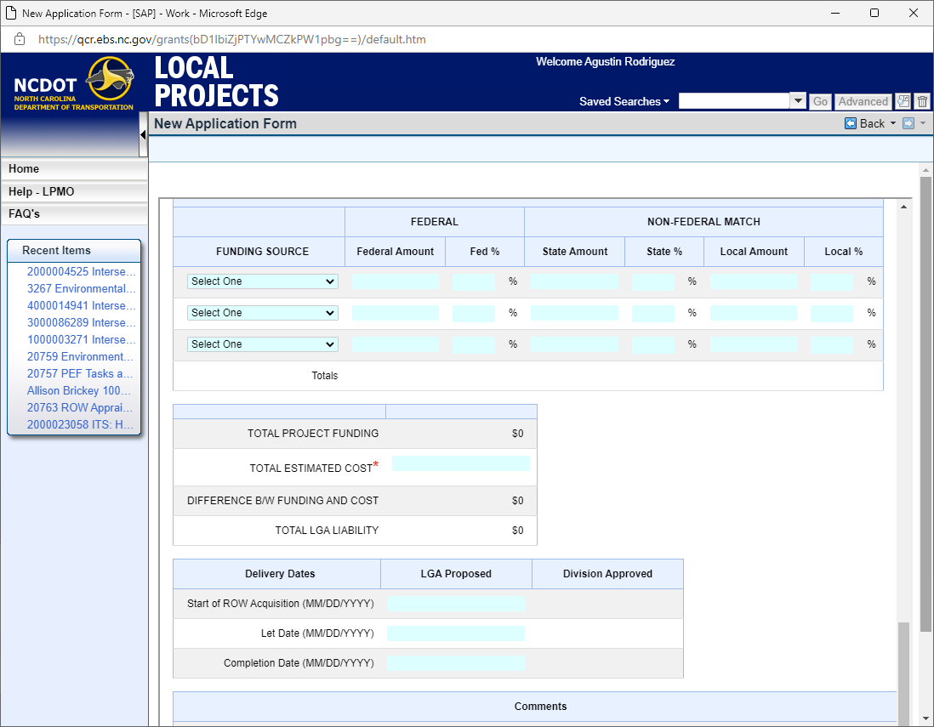
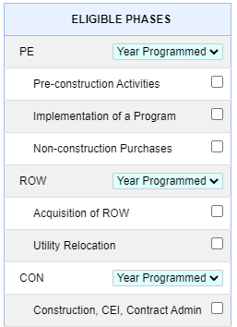
Application Process – Agreement Request
Notes:
If your project will be managed through the on-line project management tool, then this is the form you will use to request an agreement. It will ask for contact information, project scope, funding, delivery schedule. Once it’s submitted, it comes to the Local Programs Management Office in a workflow. LPMO will review, the Division will review, if there are questions, we’ll go back to you – there may be some items that you need to have resolved.
If your project is managed outside the on-line project management tool, then contact your DOT representative to get more information on requesting an agreement – this may be the Division Project Manager or the funding program at DOT that you are working with.

Slide 32
Actions for Application
Your Application will be Returned, Rejected or Approved:
Returned: If the application needs to be corrected, or needs additional information
Rejected: If the Project is not programmed in the STIP, you can’t start agreement process.
Approved: An Agreement is started by the LPMO
Notes:
Once you have completed your application and you have submitted it will come to my inbox. I will review the application and if I see the Project has been programmed in the STIP, your scope, your funding and your eligible phases are identified correctly then I will approve the application. It will then go to the Division for them to review and approve the Delivery Dates. These are only being checked to make sure they are reasonable.

Slide 33
View Agreement / Submit Documents
Notes:
Once you have an approved agreement that is fully executed, you may View your Agreement on the Portal.

Slide 34
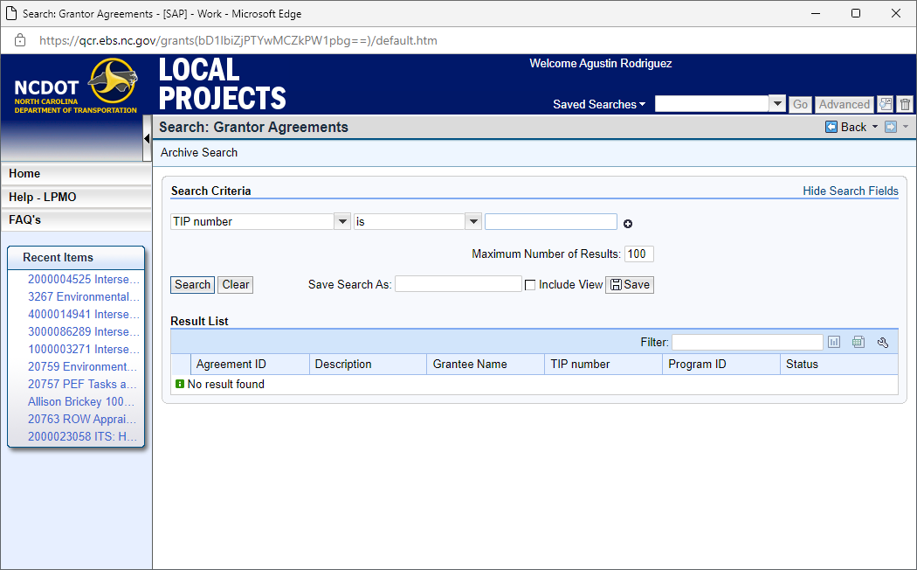
View Agreement / Submit Documents

Slide 35
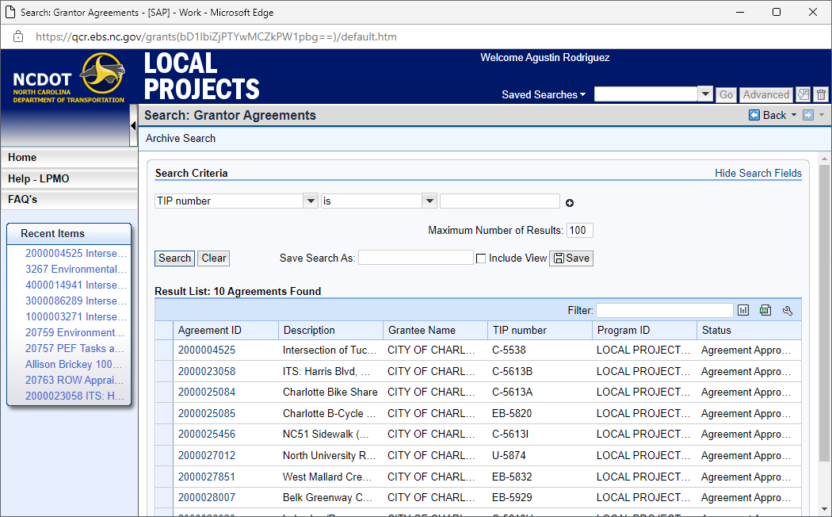
View Agreement / Submit Documents

Slide 36
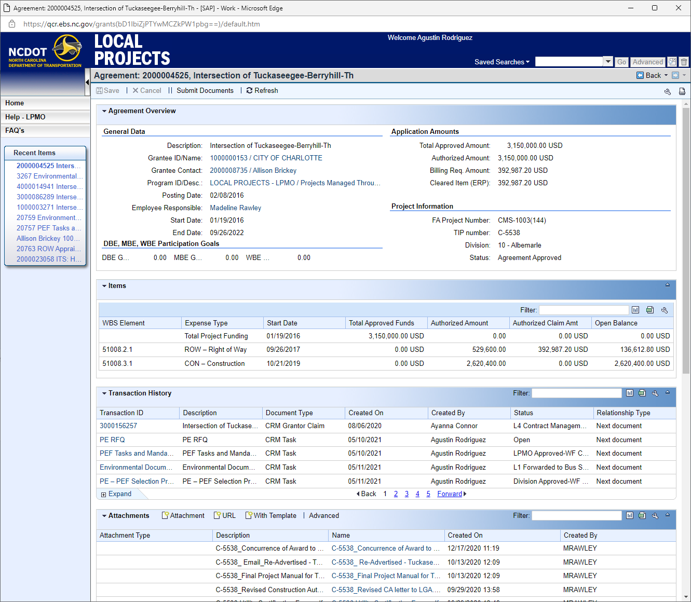
View Agreement / Submit Documents

Slide 37
View Agreement / Submit Documents
Notes:
Once you have completed your application and you have submitted it will come to my inbox. I will review the application and if I see the Project has been programmed in the STIP, your scope, your funding and your eligible phases are identified correctly then I will approve the application. It will then go to the Division for them to review and approve the Delivery Dates. These are only being checked to make sure they are reasonable.

Slide 38
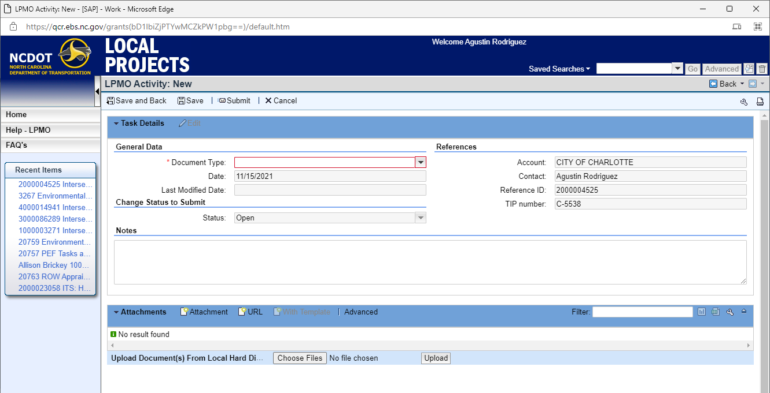
View Agreement / Submit Documents

Slide 39
View Agreement / Submit Documents

Slide 40
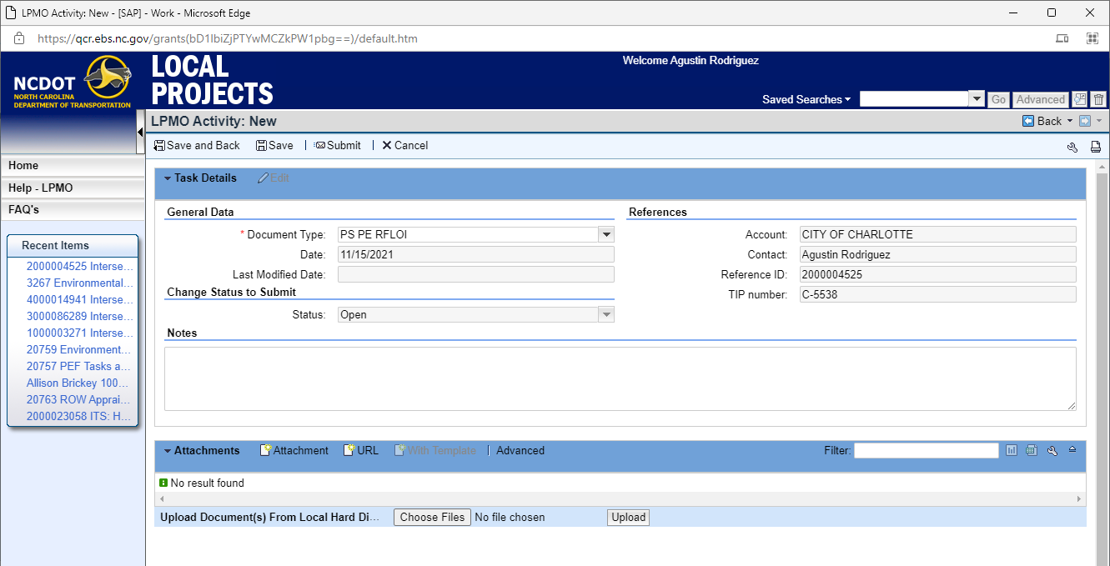
View Agreement / Submit Documents

Slide 41
Documents you will Submit
Notes:
This is a list of the documents you will need to make sure are submitted in the EBS Portal for your project.
I am going to give a handout that will list these items along with the directions on how to submit.

Slide 42
Submit Change Request
Notes:
When you are ready to start soliciting for professional engineering services (if PE is eligible for reimbursement) you will need to Submit a Change Request in the EBS
On your home page you will click on Submit Change Request

Slide 43
Submit Change Request
Notes:
Type in your TIP Project number and click “Search”

Slide 44
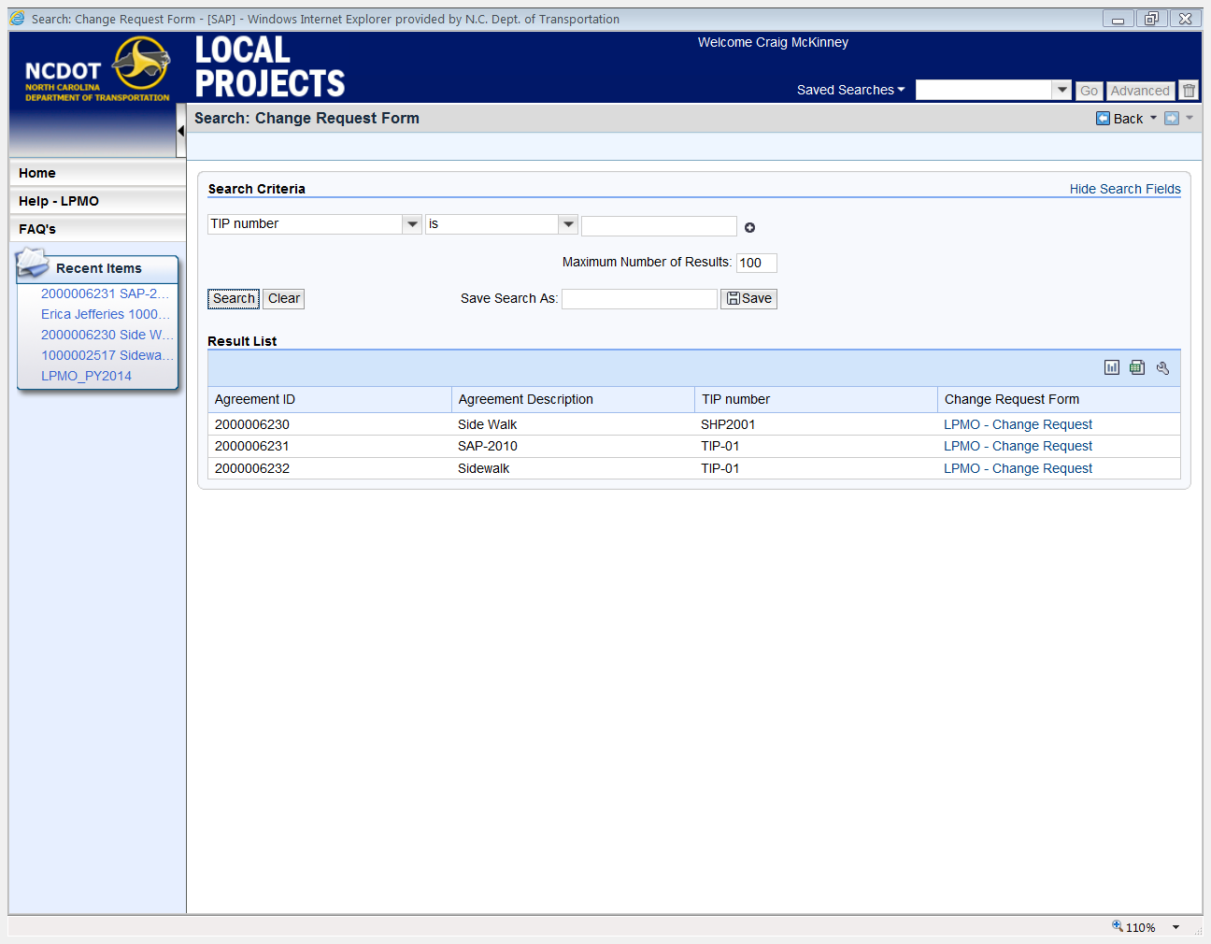
Submit Change Request
Notes:
Find your Project and click on LPMO – Change Request

Slide 45
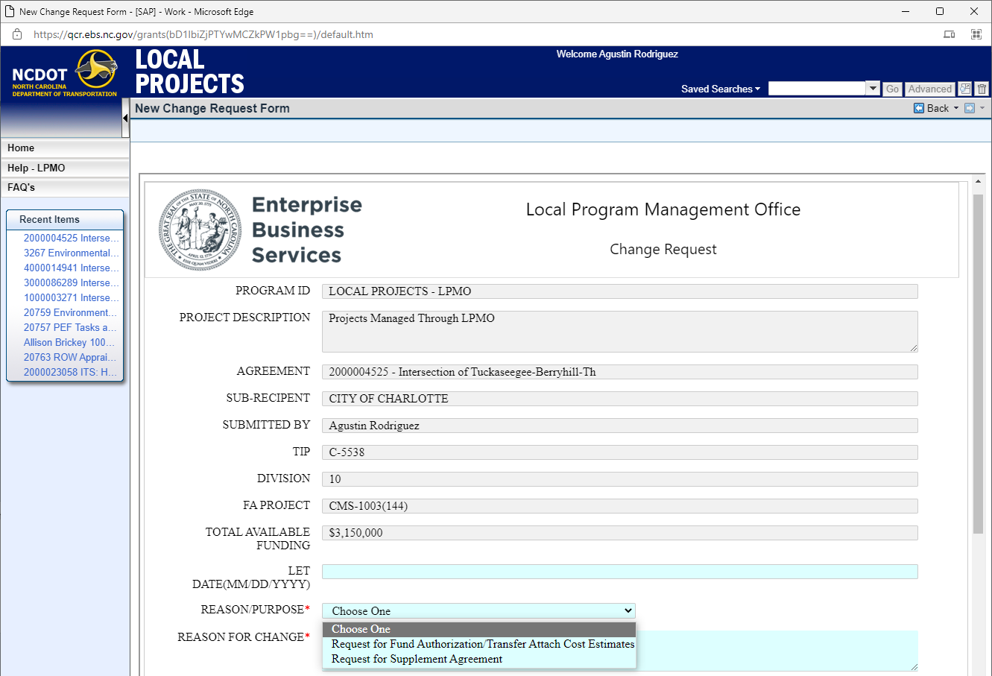
Change Request Form
Notes:
Your Project information will already be populated. You will have 2 options for a Change request.

Slide 46
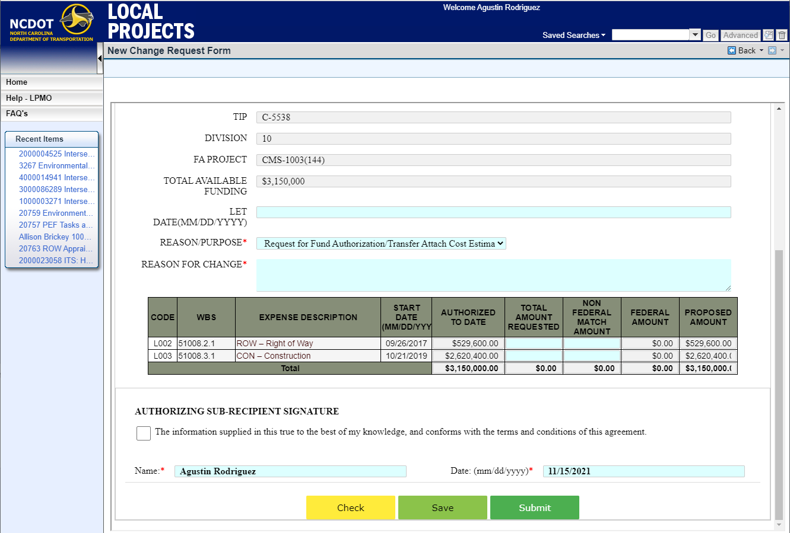
Submit Change Request

Slide 47
Submit Reimbursement Request

Slide 48
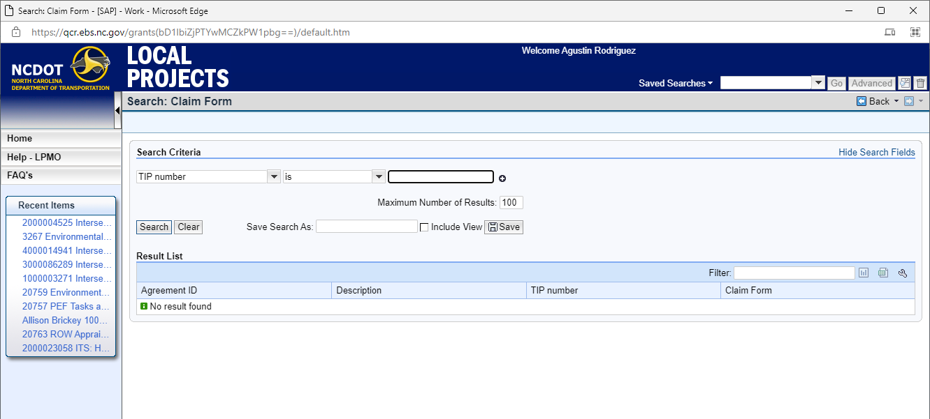
Submit Reimbursement Request

Slide 49
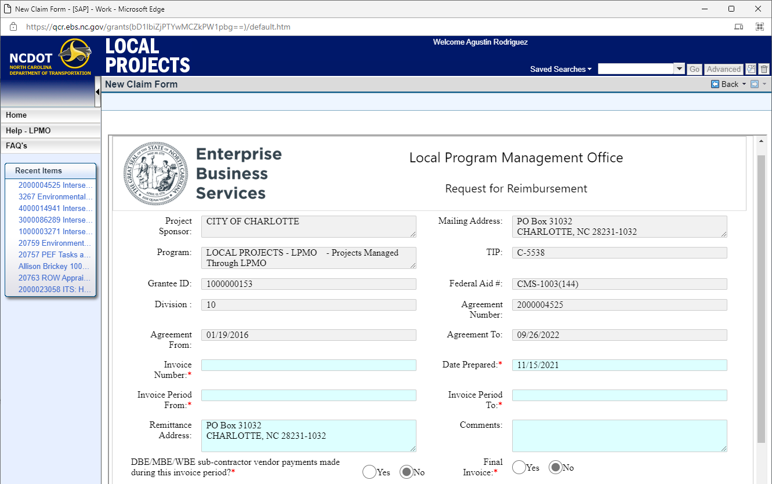
Submit Reimbursement Request

Slide 50
Submit Reimbursement Request

Slide 51
Submit Reimbursement Request

Slide 52
Helpful Hints for Using EBS Portal
Use browsers other than Internet Explorer (e.g. Edge or Chrome)
If you forget your password, notify the SAP Help Desk – link is on EBS login page.
System times out quickly – plan your work accordingly
Check your SPAM or JUNK Folder for system e-mails
All notification e-mails should include TIP number
Use the “wrench” symbol to personalize each section for viewing

Slide 53
Thank you! Local Programs Management Office NCDOT – Transportation Program Management
Marta Matthews
919-707-6626 mtmatthews@ncdot.gov
Madeline Rawley
919-707-6630
mrawley@ncdot.gov

