Slide 1
Strategic Transportation Corridors Corridor U: U.S. 74
Nastasha Earle-Young, NCDOT
August 2020

Slide 2
Agenda
Strategic Transportation Corridors: Corridor U
Data Collection Review
Corridor Analysis Review
Preliminary Corridor Vision
Stakeholder Involvement

Slide 3
Timeline
Strategic Transportation Corridors: Corridor U
Start of Study | Spring 2018
Steering Committee Meeting | Spring 2018
MPO/RPO Presentations | Summer 2018
Data Collection | Fall/Winter 2019
Steering Committee Meeting | Spring 2020
Public Survey | Spring 2020
Steering Committee Meeting | Summer 2020
Draft Vision | Early Summer 2020
MPO/RPO Presentations | July- September 2020
State Resource Agencies Feedback | August 2020
Final Vision Plan | Winter 2020

Slide 4
Facilities Inventory
Strategic Transportation Corridors: Corridor U
Highway assets inventory
Approximately 284 miles along highway corridor
Federally designated truck route along entire corridor
Bridges inventory
304 bridges along highway corridor
6 structurally deficient; 91 functionally obsolete
All documents are available:
https://connect.ncdot.gov/projects/planning/Pages/STC-Master-Plans-Bundle-2.aspx
Notes:
Facilities inventory data was collected along the US 74 corridor using NCDOT GIS layers and shapefiles. -highway corridor divided into logical breaks based on travel lanes, functional class, and access control
-US 74 corridor has full & partial access control in different sections
-Has interstate, freeway, & principal arterial classification in different sections -at-grade railroad crossing inventory includes at-grade crossings of cross streets immediately adjacent to the main corridor
-the larger rail network includes 1158 miles of active track and 27 rail facilities across all Corridor US 74 counties
-structurally deficient = bridge is in relatively poor condition or has insufficient load carrying capacity
-functionally obsolete = bridge is narrow, has inadequate clearances or other geometric issues, and can no longer service today’s traffic
-bridge must be 10 years and a highway bridge and cannot be classified as both categories
RPOs – Isothermal RPO, Rocky River RPO, Lumber River RPO, Mid-Carolina RPO, Cape Fear RPO
MPOs – Gaston-Cleveland-Lincoln MPO, Charlotte Regional TPO, Wilmington MPO

Slide 5
Transportation Plan Recommendations
Strategic Transportation Corridors: Corridor U
Compiled transportation plans and recommended projects along the corridor from:
Statewide Transportation Improvement Program (STIP): 70 projects
Comprehensive Transportation Plans (CTPs): 11 CTPs
Metropolitan Transportation Plans (MTPs): 3 MTPs
Feasibility Studies (FS): 6 within past 10 years
Traffic Forecasts (TF): 37 within past 10 years
Most of corridor recommended to be classified as freeway
Some segments in developed/urban areas recommended to be classified as boulevard (with current or planned bypass)
Notes:
-70 current STIP projects
-6 identified FS (within 10 years)
-37 identified forecasts (within 5 years)
-CTPs – Polk Co, Rutherford Co, GCL MPO, CRTPO, Anson Co, Richmond Co, Scotland Co, Robeson Co, Columbus Co, Brunswick Co, WMPO
-MTPs – GCL MPO, CRTPO, WMPO

Slide 6
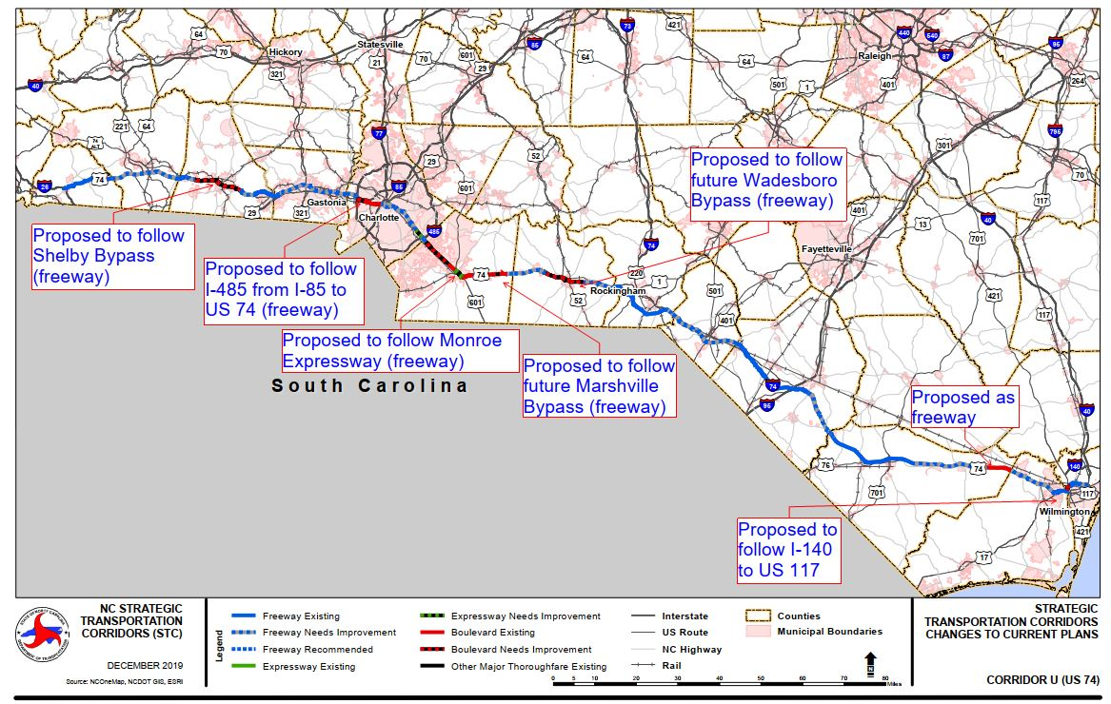
Strategic Transportation Corridors: Corridor U

Slide 7
Public Survey
Strategic Transportation Corridors: Corridor U
Survey Dates: April 6, 2020 to June 6, 2020
Advertised via email, website, and newsletters
Views 1,524 | Participants 638 | Responses 8,260 | Comments 155
Full Survey Results available:
https://connect.ncdot.gov/projects/planning/STC%20Documents/US%2074%20public%20survey%20results.pdf
Notes:
42 percent of those who viewed the survey ended up responding

Slide 8
U.S. 74 – Public Survey Results
U.S. 321 and U.S. 74 Strategic Transportation Corridors
From Monroe to Wilmington, what changes would you like to see on U.S. 74 in the next 20 years?

Slide 9
U.S. 74 – Public Survey Results
U.S. 321 and U.S. 74 Strategic Transportation Corridors
From Monroe to Wilmington, do you support the preliminary vision of a freeway (access only at interchanges/ramps, speed limit 55 mph or greater, no traffic signals)?
380 respondents
Notes:
91% agree at a minimum

Slide 10
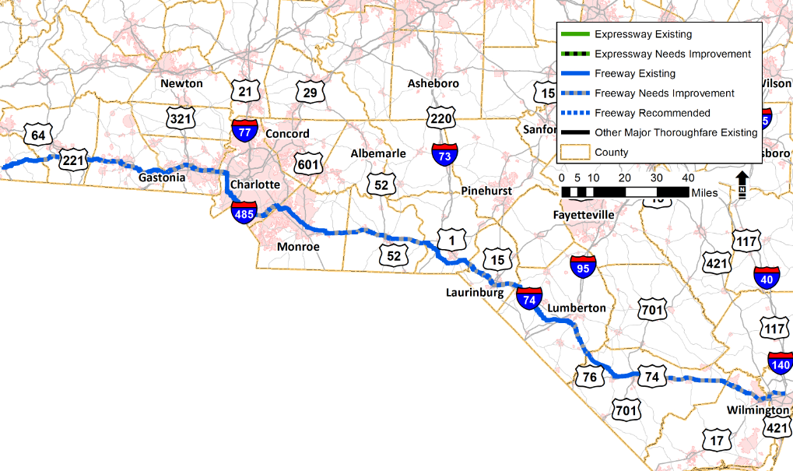
Recommended Vision
Strategic Transportation Corridors: Corridor U
Freeway: I-26 in Polk County to US 117 in New Hanover County
Notes:
Bypasses that once complete and open to traffic where the corridor could be moved in the future would be: Shelby bypass, Wadesboro bypass, and Delco bypass.
The recommended vision moves the corridor to follow I-485 from US 74 on the northwest side of Charlotte to US 74 on the southeast side of Charlotte. It will also follow the Monroe Expressway.
The recommended vision moves the corridor to follow I-140 from US 74 to I-40 on the northern side of Wilmington.

Slide 11
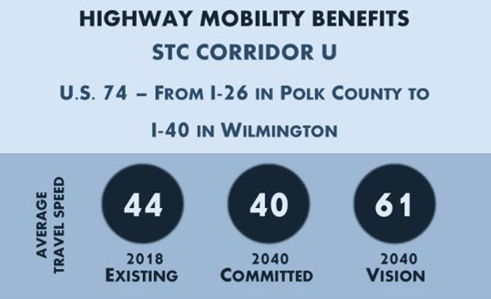
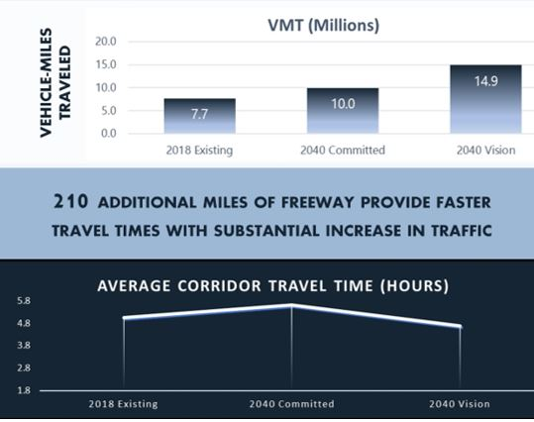
Mobility Analysis
Strategic Transportation Corridors: Corridor U
Increases the average corridor travel speed by 21mph
Notes:
The recommended freeway vision and the suggested movement to different facilities of the corridor increases the average travel speed in 2040 by 21mph.
The recommended vision would add 210 miles of freeway and increase the VMT to 14.9 million in 2040.

Slide 12
Identified for Further Study
Strategic Transportation Corridors: Corridor U
Marshville Bypass
Wadesboro Bypass
Military Connections
Transit connections
Resiliency Assessment

Slide 13
Strategic Transportation Corridors: Corridor U
Corridor U
Questions?

Slide 14
Contact Information
U.S. 321 and U.S. 74 Strategic Transportation Corridors
Nastasha Earle-Young, NCDOT Project Manager
nbearle-young@ncdot.gov
919-707-0931
Tyler Bray, Atkins Project Manager
tyler.bray@atkinsglobal.com
919-431-5274

