Slide 1
CT FY24 Operating Statistics Report Updates July 16th and 18th 2024

Slide 2
Webinar Overview
Why?
Deadlines
Changes to Report
Accounting Methods
New NTD Reporting Requirements
Report Overview
Live Demo
Preview FY25 Report

Slide 3
Why?
Federal
ALL public transit systems are required to report all service and financial data
Data used to inform federal funding formulas that determine funding back to the states and transit systems, i.e. 5307, 5311, …
State
Compare reporting statistics from year-to-year and create transit system, peer group, and statewide profiles
Economic Benefits
Flyer created to show why transit is important in your service area
You!
Easy way for you to compare your service & financial data year-to-year
Helps to understand if things changed, then investigate why

Slide 4
OpStats Report Deadlines
Report Deadlines
The reports are due to PTD no later than:
1st Quarter: October 31
2nd Quarter: January 31
3rd Quarter: April 30
4th Quarter/Annual Report: August 31
Please submit draft report if fiscal year has not been closed out

Slide 5
Changes to FY24 Report
Overview tab updated
Fares
Minimum advanced reservation
Brokered Medicaid trips and revenue
Safety & Security
Physical assaults
Non-physical assaults
Other safety and security

Slide 6
Accounting Method
The Capital Expenses should be reported in the fiscal year the vehicle was received, not when it was ordered.
Example:
A vehicle was purchased on March 1, 2024 but was not received until after July 1, 2024. The expenses and revenues should be reported in FY25
Similarly for Operating Expenses
Report ALL expenses incurred during the fiscal year and the revenues used to pay for those expenses
This includes grant revenues that are reimbursed in FY25 but were submitted for expenses incurred in FY24
Pending FY24 grant claims are assumed to be reimbursed

Slide 7
Enabling Macros

Slide 8
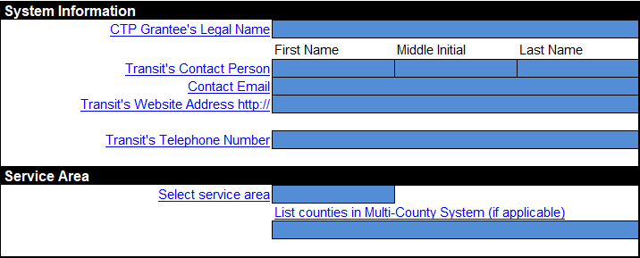
Overview: System Information
Only Enter data into colored cells
Color code for FY24 is blue

Slide 9
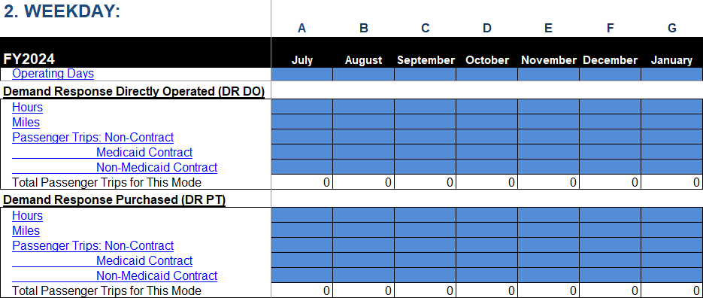
Overview: Operating Modes
Be sure to check the "check box” for your operating modes

Slide 10
Overview – Operating Modes cont’d
Fixed Route
Select the route types if check “MB DO” OR “MB PT” mode
Microtransit

Slide 11
Overview – NEW Sections
Report the base fares for each mode operated.
Provide the minimum advanced reservation time in hours and why.

Slide 12
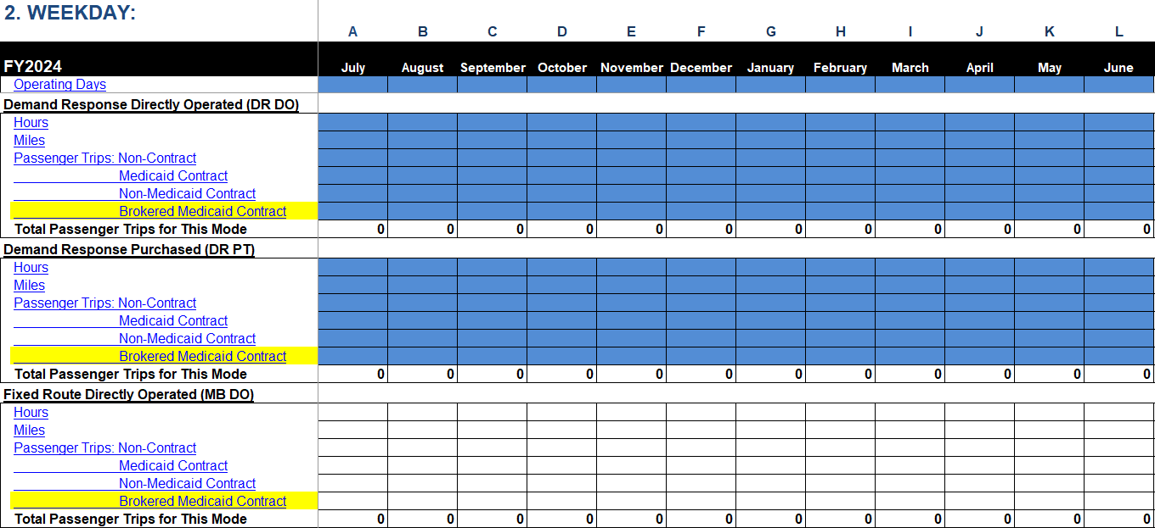
Weekday, Saturday, & Sunday

Slide 13
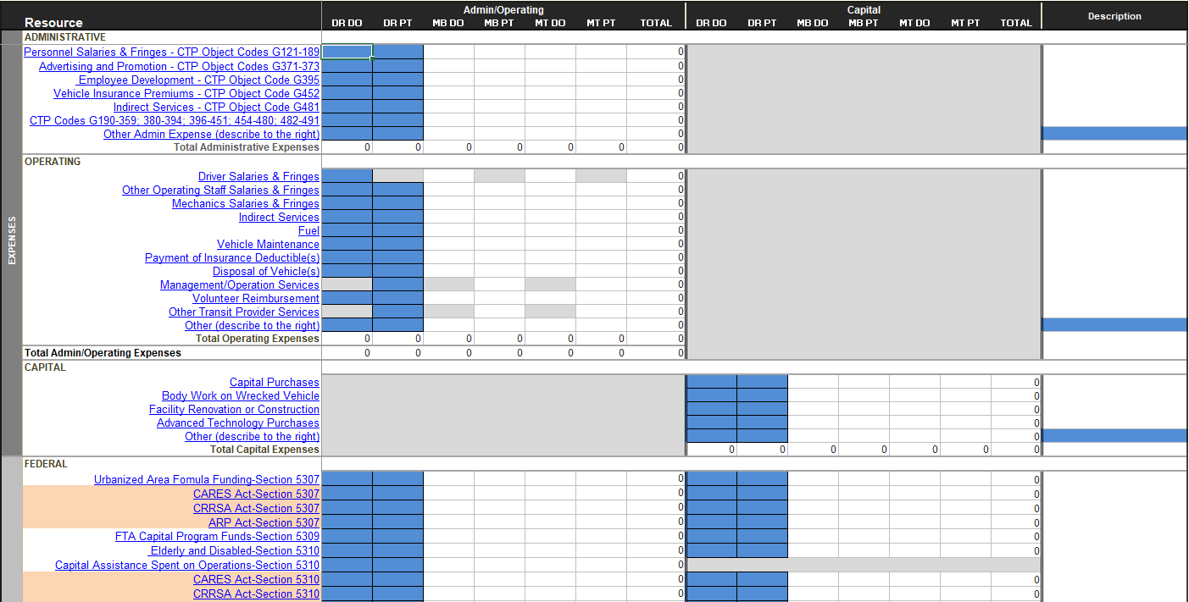
Finance Tab

Slide 14
Financial Information: Changes
Brokered Medicaid Revenue
Trying to capture the impact brokered trips have on your service and Medicaid/Contract revenu

Slide 15
Allocating Finances to Modes
No longer allowed to proportionalize ALL finances based on percentage of service hours by mode
NTD strongly encourages assigning direct costs whenever possible
Examples
Vehicles dedicated to a mode should be able to report direct costs
Fuel
Maintenance
Vehicle Insurance Premiums
Fares
Other Directly Generated Funds/Medicaid Revenue
Costs that cannot be directly associated with mode may be allocated
Allocate fuel and maintenance by percent miles within each mode
Allocate driver salaries by percent service hours within each mode
Do NOT allocate finances to modes using a single percent split for all line items

Slide 16
Reporting ROAP Revenues
Do NOT report total disbursement
Any unexpended funds used in the following fiscal year should be reported at that time
Only report revenues received for expenses incurred in the current fiscal year

Slide 17
Typical Federal/State/Local splits
5311
Admin: 80/5/15
Capital: 80/10/10
Operating: 50/0/50
5339
Capital: 80/10/10
5307
Capital: 80/0/20
ADA Capital: 90/0/10
Operating: 50/0/50

Slide 18
5311 Federal/State/Local example
Grant revenues show federal + state allocation
85%
To calculate splits, follow these steps
5311 grant = $100,000
5311 allocation = $100,000 / 0.85 = $117,647.06
5311 federal share = $117,647.06 * 0.8 = $94,117.65
5311 state share = $117,647.06 * 0.05 = $5,882.35
5311 local share = $117,647.06 * 0.15 = $17,647.06

Slide 19
Annual Statistics: Maintenance Information
Choose whether maintenance is performed In-House, Contracted, or Both
Enter 1 if maintenance facility is owned or leased by you
Otherwise, enter 0
If county department and use a county garage for maintenance, choose In-House and enter 1 in # Owned cell

Slide 20
Safety & Security
New form in FY23
Previously collected in the NTD Supplemental Survey
New tabs in FY24 to collect safety and security information for NTD’s S&S-60 form
If there were no assaults, physical or non-physical, please enter a ‘0’ in the first cell

Slide 21
Major Safety & Security Event
A reportable event that meets any of the NTD reporting thresholds in the next slide and:
Occurs at a transit revenue facility, maintenance facility, or rail yard;
Occurs on transit right-of-way or infrastructure (the underlying framewok or structures that support a public transportation system);
Occurs during a transit-related maintenance activity; or
Involves a transit revenue vehicle

Slide 22
Major Safety & Security Event Thresholds
NTD Events: any event involving the operation of a transit system if, as a result, one or more of the following occurs
An individual dies either at the time of the event or within 30 days of the event
An injury requiring immediate medical attention away from the scene for one or more persons
A collision, personal casualty, or fire causes property damage in excess of $25,000
Collisions involving transit vehicles that require towing away from the scene for a transit roadway vehicle or other non-transit roadway vehicle
An evacuation due to life safety reasons
NTD Fatalities
A transit-caused fatality within 30 days of the a transit event
NTD Injuries
Any damage or harm to persons as a result of an event that requires immediate medical attention away from the scene (should be total persons transported for immediate medical attention).

Slide 23
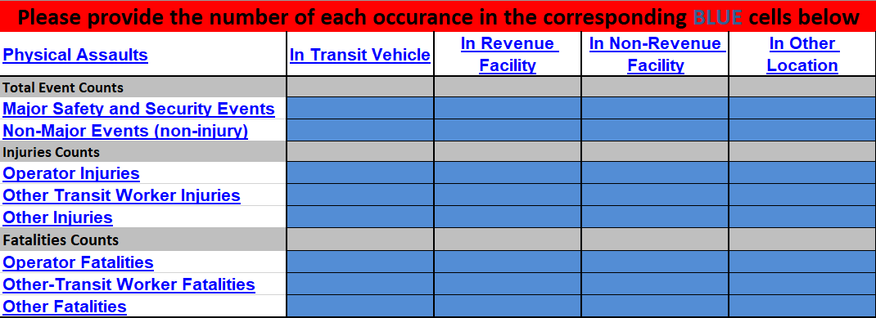
Physical Assaults

Slide 24
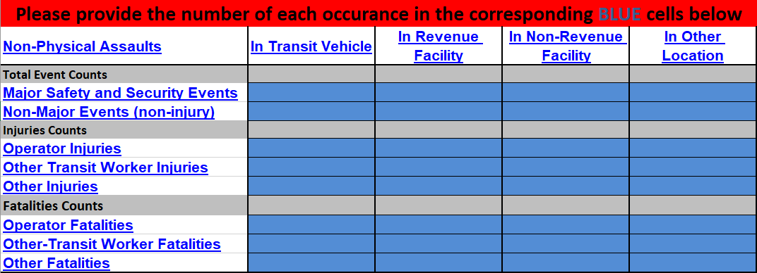
Non-Physical Assaults

Slide 25
Other Safety & Security Data

Slide 26
Important!
Enter data into colored cells only
Report ALL Expenses and Revenues
Revenues DO NOT have to equal expenses
Report Contract Revenue in Other Directly Generated Funds
Unless revenues cover full cost of service (admin + operating + capital)
CA Spent on Operations moved to Admin/Operating column

Slide 27
NTD Validation
Reports due to NTD by October 31
ITRE/PTD validate OpStats after submission
NTD runs analysis comparing current fiscal year to previous fiscal year
If current fiscal year values greater than ±10% NTD requires explanation
Examples
Added/removed service
Gained/lost sponsoring agency/funding
Higher fuel/maintenance costs
Increase in driver salaries
etc...

Slide 28
Changes to Service/Financial Data?
Report causes for changes to service or financial data on Annual Statistics tab

Slide 29
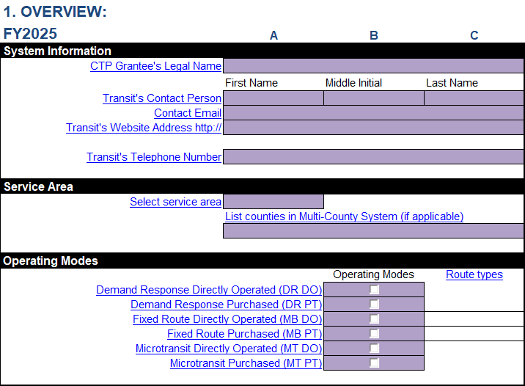
FY25 OpStats Report
Report will be available on IMD website
https://connect.ncdot.gov/business/Transit/Pages/Transit-Reports.aspx
Notes:
Is this slide intended for FY23?

Slide 30
Contact
Jeremy Scott
jscott@ncsu.edu
919.515.8624
Jonah Freedman
jfreedman@ncsu.edu
919.515.8622

