Slide 1
Integrated Mobility Division
Transit Systems Call
April 7, 2021

Slide 2
AGENDA
CARES Act Implementation
ARP Act Overview
COVID-19 Response
NC Transit Cares Update
Other Training, Reminders and Updates
Questions

Slide 3

CARES Act Update
5311 CARES overall status
5311 Claims Summary
Update on 5307GA and ADTAP

Slide 4
5311 CARES Funding Overall Status
$94.9 Million – total available from FTA
$62 Million – awarded by FTA so far (includes 10% admin.)
  Includes $9.6 Million in Round 3 funding recently awarded by FTA
$14.6 Million – pending intercity bus application
$18.5 Million – amount remaining
  Additional rural needs, with priority for operating but may include capital – precise allocation approach is undecided.

Slide 5
5311 Claims Reimbursements
(76 Agreements)
304 Submitted
$26,024,161 in claims
$25,724,303 approved for payment
Notes:
Turn over to Myra

Slide 6
CARES 5307GA/ADTAP
5307
13 Agreement
19 Claims
$2,570,972 in claims
$2,206,755 approved for payment
ADTAP
21 Agreements
5 claims
$114,889 in claims
$114,889 approved for payment
Notes:
Myra

Slide 7
American Rescue Plan Apportionment
Pre-Award eligible
100% funding, no match
Available thru 9/2024
Operating
  Payroll including admin
  Prev maint
  Cleaning & PPE
  Operations - including to vax sites, food, and medical
Essential services
  Access to food/water
  Communications
  Medical care
Transit Planning - NOFO w/in 180 days
Capital Investments - More info coming soon
Emergency relief Docket - For additional relief
Notes:
- Reminder - CRRSAA funding – no 5311, some 5307 for some urban areas, $780k in 5310 (distribution method not yet determined)

Slide 8
FTA Discretionary Grant Programs
NOFOs to be released within 180 days

Slide 9
North Carolina FTA Formula Apportionments

Slide 10
COVID-19 Response
COVID-19 Impact Reporting Requirements
Mask mandate
Transportation to vaccination sites
NC Transit Cares updates

Slide 11
Transit COVID-19
Response Program Information Collection Requirements
New requirement for 5311 recipients
Starts April 1, 2021
First SmartSheet survey due by COB April 8
Baseline Form
  Service impacts from March 13, 2020 – February 28, 2021
  Information due from NCDOT to FTA by April 16th
Recurring Form
  Collects cumulative data March 2021 – December 2021
  Workforce data
  Service impacts
  COVID-19 Data
Notes:
Blair

Slide 12








NC Transit to Vaccinations
Connecting citizens to COVID-19 vaccinations
DHHS funding spend down by transit agencies continues
RFI solutions tools still available
Website & weekly data reporting continuing
Weekly Recap Newsletter continuing
United Way/LYFT free rides to supplement transit starting mid April
UBER free rides to supplement transit coming
Notes:
Stephanie

Slide 13
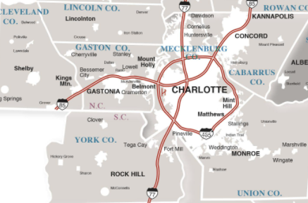
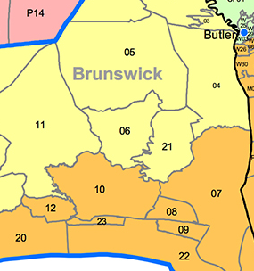
NC Regional Microtransit Pilots
Connecting citizens with enhanced transportation
VIA Microtransit Pilots
  Wilson (in place)
  New Hanover & Brunswick Counties collaborating on a new pilot
UBER Microtransit Pliot
  Cabarrus, Cleveland, Lincoln, Mecklenberg, and Union Counties collaborating on a new pilot
Notes:
Stephanie

Slide 14
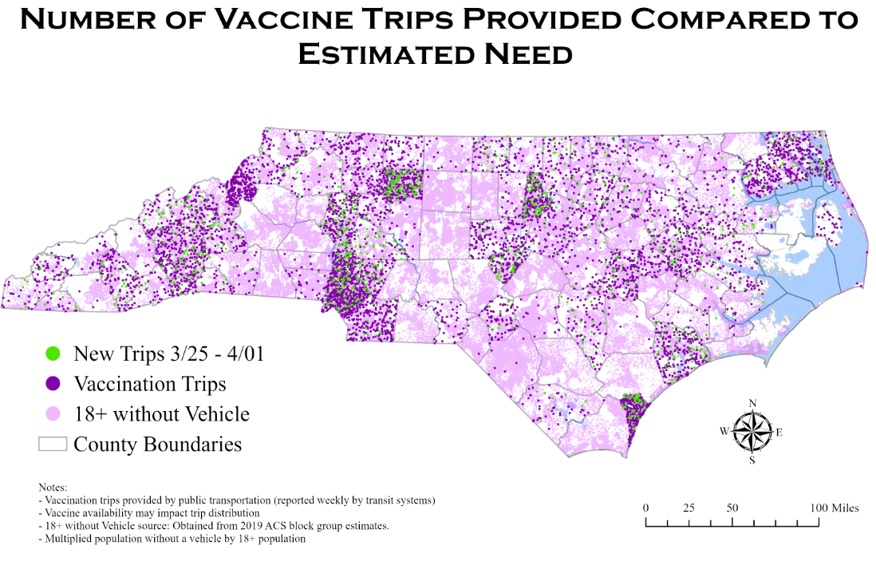
Through April 7th, 2021
Total Miles Traveled: 59,306
Total Trips: 7,129
Total Riders: 4,925
72 (74%) Different Systems have submitted 574 Reports
Notes:
Blair
- Reminder to report information

Slide 15
Reminder On Incidental Use of Transit Vehicles (per the FTA FAQ – CE18):
“The use of transit vehicles to provide non-public transportation service (non-shared ride or closed door) to COVID-19 vaccination sites, or the use of transit facilities as vaccination sites, is eligible as an incidental use if the services do not conflict with the provision of transit services or result in a reduction of service to transit passengers. Under the FTA Emergency Relief Program (49 U.S.C. § 5324), recipients are permitted to use Urbanized Area or Rural Areas formula funds administered under the provisions of the Emergency Relief Program or CARES Act funds until January 20, 2022, to pay for the operational costs of such services.
During the COVID-19 public health emergency, prior approval for the incidental use of transit assets for the provision of essential services is not required.”
For Charter Reports:
These are not considered Charter services, so these trips should be treated normally.
For Opstats Reports:
Report all vaccine transportation trips as regular service unless 1) the service is limited to one person at a time or 2) the service is not open to the general public (closed door). In these cases, the service should be reported as incidental.

Slide 16
DHHS CARES Act Vaccine Trip Claims (as of April 6, 2021)
NEW: Please add week of service to DHHS claim form on the month or contract line.
184 Submitted
$78,507.77 in claims
$78,311.65 reviewed and approved
Notes:
Carolyn

Slide 17

RFI for Vaccine Transportation Technology
Vendors who submitted information through RFI were able to present on 2/17
Please reach out to your planner for RFI submissions
Sole Source Procurement is an option for emergency software or transportation-as-a-service needs
For any procurement related questions, reach out to
Chris Dodson
919-707-4696
cbdodson@ncdot.gov
Notes:
Chris
Reminder that we have received additional vendor information after the date, including from Moovit and Transloc (waving certain fees associated with their product through the end of the year). 5 minute video recording/pitch to be sent to systems for new vendors. Reach out if interested in learning more or exploring options.

Slide 18
NC Transit Cares
Safety and Health Workgroup
Funding Workgroup
Technology Workgroup

Slide 19
Safety and Health Workgroup
Completed action items:
HVAC Technology Reference Document
Covid-19 Safety Training Webinar
Covid-19 Safety Action Plan for NC agencies
10 minute quick hit safety training videos for operators and staff

Slide 20
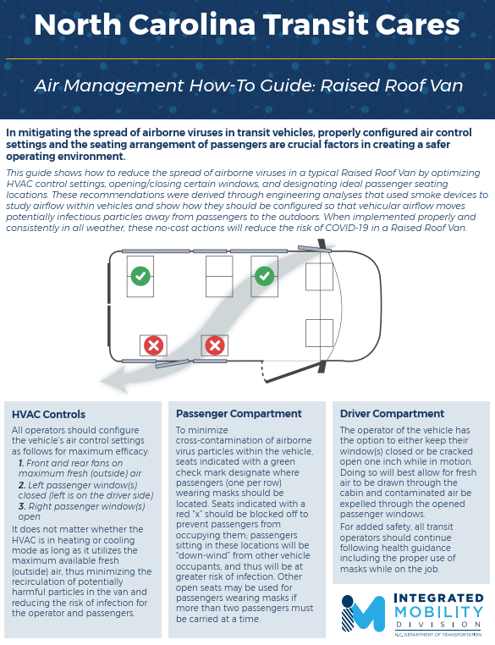

Slide 21
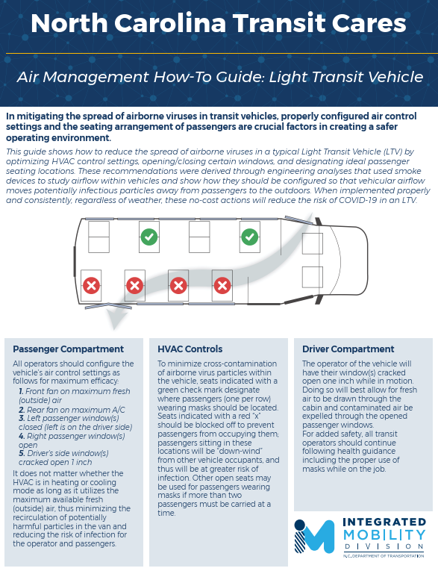

Slide 22
NCDOT/NCPTA Funding Workgroup Update
Project Scope:
  Follow-up on funding priority innovation from NC Transit Cares project
  Worked with existing NCDOT/NCPTA funding workgroup to:
    Establish overall strategic goals for the innovation
    Establish follow-up priorities
    Develop action plans for priorities and define next steps
  Work Process:
    Subgroup Co-Chair Leadership (Scott Rhine – Urban, Tawanna Williams – Rural)
    Weekly virtual meetings: Late March – Early April

Slide 23
NCDOT/NCPTA Funding Workgroup Update
Strategic Goals:
  Identify and develop follow-up strategies and actions to assist NCDOT and NC transit agencies in better utilizing existing funding resources
  Identify and develop follow-up strategies and actions to assist NCDOT and NC transit agencies in securing more predictable and sustainable (expansion) future funding resources
  Other suggestion: Explore Regional planning opportunities to help identify and facilitate resource sharing/funding efficiencies

Slide 24
NCDOT/NCPTA Funding Workgroup Update
Priorities and Follow-up Actions:
  Reinstatement of SMAP/ROAP funding (on-going)
  Cares Act funding distribution and use (on-going)
  3. Enhanced capital planning, programming, and predictability
  Fund balances review and utilization
  Update state management plan (on-going)
Notes:
Reinstatement of SMAP/ROAP funding (on-going)
Inform General Assembly: NCDOT – Education, NCPTA – Advocacy
SMAP/ROAP currently included in General Assembly biennial budget
Continue to monitor and respond to questions; spend all resources
Cares Act funding distribution and use (on-going)
NCDOT continue monthly transit system calls to provide updates
NCDOT establish single point of contact for system questions/issues
NCDOT continue to problem solve and provide guidance
FTA time extension – June 30, 2020
Capital item threshold - $5,000 (versus $500)
Review of 5307 funding use
3. Enhanced capital planning, programming, and predictability
NCDOT and NC transit agencies work together to develop options to ensure required federal capital match is satisfied
Form follow-up workgroup and coordinate with priority iv (July 30th)
4. Fund balances review and utilization
NCDOT and NC transit agencies work together to determine available Federal and State transit fund balances
Develop options to ensure all available resources are programmed and used
Form follow-up workgroup and coordinate with priority iii (July 30th)
5. Update state management plan (on-going)
NCDOT has retained RLS (Rich Garrity) to help with initial SMP update for triennial review (May 26th)
Once review complete, NCDOT will work with NC transit agencies to refine plan to focus on more specific issues and needs (Complete by end of calendar year)

Slide 25
Technology Workgroup Update
Notes:
Kai Monast

Slide 26

Reminders, training and other updates
Technology
Procurement
Capital/operating expenses
Charter Report
OpStats
Program income
NCPTA conference

Slide 27
Procurement of Technology Software
Request for Proposals
  At least 3 quotes/proposals needed
  Procurement Checklist and History Form
  Independent Cost Estimate (how price was determined to be reasonable; can be addressed on History Form)
Prior approval from NCDOT-IMD needed for any purchase over $10,000
For any questions or procurement submissions, contact:
Chris Dodson – cbdodson@ncdot.gov
  919-707-4696
Notes:
- Short-term plan
- Long-term plan is statewide RFP and secure capital funding for technology replacement and/or upgrades for all systems

Slide 28
Other Procurement Updates
Raised roof vans are currently available from Ilderton Dodge through Statewide Term Contract #070A
  12 passenger & 13 passenger models of high top raised roof vans available through this contract (Ford Transit U4X)
  2 lift station and 3 lift station options for lift equipped vans
  Order forms will be posted on NCDOT-IMD Procurement page ASAP
Contract expires April 30, 2021
Notes:
Chris

Slide 29
Capital vs. Operating Expenses
Operating is generally defined as costs necessary to operate, maintain, and manage a public transportation system.
Capital is generally defined as facilities or equipment with a useful life of at least one year.
Equipment is further defined as an article of tangible property having a useful life of more than one year and acquisition cost greater than $5,000 per unit.
Greater flexibility under CARES act for items in the grey area that are necessary for safe operations.
Notes:
Technology, including tablets and radios, are explicitly defined by FTA as capital.
Items that are attached to a vehicle and materially change the value of the vehicle like wheel chair lifts are considered capital, regardless of cost.

Slide 30
Reports
Due April 15
Charter (EBS)
OpStats (EBS)
Program Income (Send to Myra directly)
Training report (EBS)

Slide 31

NCPTA Conference April 12-14
New Directors IMD overview – April 13
NCDOT Secretary Boyette – April 14
IMD vision, mission, goals, and strategies – April 14

Slide 32
Job Posting
IMD Deputy Director for Finance and Administration
Posted 4/7 and closes on 4/19
GN 15
Salary $56,046 – $100,814

Slide 33

Integrated Mobility Division Organization
Director
Ryan Brumfield (Interim)
Planning and Programming
John Vine-Hodge
Finance and Administration
Vacant
Innovations
and Data
Ryan Brumfield
Regional
Planning
Statewide Planning and Programming
Safety, Education, and Compliance
Grant Administration
Finance
Notes:
A foundational goal of our Division moving forward will be multimodal planning to make sure all transportation professionals in North Carolina are analyzing the right data to understand underlying demand for non-highway modes and are properly incorporating that data into project development activities. We want to make sure our programs and investments align with underlying need in communities for multimodal transportation. So our new structure will separate out grant administration activities so that the planning and programming section can focus on planning activities given the importance of this role for our Division.
Other foundational objectives include data analysis and innovation. It is important that we use data to guide all decisions and that we move new ideas forward and are recognized as a thought leader in emerging mobility trends.

Slide 34

QUESTIONS
Previous slides, recordings and FAQs:
https://connect.ncdot.gov/business/Transit/Pages/Transit-Meeting-Resources.aspx
Notes:
- Remind them of our webpage with slides, recordings and previous questions.

Slide 35
Integrated Mobility Division
Transit Systems Call

