Slide 1
Integrated Mobility Division Transit Systems Call
August 11, 2021
Notes:
Mention up front that we are aware of the issues many systems are facing related to Medicaid transformation and the new managed care model. We are in close contact with David and NCPTA. David and Kim are on and should be able to help field any questions at the end of the presentation about managed care.
NCGA budget status

Slide 2
AGENDA
CARES Act Implementation
COVID-19 Response
Other Reminders and Updates
Questions

Slide 3
CARES Act Update
5311 Claims Summary
Update on 5307GA and ADTAP

Slide 4
5311 Claims Reimbursements (76 Agreements)
458 Submitted
$41,575,039 in claims
$40,222,500 approved for payment

Slide 5
CARES Intercity Reimbursements (4 Agreements)
2 Submitted
$6,025,323 in claims
$5,325,958 approved for payment

Slide 6
CARES 5307GA/ADTAP
5307
37 Claims
$4,646,463 in claims
$4,310,850 approved for payment
ADTAP
19 claims
$657,157 in claims
$657,157 approved for payment
Notes:
Myra-
Some of you haven’t submitted your final claims from FY21. It is imperative that you get those submitted asap, as Finance has begun closing 5311 admin and operating projects.
We ask that you submit monthly claims on your CARES projects. You can also submit monthly claims on your other projects as well.

Slide 7
COVID-19 Response
COVID-19 Impact Reporting Requirements
PT Drivers 1,000 Hour Rule
Mask mandate
Transportation to vaccination sites
DHHS Funding Updates
How To Guide – 40’ Bus

Slide 8
COVID-19 Response Reporting
Federal Transit Administration (FTA) has launched an online application to collect information from recipients and subrecipients on the impacts of COVID-19. The FTA will use information submitted through the application to inform FTA actions in support of the transit industry’s COVID-19 recovery efforts and implementation of the Federal mask requirement for public transportation. Information on the program can be accessed at this link: https://www.transit.dot.gov/COVID-19Data
Submit this month’s information ASAP (IMD must submit to FTA by COB August 15)
Notes:
Blair

Slide 9
Part-Time Drivers 1,000 Hour Rule
Employer must participate in LGERS for regular positions that typically require at least 1,000 hours of work in a calendar year.
If a position does not typically require 1,000 hours of work in a calendar year, LGERS contributions are not required.
Part-time transit employees may exceed 1,000 hours in a given calendar under unique circumstances (e.g., driver shortage) and the agency is not required to contribute to LGERS.
Notes:
Blair

Slide 10
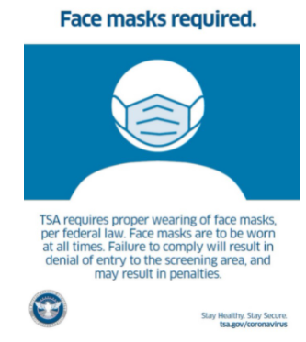
TSA Mask Mandate
The Transportation Security Administration (TSA) is extending the face mask requirement for individuals across all transportation networks throughout the United States, including at airports, onboard commercial aircraft, on over-the-road buses, and on commuter bus and rail systems through September 13.
Notes:
Blair

Slide 11
NC Transit to Vaccinations
Connecting citizens to COVID-19 vaccinations
Ride United free rides launched April 20; 844-771-RIDE
DHHS funding spend down by transit agencies continues
RFI technology solutions tools still available
IMD is available to provide technical assistance with any new or emerging vaccine related needs
Please continue reporting trips and claims.
Notes:
Ryan

Slide 12
DHHS CARES Act Vaccine Trip Claims (as of August 10, 2021) REMINDER: Please add week of service to DHHS claim form on the month or contract line.
590 Submitted
$259,315 in claims submitted
$257,943 reviewed and approved
Notes:
Carolyn

Slide 13
DHHS Funding Eligibility
Initial approval from DHHS to expand eligibility to include ROAP-eligible trips to mitigate the impacts of COVID-19.
Goal to expend funding by September 30 (legislative deadline is December 31).
Can include retroactive costs.
Once officially approved, additional guidance will be provided.
Notes:
Ryan

Slide 14
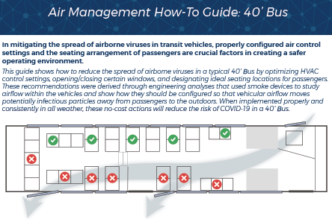
Notes:
Will be added to website.

Slide 15
Other Reminders & Updates

Slide 16
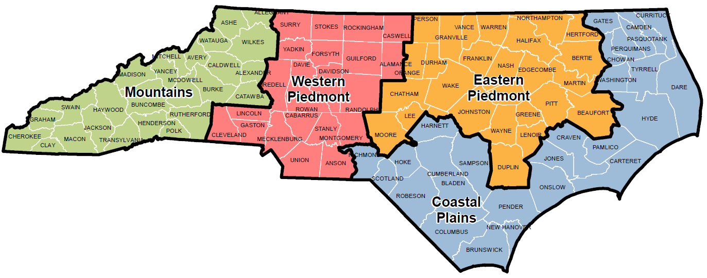
IMD Regions - Contacts
Mountains
Section | Contact | Office Number | Email Address
Finance | Rose Hafford | 919-707-2600 | rlhafford@ncdot.gov
Grants Administration | Bernard Clark | 919-707-4678 | bbclark2@ncdot.gov
Planning | Bryan Lopez | 919-707-2606 | balopez@ncdot.gov
Safety, Education and Compliance | Ross Dragon | 919-707-4681 | radragon@ncdot.gov
Western Piedmont
Section | Contact | Office Number | Email Address
Finance | Inger Bautista | 919-707-4683 | imbautista@ncdot.gov
Grants Administration | Kenetta Spence | 919-707-4673 | kmmclean@ncdot.gov
Planning | Bryan Lopez | 919-707-2606 | balopez@ncdot.gov
Safety, Education and Compliance | Ross Dragon | 919-707-4681 | radragon@ncdot.gov
Eastern Piedmont
Section | Contact | Office Number | Email Address
Finance | Cassandra Wilson | 919-707-4671 | cdwilson@ncdot.gov
Grants Administration | Tony Sumter | 919-707-4689 | asumter@ncdot.gov
Planning | Bryan Lopez | 919-707-2606 | balopez@ncdot.gov
Safety, Education and Compliance | Eartle McNeill | 919-707-4686 | elmcneill1@ncdot.gov
Coastal Plains
Section | Contact | Office Number | Email Address
Finance | Katie Dunn | 919-707-4670 | kedunn@ncdot.gov
Grants Administration | Alexius Farris | 919-707-4698 | aafarris@ncdot.gov
Planning | Bryan Lopez | 919-707-2606 | balopez@ncdot.gov
Safety, Education and Compliance | Eartle McNeill | 919-707-4686 | elmcneill1@ncdot.gov
Notes:
Pam

Slide 17
FY 2023 Call for Projects
FY 2023 Call for Projects
Call for Projects: July 12 – October 8, 2021
5311 Admin/Operating Combined Capital
5310 Operating Mobility Manager
5310 Capital – Purchase of Service ConCPT
Rural State Operating* Traveler’s Aid
STI – Capital – Rural STI – Capital –Urban
Non-STI Rural Expansion Vehicle
*5303, TDM, Internship/Apprentice to be posted later in 2021.
*5307 FY 2022 applications previously submitted are in review process
Notes:
Pam

Slide 18
IMD Apprentice & Intern Programs
Program returning in FY 22-FY 23 (starts May 2022)
Call for projects was posted this week
Maximum Salaries/Budgets have been increased to reflect current market demands.
Sponsor applications must be submitted by COB on November 1, 2021
Approved sponsors notified by December 1, 2021
Recruitment period is November 1, 2021 through March 31, 2022
Notes:
Pass to Kevin

Slide 19
Second Call for Projects
IMD will be issuing a second call for projects by November.
Focus will be on committing state and federal funds not already included in existing grants or the current FY 23 call for projects.
May include remaining CARES Act funds, ARPA funds, CRRSAA funds, and state funds.
May be in the form of a call for interest.
More information will be provided on the September call.
Notes:
Ryan – high level

Slide 20
State Management Plan & Business Guide Updates
SMP draft updates being finalized with goal to distribute to transit systems for comment by early October.
Goal to complete SMP update by January 1.
Business guide update also to be completed by January 1.

Slide 21
Transit Employee Salary Study
Survey released last week.
Deadline is COB August 19.
Survey seeks to understand existing salaries and challenges with recruiting employees, particularly drivers.
Recommendations will be included in a final report that can be shared with county board members and others.
Notes:
Ryan

Slide 22
Technology RFP Development
Consistent with best practices and industry trends On-demand as well as pre-scheduled trips
Increased value All participating agencies benefit from scale
Common, state-wide platform with better support and security All participating agencies benefit from standardization
Simpler, and faster acquisition and implementation Adaptable to the needs and readiness of each agency
Notes:
Provide brief overview, then pass to Morven.

Slide 23
Technology RFP Development
2021 |  |  |  |  |  | 2022
July | August | September | October | November | December | January | February
Survey
7/14 – 7/23
3 Listening Workshops
August
Award in Early 2022
Specifications Developed
September - November
Notes:
Blair to give dates of workshops and stats

Slide 24
Procurement Updates
FY22 Vehicle Order Forms are being sent out individually to each agency
Order forms will be sent soon after confirmation of fully approved FY22 budget agreement
Please place LTV orders no later than 10/4/21 as that is when the current NCDOT-administered contract expires; Current LTV order forms will be obsolete as of 10/5/21
All FY22 vehicle orders (including minivans, RR vans, LTVs etc…) must be placed no later than 12/31/21 so that deliveries may take place before POP deadline
New NCDOT Rolling Stock bid should be advertised by end of September
New rolling stock contract awards to take place by end of this calendar year
New contract will include LTVs and Raised Roof vans
NCDOT-IMD Vehicle Ordering/Disposition training to take place later this year
Notes:
Chris

Slide 25
Fare free study
ITRE is leading a study regarding fare elimination
Includes a review of case studies and best practices
Analysis of pros and cons of going fare free, including potential benefits and impacts
Notes:
Status update on fare free transit- I interviewed GoDurham and learned a lot about why they think fare free is important. I've collected many articles and started a literature review. Like we discovered when I first brought up the idea, there is a philosophical disagreement about whether to go fare free or not. I was thinking about laying out the philosophical arguments and including data analysis of how much we earn in fares. I was planning on conducting a survey, but I don't think this is necessary at this time. I think we need to lay out the arguments for and against fare free first and decide how to proceed after that.

Slide 26
Reports
Submit annual ROAP reports ASAP through SmartSheet (was due July 31)
All systems must submit a report even if you did not have carryover ROAP funding from FY 20 to FY 21.
We will not release FY 22 ROAP funding when available if you have not submitted your ROAP report.
FY 21 OpStats end of year report due August 31
Notes:
FY 22 reporting calendar has been emailed out and is on our website

Slide 27
Emergency Preparations
Submit updated contact information to Blair ASAP if you have any changes.
Ensure you are prepared to submit status updates to IMD in the event of emergencies.
Kevin Edwards and Blair Chambers are IMD’s leads on emergency response activities.
Notes:
Blair to add any notes on this topic.

Slide 28
STIP Updates
Recent estimates reveal that the STIP is overprogrammed by several billion dollars.
Some projects currently in the STIP may come out.
Working group is meeting regularly to develop recommendations.
IMD is participating in workgroup meetings to ensure transit has a voice and transit projects are not disproportionately impacted.
Notes:
Joe and Kai will participate in workgroup meetings.

Slide 29
Complete Streets
New policy adopted in 2019.
Working on updates now to streamline and standardize evaluation process used to decide when to add complete streets components on projects.
Will result in improved guidance for NCDOT planners and engineers.
Important for transit agencies to participate in project development discussions with NCDOT Division Offices so transit is adequately considered.
Notes:
Joe

Slide 30
QUESTIONS
Previous slides, recordings and FAQs:
https://connect.ncdot.gov/business/Transit/Pages/Transit-Meeting-Resources.aspx
Notes:
- Remind them of our webpage with slides, recordings and previous questions.

Slide 31
Integrated Mobility Division Transit Systems Call

