Slide 1
Integrated Mobility Division Transit Systems Call
September 8, 2021
Notes:
NCGA budget status

Slide 2
AGENDA
ROAP & SMAP Update
CARES Act Implementation
COVID-19 Response
Compensation Study – early findings
Other Reminders and Updates
Questions
Lightning Training - Procurement

Slide 3
ROAP & SMAP Update
IMD has been given approval to proceed with disbursing funds.
Traditional formula will be used to determine amounts.
Remaining unspent funds will be deducted from amounts.
Applications will open next week. We will send out guidance and instructions.
Applications will be due October 1.
Funds will be disbursed by October 31.
Notes:
Guidance will include allocation amounts. Any unspent funds will later be deducted before final allocation amounts are determined.
We will move to monthly ROAP reporting after funding is disbursed (similar to how we require reporting for DHHS CARES)

Slide 4
CARES Act Update
5311 Claims Summary
Update on 5307GA and ADTAP

Slide 5
5311 Claims Reimbursements (76 Agreements)
474 Submitted
$43,007,153 in claims
$42,879,727 approved for payment

Slide 6
CARES Intercity Reimbursements (4 Agreements)
2 Submitted
$12,918,314 in claims
$12,918,314 approved for payment

Slide 7
CARES 5307GA/ADTAP
5307
38 Claims
$4,855,615 in claims
$4,822,110 approved for payment
ADTAP
25 claims
$685,421 in claims
$685,421 approved for payment
Notes:
Any subrecipients who have not received their 5311 and/or 5339 FY 22 agreements, please reach out to Myra or Cassandra.

Slide 8
COVID-19 Response
COVID-19 Impact Reporting Requirements
Mask mandate
Transportation to vaccination sites
DHHS Funding Updates

Slide 9
COVID-19 Response Reporting
Federal Transit Administration (FTA) has launched an online application to collect information from recipients and subrecipients on the impacts of COVID-19. The FTA will use information submitted through the application to inform FTA actions in support of the transit industry’s COVID-19 recovery efforts and implementation of the Federal mask requirement for public transportation. Information on the program can be accessed at this link: https://www.transit.dot.gov/COVID-19Data
Submit this month’s information ASAP (deadline to IMD is September 10)
Notes:
Blair

Slide 10
TSA Mask Mandate
The Transportation Security Administration (TSA) is extending the face mask requirement for individuals across all transportation networks throughout the United States, including at airports, onboard commercial aircraft, on over-the-road buses, and on commuter bus and rail systems January 18, 2022.
Notes:
Blair

Slide 11
NC Transit to Vaccinations
Connecting citizens to COVID-19 vaccinations
Ride United free rides launched April 20; 844-771-RIDE
DHHS funding spend down by transit agencies continues
RFI technology solutions tools still available
IMD is available to provide technical assistance with any new or emerging vaccine related needs
Please continue reporting trips and claims.
Notes:
Ryan

Slide 12
DHHS CARES Act Vaccine Trip Claims (as of September 7, 2021) REMINDER: Please use Expanded DHHS Claim form with Trip Tiers
622 Submitted
$553,521 in claims submitted
$550,582 reviewed and approved
Notes:
Carolyn

Slide 13
Expanded Trip Expenses by Trip Type Since August 12, 2021 REMINDER: Please use Expanded DHHS Claim form with Trip Tiers
Tier 1 Trips (Vaccine)
$9,587
Tier 2 Trips (Covid-19 tests or health care, logistical support)
$0.00
Tier 3 (ROAP-eligible Trips)
$261,657
Notes:
Carolyn
We check balances as we review and approve claims. We will let you know if you are getting close.

Slide 14
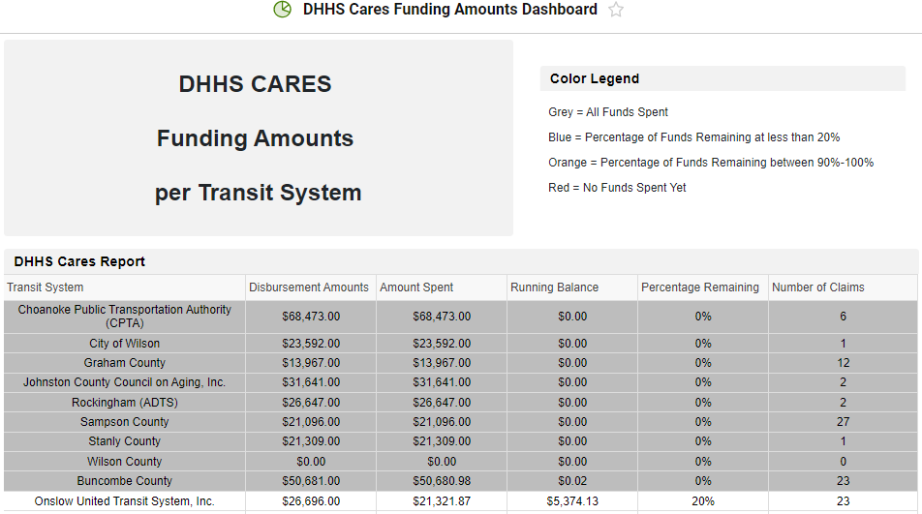
DHHS Cares Funding Amounts Dashboard
Notes:
Blair
Blair will send out link to SmartSheet after the meeting.

Slide 15
Compensation Survey of North Carolina Transit Systems – Preliminary Survey Findings
NC Transit Agencies Call ǀ September 8, 2021

Slide 16
Compensation Survey of North Carolina Transit Systems
Main objective: Are transit agencies providing compensation that will attract and retain employees?
Salary, wages, benefits of operators (agency and contractor), other operations and maintenance staff
Statewide Survey of Transit Agencies
Online and word document – responses supplemented with grantee data from ITRE
Total responses: 74
Urban only – 9
Rural only – 35
Both Urban and Rural - 31

Slide 17
Vacancies within Transit Agencies
334 total vacancies (reported by 60 transit agencies)
311 operator vacancies (reported by 55 transit agencies)
7 mechanic vacancies (reported by 5 transit agencies)
15 other vacancies
Since March 2020:
389 operators retired
52 FTEs reduced

Slide 18
Reasons for Vacancies
Unemployment benefits are better
Health concerns and COVID-19
Less interest in benefits with a low salary
Certain number of years of experience required
High risks with low pay
Drug screening

Slide 19
Wage/Rate Range for Operators/Other Operations Staff
Agency Operator Staff
Contractor Operator Staff
Other Agency Operations Staff
No CDL Required
$8/hr - $19/hr
$23,000/yr - $44,600/yr
CDL Required
$10/hr - $26/hr
$23,900/yr - $54,800/yr
Majority increased wages between 2020-2021
No CDL Required
$7/hr - $20/hr
CDL Required
$12/hr - $23/hr (or no max)
Dispatchers
$10/hr - $22/hr
$25,600/yr - $65,300/yr
Operations Supervisors
$12/hr - $40/hr
$27,000/yr - $81,000/yr

Slide 20
Benefits Provided to Operators
Benefits are available to:
All operators – 20%
Full-time operators only – 66%
Part-time with minimum hours – 14%
Provide CDL Training to new operators
No – 73%
Yes – 24%
Yes, after minimum length of employment – 3%

Slide 21
Operator Compensation Compared to Local Labor Market

Slide 22
Wage/Rate Range for Mechanics/Maintenance Staff
Agency Maintenance Supervisor Staff
Agency Mechanic Staff
No CDL Required
$10/hr - $33/hr
$33,000/yr - $41,600/yr
CDL Required
$12/hr - $32/hr
$34,800/yr - $66,700/yr
No CDL Required
$10/hr - $33/hr
$33,000/yr - $41,600/yr
CDL Required
$12/hr - $32/hr
$34,800/yr - $66,700/yr
Wage increases in 2021

Slide 23
Recruiting and Retaining Employees
Recruiting
Retention
Notice on organization’s website
Employee/personal referral
Online job listings
Community colleges
Signing/hire bonus
Pay and Benefits
Employee recognition program
Referral bonus
Increasing wages/rates
4-day work week
Paid CDL training/training opportunities
Benefits package
Annual COLA (Cost-of-living adjustment)

Slide 24
Next Steps
Completion of survey data analysis
Summary of available national industry data
Recommendations from literature review
Draft and Final Technical Report and Executive Summary/Briefing Document
Contact Info
Beth Hamby - bhamby@kfhgroup.com
Sarah Lasky - slasky@kfhgroup.com

Slide 25
Technology RFP Updates

Slide 26
Technology RFP Development
Consistent with best practices and industry trends On-demand as well as pre-scheduled trips
Increased value All participating agencies benefit from scale
Common, state-wide platform with better support and security All participating agencies benefit from standardization
Simpler, and faster acquisition and implementation Adaptable to the needs and readiness of each agency
Notes:
Provide brief overview, then pass to Morven.

Slide 27
Technology RFP Development
2021 |  |  |  |  |  | 2022
July | August | September | October | November | December | January | February
Survey
3 Listening Workshops
Award in Early 2022
Specifications Developed
September - November
Notes:
Blair to give dates of workshops and stats

Slide 28
What scheduling features are essential?

Slide 29
What challenges and concerns does your agency have regarding new scheduling systems?
Training for staff, on-going support of new software
Fluid transition to new system
Cost of new system
Ease of use
Standard reporting that meets NTD reporting requirements
Accurate information
Ability to access data from old system
System that works well for fixed route, as well as on-demand paratransit

Slide 30
What would your customers like to see to improve the system?
Vehicle location information
Mobile App
Ability to make payments with debit/credit cards
Electronic notifications
More ability to schedule their own trip

Slide 31
Other Reminders & Updates

Slide 32
FY 2023 Call for Projects
FY 2023 Call for Projects
Applications w/ Supporting Docs Due in EBS October 8, 2021
5311 Admin/Operating Combined Capital
5310 Operating Mobility Manager
5310 Capital – Purchase of Service ConCPT
Rural State Operating* Traveler’s Aid
STI – Capital – Rural STI – Capital –Urban
Non-STI Rural Expansion Vehicle
*5303, TDM, to be posted later in 2021.
*5307 FY 2022 applications previously submitted are in review process
Notes:
Pam

Slide 33
Second Call for Projects
IMD will be issuing a second call for projects by November.
Focus on committing state and federal funds not already included in existing grants or the current FY 23 call for projects.
May include remaining CARES Act funds, ARPA funds, CRRSAA funds, and state funds.
Draft program guidance underway.
Rural Capital; Technology Operating (SAS); Operating Assistance, Advanced Technology for Large Urbans.
Notes:
Pam

Slide 34
Procurement Updates
FY22 Vehicle Order Forms are being sent out individually to each agency
Order forms will be sent soon after confirmation of fully approved FY22 budget agreement
Please place LTV orders no later than 10/4/21 as that is when the current NCDOT-administered contract expires; Current LTV order forms will be obsolete as of 10/5/21
All FY22 vehicle orders (including minivans, RR vans, LTVs etc…) must be placed no later than 12/31/21 so that deliveries may take place before POP deadline
NCDOT-IMD Vehicle Ordering/Disposition training to take place as part of New Director’s Training in the future
Notes:
Chris

Slide 35
Emergency Preparations
Submit updated contact information to Blair ASAP if you have any changes.
Ensure you are prepared to submit status updates to IMD in the event of emergencies.
Kevin Edwards and Blair Chambers are IMD’s leads on emergency response activities.
Notes:
Blair to add any notes on this topic.

Slide 36
State Management Plan & Business Guide Updates
SMP draft updates being finalized with goal to distribute to transit systems for comment by early October.
Goal to complete SMP update by January 1.
Business guide update also to be completed by January 1.

Slide 37
Training Updates
Link to past New Director’s Training recordings: https://connect.ncdot.gov/business/Transit/Pages/Training-Hub.aspx
Starting “lightning” trainings at end of each monthly call
Starting in 2022, New Director’s Training will occur prior to the start of the new application cycle
Please reach out to IMD staff if you have urgent training needs or require technical assistance.

Slide 38
QUESTIONS
Previous slides, recordings and FAQs:
https://connect.ncdot.gov/business/Transit/Pages/Transit-Meeting-Resources.aspx
Notes:
- Remind them of our webpage with slides, recordings and previous questions.

Slide 39
Procurement Training
Procurement ($10,000-$29,999)
Contact or send requests for quotes to at least 3 responsible vendors
Quotes can be informal (over the phone or email)
Procurement Checklist and History Form
All bids over $25,000 require a Debarment Certification signed by vendor
Require E-Verify compliance for any service or installation
Notes:
Blair

Slide 40
Procurement Training
Procurement ($30,000-$89,999) for Equipment/Supplies; $30,000-$499,000 for Construction
Contact or send requests for quotes to at least 3 responsible vendors
Must receive at least 3 quotes back
Procurement Checklist and History Form
All bids over $25,000 require Debarment Certification signed by vendor
Require E-Verify compliance for any service or installation
Buy America certification needed for projects over $150,000
Notes:
Blair

Slide 41
Procurement Training
Procurement Sealed Bid ($90,000 and above); $500,000 and above for Construction
Must advertise bid for at least 7 full days before bid opening
May use electronic ad, newspaper or both (must have prior agency board approval if solely electronic)
Procurement Checklist and History Form
Requires Debarment Certification signed by vendor
All bids exceeding $100,000 vendors and/or consultants must sign Lobbying Certification
Require E-Verify compliance for any service or installation
Buy America certification needed for all bids involving construction, equipment or materials over $150,000
Notes:
Blair

Slide 42
Procurement Training
Visit the Procurement page on the Connect NCDOT website for additional resources/documentation:
https://connect.ncdot.gov/business/Transit/Pages/Transit-Procurement.aspx
Chris Dodson, Procurement Specialist
919-707-4696
cbdodson@ncdot.gov
Notes:
Blair

