Slide 1
Integrated Mobility Division Transit Systems Call
October 13, 2021
Notes:
NCGA budget status

Slide 2
AGENDA
Vaccine Transportation
CARES Act Implementation
Other finance and grant admin. updates
Other Reminders and Updates
Questions
Lightning Training – EBS claims submittal

Slide 3
NC Transit to Vaccinations
Connecting citizens to COVID-19 vaccinations
DHHS funding spend down by transit agencies continues
RFI technology solutions tools still available
IMD is available to provide technical assistance with any new or emerging vaccine related needs
Please continue reporting trips and claims.
Notes:
Ryan

Slide 4
DHHS CARES Act Vaccine Trip Claims (as of October 13, 2021) REMINDER: Please use Expanded DHHS Claim form with Trip Tiers
724 Submitted
$1,112,936 in claims submitted
$1,003,421 reviewed and approved

Slide 5
Expanded Trip Expenses by Trip Type Since August 12, 2021 REMINDER: Please use Expanded DHHS Claim form with Trip Tiers
Tier 1 Trips (Vaccine)
$21,783
Tier 2 Trips (Covid-19 tests or health care, logistical support)
$253
Tier 3 (ROAP-eligible Trips)
$763,144

Slide 6
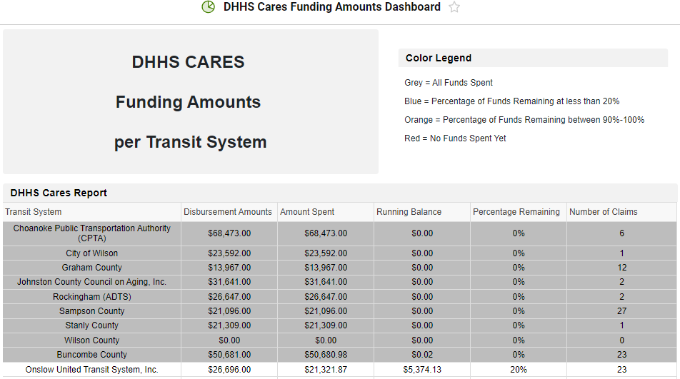
DHHS Cares Funding Amounts Dashboard
Notes:
Blair will add SmartSheet link in chat.
For systems that have exhausted your funding, you may use CARES Act funding for vaccine transportation.

Slide 7
NCDOT-IMD Transit System Meeting
DHHS Slides for Presentation
October 13, 2021

Slide 8
Vaccine Approval Outlook
Anticipated increase in demand for transportation needs is expected as vaccines are approved for booster doses and pediatric vaccinations throughout the rest of the year.
Which vaccine manufacturers have submitted their packets for review?
When will FDA meet to discuss the packets submitted? | 9/17/21 | 10/14/21 | 10/15/21 | 10/26/21
FDA Emergency Use Authorization | 9/22/21 | TBD | TBD | TBD
ACIP/CDC Recommendation | 9/24/21 | 10/20-10/21/21 | 10/20-10/21/21 | 11/2-11/3/21
BOOSTERS
BOOSTERS
BOOSTERS
5-11
Key transportation considerations and best practices:
Accommodation for families that may be traveling together
Access for rural populations
Dedicated Ride vans

Slide 9
Additional Doses and Boosters
Notes:
Booster Shots:
Although we continue to see highly effective protection against severe cases of COVID-19 in those fully vaccinated, public health experts are starting to see some reduced protection against mild and moderate COVID-19 infections in vaccinated people.
To address this, the FDA and CDC amended the emergency use authorization (EUA) for the Pfizer COVID-19 Vaccine to allow for use of a single booster dose to be administered at least six months after completion of the primary series.
Boosters are available now for:
People 65 and older
Residents in long-term care
People 18 and older with underlying medical conditions
People who work in high-risk settings like healthcare workers, teachers and childcare providers or food workers
If you have questions, talk to a doctor, nurse or pharmacist for advice.
Additional Doses:
Emerging data suggest some people with moderately to severely compromised immune systems do not always build the same level of immunity after vaccination and can get extra protection from an additional dose of the COVID-19 vaccine.
These additional doses are approved and available now for those who qualify.
Moderately or severely immunocompromised due to a medical condition or receipt of immunosuppressive medications or treatments? These conditions and treatments include but are not limited to:
Active treatment for solid tumor and hematologic malignancies
Receipt of solid-organ transplant and taking immunosuppressive therapy
Receipt of chimeric antigen receptor (CAR)-T-cell or hematopoietic stem cell transplant (within 2 years of transplantation or taking immunosuppression therapy)
Moderate or severe primary immunodeficiency (e.g., DiGeorge syndrome, Wiskott-Aldrich syndrome)
Advanced or untreated HIV infection (people with HIV and CD4 cell counts <200/mm3, history of an AIDS-defining illness without immune reconstitution, or clinical manifestations of symptomatic HIV)
Active treatment with high-dose corticosteroids (i.e., ≥20mg prednisone or equivalent per day when administered for ≥2 weeks), alkylating agents, antimetabolites, transplant-related immunosuppressive drugs, cancer chemotherapeutic agents classified as severely immunosuppressive, tumor-necrosis (TNF) blockers, and other biologic agents that are immunosuppressive or immunomodulatory.

Slide 10
Boosters – Tips for vaccinating employees
How can I help vaccinate employees (booster doses)?
Connect Employees with Vaccine Appointments
Assist employees with identifying vaccination sites offering walk-in or appointments: www.myspot.nc.gov
Host vaccination on-site. Inquire with your occupational health provider or insurance provider to explore options; Employers can contact their local health department for help with finding vaccine resources in their community (https://www.ncalhd.org/map/).
Support transportation to and from vaccination sites
Share Information with Employees, including Eligibility for Boosters
Invite Community Health Workers (CHW Contact Information) or a local provider to meet with staff and answer questions; offer the session during working time, not only during breaks.
Share print materials (links to key resources)
Assist with Vaccine Record Location
Help employees locate their vaccination record (if they lost their vaccine card) to identify what vaccine brand they received and when they would be due for a booster dose, if eligible (How to View Your COVID-19 Vaccination Information)
Offer Staff Paid Time-off for Vaccine Appointments and if unwell
Offer paid time off to staff receiving a vaccination if they are experiencing side effects.
Implement Preventative Policies
Implement policies like requiring vaccination or weekly testing
Notes:
Charlene

Slide 11
CARES Act Update
Rnd. 4 Distribution Plan
5311 Claims Summary
Update on 5307GA and ADTAP

Slide 12
CARES Act Round 4 Distribution Plan
Approximately $20 Million remaining
Operating expenses with same parameters as previous rounds
We encourage systems to plan to use some funding for scheduling software under the new state contract next year
Formula based distribution:
75% based on traditional 5311 formula
25% based on maximum vehicles in service
Will submit application to FTA by end of November
Current agreements will be amended once awarded by FTA

Slide 13
5311 Claims Reimbursements (76 Agreements)
491 Submitted
$43,999,409 in claims
$43,562,528 approved for payment

Slide 14
CARES Intercity Reimbursements (4 Agreements)
3 Submitted
$13,069,879 in claims
$12,918,314 approved for payment

Slide 15
CARES 5307GA/ADTAP
5307
45 Claims
$5,013,483 in claims
$4,920,833 approved for payment
ADTAP
25 claims
$685,421 in claims
$685,421 approved for payment
Notes:
Any subrecipients who have not received their 5310 and/or 5303 FY 22 agreements, please reach out to Myra or Cassandra.

Slide 16
Other Funding and Grant Administration Updates

Slide 17
ROAP & SMAP Reminder
IMD was given approval to proceed with disbursing funds.
Traditional formula will be used to determine amounts.
Remaining unspent funds will be deducted from amounts.
Applications are open and guidance has been provided.
Applications will due October 31.
Funds will be disbursed in November.
Notes:
We will move to monthly ROAP reporting after funding is disbursed (similar to how we require reporting for DHHS CARES)

Slide 18
FY 2023 Call for Projects
FY 2023 Call for Projects
Applications w/ Supporting Docs Due in EBS October 8, 2021
5311 Admin/Operating Combined Capital
5310 Operating Mobility Manager
5310 Capital – Purchase of Service ConCPT
Rural State Operating* Traveler’s Aid
STI – Capital – Rural STI – Capital –Urban
Non-STI Rural Expansion Vehicle
*5303, TDM, to be posted later in 2021.
*5307 FY 2022 applications previously submitted are in review process
Notes:
Pam

Slide 19
Second Call for Projects
IMD will be issuing a second call for projects on November 1 (due Feb. 1)
Focus on committing state and federal funds not already included in existing grants or the current FY 23 call for projects.
May include remaining CARES Act funds, ARPA funds, CRRSAA funds, and state funds.
Draft program guidance underway.
Rural Capital; Technology Operating (SAS); Operating Assistance, Advanced Technology for Large Urbans.
Notes:
Pam

Slide 20
Other Updates & Reminders

Slide 21
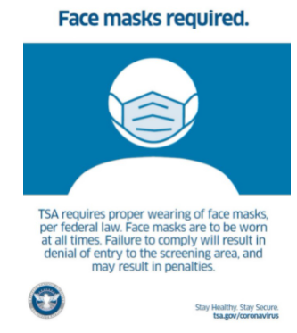
TSA Mask Mandate
The Transportation Security Administration (TSA) is extending the face mask requirement for individuals across all transportation networks throughout the United States, including at airports, onboard commercial aircraft, on over-the-road buses, and on commuter bus and rail systems January 18, 2022.
Notes:
Blair

Slide 22
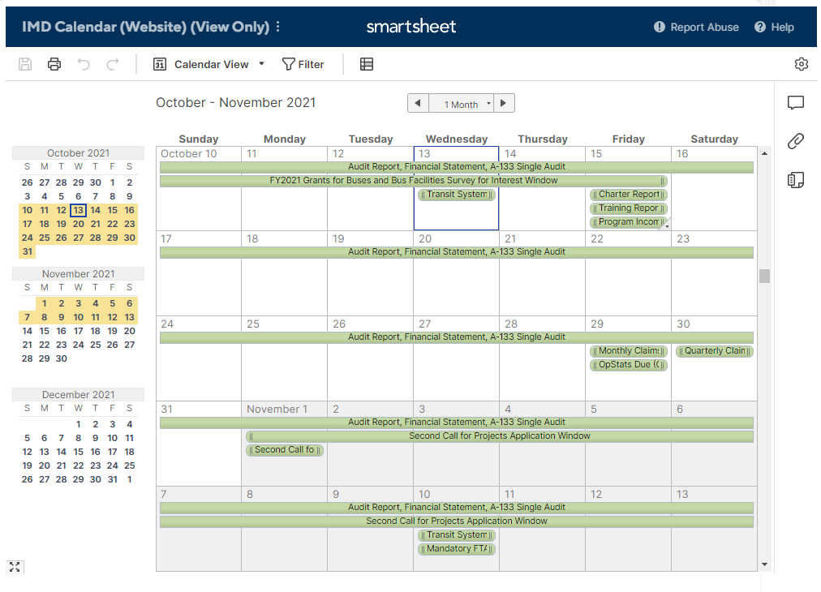
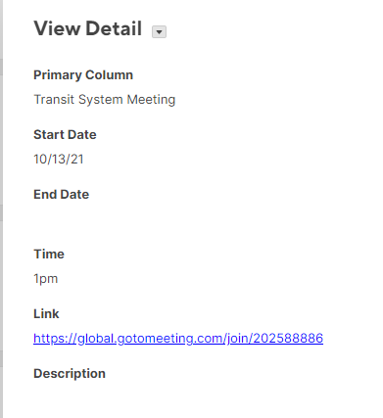
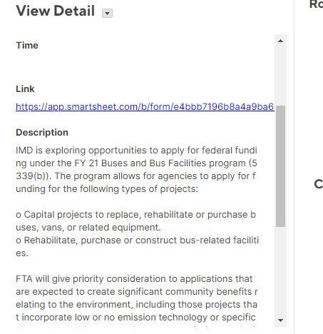
Transit Communication Hub

Slide 23
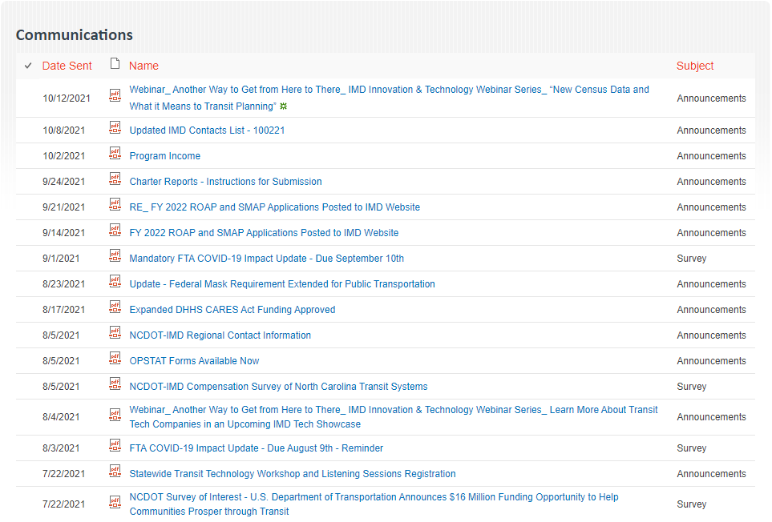
Transit Communication Hub

Slide 24
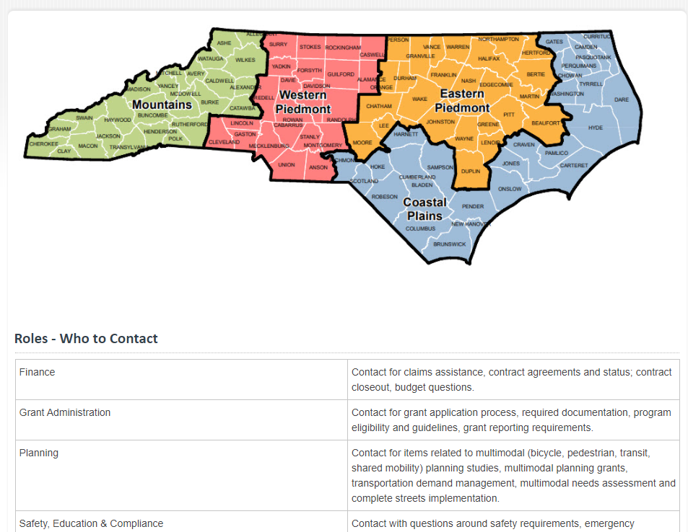
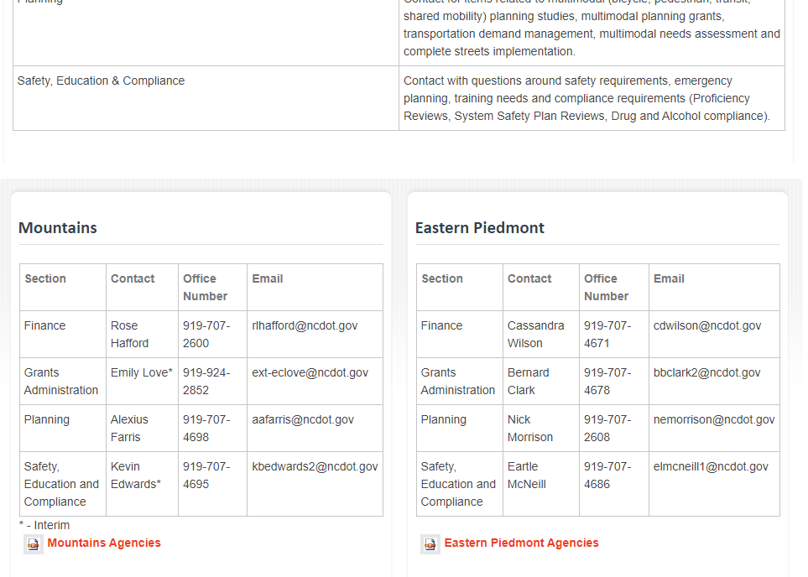
Regional Contact Information

Slide 25
Technology RFP Timeline Updates
2021 |  |  |  |  |  | 2022
July | August | September | October | November | December | January | February
Survey
3 Listening Workshops
Award in Early 2022
Specifications Developed
September - November
Notes:
Ryan

Slide 26
Compensation Study Updates
Wrapping up edits to final report.
Developing one-page infographic with highlights of findings.
Anticipate release of report, executive summary, and infographic by the end of the month.

Slide 27
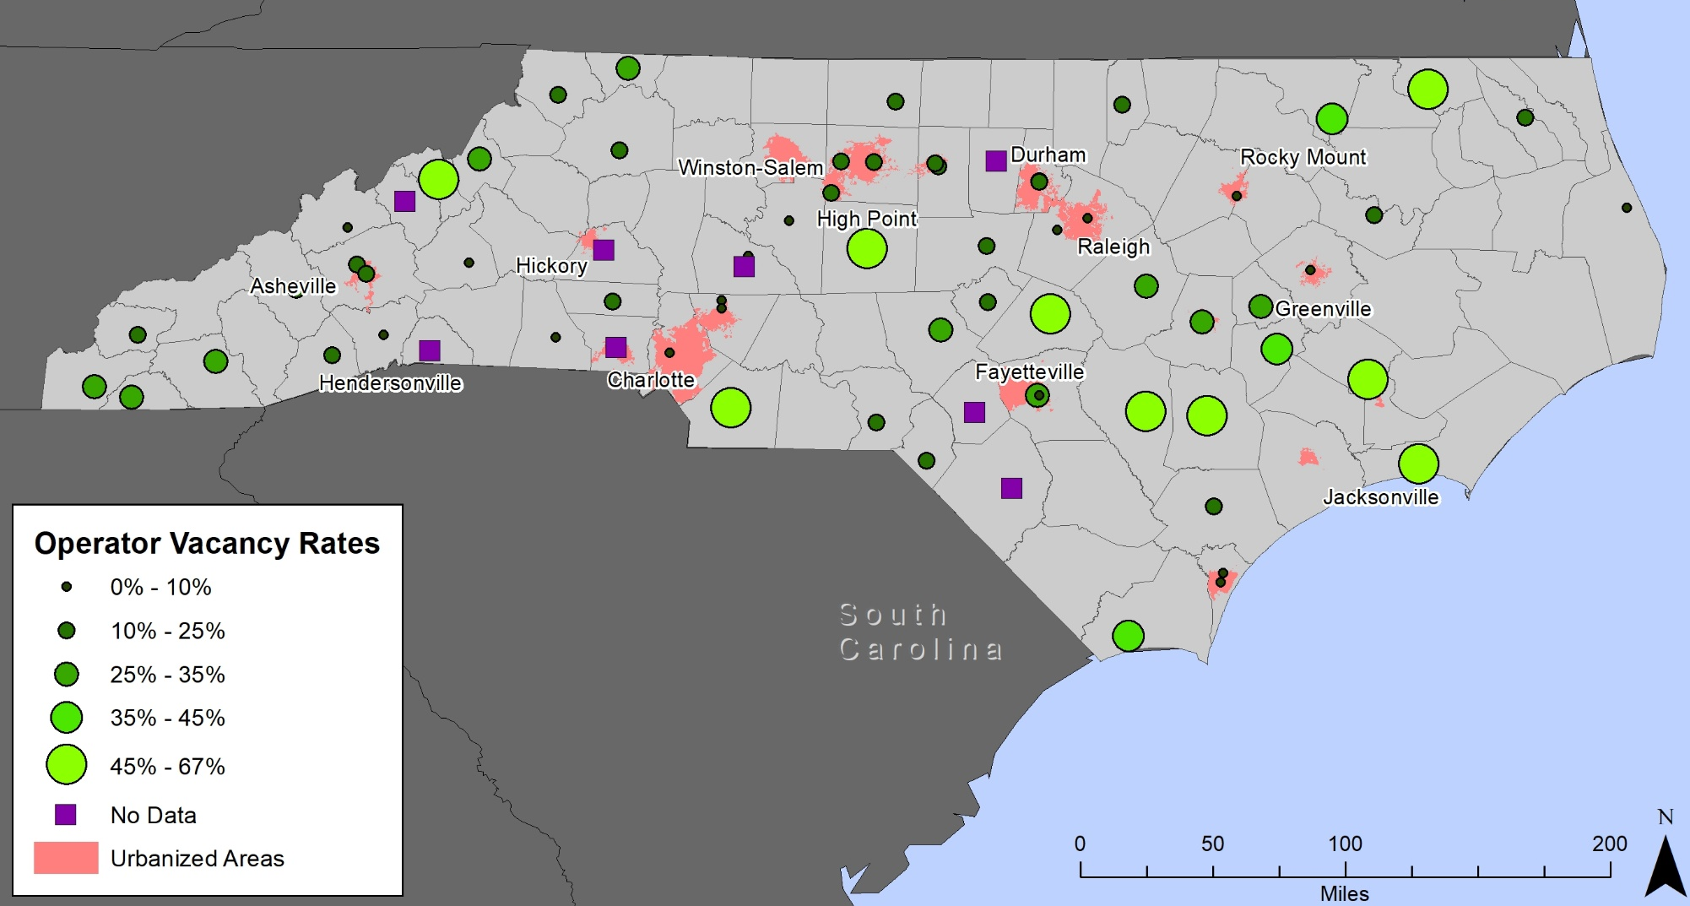
Compensation Study Findings

Slide 28
Compensation Study Findings
Blended services can create more opportunities
Challenges are more pronounced in rural areas and for smaller transit systems
Higher pay leads to lower vacancies
Reliable hours and pay attracts workers
Workers want training, health benefits, and a quality work environment
Notes:
Blended services can create more opportunities – Transit systems which blend purchased and directly operated transportation services have lower average vacancy rates. Blended services can create more options for systems to recruit and retain operators.
Challenges are more pronounced in rural areas and for smaller transit systems – Vacancy rates tend to be higher the farther a transit system is from an urbanized area. Vacancy rates tend to be lower for larger transit systems (measured by number of vehicles) and systems which have fixed or deviated-fixed route services.
Higher pay leads to lower vacancies – Systems with higher minimum and maximum pay rates have lower vacancy rates on average.
Reliable hours and pay attracts workers – Systems with a higher percentage of fulltime drivers and with more generous overtime levels have lower vacancy rates.
Workers want training, health benefits, and a quality work environment – Systems which offer wellcare benefits, offer CDL training, and which foster a quality working environment have lower vacancy rates.

Slide 29
Workforce Workgroup Formed
IMD will lead a workforce workgroup with select transit system directors, NCPTA, NCDMV, and others
The group will develop strategies and recommendations to address the driver shortage challenge

Slide 30
Procurement Updates
LTV Contract Status Update
As of 10/5/21, the previous NCDOT-specific contract for LTVs has expired
Currently finalizing the bid posting for an NCDOT-specific contract for LTVs as well as raised roof vans
As of now we expect that bid to be posted prior to the end of October
Contract awards should take place between January – February of 2022
Notes:
Chris

Slide 31
State Management Plan
SMP draft updates being finalized this week.
Next step: distribute to transit systems by next week for comment – 30-day review period.
November – December – update document incorporating comments/feedback.
Complete SMP update by January 1 – share with transit agencies and FTA.
Note: Business guide update also anticipated to be completed by January 1.
Notes:
John

Slide 32
Training Updates
Link to past New Director’s Training recordings: https://connect.ncdot.gov/business/Transit/Pages/Training-Hub.aspx
Continuing “lightning” trainings at end of each monthly call
Starting in 2022, New Director’s Training will occur prior to the start of the new application cycle
Please reach out to IMD staff if you have urgent training needs or require technical assistance.

Slide 33
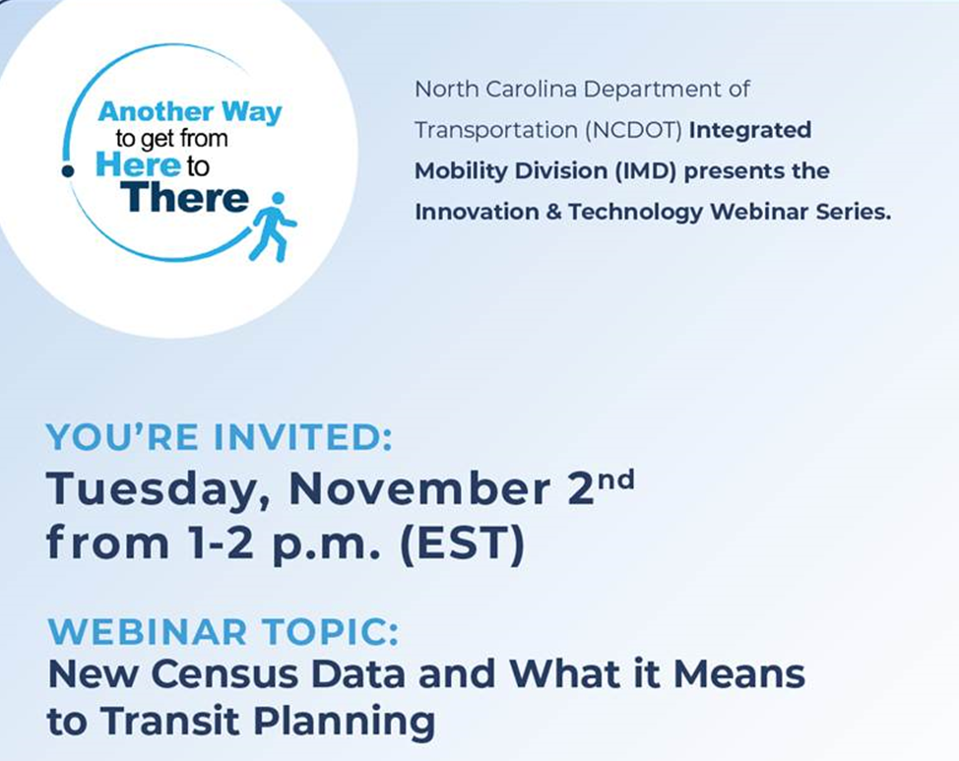
Upcoming Webinar

Slide 34
Reports
Due October 15
Charter (SmartSheet)
Program Income (Send to Myra directly)
Training report (EBS)
Vehicle and lift preventative maintenance data (EAM)
Notes:
New process for submitting charter reports via smartsheet

Slide 35
QUESTIONS
Previous slides, recordings and FAQs:
https://connect.ncdot.gov/business/Transit/Pages/Transit-Meeting-Resources.aspx
Notes:
Remind them of our webpage with slides, recordings and previous questions.
Turn over to Myra to introduce the EBS team for training.

