Slide 1
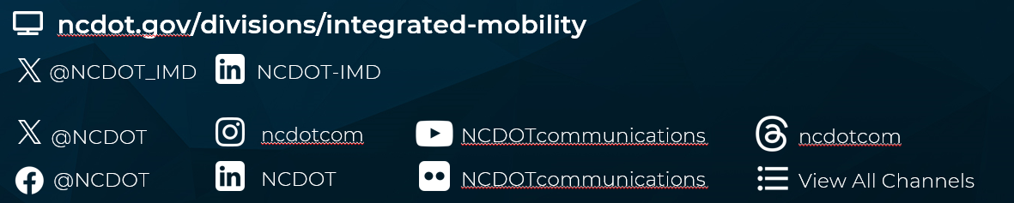
Integrated Mobility Division
Transit Systems Call
October 14, 2026

Slide 2
AGENDA
Opening/Announcements
Finance Updates
Grant Administration Updates
Procurement Updates
Surveys, Project Calls and Special Updates
Special Training Opportunities
Training Updates
Calendar Updates

Slide 3

November Transit Call
Just a reminder that the November Transit Call will be 1 day earlier on Tuesday the 10th due to Veteran's Day (State Holiday) falling on the normal 2nd Wednesday.

Slide 4

Finance Branch Updates

Slide 5
Finance – FY27 Upcoming Due Dates
FY27 Grant Agreements
Due Date | Task
​August - October 2026 | Federal Contracts sent to Subrecipients
October 15, 2026 | FFY26 Q4 - Program Income Report due FFY26 Q4 - Charter Report due
October 30, 2026 | September claims are due
October 30, 2026 | Q1 claims are due
November 30, 2026 | October claims are due

Slide 6
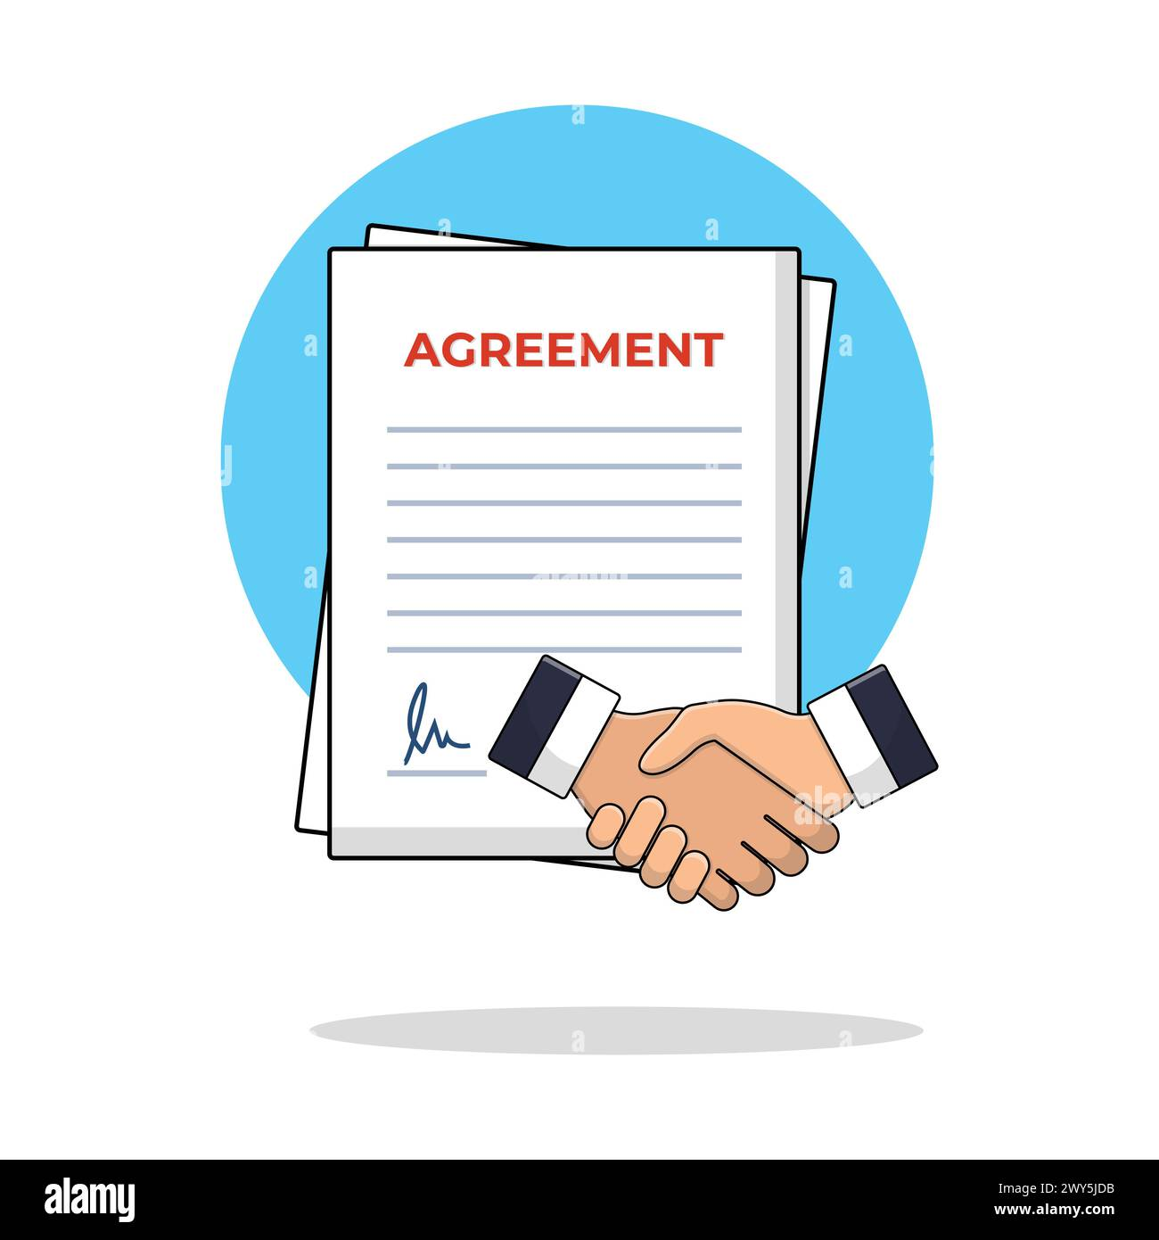
Finance – FY27 Contracts
REMINDER: As you receive FY27 contracts from Finance, please review your contract for accuracy and return to IMD within 30 days. You will receive an email notification from DocuSign asking you to view your documents and sign.
Please do not attest your own signature; this will cause delays in assigning your agreement. Note only the authorized official can sign these contracts.
If you have not received all your FY27 contracts, please reach out to your assigned Accounting Specialist.
Without a fully executed agreement, claims cannot be submitted.

Slide 7
Finance –Naming Convention for Files
File names for a claim’s supporting documentation must have the G-Code or M-Code in the file name. This is applicable to all grant types.
Please attach each required document separately except for Salaries & Fringes (G121-189).
Please do not combine all required supporting documentation as one attachment.
It is important that the naming convention be consistent across all claims and agencies to assist with efficient and effective reviews as well as future processing.
The Finance staff and Accounts Payable will return your claim if this process is not followed.

Slide 8
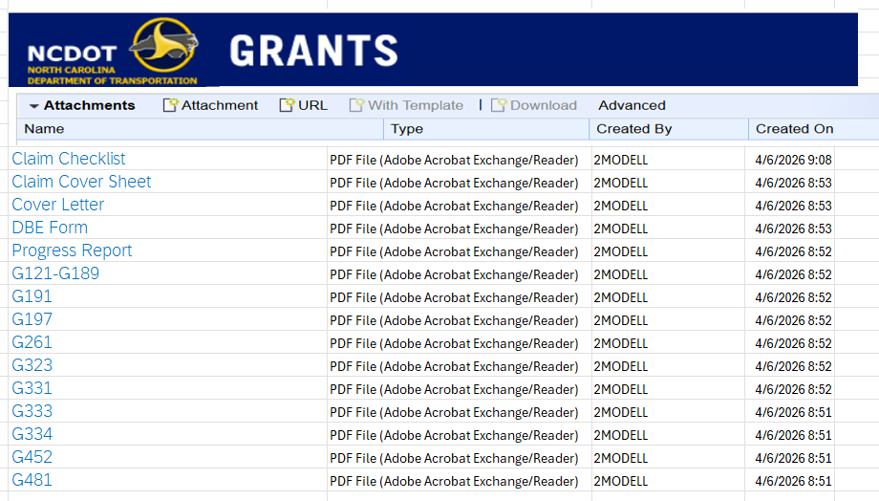

Finance – How to Name Supporting Docs

Slide 9
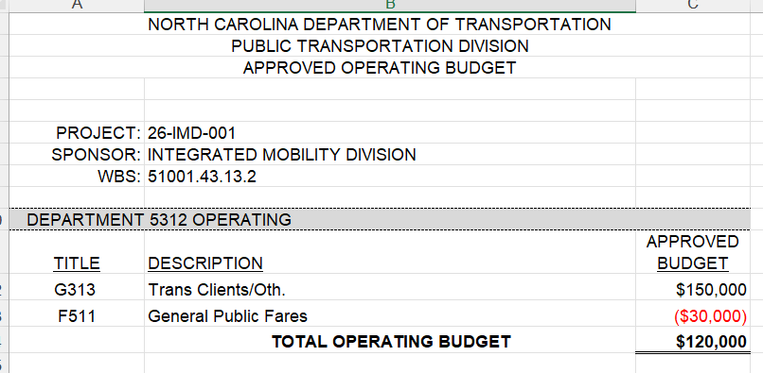
Finance – Fares / Contra-Accounts
F511-General Public Fares is a contra-account that is used to document the fares collected but does not take away from your original approved budget amount.
The budgeted amount on F511 cannot be moved to an expense line to increase the budgeted amount on another G-code.
Note: If F511 (General Public Fares) needs to be increased because more fares were collected than budgeted, G313 will also increase at a proportionate rate so that the Total Operating Budget does NOT change.

Slide 10
Finance – Reminders
Ensure the agency contact information on the claim is correct.
Ensure you are communicating with the claim reviewer.
If claim corrections are needed, and those corrections have not been received within 3 business days, the claim will be returned.
Claims with line items in overdraft will be returned and requested to be adjusted.
October ROAP and SMAP disbursements have been sent out to receiving counties. If you have not gotten notification, please reach out to your County Finance Manager.

Slide 11
Finance – Vehicle Claims
IMPORTANT REMINDER: vehicle reimbursement claims must also include the following:
  Inspection forms: send to Faye McCullen @ fmccullen@ncdot.gov
  Final vendor invoice
  MVR-1 Title application must be signed and notarized
  NCDOT-IMD as the first lien holder and insurance policy information
  Original vehicle order form
  Copy of check for vehicle payment or Advance Payment form
  Lettering & logo invoice (if applicable)
  IMD procurement letter (if your vehicle is not on a state contract)

Slide 12
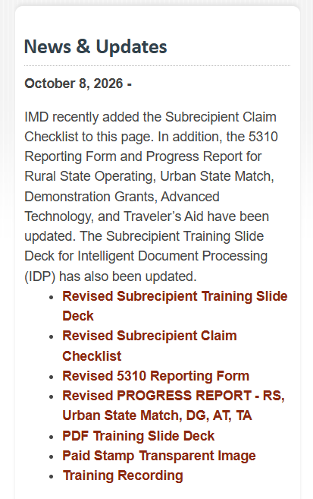

Finance – Webpage Updates
Several updates have been made to the Finance webpage. Revisions are linked under the "News & Updates"

Slide 13
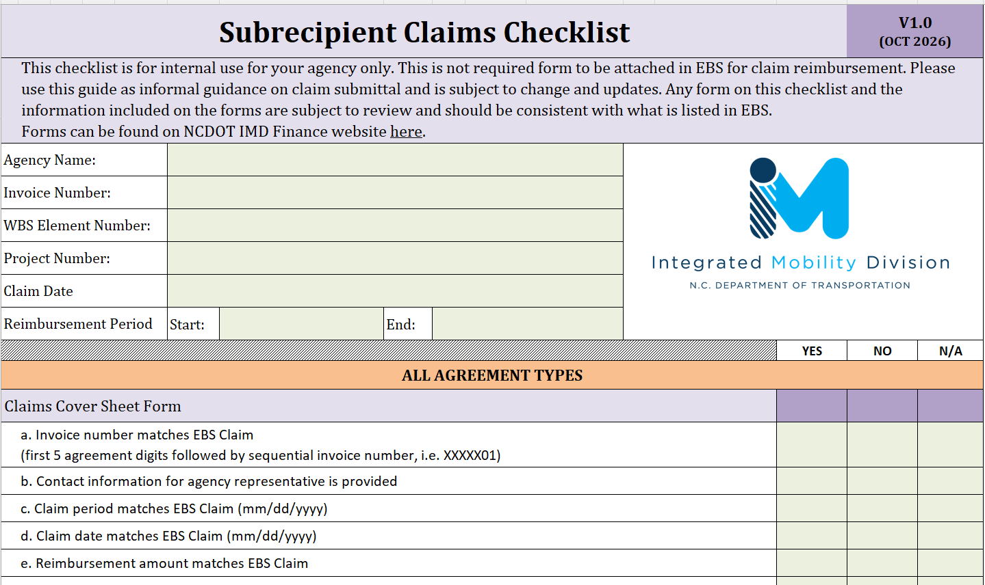
Subrecipient Claims Checklist
Notes:
This checklist is not a required form. Please use this as an informal guide for claim submissions.

Slide 14
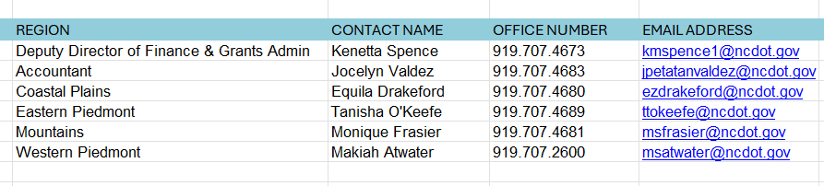
Finance – Contacts

Slide 15
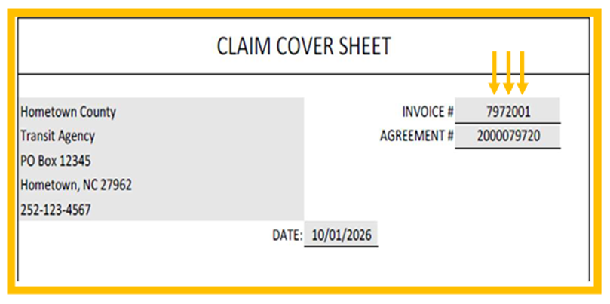
Updated Invoice Number Format
****The NEW invoice format will take effect beginning with your November claim, which is due by December 30. Any claims submitted after the November claim that do not comply with the new invoice format requirements will be returned for correction.
The invoice number is now the last five digits of the agreement number, followed by the sequential invoice number
(e.g. XXXXX01, XXXXX02, …)
Sample
**Forms that require the NEW
invoice number format are:
Claim cover sheet
Claim cover letter
DBE form

Slide 16

Grant Administration Updates

Slide 17
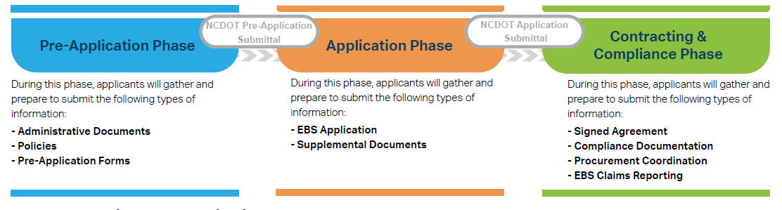
ncdot.gov
FY 28 Unified Grant Application (UGA) Process
We are here
Grants were due October 2nd
NOTES:
Outstanding Phase I Documents will DELAY review of your applications. This includes documents like Conflict-of-Interest Statements or Expired UEI Information. Applications without approved Phase I documents cannot be sent to the Board of Transportation for approval.
Documents, applications, etc. returned for updates, must be returned within 7 days.
We are working to improve processes. This means that RGSs cannot “chase down” applications. Responsibility to submit applications is the systems.
Notes:
Unified Grant Application Process consists of three phases.
Pre-Application Phase begins with completing a Pre-Application Registration Form. You will submit supplemental documents that don’t require any funding decision.
During the Application Phase, you can submit all remaining application documents through EBS dropbox.
After you submit EBS funding application, you can proceed to work on contracting & compliance documents.

Slide 18
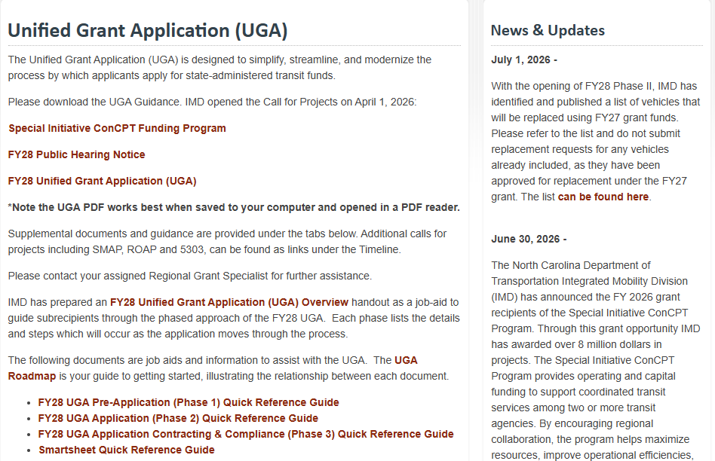
UGA Page from IMD Connect Site
Vehicles Funded w/ FY27 Grants
FY28 UGA Links
Tools you can use

Slide 19

Unified Grant Application (UGA) Process
ncdot.gov
O
Fiscal Year 2028
Document Tips, Tricks, and Reminders
Applicant Profile Form
Public Hearing Requirements
Program Resolution &
Local Share Certificate
Program Resolution must have the Authorized Representatives title and be signed by the
Certifying Official and Notary. The Authorized Representative cannot be the Certifying Official or Notary.
Local Share Certificate amounts must meet or exceed the required percentage and dollar amount for each grant.
If you have not completed the application profile form, please do so immediately.
Thank you to those who completed it last week after my email.
There is a link to the application profile form is on line 28 in your SmartSheet Workspace.
The Public Hearing
must be held.
Ensure all documentation related to the public hearing is attached in your workspace.
Notes:
These are the applications due in EBS on Friday, October 4.

Slide 20
Unified Grant Application (UGA) Process
ncdot.gov
O
Fiscal Year 2028
Document Tips, Tricks, and Reminders
Internship and Apprentice
ConCPT Grants
The deadline for the Internship/Apprentice application has been extended to November 2, 2026.
Workspaces will need to be updated with spaces for the application to be attached in SmartSheet.
If your agency plans to apply for this funding opportunity, please notify your Regional Grants Specialist.
The ConCPT Grant Application Guidance is currently under review. The application period is not currently open.
Once the guidance has been finalized and posted and the application period opens, a notification will be sent to all systems.
Notes:
These are the applications due in EBS on Friday, October 4.

Slide 21
ROAP
Overall Stats
Primary | Description | Amount | % Total Allocation
ROAP Allocation | 1. Funds approved from legislators | $18,664,413
Carryover | 2. Unspent funds from previous year | $1,171,937
Allocation + Carryover | 3. Total of 1 + 2 | $19,836,350
Transferred Out | 4. Transferring ROAP funds to match eligible grant programs | $321,269 | 2%
YTD Expenditures | 5. Total approved expenses to date | $4,711,962 | 24%
Total Balance | 6. Remaining funds to date | $14,803,119 | 75%
Other Funds Used | 7. Funds Used that exceed the transit systems' allocations | $526,925
We are off to a strong start with spending and reporting. Please submit outstanding reports ASAP.
Disbursements
  If your application was approved by August 22nd, you should have received your funding and you Disbursement Letter from the Finance Team. Please verify it was received.
  Those with applications more recently approved, disbursement were keyed the end of last week, so they should arrive via ACH in the next two weeks.
Percent of Transit System ROAP Reports Submitted by Month
July | 91% | January | -
August | 89% | February | -
September | 26% | March | -
October | - | April | -
November | - | May | -
December | - | June | -

Slide 22
ROAP
Reporting Requirements
Reporting Deadlines
ROAP reports are due 30 days after the end of each month.
  Example: July report → due August 30.
Reports must be submitted monthly. Combined or multiple-month reports are not permitted.
Reporting ROAP Fund Transfers
All ROAP fund transfers must be reported in the month the transfer occurs.
Transfers should not be reported in a later month.
Report Confirmation & Corrections
After the RGSs approve the report, an ROAP Report email will be sent.
Confirmations and/or corrections are due within 4 days of receiving the email.
FY2027 ROAP Report Due Dates
July 2026 | PAST DUE!
August 2026 | PAST DUE!
September 2026 | Friday, October 30, 2026
October 2026 | Monday, November 30, 2026
November 2026 | Wednesday, December 30, 2026
December 2026 | Friday, January 29, 2027
January 2027 | Friday, February 26, 2027
February 2027 | Tuesday, March 30, 2027
March 2027 | Friday, April 30, 2027
April 2027 | Friday, May 28, 2027
May 2027 | Wednesday, June 30, 2027
June 2027 | Thursday, July 15, 2027

Slide 23

Procurement

Slide 24
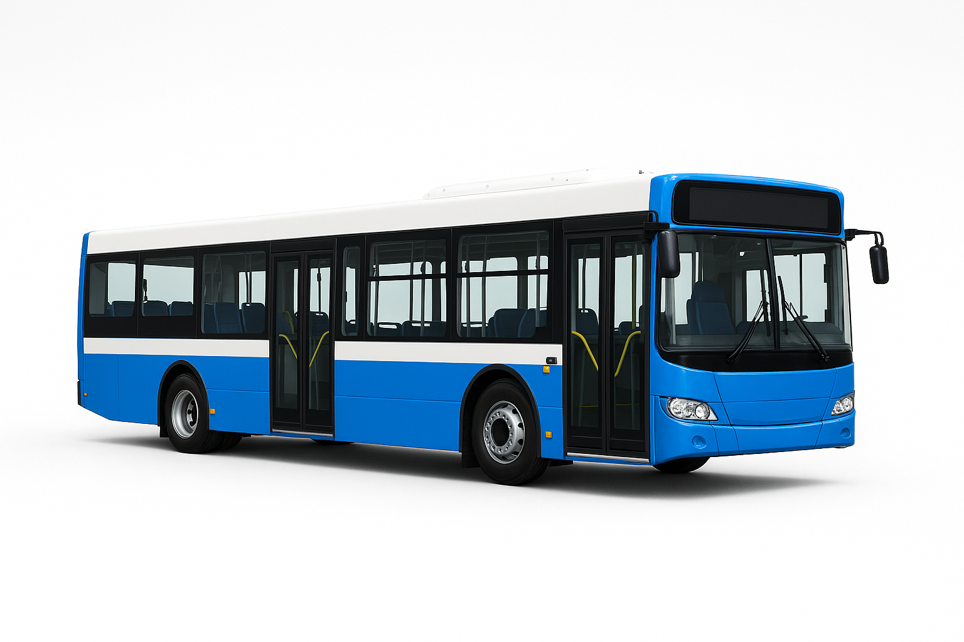
Statewide Vehicle Invitation For Bid (IFB)
Traditional Vehicle Statewide Contract
IMD has completed its review and sent back comments to Purchasing to begin its clarification process with the vendors on any questions or issues with the reviews.
We had 9 vendors bid (up from 4 in 2022).
There were approximately 400 plus spec issues to confirm or deny.
Current Contract
We are extended the current contract through January. Those details will be available soon.
The current contract becomes expired when the new contract becomes active.
Heavy-Duty/Large Bus Statewide Contract
The IFB Creation is close to completion.

Slide 25
Procurement
  FY27 Vehicle Order Forms
    Will be released by end of this calendar week; your system will receive the specific vehicle order forms (along with the current IMD Vehicle Ordering Policies and Procedures) that relate to the G-codes that your system was funded in FY27
    Order forms will be reflective of the current contract that is currently active (Contract #54-SG-05062022)
    Systems with vehicle types NOT covered under NCDOT contract (ie minivans or large buses) will need to complete a competitive procurement process
    Please order as soon as reasonably possible once you receive your respective FY27 order forms
  IMD Procurement Trainings
    IMD will be working on several pre-recorded training videos to address commonly asked procurement questions; topics include:
      Vehicle ordering process
      Sealed bid process (for procurements over $90,000)
      IMD-specific ProcurementPRO training
  IMD Triennial Prep
      Review of collected documentation by IMD is now underway
      Any additional questions or needed documentation will be addressed during standing Grants/Finance/Procurement check-in meetings
  Please reach out to Chris Dodson (cbdodson@ncdot.gov; 919-707-4696) with any questions or concerns

Slide 26

Special Project Updates

Slide 27

Customer Service Survey
Purpose: Survey results will be used to inform internal customer service training for IMD staff and identify opportunities to strengthen service delivery.
Survey Details:
  Open September 30–October 14; now extended to
  October 21!
  Anonymous & optional participation
  Approximately 10–15 minutes to complete
Current Stats:
  66 responses
  Goal: 142 responses, which is 20% of individuals sent the survey

Slide 28

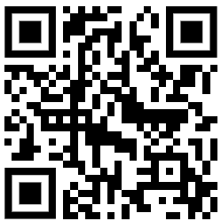
Statewide Active Transportation Plan
What’s Happening?
NC’s current statewide bicycle and pedestrian plan, WalkBikeNC, was adopted in 2013.
  North Carolina has changed a lot since 2013.
Our goal is to create a new action-oriented blueprint for improving walking, biking, and rolling across the state of North Carolina.
  The updated plan will guide future partnerships, policies, programs, and projects to create safer and more connected walking, biking and rolling options.
  The plan is not anticipated to update or generate any statewide bicycle/pedestrian/ multimodal networks.
Efforts began August 2026 and are anticipated to take about 12-months.
How Can You Get Involved?
Sign-up on our email list to hear about plan milestones or engagement opportunities.
  https://publicinput.com/ncactivetransportation
We are asking North Carolinians to share their active transportation stories and photos.
  Share your own active transportation stories and photos through our community stories platform and ask others to do the same!
NCDOT Active Transportation Plan webpage: http://ncdot.gov/activetransportationplan

Slide 29
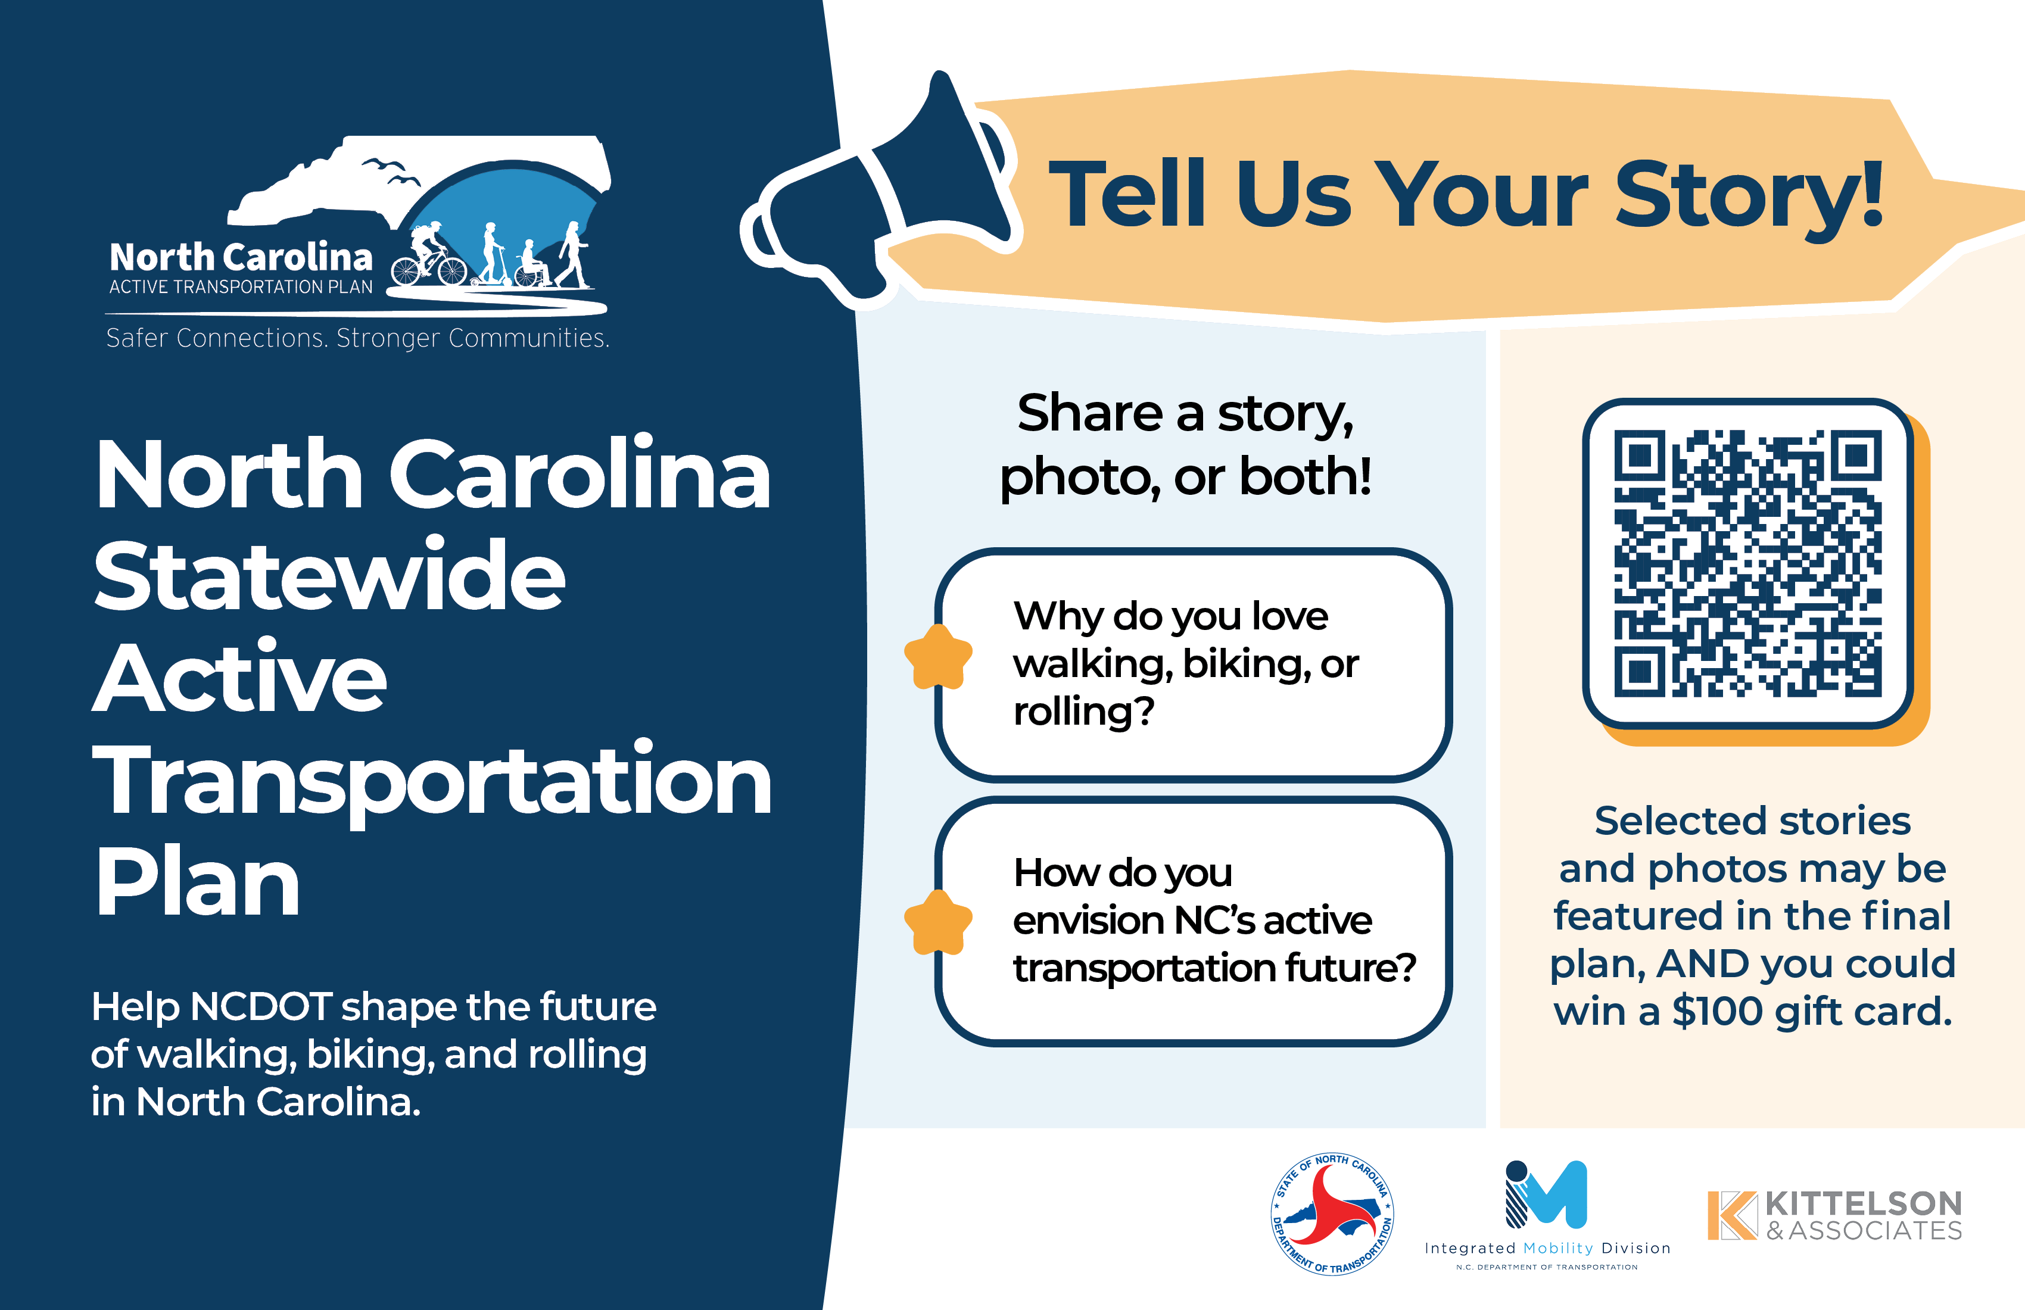

Slide 30
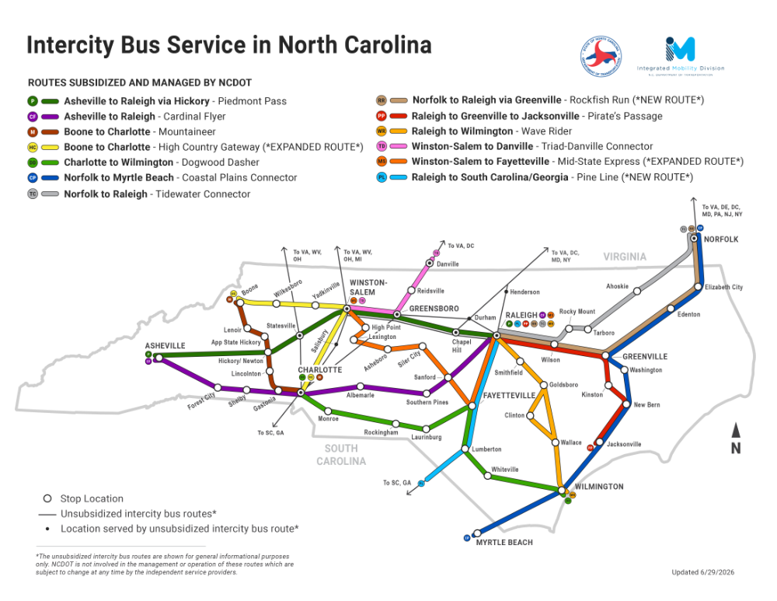
Local Transit Agency Website Updates for Intercity Bus Connectivity
Between Oct 5–12, outreach was conducted to Local Transit Agencies, Universities, and TDM Programs requesting website updates to reflect:
NCDOT‑subsidized Intercity
Bus Service
Local transit connections
Intercity Bus stop locations
Routes serving the locality
Date of last update
If contacted, please process your request as soon as possible.
Our goal is to ensure your website reflects the most accurate and appropriate Intercity Bus information.
Reach out if you have questions or need assistance!
Website information will be reviewed at least annually
Thank you for your collaboration! More exciting updates to come regarding Intercity Bus!
Total agencies identified: 58
14 completed updates
10 updates in progress
Notes:
Good afternoon everyone! My name is Dalton Kaiser, and I’m a Statewide Planner with NCDOT’s Integrated Mobility Division. I’m presenting today’s update on behalf of my supervisor, Hart Evans, and I’ll be covering some of the recent initiatives underway within our Intercity Bus Program.
Between October 5th and 12th, I reached out to Local Transit Agencies, Universities, and TDM Programs with a request to update their websites to highlight the presence of subsidized Intercity Bus service in their communities. Each request was customized for the agency so the information would fit naturally into their existing website layout.
These updates help riders understand where their local Intercity Bus stop is located, what local transit connections are available to reach that stop, which routes serve their area, and when the information and map were last updated so riders know the details are current, reliable, and something they can feel confident using. I also provided suggested website placement when no Intercity Bus information previously existed, along with content agencies could easily integrate on their end.
In total, we identified 58 agencies. As of October 13th, 14 agencies have already completed their updates, 10 are working with their IT teams to process their updates, and the remainder still need to respond; therefore, we are just above 40% complete with this round of updates! If I’ve reached out to you, please go ahead and process the request as soon as you can. For those who have processed our request to update your agency’s site, we sincerely appreciate your willingness to assist!
If you have any questions or want to ensure the information posted on your website is accurate and suitable for your agency, I’m more than happy to assist and work with you directly.
Looking ahead, anytime we update the Intercity Bus Program or Map, I’ll review each agency’s website to make sure the information stays current. If any changes are needed, I will make sure to reach back out to your agency. No matter what, each agency’s website will be review at least once a year to ensure all information regarding Intercity Bus is accurate and up to date.
Thank you all for your ongoing collaboration! We have more exciting updates coming soon regarding NCDOT’s Intercity Bus Service, and we look forward to sharing those with you!

Slide 31

Paved Trails & Sidewalks
Feasibility Study Grant Program
Copy/paste any of the icons below into your presentation. Please change color to white if using them on a dark background.
NCDOT Integrated Mobility Division
Joseph Furstenberg – Senior Project Manager, MPA

Slide 32
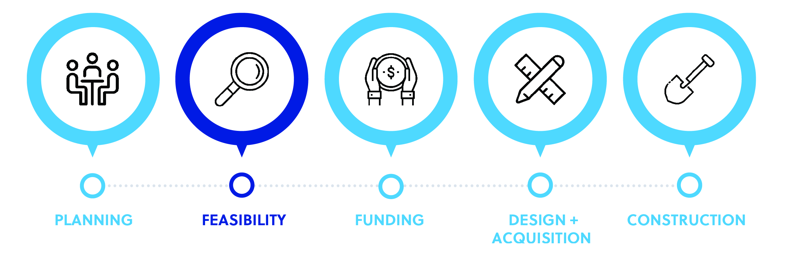
PURPOSE
Paved Trails & Sidewalks
Feasibility Study Grant Program
The purpose of the Paved Trails and Sidewalks Feasibility Studies Grant Program is to improve the pathway of bicycle and pedestrian projects accessing state and federal funding, resulting in successful implementation of projects led by communities multimodal infrastructure.
Applications are open on October 1st 2026 through November 6th 2026
Click Here to Apply

Slide 33
ELIGIBILITY
Paved Trails & Sidewalks
Feasibility Study Grant Program
The following governmental entities and non-profit organizations can apply to the Paved Trails and Sidewalk Feasibility Study Grant Program:
Any municipality or county within North Carolina
Metropolitan Planning Organizations (MPOs) and Rural Planning Organizations (RPOs) in North Carolina
Bicycle, pedestrian, and transit agencies and advocacy groups, Friends-of-the-Trail groups, and Land Conservancies
Due to limited funding, the following entities are ineligible to apply to the Paved Trails and Sidewalk Feasibility Study Grant Program:
Colleges or universities
Other entities such as Business Improvement Districts
Applicants must re-apply each year to be considered within the current grant cycle. Please note that all applications and relevant documents will be accepted online at the program webpage.

Slide 34
FEASIBILITY STUDY SCALE
Paved Trails & Sidewalks
Feasibility Study Grant Program
 | Small-Scale Feasibility Study | Large-Scale Feasibility Study
Cost | $60,000 - $80,000 | $80,000 - $120,000+ Significantly more complex and extensive corridors may result in a higher plan cost
Number of Route Alternatives | Up to 4 alternatives to be evaluated | Greater than 4 alternatives to be evaluated
Mileage Range | ¼ mile to 3 miles | 3+ miles
Jurisdictional Range | Up to 2 jurisdictions along the corridor | 2+ jurisdictions along the corridor (may require additional jurisdictional meetings/coordination)
Corridor Constraints | Minimal utilities Moderate topography Smaller FEMA studied streams (creeks and streams) Moderate roadway characteristics constraints (minor road crossings, moderate to high traffic volumes, moderate to high-speed limits) | Rail corridors/crossings Significant roadway characteristic constraints (controlled access roadways, major road crossings, high traffic volumes, high speeds) Larger FEMA studied streams (major water bodies – rivers, lakes) Moderate/significant utilities Significant topography
Community + Stakeholder Engagement Expectation | 3 steering committee meetings (virtual) 1 online survey 1 public meeting Up to 4 focused stakeholder (landowners, local businesses, underrepresented groups, etc.) meetings (1-on-1 or may include multiple stakeholders per meeting) | 4-5 steering committee meetings (virtual) 1 online survey 1 public meeting Up to 8 focused stakeholders (landowners, local businesses, underrepresented groups, etc.) meetings (1-on-1 or may include multiple stakeholders per meeting)

Slide 35
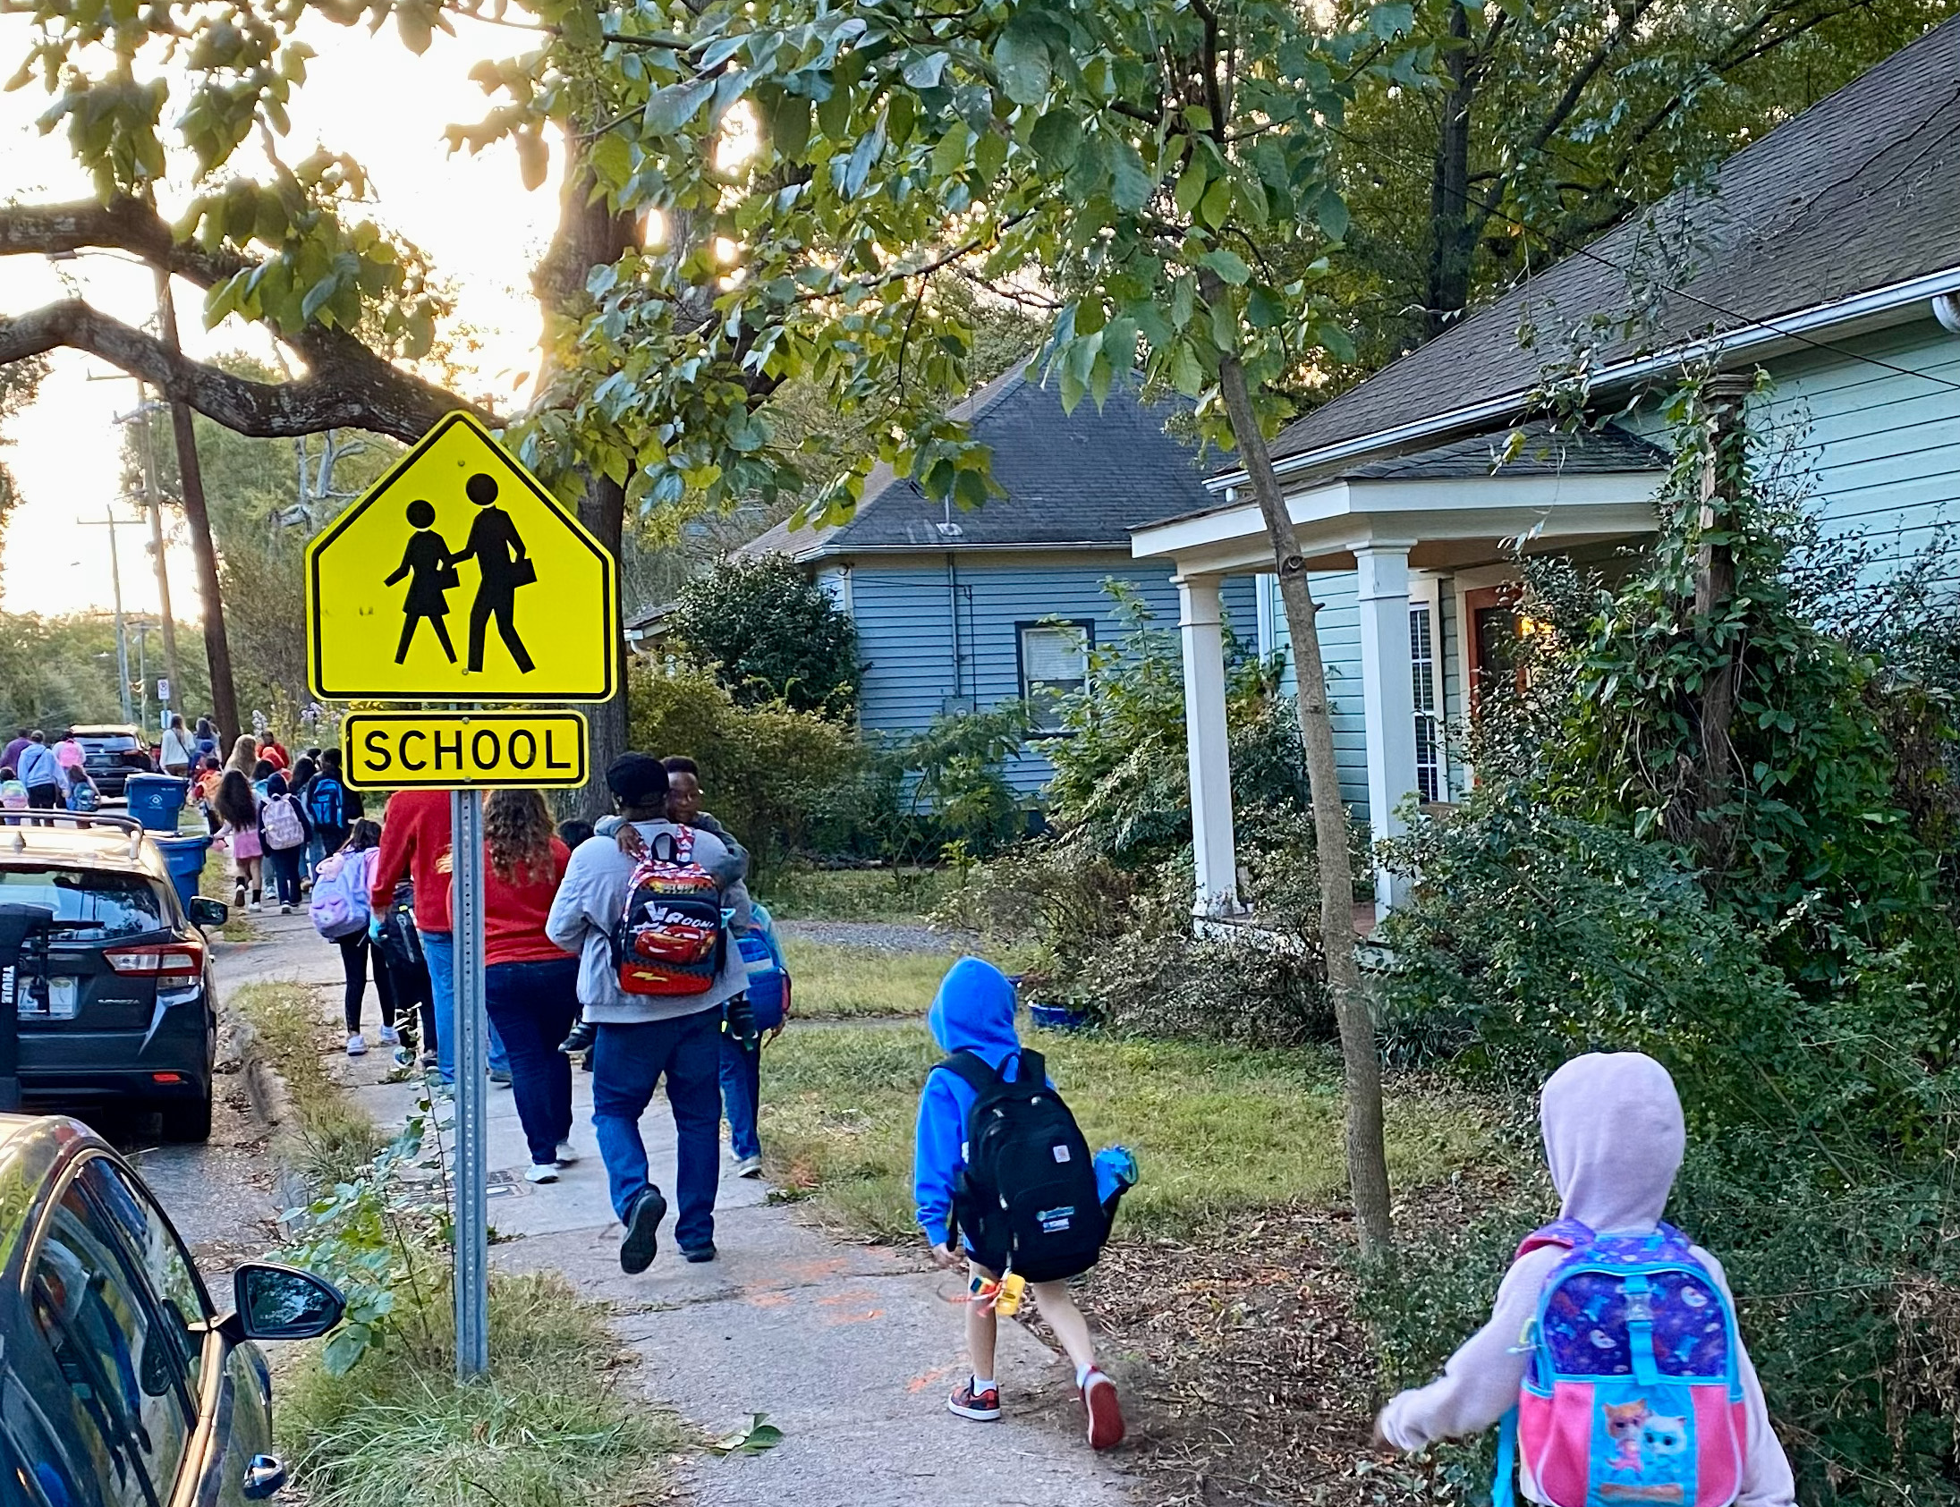
NC Safe Routes to School Planning & Programming Grants
Next call for applications opened Oct 5
Application deadline on November 6, by 11:59pm
Project proposals should be between $25,000-$300,000
Period of Performance (18 months)
  Jan 1, 2027 – June 30, 2028
Funded with TAP
  80% federal, 20% local match required
Reimbursement-based funding
Projects must clearly serve K-12 students and support safe walking, bicycling, or rolling
Guidance & application form: https://connect.ncdot.gov/projects/BikePed/Pages/saferoutestoschool.aspx

Slide 36
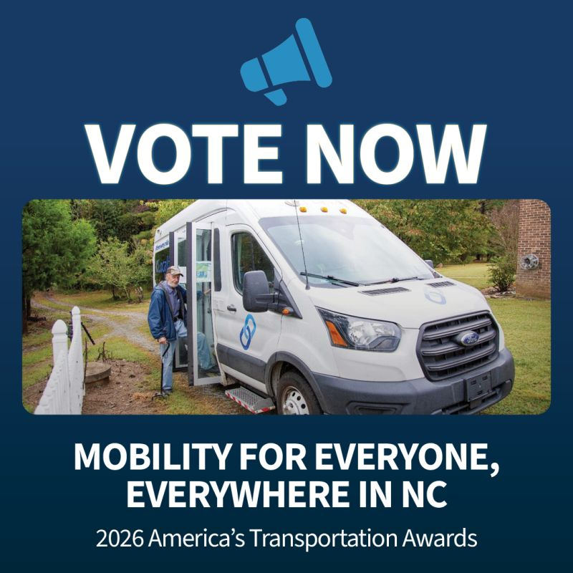
AASHTO's 2026 America's Transportation Awards
https://americastransportationawards.org/
https://americastransportationawards.org/2026/08/24/north-carolina-department-of-transportations-mobility-for-everyone-everywhere-in-nc/
Deadline – November 15th

Slide 37
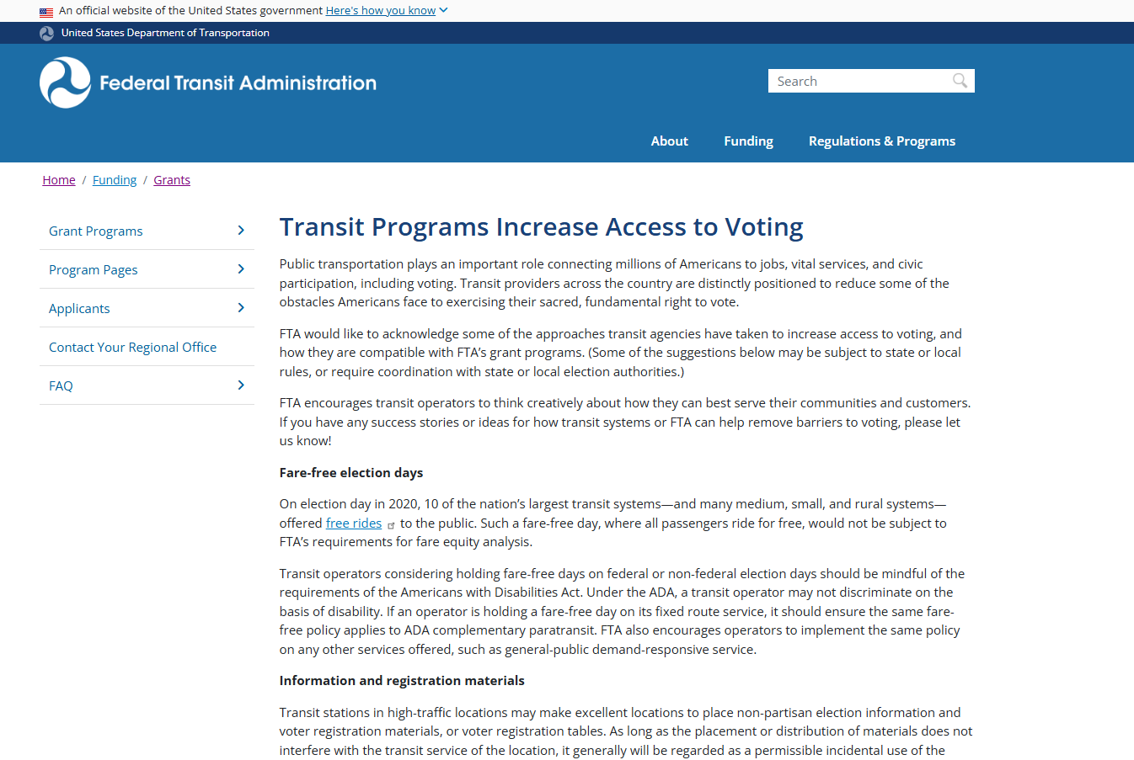

Slide 38
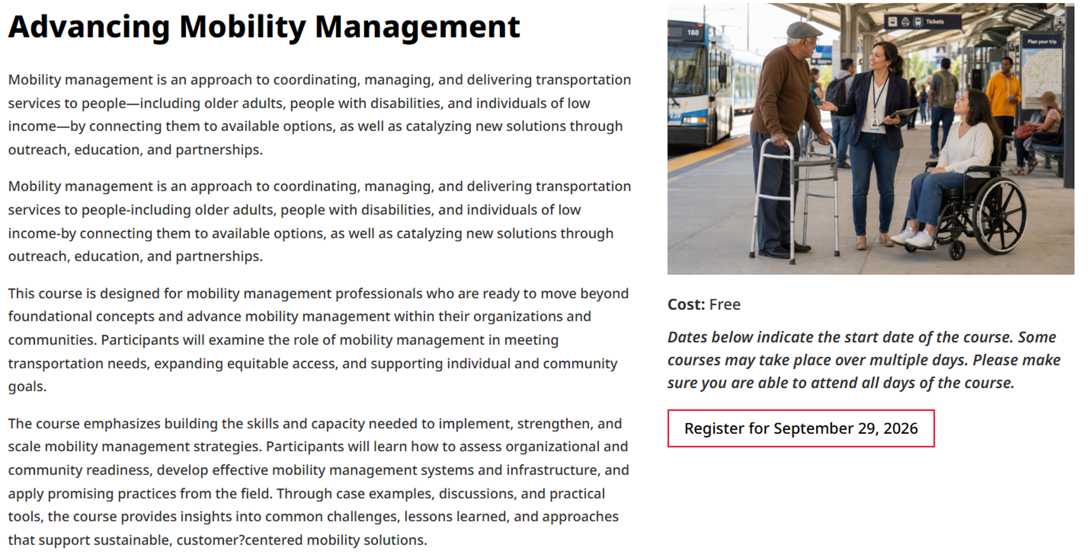
Class is at ITRE on November 12-13, 2026
You must register through the NTI Website.
If this is your first NTI course, please click on this link to setup your profile so that you can register for this class and others - https://ce-catalog.rutgers.edu/checkOutAccountInfo.cfm?newAcct=1

Slide 39
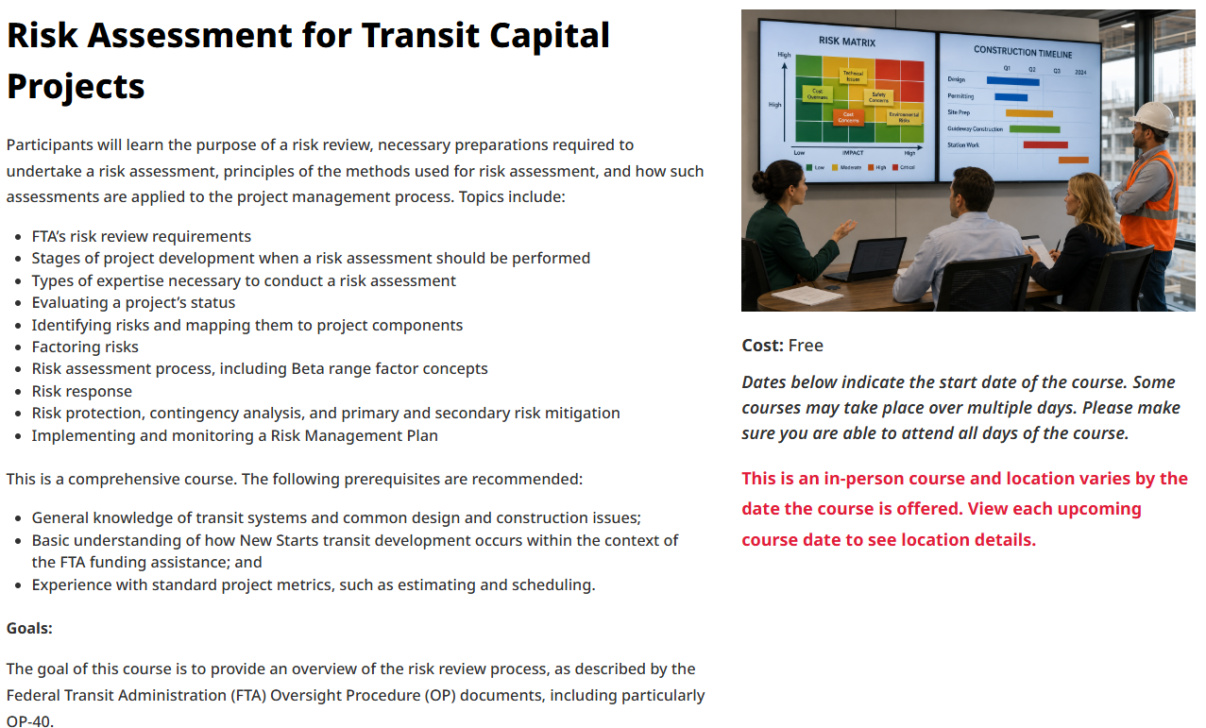
Class is located at Raleigh Union Station on March 22-23, 2027
You must register through the NTI Website. The class will be available to register on November 2, 2026.
If this is your first NTI course, please click on this link to setup your profile so that you can register for this class and others - https://ce-catalog.rutgers.edu/checkOutAccountInfo.cfm?newAcct=1

Slide 40

Training Updates

Slide 41
Cost Allocation Planning, Indirect Cost
& Program Income
Date(s)/Times/Location:
  10/29/26 10:00 a.m. – 12:00 p.m.
  Virtual Webinar Cost Allocation & Allowability Registration Link
Description: This technical course provides a practical guide to cost allocation and financial compliance. This specialized course focuses on the unique concerns of passthrough funding, covering cost allocation methodologies under FTA regulations and 2 CFR 200 Uniform Guidance. Participants will learn how to identify, segregate, and document direct project costs versus agency overhead to ensure operational cost recovery and audit compliance.
Target Audience: Subrecipient finance directors, accountants, transit system directors, and grants managers.
Value of Attending: Key topics include developing Cost Allocation Plans (CAPs), differentiating between direct allocation metrics and indirect cost rates, and the practical mechanics of direct cost allocation.

Slide 42
R-STEP Listening Session
Date(s)/Times/Location:
  11/03/26 2:00 p.m. - 3:30 p.m.(Rescheduled)
  Virtual Session - R-STEP Listening Session Registration Link. No need to register again if you were signed up for the August Session
Description: NCDOT-IMD's Strategic Training Program seeks input from Transit Systems regarding training needs. This is a casual conversation between the Training Coordinator and up to 45 Transit Directors and Trainers. R-STEP meeting goals include receiving input on current and future training topics, locations, and delivery methods (in-person or virtual).
Target Audience: Training Managers, Lead Trainers, and/or Transit Directors from transit systems that receive 5311 funds.
Value of Attending: Participants will have an opportunity to directly influence the development of NCDOT-IMD’s Strategic Training Program by sharing their systems’ current and future training needs. Attendee feedback on priority topics, preferred locations, and delivery methods will help ensure future training opportunities are relevant, accessible, and responsive to North Carolina’s rural transit systems. The session will also encourage collaboration and the exchange of ideas among transit leaders and training professionals.

Slide 43
Drug & Alcohol Program Training
Drug & Alcohol Program Manager (DAPM)
  November 16-18
    Virtual Class November 2026 DAPM Registration Link
Reasonable Suspicion Determination
  November 19
    Virtual Class November 2026 Reasonable Suspicion Determination Registration Link

Slide 44

Calendar & Resource
Updates

Slide 45
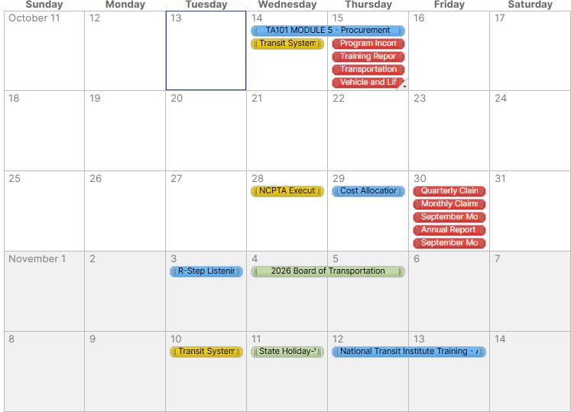
Transit Communication Hub
Important Dates – Next 30 Days
Reporting Due:
Program Income 10/15
Charter Reporting 10/15
Training Reporting 10/15
Vehicle & Lift Preventative Maintenance Data 10/15
TDM Claims 10/15
Monthly/Quarterly Claims 10/30
September Monthly OpStats 10/30
Annual Report OpStats (FY26) 10/30
September Monthly ROAP Report 10/30
Meetings:
Next Transit Call 11/10
Training:
Cost Allocation & Allowability, Indirect Cost,
and Program Income 10/29
R-Step Listening Session 11/03
NTI – Advancing Mobility Management 11/12 & 11/13
Holidays:
Veteran's Day 11/11
​If you would like to add this calendar to your own Outlook, iCal, etc., copy and paste this URL to subscribe from your calendar: webcal://publish.smartsheet.com/2abc0d6e1a874cb8ab9d1cd4585d6635.ics
Notes:
Blair

