Slide 1
Accessing Census Data for Title VI Program Plans
April 17, 2024
NC Department of Transportation
Kelly Karres, Data Dissemination Specialist, U.S. Census Bureau

Slide 2


Session Overview: What to Expect
Intro to U.S. Census Bureau + Census Data
Who we are, what we do, our mission
Finding the Data You Need for Title VI Plan
Where the data comes from
Where the data are located
Things to keep in mind
Online Training
Go live and learn how to access the data, using the table shells from the plan, as our guide

Slide 3

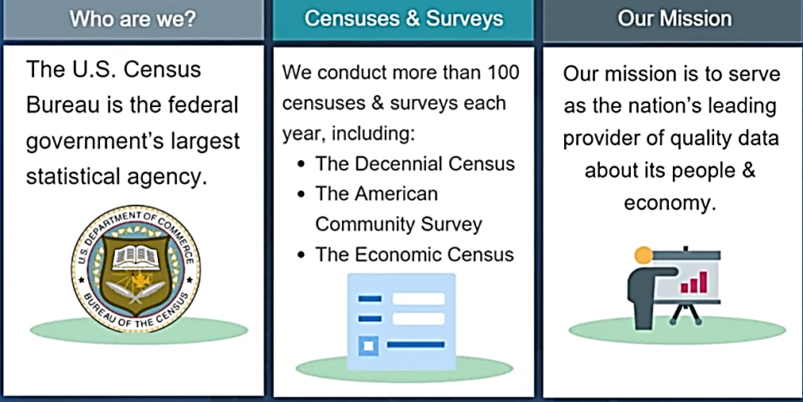
The U.S. Census Bureau: Who We Are, What We Do, Our Mission

Slide 4














U.S. Census Bureau: Censuses, Surveys + Programs

Slide 5

Nationwide household survey
Sample size of 3.5 million addresses
Designed to provide communities with reliable and timely social, economic, demographic and housing data every year
Part of the decennial Census program
What is the American Community Survey?

Slide 6
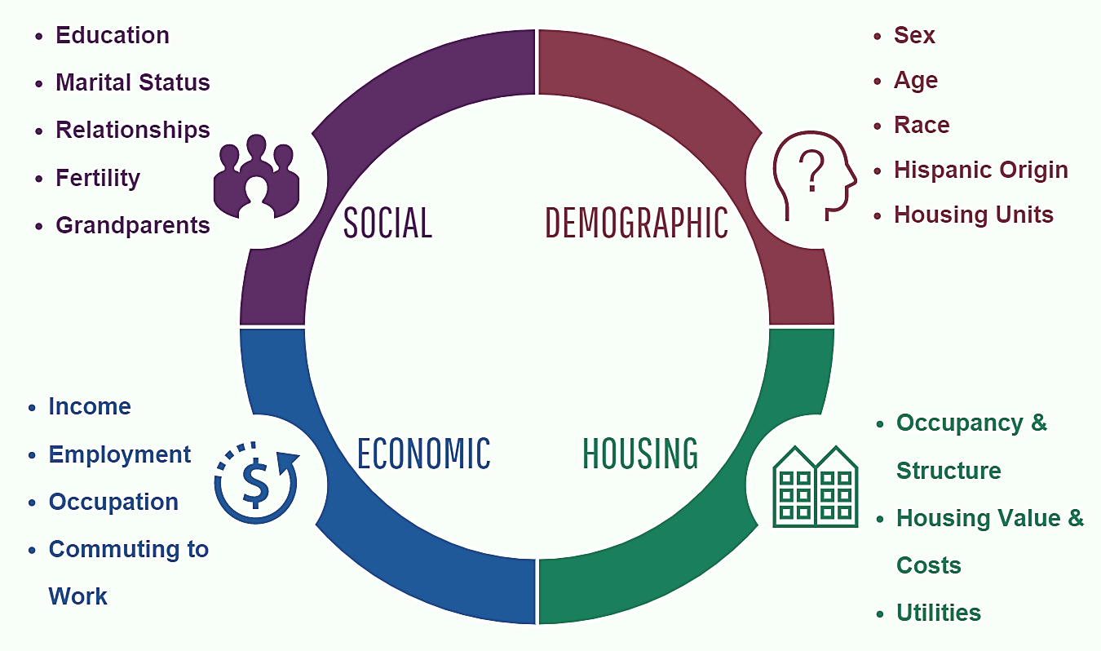
American Community Survey Topic Areas

Slide 7

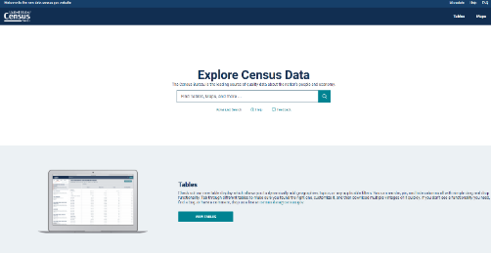
Finding the Data You Need
data.census.gov
Data.census.gov is the Census Bureau’s main data tool. It is the platform to access demographic and economic data from the Census Bureau.
Use when you need to access:
  Specific data tables
  Data profiles
  Detailed data tables
  Detailed thematic maps
  Microdata tool
Explore Census Data

Slide 8

Online Data Training: data.census.gov

Slide 9

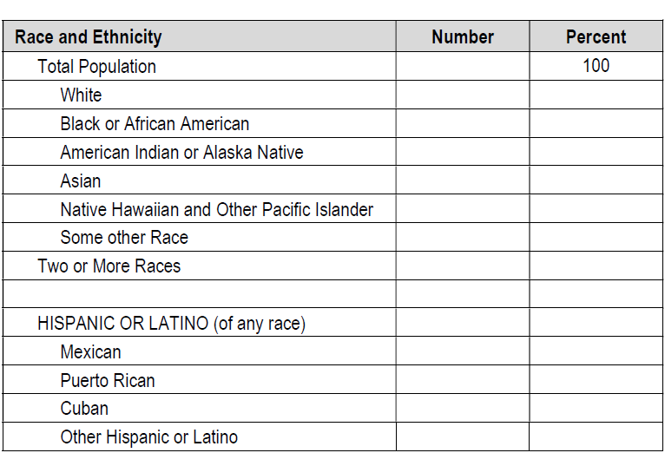
DP05: ACS Demographic and ... - Census Bureau Table

Slide 10

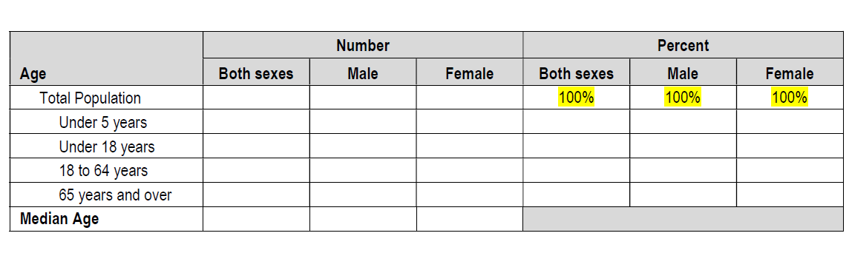
This table does not provide data for the 18 to 64 age group. You will need to calculate the data for the 18 to 64 category by subtracting Under 18 and+ 65 years and over from the Total Population.
S0101: Age and Sex - Census Bureau Table

Slide 11

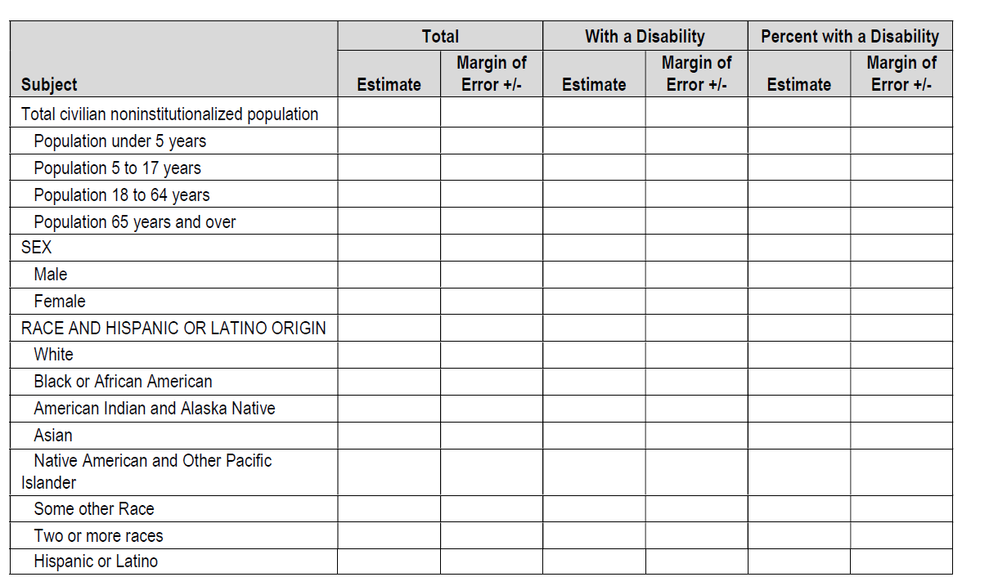
For the 18 to 64 category, you will need to combine the categories 18-34 and 35-64.
For the 65 and over category, you will need to combine the categories 65 to 74 and 75 and over.
S1810: Disability Characteristics - Census Bureau Table

Slide 12

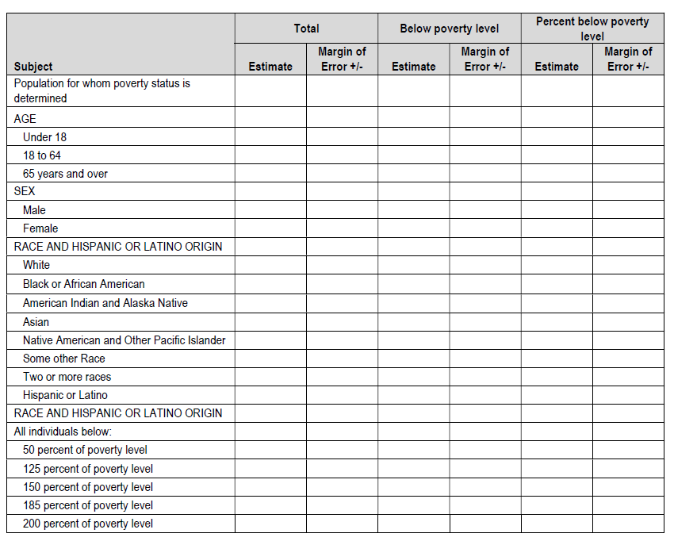
S1701: Poverty Status in the Past ... - Census Bureau Table

Slide 13

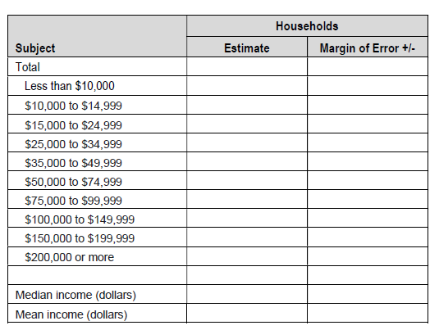
S1901: Income in the Past 12 Months ... - Census Bureau Table

Slide 14


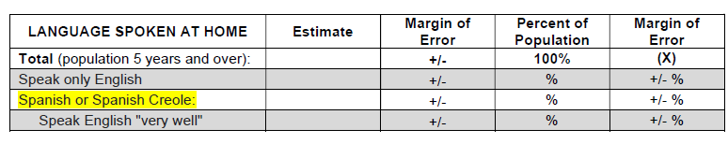
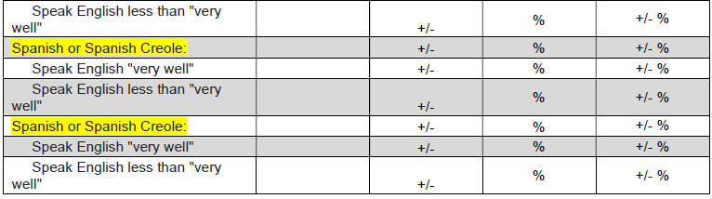
See pages 26 and 30 of the plan template for more information on the language sections.
Replace the yellow text in the table with every
language group that has at least 1,000 people who speak English less than very well, or those with less
than 1,000 LEP persons that reaches 1,000 people when the margin of error (MOE) is added to the
estimate.
Factor #1 in the Four Factor Analysis
S1601: Language Spoken at Home - Census Bureau Table

Slide 15
Resources + Contact Us

Slide 16

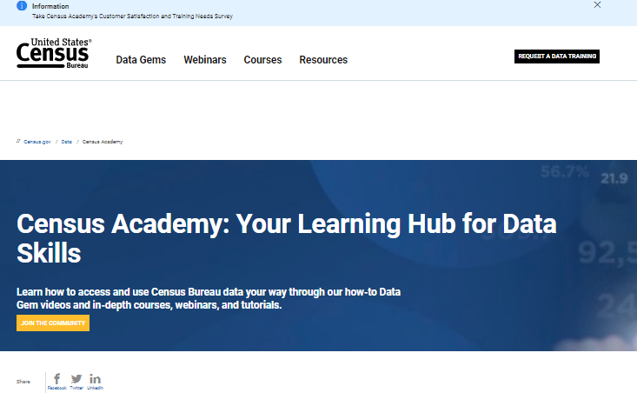
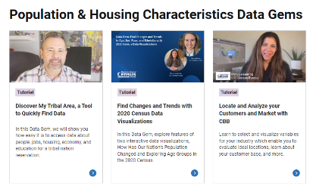
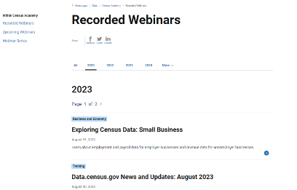
Independent Learning on All Census Topic Areas and Tools:
Webinars, Data Gems and Courses on Census Academy
Census Academy

Slide 17

Resources & Contact Information
Contact us:
Kelly Karres
Kelly.karres@census.gov
704-726-7829
Ask Data
Census.askdata@census.gov
1-844-ASK-DATA
Links to Tools & Resources on census.gov:
Data Tools and Apps (census.gov)
QuickFacts FAQs
data.census.gov Resources
Index A-Z
Census Glossary
Census Academy
OnTheMap (census.gov)

Slide 18
THANK YOU

