Slide 1
SharePoint 2013 Contributor Class
Deanna Springall/Leung Chan

Slide 2
Agenda
Overview
What is SharePoint?
NCDOT Websites
Roles
Search
SharePoint Interface
SharePoint Changes
Items & Lists
Files & Libraries
SharePoint & Office
Help
Wrap Up

Slide 3
Introductions
Name
Where You Work and What You Do
SharePoint Experience – Inside NCDOT? Connect NCDOT?
Instructor’s Intro

Slide 4
Housekeeping
Restrooms
Vending machines
No food; drinks OK if they have lid or cap
Lunch spots on bulletin board
Wireless: NCDOT_GUEST
Username: guestMM@ncdot.gov (guest04@ncdot.gov)
Password: gMMYYYY (g042015)

Slide 5
Class Goals
Become comfortable with the Contributor tasks covered in this class
Understand the division of labor between a SharePoint Contributor and a SharePoint Designer
Know where to find resources

Slide 6
Class Techniques
Videos
Lectures and slides
Demos
Exercises
Class demos may not be the same as the demos in the slides
This is intentional – you get more examples

Slide 7
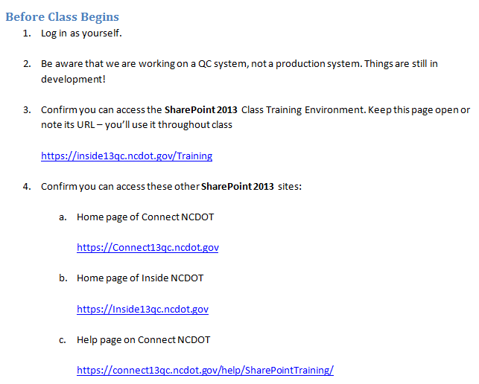
Let’s Get Started
Have you logged in as yourself?
Can you access the SharePoint 2013 sites listed in the handout?

Slide 8
Demo of Contributor Training Site

Slide 9
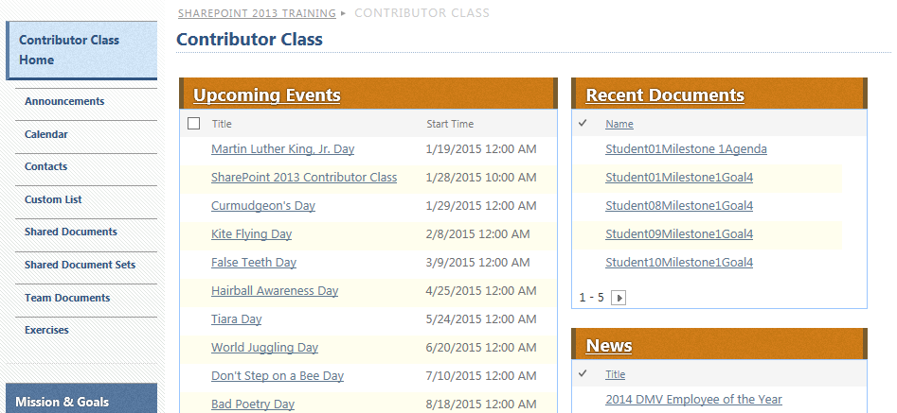
Contributor Training Site

Slide 10
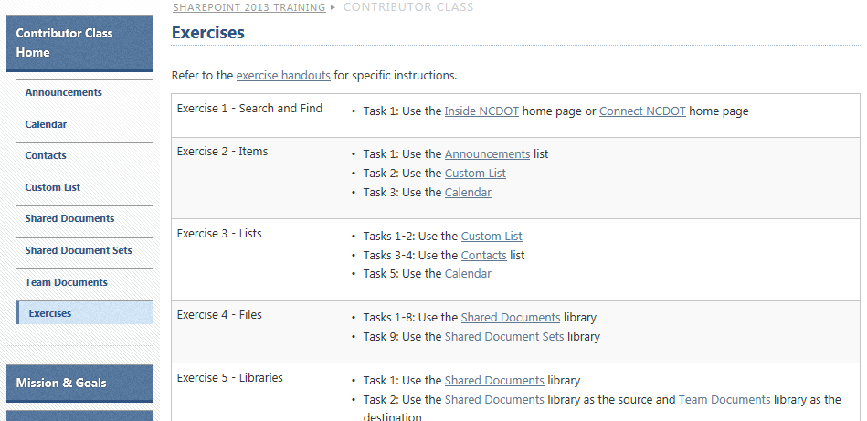
Contributor Training Site

