Slide 1
SharePoint 2013 Designer Class
2015/2016
Deanna Springall

Slide 2
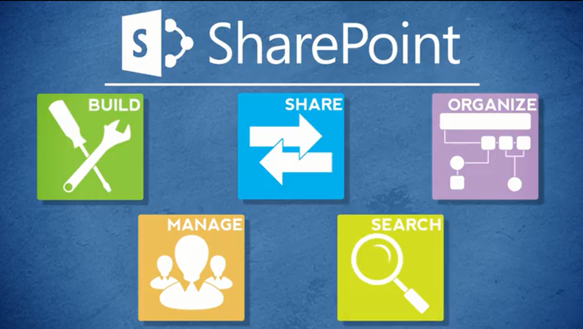
Agenda
Overview
Review
Roles
Lists
Libraries
Columns
Views
Pages
Web Parts
Navigation
Office
Wrap-Up

Slide 3
Introductions
Name
Where You Work and What You Do
SharePoint Experience – Inside NCDOT? Connect NCDOT?
Instructor’s Intro

Slide 4
Housekeeping
Restrooms
Vending machines
No food; drinks OK if they have a lid or cap
Lunch spots on bulletin board
Wireless
NCDOT_GUEST
Username: guestMM@ncdot.gov Example: guest07@ncdot.gov
password: gMMYYYY Example: g072015

Slide 5
Class Goals
Become comfortable with the Designer tasks covered in this class
Understand the division of labor between a SharePoint Contributor, SharePoint Designer and the Web Services team
Know where to find resources

Slide 6
Class Techniques
Lectures and slides
Demos
Exercises
Videos

Slide 7
Let’s Get Started
Log in as yourself
Confirm that you can access:
Inside NCDOT: https://Inside.ncdot.gov
Connect NCDOT: https://Connect.ncdot.gov
Get familiar with the Designer Training Site

