Slide 1
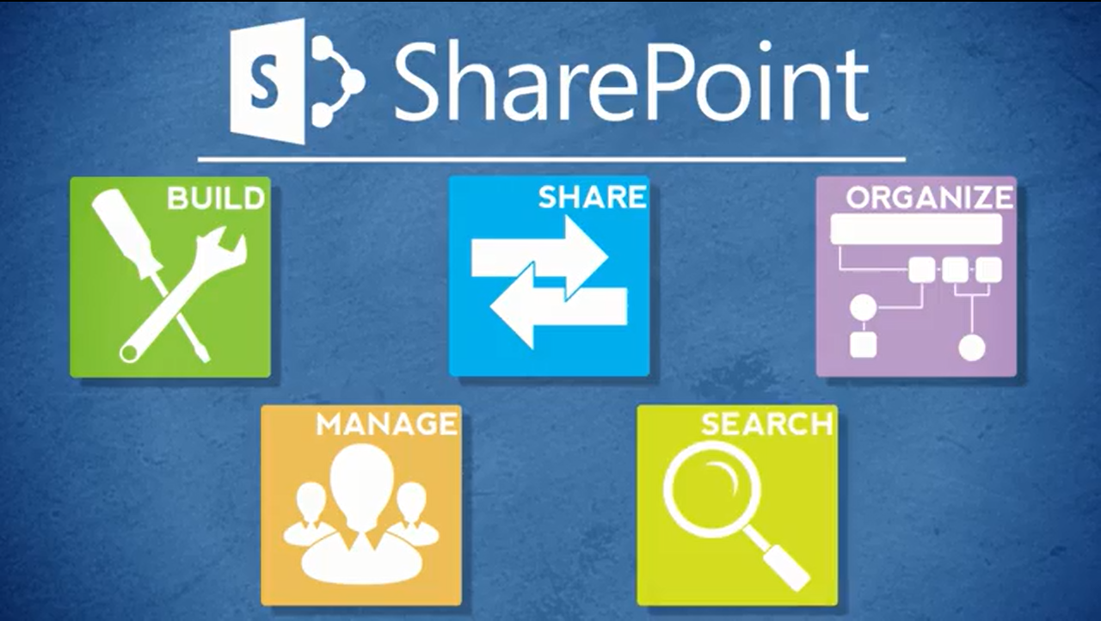
Roles

Slide 2
Your Role: End User
End Users use Inside NCDOT and Connect NCDOT for basic browsing and reading
Typical tasks can include:
  Open or download files
  Create alerts
  Email links
  Search the site
  Change views
  View properties

Slide 3
Other Roles
Contributor
Designer
Business Owner
Data Steward
Web Services

Slide 4
Contributor
Contributors maintain SharePoint content
Typical tasks include
  Add content to lists and libraries
  Edit, move, delete and restore content
  Tag content for security and content type
  Work with the Designer and Business Owner to enhance the site

Slide 5
Designer
Designers organize SharePoint content and determine how to display that content
Typical tasks include:
  Configure optional features
  Create lists, libraries, and pages
  Create columns, filters and views
  Add web parts, navigation, tabs and buttons
  Work with the Contributor and Business Owner to enhance the site

Slide 6
Business Owner
Business Owners are responsible for the content and accuracy of their SharePoint websites
Typical tasks include:
  Determine what content should be posted
  Help create content as needed
  Review content for accuracy
  Work with the Contributor and Designer to enhance the site

Slide 7
Data Steward
Data Stewards are responsible for accurately classifying NCDOT data
Typical tasks include
  Determine if data is Unrestricted or Restricted
  Determine appropriate content types for data

Slide 8
Web Services
The Web Services team implements advanced SharePoint features
Typical tasks include
  Create sites and activate features
  Manage permissions and content types
  Develop workflows
  Manage site collections
Contact the Help Desk to request assistance from Web Services

