Slide 1
Agenda
Overview
What is SharePoint?
NCDOT Websites
Roles
Search
SharePoint Interface
SharePoint Changes
Items & Lists
Files & Libraries
SharePoint & Office
Help
Wrap Up

Slide 2
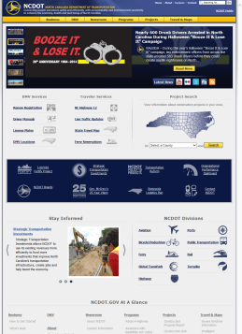
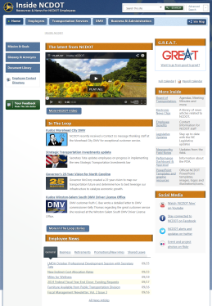
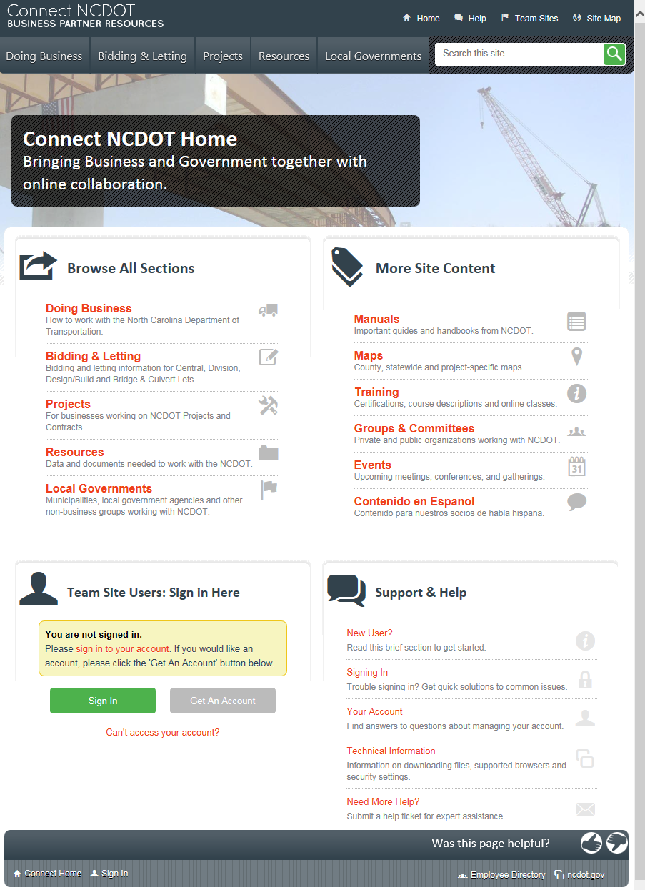
NCDOT Websites: Audiences
NCDOT.GOV - NOT SharePoint - for the public
Inside.NCDOT.GOV - SharePoint - for NCDOT employees
Connect.NCDOT.GOV - SharePoint - for business partners and NCDOT

Slide 3
Demo of Sites

Slide 4
NCDOT Websites: Inside
Inside.NCDOT.GOV - SharePoint - for NCDOT employees

Slide 5
When Do You Use Inside?
Audience = NCDOT employees
The “tabs” part of the site can be viewed by any NCDOT employee
Project and team sites are reserved for internal collaboration – you need specific permissions to access them
The site map helps clarify this

Slide 6
Inside: Site Map and Access
The left side lists content under five tabs
Home
Employee
Transportation Services
DMV
Business & Administration
Content can be seen by any NCDOT employee
The right side lists project and team sites
Projects have a distinct beginning and end
Teams are ongoing business units
Team and project sites can only be used by their members
Access

Slide 7
NCDOT Websites: Connect
Connect.NCDOT.GOV - SharePoint - for business partners and NCDOT

Slide 8
When Do You Use Connect?
Audience = Business partners and NCDOT
Part of the site is public
Project and team sites are reserved for internal/external collaboration – you need specific permissions to access them
The site map helps clarify this

Slide 9
Connect: Site Map and Access
The left side lists content under five tabs
Business
Bidding & Letting
Projects
Resources
Local Governments
Content can be seen by the public
The right side lists
Links to Help
Team sites for NCDOT employees and external partners who need to collaborate
Team and project sites can only be used by their members
Access

