Slide 1
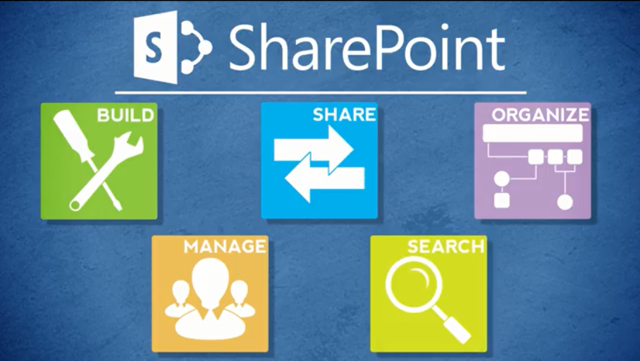
Agenda
Overview
Review
Roles
Lists
Libraries
Columns
Views
Pages
Web Parts
Navigation
Office
Wrap-Up

Slide 2
Your Role: Designer
Designers organize SharePoint content and determine how to display that content
Typical tasks include:
  Create lists, libraries and pages
  Create columns and views
  Add web parts and navigation
  Configure optional features
  Work with the Contributor and Business Owner to enhance the site

Slide 3
Other Roles: End User
End Users use Inside NCDOT and Connect NCDOT for basic browsing and reading
Typical tasks can include:
  Open or download files
  Create alerts
  Email links
  Search the site
  Change views
  View properties

Slide 4
Other Roles: Contributor
Contributors maintain SharePoint content
Typical tasks include:
  Add content to lists and libraries
  Edit, move, delete and restore content
  Tag content for security and content type
  Work with the Designer and Business Owner to enhance the site

Slide 5
Other Roles: Business Owner
Business Owners are responsible for the content and accuracy of their SharePoint websites
Typical tasks include:
  Determine what content should be posted
  Help create content as needed
  Review content for accuracy
  Work with the Contributor and Designer to enhance the site

Slide 6
Other Roles: Data Steward
Data Stewards are responsible for accurately classifying NCDOT data
Typical tasks include:
  Determine if data is Unrestricted or Restricted
  Determine appropriate content types for data
More information
https://inside.ncdot.gov/Teams/ncdotea/Pages/ContentDataManagement-.aspx

Slide 7
Other Roles: Web Services
The Web Services team implements advanced SharePoint features
Typical tasks include:
  Create sites and activate features
  Manage permissions and content types
  Develop workflows
  Manage site collections
Contact the Help Desk to request assistance from Web Services

