Slide 1
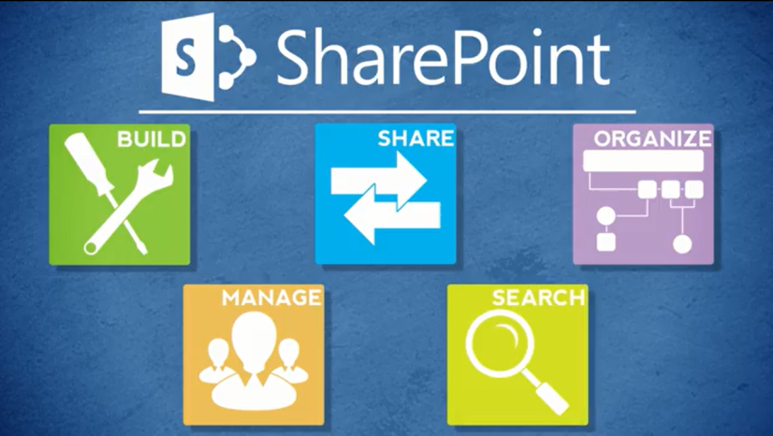
Agenda
Overview
Review
Roles
Lists
Libraries
Columns
Views
Pages
Web Parts
Navigation
Office
Wrap-Up

Slide 2
About Lists
Common lists in use at NCDOT
Announcements – News, information
Calendar – Date-based view of events
Contacts – Information about people
Links – Hyperlinks to resources
Tasks – Work items
Custom – NCDOT-specific, created by Designer or Web Services

Slide 3
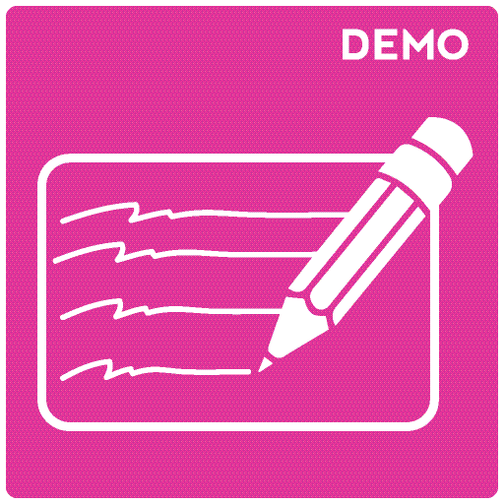
Let’s Learn How to…
Create, delete and restore standard
SharePoint lists
Create a calendar and overlay
multiple calendars
Manage alerts for others

Slide 4
Create a List
Settings gear > Add an app > list icon
Enter a name > Create
  Make the name meaningful
  Use dashes rather than spaces; SharePoint converts spaces to %20, which makes the URL longer and interferes with readability

Slide 5
Delete and Restore a List
Delete List
LIST tab > List Settings > Delete this list > OK
Restore List
Settings gear > Site contents > RECYCLE BIN
Select item > Restore Selection > OK

Slide 6
Create and Overlay Calendars
Create Calendar
Settings gear > Add an app > Calendar
Enter a name > Create
Overlay Calendars
CALENDAR tab > Calendars Overlay > New Calendar
Define name, calendar type as SharePoint, description and color
Enter URL of SharePoint site that contains calendar > Resolve
List drop-down > Select calendar to overlay > List View drop-down > Select calendar view to overlay > OK > OK

Slide 7
Manage Alerts for Others
View and Delete Alerts for Others
Settings gear > Site settings > User alerts
Select user > Update
To delete an alert, select alert > Delete Selected Alerts > OK
Set Item or File Alert for Others
Select an item or file > ITEMS or FILES tab > Alert Me
Set alert on this item or Set alert on this document or Set alert on this page
Enter user names > Define alert details > OK
Set List, Library or Page Alert for Others
LIST or LIBRARY or PAGE tab > Alert Me >
Set alert on this list or Set alert on this library or Set an alert on this page
Enter user names > Define alert details > OK

Slide 8
About List Settings
List name and description
Ratings
Validation
Versioning
  Item Version History

Slide 9
List Name and Description
Rename the list later for readability
Add or modify list description

Slide 10
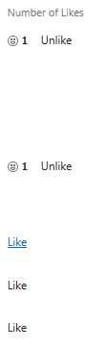
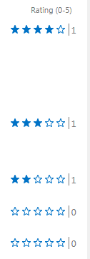
Ratings
Users can rate files with Stars or Likes
This helps you evaluate content and prioritize improvements
Users must have at least Contributor permissions to rate files – limits utility

Slide 11
Validation
You can validate data within a column
  Example: Confirm that a high temperature value is below some maximum
  More later…
You can compare columns
  Example: Compare the day’s high and low temperature to check that the high temperature is greater than or equal to the low temperature

Slide 12
Item Version History
You can
See when an item was changed, who changed it, and what changes were made
View and restore earlier versions
Review comments

Slide 13
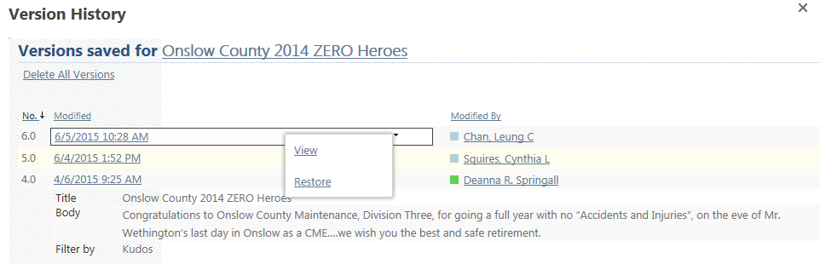
Item Version History
A new version is created when
You add an item
You save an item after an editing session
Versions use whole numbers (1.0, 2.0, etc.)

Slide 14
Let’s Learn How to…
Modify a list’s name and description
Enable and configure Validation
Enable and configure Item
Version History

Slide 15
Modify List Name and Description
LIST tab > List Settings > List name, description and navigation
Change name or description > Save
This process does not change the URL. If your original name used dashes, this is how to replace dashes with spaces for readability.

Slide 16
Configure Validation
LIST tab > List Settings > Validation Settings
Define formula and message > Save

Slide 17
Configure Item Version History
LIST tab > List Settings > Versioning Settings
Yes for Create a version each time you edit an item in this list?
Depending upon Versioning and Content Approval, define number of versions, number of drafts, and Draft Item Security > OK

Slide 18
NCDOT Best Practices – List Settings
Item Version History – On if needed
Content approval – Off
Advanced settings
  Available offline – Yes
  Quick Edit – Yes
    Tabular Edit (a view setting) must be on for Quick Edit to work in that view
  Search – Yes
  Folders – No
  Content types – Yes
  Leave other settings unchanged

Slide 19
Plan Your Lists
Plan early and carefully. Once lists have content, it is more difficult to make changes.
Avoid changing the list name (except to add spaces)
Use separate lists if items need different approval processes or versioning options
Decide what information needs to be seen easily, then customize the view to show that
  Contact list? Users probably want to see the name, phone number and email

Slide 20
Later, We’ll Learn How to…
Customize lists with views and columns
Modify navigation

Slide 21
When Do List Changes Go Live?
Inside
  Immediately
Connect team/project sites
  Immediately
Unauthenticated (public) area of Connect
  Make changes on a staging server; changes are copied to a production server at :42 after the hour
There may be review or approval processes in your area

Slide 22

Exercise 1: Lists
Go to the Designer Class home page
Click Exercises for the links you’ll need

