Slide 1
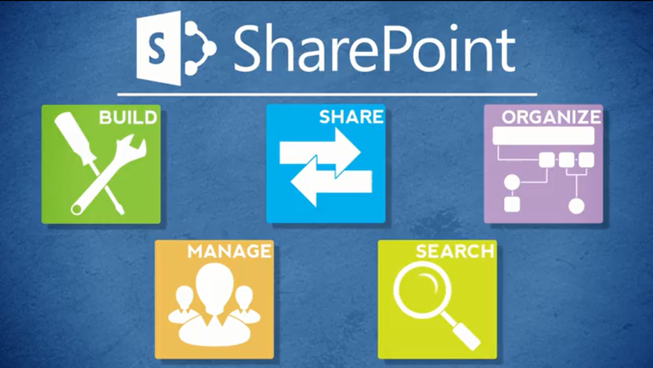
Agenda
Overview
Review
Roles
Lists
Libraries
Columns
Views
Pages
Web Parts
Navigation
Office
Wrap-Up

Slide 2
About Libraries
Common libraries in use at NCDOT include:
Assets – Store image, audio and video files
Document – Store files
Pages – Store publishing pages
Picture – Store pictures and slides

Slide 3
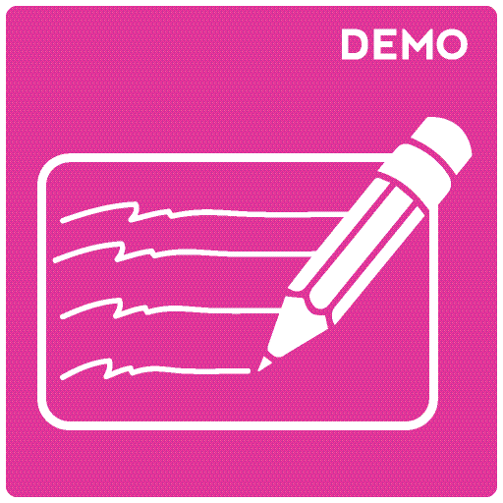
Let’s Learn How to…
Create a library
Delete and restore a library

Slide 4
Create a Library
Settings gear > Add an app > library icon
Enter a name > Create
Make the name meaningful
Use dashes rather than spaces; SharePoint converts spaces to %20, which makes the URL longer and interferes with readability

Slide 5
Delete and Restore a Library
Delete
LIBRARY tab > Library Settings > Delete this library > OK
Restore
Settings gear > Site contents > RECYCLE BIN
Select file > Restore Selection > OK

Slide 6
About Library Settings
List name and description – same as lists
Rating – same as lists
Validation – same as lists
Versioning
Require check out
Document version history (major versions)
Content approval
Change template

Slide 7
Check Out/Check In
Check Out/Check In prevents multiple users from editing the file at the same time and making conflicting changes
An author checks out a file
The file can only be edited by that user
No changes-in-progress are visible to others, but others can view the current version of the file
Others can see if a file is checked out and to whom
The author checks in the file
The author can add comments
The new version becomes available to others

Slide 8
Document Version History
Version history tracks changes over time
See when a file was changed, who changed it, and what changes were made
View and restore earlier versions
Review comments

Slide 9
Document Version History Options
No versioning
Major versions - end in .0 (1.0, 2.0)
Major and minor (draft) versions – not covered here

Slide 10
Example of Item Version History
Versions use whole numbers (1.0, 2.0, etc.)

Slide 11
What Versions Are Retained?
Keep the following number of major versions
If three major versions are allowed and the current version is 6.0, versions 4.0 through 6.0 are kept
If you delete a version, it is deleted from the history
If you delete version 5.0, the version history shows versions 4.0 and 6.0

Slide 12
Versioning Tips
Some libraries, such as Site Assets, probably don’t need versioning
Minimize the number of versions to avoid maxing out the content database; NCDOT recommends no more than 3-5 versions
Contact your Data Steward to decide if your organization must save all versions for legal or other reasons

Slide 13
Content Approval
Content approval treats new and modified files as drafts and gives them a status of Pending
Drafts are only visible to their authors and to approvers until an approver changes the status to Approved
If Content Approval is enabled, a new column and new views are added to the library

Slide 14
Draft Item Security
Within Content Approval, the Draft Item Security settings determines who can see drafts
The default is Only users who can approve items (and the author of the item)
The option for Only users who can edit items lets drafts be seen by Contributors and Designers

Slide 15
Change Template for a Library
Document libraries offer a blank Word document when you create a document within that library
You can change that to another template, such as Excel or PowerPoint

Slide 16
Let’s Learn How To…
Enable document version history – major versions
Enable Require check out
Enable Content approval
Change the template

Slide 17
Enable Document Version History
LIBRARY tab > Library Settings > Versioning Settings
Create major versions > Define number of major versions > OK

Slide 18
Enable Require Check Out
LIBRARY tab > Library Settings > Versioning Settings
Yes for Require documents to be checked out before they can be edited? > OK

Slide 19
Enable Content Approval
LIBRARY tab > Library Settings > Versioning settings
Yes for Require content approval for submitted items?
Define Draft Item Security > OK

Slide 20
Change the Template
LIBRARY tab > Library Settings > Advanced Settings
No for Allow management of content types
Under Template URL, change URL to that of the template to use
OK

Slide 21
Problems with Folders
There’s only one path through folders – if files are organized by author, how do you find files by project?
Deeply nested folders can exceed the limit of 256 characters in a SharePoint URL
It is very easy to put the same file in different folders, which introduces duplication and confusion
Sorting and filtering do not work across folders
You don’t know how many files are in a folder

Slide 22
The Solution? Metadata
You don’t need folders as much as you think you do!
Instead, use
Properties (metadata)
Grouping

Slide 23
Let’s Learn How To…
Make better use of metadata
Reduce use of folders

Slide 24
Use Metadata Rather than Folders
Demo from Contributor class

Slide 25
NCDOT Best Practices – Library Settings
Document version history – On, major versions only
Content approval – Off
Check out/check in – On
Advanced settings
Available offline – On
Quick Edit – On
Search – On
Folders – Off
Content types – On
Leave other settings unchanged

Slide 26
Plan Your Libraries
Plan early and carefully. Once libraries have content, it is more difficult to make changes.
Use separate libraries if files require different approval processes or versioning options
Decide what information needs to be seen easily, then customize the display to show it
Document library? Users will probably find the title more useful than the file name

Slide 27
Later, We’ll Learn How to…
Customize libraries with views and columns
Modify navigation

Slide 28
When Do Library Changes Go Live?
Inside
Immediately
Connect team/project sites
Immediately
Unauthenticated (public) area of Connect
Make changes on a staging server; changes are copied to a production server at :42 after the hour
There may be review or approval processes in your area

Slide 29
Exercise 2: Libraries
Go to the Designer Class home page
Click Exercises for the links you’ll need

