Slide 1
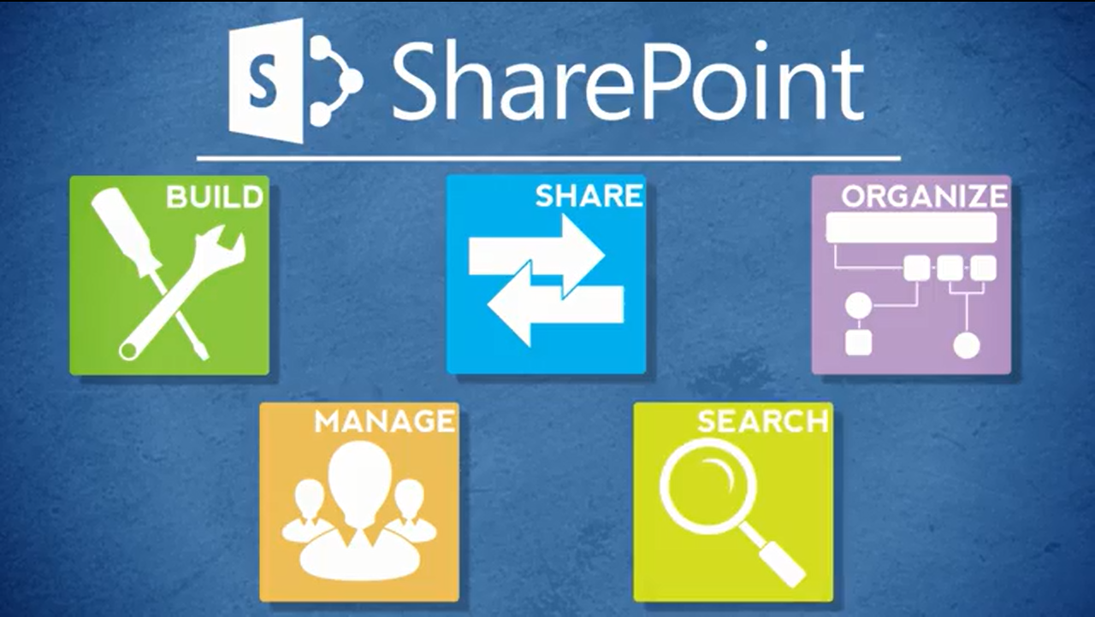
Agenda
Overview
What is SharePoint?
NCDOT Websites
Roles
Search
SharePoint Interface
SharePoint Changes
Items & Lists
Files & Libraries
SharePoint & Office
Help
Wrap Up

Slide 2

Demo of Interface

Slide 3
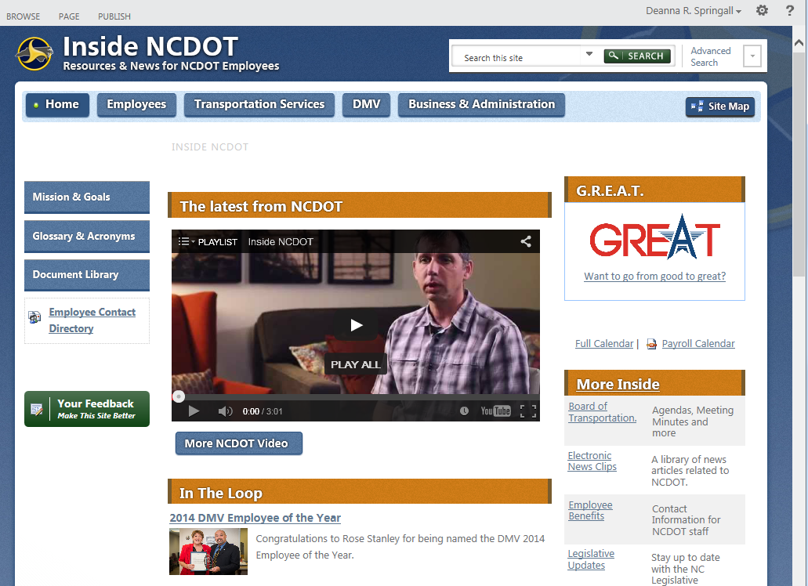
Inside: Interface
Ribbon
Settings Gear
Logo
Search
Top Navigation
Quick Links
Breadcrumbs
Quick Launch
Page content

Slide 4
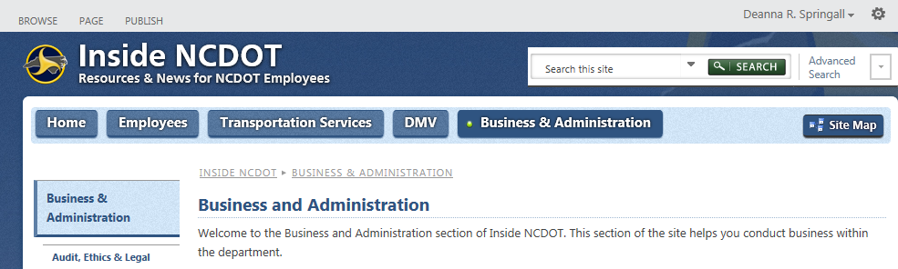
Inside: Breadcrumbs

Slide 5
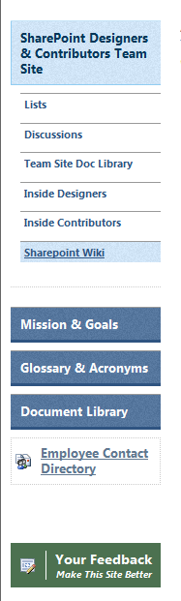
Inside: Quick Launch
Can be customized by a Designer
Always contains five elements
May vary with your permissions

Slide 6
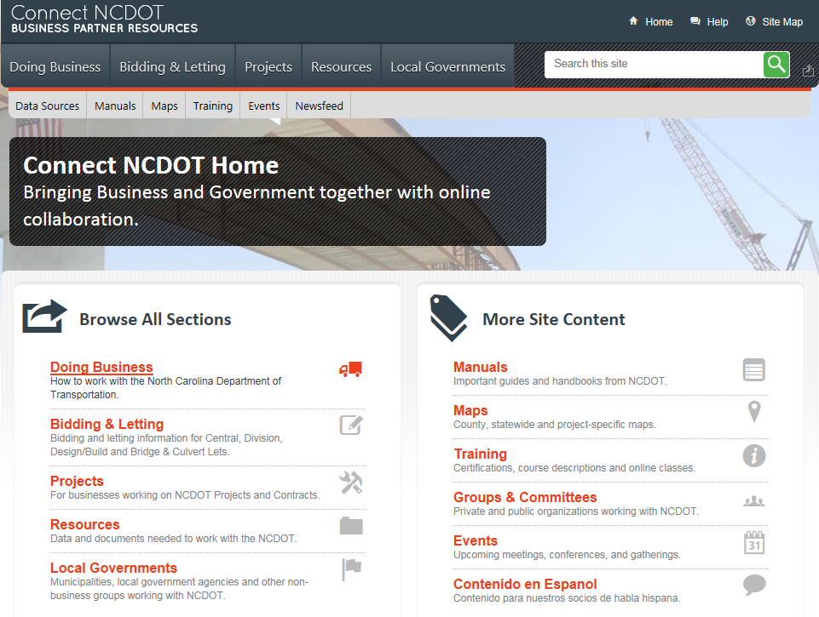
Connect: Interface – Unauthenticated (Public) Pages
Logo
Quick Links
Top Navigation
Search
Secondary Nav
Page content

Slide 7
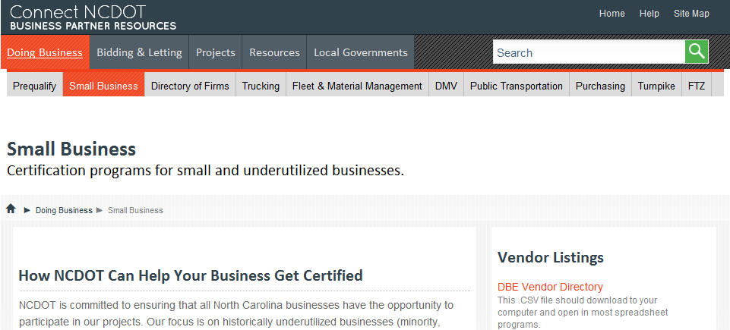
Connect: Breadcrumbs
Appear on the internal pages of the
unauthenticated (public) site

Slide 8
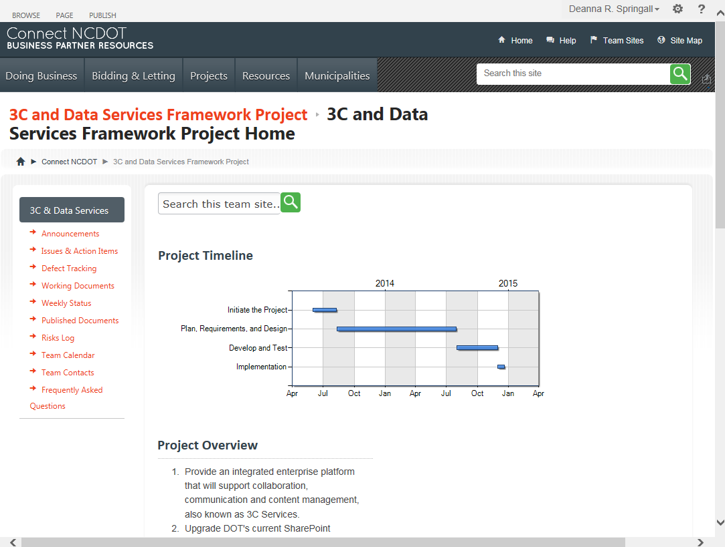
Connect: Interface – Team Sites
Ribbon
Settings Gear
Logo
Quick Links
Top Navigation
Search
Breadcrumbs
Quick Launch
Page content

Slide 9
Connect: Breadcrumbs

Slide 10
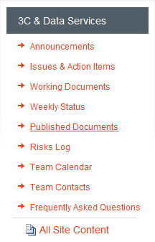
Connect: Quick Launch
Appears on team sites
Can be customized by a
Designer in some places
May vary with your permissions

Slide 11
The Ribbon
Like other Microsoft Office applications, the SharePoint ribbon offers commands and tools
On the ribbon, tabs organize groups of related commands and tools
The ribbon is both context-sensitive and security trimmed

Slide 12
Context Sensitivity
SharePoint
Knows where you are
Knows what you are working on
Displays options appropriate for that context

Slide 13
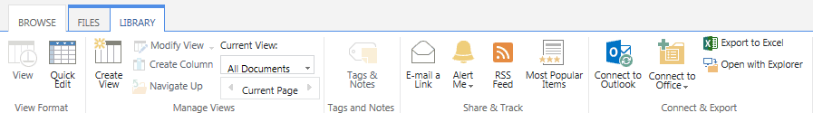
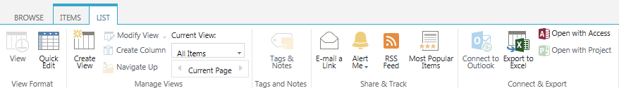
Context Sensitivity
Library: FILES and LIBRARY tabs
List: ITEMS and LIST tabs

Slide 14
Security Trimming
SharePoint
Knows who you are
Activates options according to your permissions
Hides or grays out options if you do not have the appropriate permissions

Slide 15
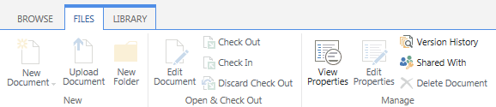
Security Trimming
In a document library, an End User can only use View Properties, Version History, and Shared With

Slide 16
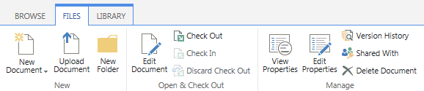
Security Trimming
In a document library, a Contributor has permissions to work with documents (add, check out, edit, delete) and their properties

Slide 17
SharePoint Hierarchy: Site Collections
Site collection contains a top-level site with sites below it
Sites can be deeply nested
Sites are also called subsites

Slide 18
SharePoint Site Collection on Connect
Top-level site:
Sites:
Sites:
Sites:
Connect NCDOT
Doing Business
Resources
CADD
Trucking
On-the-Job Training
Small Business
GIS

Slide 19
SharePoint Hierarchy: Sites
Each site has components such as lists, libraries, pages, images, etc.
Many NCDOT sites are for teams or projects

Slide 20
SharePoint Site on Inside
DMV
(home page)
DMV
Documents (library)
Hearings
(page)
Documents
Vehicle Services
(folder)
DMV Extended Hrs Locations
(list)
DMV FAQs
(list)
Images
(library)
Images
Documents
VS Manuals
(folder)
Documents
Items
Items
License & Theft
(page)
Items
DMV Alerts
(list)
Lists
Items
Lists
Items
Gray – documents
Orange – folder
Purple – library
Blue – items
Green – list
Olive – page

