Slide 1
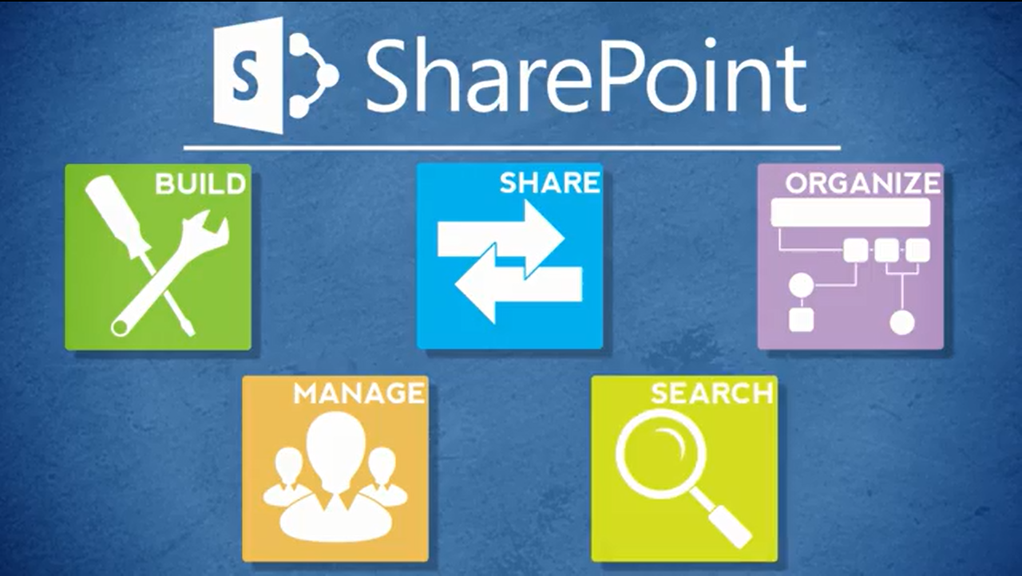
Agenda
Overview
What is SharePoint?
NCDOT Websites
Roles
Search
SharePoint Interface
SharePoint Changes
Items & Lists
Files & Libraries
SharePoint & Office
Help
Wrap Up

Slide 2
SharePoint 2013 Is Coming
Inside NCDOT – arrived 13 April 2015
Connect NCDOT – coming late May 2015
Inside NCDOT and Connect NCDOT will have a nearly identical look-and-feel to today’s 2010 sites to smooth the transition
Here’s a quick preview of changes and new features that affect your work

Slide 3

Changes between SharePoint 2010 and SharePoint 2013

Slide 4
New Features in SharePoint 2013

