Slide 1
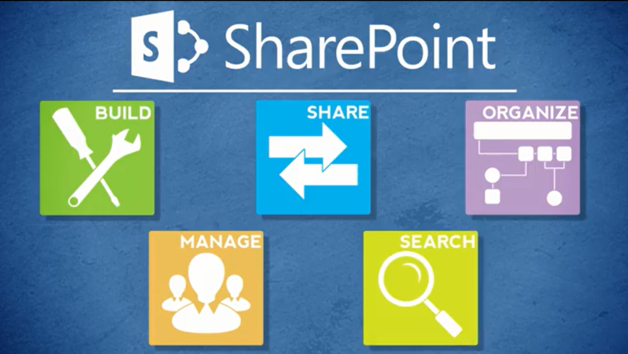
Agenda
Overview
Review
Roles
Lists
Libraries
Columns
Views
Pages
Web Parts
Navigation
Office
Wrap-Up

Slide 2
About Views
In SharePoint, you can sort and filter a list or library, but those “ad hoc” results disappear when you navigate elsewhere
A SharePoint view is a permanent setting that controls the way items or files are displayed
Creation of views is very similar for lists and libraries

Slide 3
Default View
All lists and libraries have a default view, which is the view that users first see
The default view is usually All Items for lists and All Files for libraries

Slide 4
Other Views
Some list and libraries have additional views that are automatically created
Calendar – Calendar, Current Events
Discussion Board – Recent, My Discussions, Features, Unanswered questions, Answered questions
If Content Approval is enabled –Approve/reject Items, My submissions

Slide 5
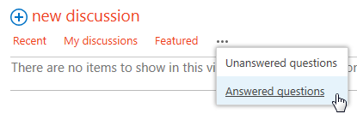
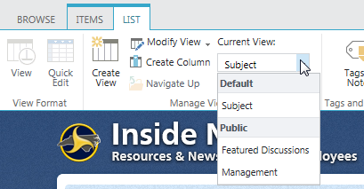
What Views Are Available?
Up to three views are listed at the top
of the list or library; select the ellipsis
to see if there are more
The LIBRARY or LIST tab also
displays available views

Slide 6
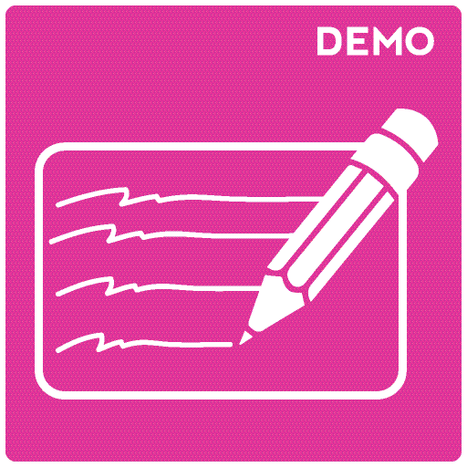
Let’s Learn How to…
Create a view

Slide 7
Create a View
LIST or LIBRARY tab > Create view
Choose view type
Enter view name > Complete additional settings > OK
OR
Sort or filter current view > SAVE THIS VIEW
Enter view name > Define audience > Save

Slide 8
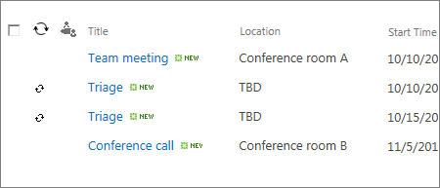
View Type: Standard View
This view displays items and files in rows
A standard view of all items or files is the default for most lists and libraries

Slide 9
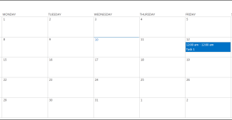
View Type: Calendar View
This view is automatically created for calendars; it is available for any list or library with a date and time column

Slide 10
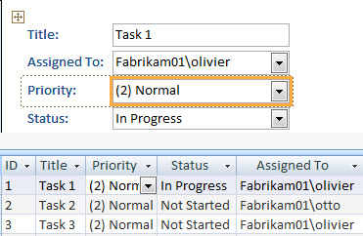
View Type: Access View
Use Microsoft Access to view and change library content; it is not available for lists

Slide 11
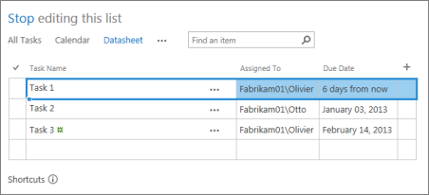
View Type: Datasheet View
This view displays a list or library in a spreadsheet format
It is the same as Quick Edit
It is an efficient way to change multiple rows at a time
You cannot create a grouped view in View Settings

Slide 12
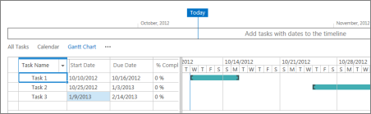
View Type: Gantt View
This view is used in project management to track progress and tasks

Slide 13
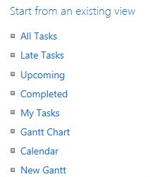
View Type: Start from Existing View
You can use an existing view as a starting point for a new view
This is very useful if you need multiple views that do not vary greatly, such as the same information for different countries

Slide 14
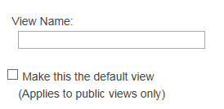
View Setting: Name
Make the name meaningful
Make it the default view if desired
Use a name with no spaces (GroupedByUnit), then edit it later to add spaces for readability

Slide 15
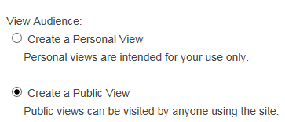
View Setting: Audience
Personal view – A view only you can see. You can use it as the starting point for other personal views, but not for public views.
Public view – A view that anyone can see. You can use it as the starting point for personal or public views. You can set any public view to be the default view.
Choose carefully! It can’t be changed.

Slide 16
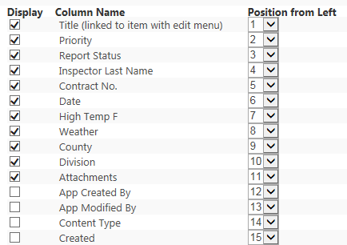
View Setting: Columns
Check the columns to hide or display and define their order

Slide 17
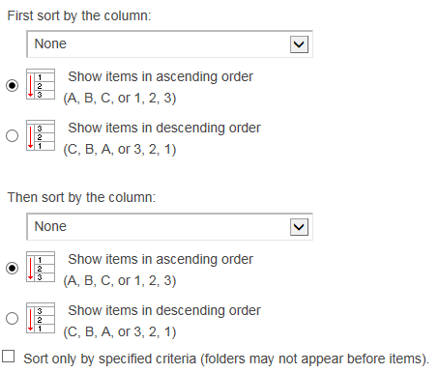
View Setting: Sort
Sort a view by one or two columns in ascending or descending order
If you keep sorted columns to the left of the view, users can more easily determine the sort criteria

Slide 18
View Setting: Filter
By default, all items are shown in a view
The maximum number of items in a view is 5000
Filters are one method to limit the number of items in a view
If there are many items, set your filter on an indexed column (an option under List or Library Settings)

Slide 19
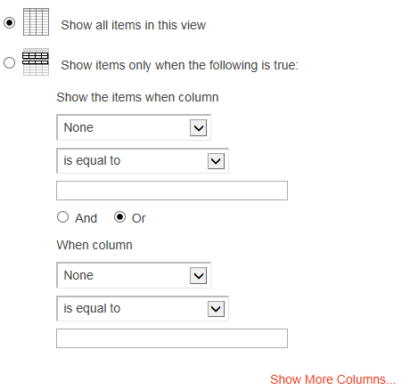
View Setting: Filter
Choose column to filter
Choose operation
  Equal, greater, less – best
  for numbers
  Begins with, contains – best
  for text
Enter value for comparison
If you filter on two values
  And – filter meets both criteria
  Or – filter meets one or both
  criteria
Select Show More Columns
to add up to 10 filters

Slide 20
View Setting: Filter
Special values include
  [Today] – Shows items for the current date
  [Me] – Shows items for the current user
You can use these values in simple equations
For example, to show items created in the last seven days
  Filter on Created column
  Set operator to is less than
  Set value to [Today]-7 (no spaces)

Slide 21

View Setting: Tabular View
This view places a checkbox by each item or file
Use checkboxes to perform bulk operations, such as checking out or deleting multiple items or files
Must be on for Quick Edit to work in that view

Slide 22
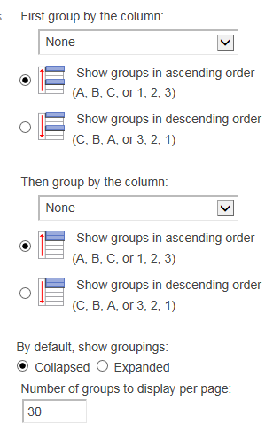
View Setting: Group By
Group content by values in one or two columns
Grouping by two columns creates a nested
grouping
Choose
  Ascending or descending
  Expanded or collapsed
  Number of groups per page

Slide 23
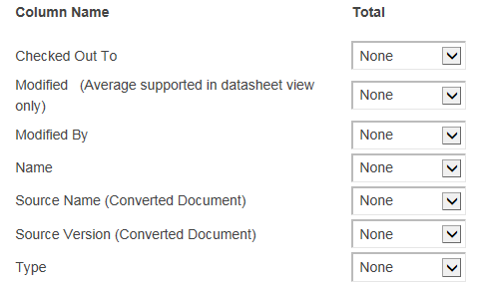
View Setting: Totals
Text columns:
  Count
Number columns:
  Count
  Average
  Maximum
  Minimum
  Depending upon the type of
  data, a number column can
  also have a sum, standard
  deviation, and variance

Slide 24
View Setting: Style
Basic table
Boxed, no labels
Boxed
Document details
Newsletter
Newsletter, no lines
Shaded
Preview pane
Default

Slide 25
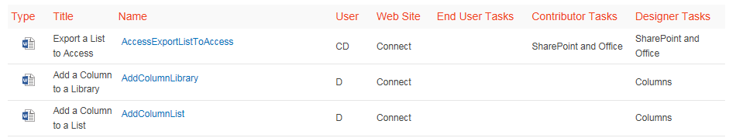
View Setting: Style – Basic Table

Slide 26
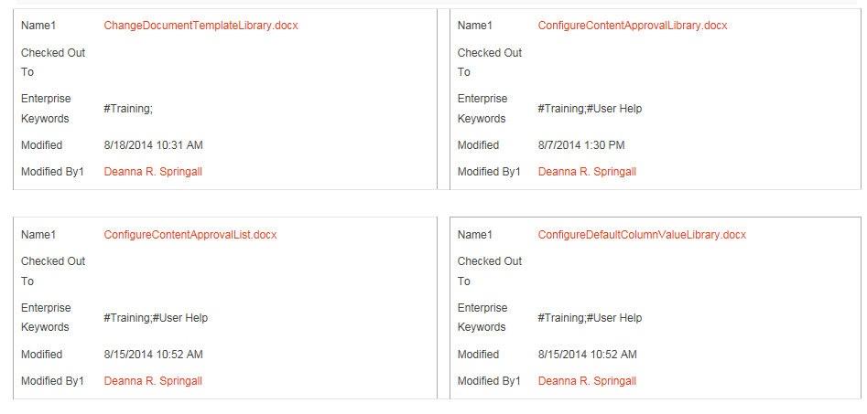
View Setting: Style – Boxed
Only available for lists

Slide 27
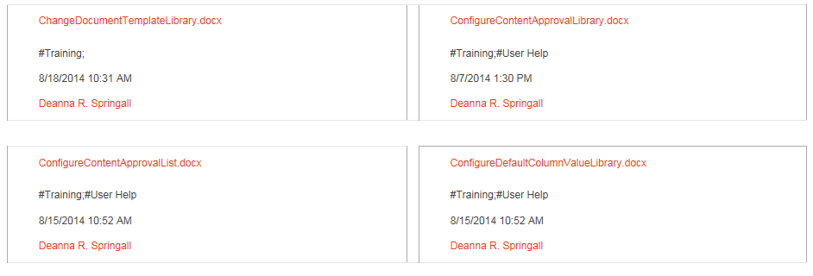
View Setting: Style – Boxed, No Labels
Only available for lists

Slide 28
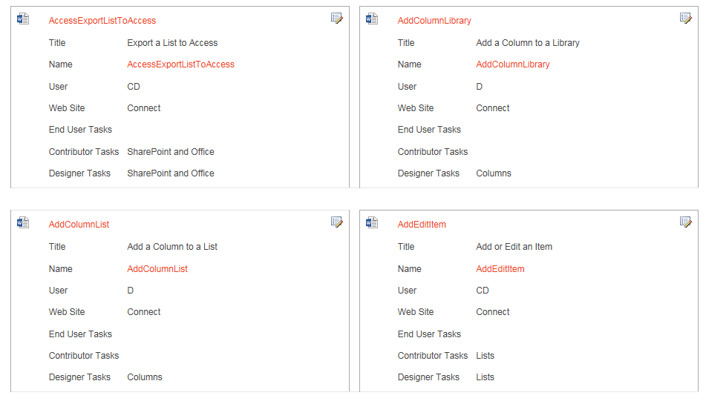
View Setting: Style – Document Details
Available for most libraries, but not lists

Slide 29
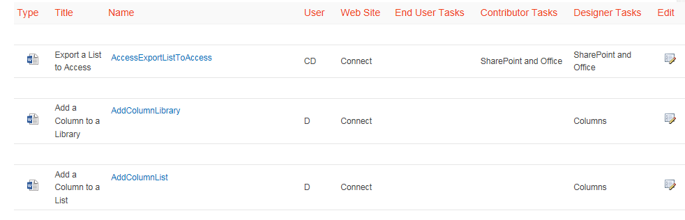
View Setting: Style – Newsletter
Displays items in rows with lines in between

Slide 30
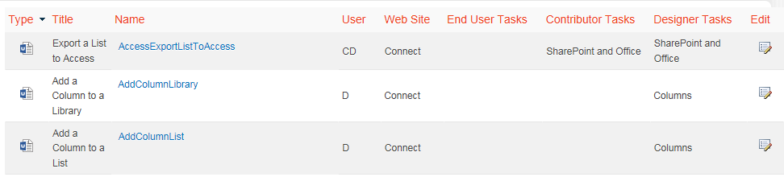
View Setting: Style – Newsletter, No Lines
Displays items in rows with alternate shading

Slide 31
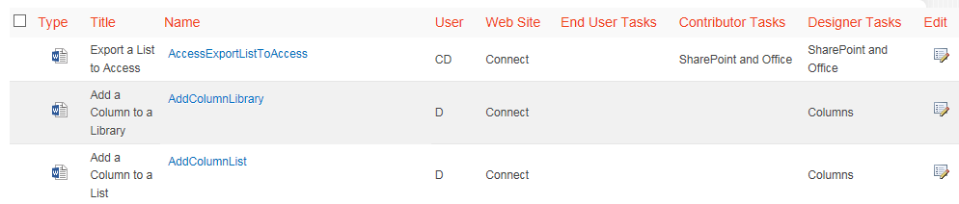
View Setting: Style – Shaded
Displays items in rows with alternate shading

Slide 32
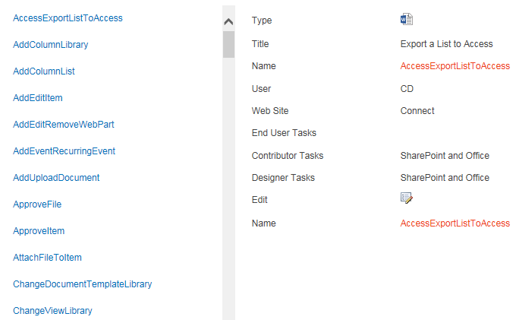
View Setting: Style – Preview Pane
Displays items on left
Hover over name to display properties on right

Slide 33
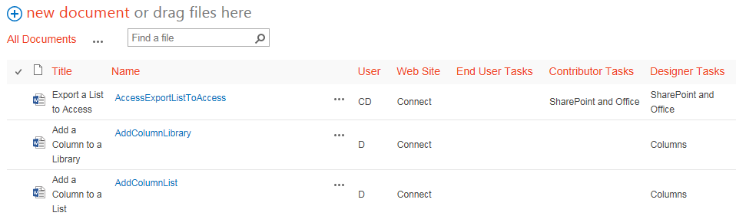
View Setting: Style – Default
Default style varies, depending on type and configuration of list or library
This example is for a document library

Slide 34
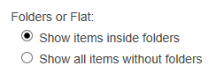
View Setting: Folders
Select Show items inside folders to display folders in the view. Open the folder to see the items within it.
Select Show all items without folders to display all the items or files. This “flat view” does not show the folders.

Slide 35
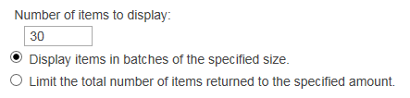
View Setting: Item Limit
Like filters, item limit is a method to restrict the number of items in a view
The maximum number of items in a view is 5000, with a default of 30 per page
You can display only one page of results or as many pages as needed
For example, if you set the number of items to display as five and limit the total number of items returned to five, only one page with five items appears in the view
This option is useful if you want to limit the number of items in web parts, such as the five most recently updated files

Slide 36
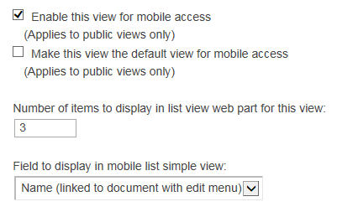
View Setting: Mobile
NCDOT does not use the Mobile settings, so do not change this last section

Slide 37
Let’s Learn How to…
Edit a view
Delete a view

Slide 38
Edit a View
LIST or LIBRARY tab > Modify View
Change settings
OK

Slide 39
Delete a View
LIST or LIBRARY tab > List or Library Settings
Select view > Delete
OR
LIST or LIBRARY tab > Modify View > Delete
You cannot delete the default view and you cannot delete a view if it is the only one.

Slide 40
Plan Your View
Use meaningful names for public views so all users can understand them
If you only need a view for your own use, create a personal view so the list of views isn’t cluttered
If you only need a view for use in a web part, create the view within the web part so the list of views isn’t cluttered (more on web parts later)
Display the most useful information in the view so users don’t have to open items or files

Slide 41
When Do View Changes Go Live?
Inside
  Immediately
Connect team/project sites
  Immediately
Unauthenticated (public) area of Connect
  Make changes on a staging server; changes are copied to a production server at :42 after the hour
There may be review or approval processes in your area

Slide 42

Exercise 4: Views
Go to the Designer Class home page
Click Exercises for the links you’ll need

