Slide 1
Agenda
Overview
What is SharePoint?
NCDOT Websites
Roles
Search
SharePoint Interface
SharePoint Changes
Items & Lists
Files & Libraries
SharePoint & Office
Help
Wrap Up

Slide 2
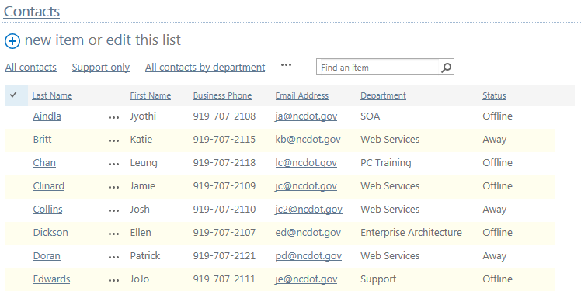
What is a List?
A list is a set of related items, such as
Announcements
Names
Dates
Tasks
Links

Slide 3
Terminology
A list contains items
An item may also be called a list item
Each item has properties
Properties are also called metadata

Slide 4
Common Lists in Use at NCDOT
Announcements – News, information
Calendar – Date-based view of events
Contacts – Information about people
Links – Links to resources
Tasks – Work items
Custom – NCDOT-specific, created by Designer

Slide 5
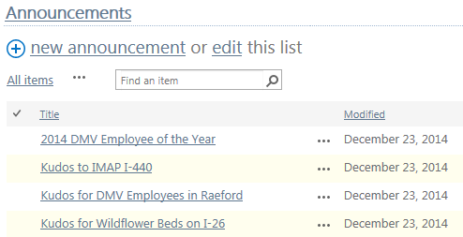
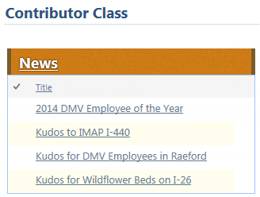
A List May Look Different on a Page
Announcements exist in the “source” list, but are often displayed on other pages

Slide 6
Let’s Learn How to Work with Items
Add and save an item
View and edit properties of an item
Delete and restore an item
Add an attachment
View version history

Slide 7
When Do Changes to an Item Go Live?
Inside
Immediately
Connect team/project sites
Immediately
Unauthenticated (public) area of Connect
Make changes on a staging server; changes are copied to a production server at :42 after the hour
There may be review or approval processes in your area

Slide 8
Demo of Items

Slide 9
The ITEMS Tab
Offers options to work with items in the list. Initially, only New options are available

Slide 10
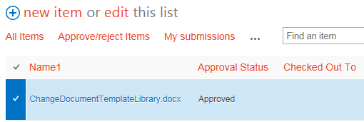
The ITEMS Tab
When you select an individual item: Other options become available

Slide 11
Properties = Metadata
Remember the Transportation Search demo?
Meaningful metadata helps with search
Accurate metadata helps with content display

Slide 12
Versioning
Versioning tracks changes to items (when, who, what)
Items have major versions (1.0, 2.0, ...)
You can view and restore earlier versions
Designer controls whether versioning is on or off

Slide 13
Exercise 2 – Items
Go to the Contributor Class home page
Click Exercises for the links you’ll need

Slide 14
Lists
So far, we have worked with the items in a list
We can also work with the list as a whole using the LIST tab

Slide 15
Let’s Learn How to…
Sort and filter a list
Email a link to a list
Set an alert on a list
Switch list views
Create a personal view of a list
Use Quick Edit to modify multiple items at the same time

Slide 16
When Do Changes to a List Go Live?
Inside
Immediately
Connect team/project sites
Immediately
Unauthenticated (public) area of Connect
Make changes on a staging server; changes are copied to a production server at :42 after the hour
There may be review or approval processes in your area

Slide 17
Demo of Lists

Slide 18
Alerts
An alert sends an email to you when changes are made to a list
You can control what changes generate an alert and how often you receive them
You can also set alerts on
Items
Files
Libraries
Search results

Slide 19
Alert Creation

Slide 20
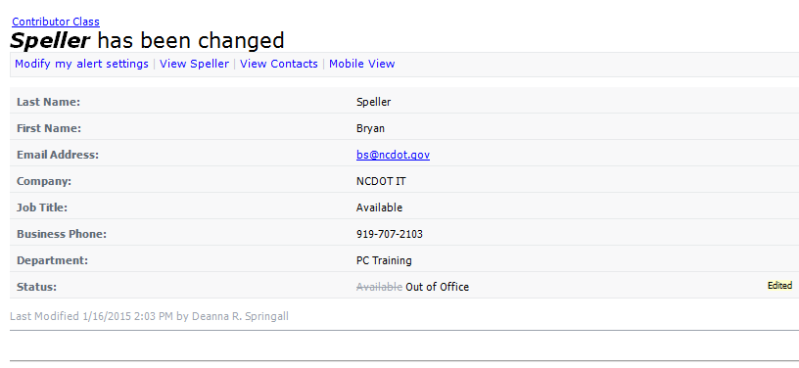
Alert Message

Slide 21
Views
In SharePoint, you can sort and filter a list, but those “ad hoc” results disappear when you leave the list
A SharePoint view is a permanent setting that controls the way items in a list are displayed
A Designer creates all views except a personal view (a view that only you can see)

Slide 22
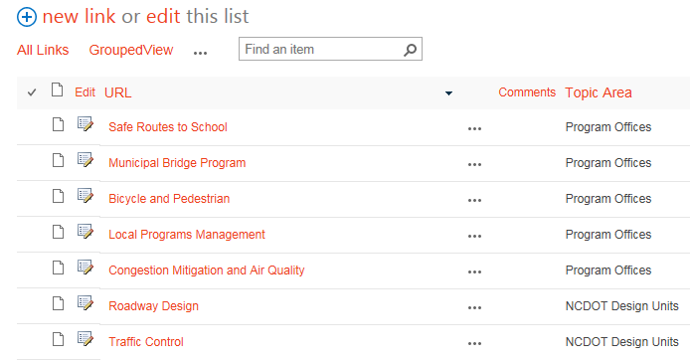
Example 1: All Items View

Slide 23
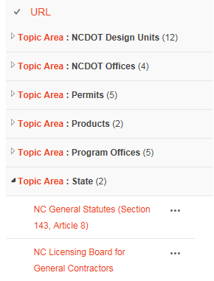
Example 1: Grouped View

Slide 24
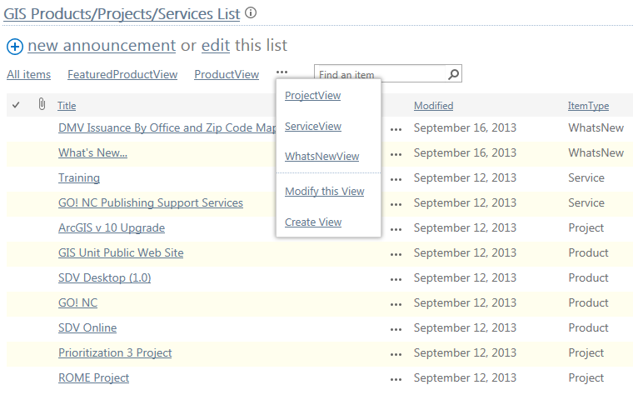
Example 2: Custom View
For most lists, the default view is All Items
Up to three views are listed
Click the ellipsis for additional views and options

Slide 25
Example 2: Custom View
The ProductView contains the items whose ItemType is equal to Product

Slide 26
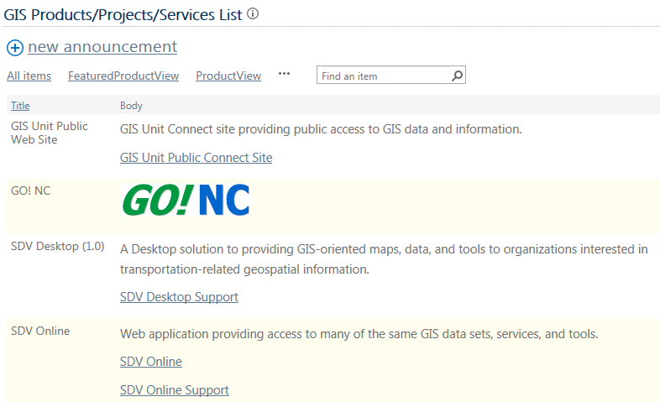
Example 2: Custom View
This is the ProductView

Slide 27
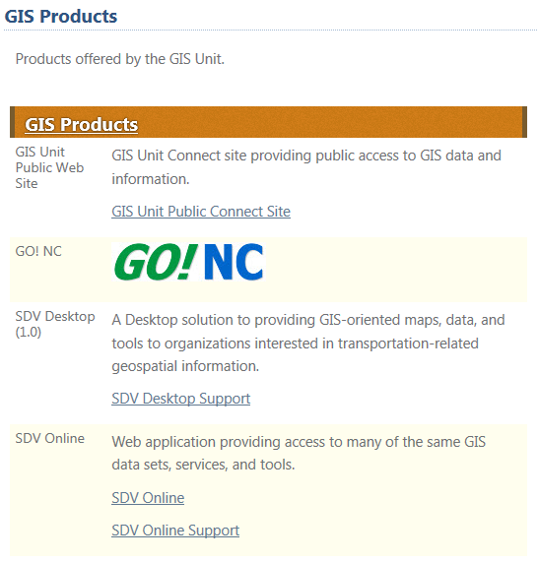
Example 2: Custom View
This is how a Designer might use the ProductView on a home page

Slide 28
List Views
Your work is important!
Items must have the correct properties for views and filters to work

Slide 29
Personal Views
Only you can see the view
Your starting point can be
Standard view
Calendar view
Access view
Datasheet view
Gantt view
Existing view

Slide 30
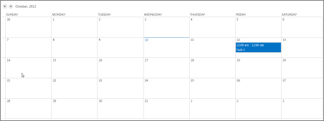
Personal Views
Standard View
Calendar View

Slide 31
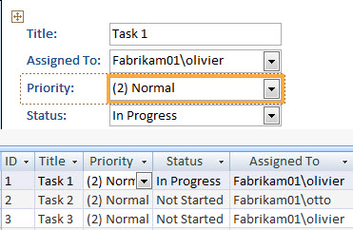
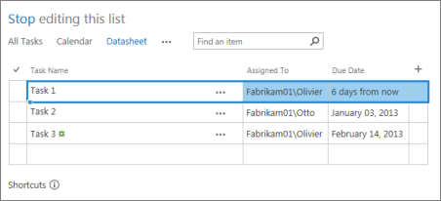
Personal Views
Access View
Datasheet View

Slide 32
Personal Views
Gantt View
Existing view

Slide 33
Quick Edit
Can you update properties for multiple items at one time?
Can you add multiple items at one time?
Yes – Quick Edit lets you work with many items at the same time
You can copy and paste
You can use the Auto Fill handle to drag

Slide 34
Example: Quick Edit

Slide 35
Exercise 3 – Lists
Go to the Contributor Class home page
Click Exercises for the links you’ll need

