Slide 1
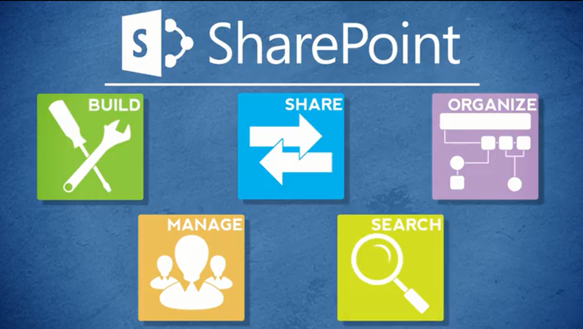
Agenda
Overview
Review
Roles
Lists
Libraries
Columns
Views
Pages
Web Parts
Navigation
Office
Wrap-Up

Slide 2
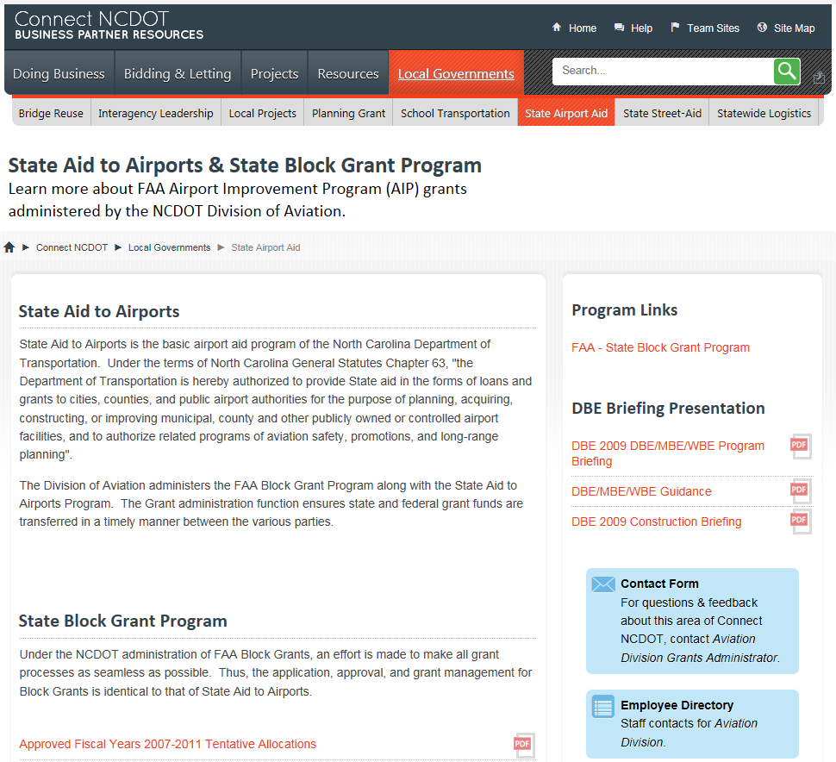
About Pages
Pages organize and present information
Pages are files that end in .aspx

Slide 3
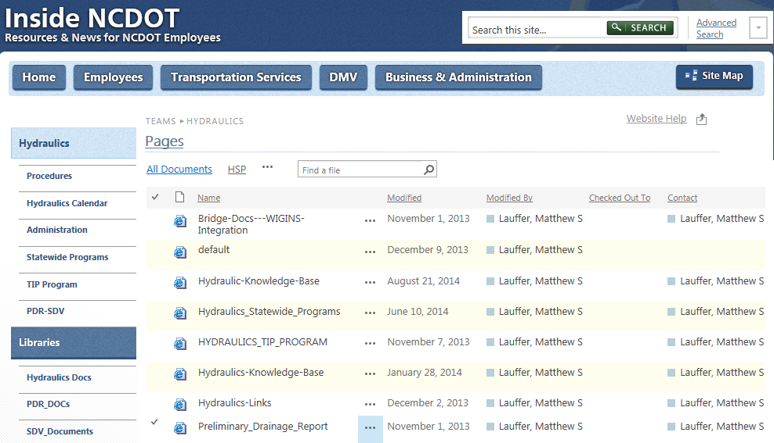
About Pages
Like other files, pages are stored in a library – in this case, the Pages library

Slide 4
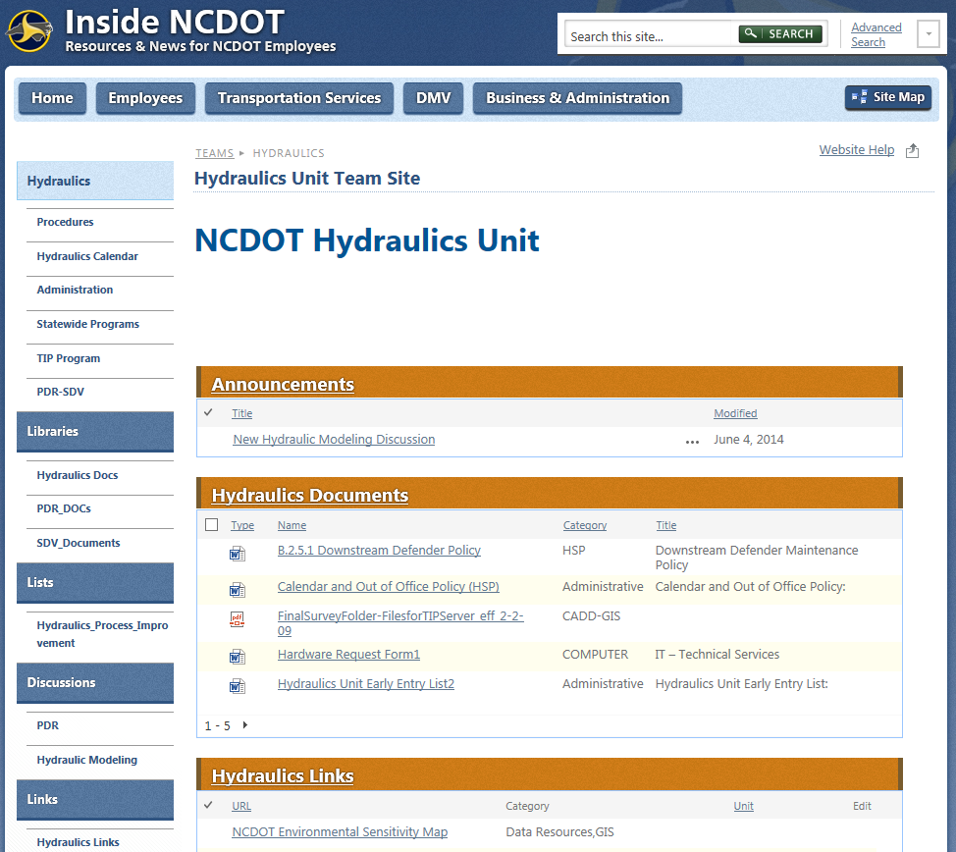
About Pages
A home page typically displays information from multiple sources
Announcements
Documents
Links

Slide 5
How Does That Happen?
To include content from multiple sources on one page, you use web parts
A web part is a reusable “container” that pulls content (such as items, files or images) from a list or library and displays it on the page
This is the concept of a data-driven page
More on web parts later….

Slide 6
NCDOT Templates
NCDOT uses the Welcome Page template with predefined page layouts
The layouts enforce a consistent look and feel and control what areas of the page can be modified

Slide 7
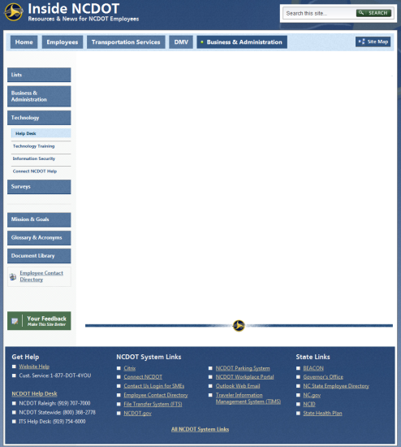
NCDOT Templates: Inside NCDOT
One layout is available
White space is editable
The top portion of Quick Launch can contain customized navigation
The bottom portion of Quick Launch always contains the same five elements

Slide 8
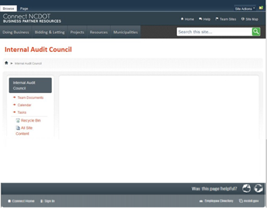
NCDOT Templates: Connect NCDOT
Several layouts are available, varying with the type and location of the site
White space is editable
Quick Launch can contain customized navigation, depending upon the type and location of the site

Slide 9
Publishing Concepts
NCDOT uses SharePoint “publishing”
You’re used to a standard “create, edit and save” process from Office files, but publishing adds one more step
You must additionally and specifically move the page from the staging server to the production server
This gives you an extra opportunity to review pages before they are visible

Slide 10
Let’s Learn How to…
Create a page
Check out and edit a page
Edit a page’s properties
Save, check in and publish a page
Delete and restore a page

Slide 11
Create a Page
Settings gear > Add a Page
Enter name > Create
PAGE tab > Page Layout > Select layout
Add content
PAGE tab > Save > Check it in > Add comments > Continue > Publish it

Slide 12
Check Out and Edit a Page
Settings gear > Edit Page
Make changes
PAGE tab > Save > Check it in > Add comments > Continue > Publish this draft
Avoid changing the layout - SharePoint may have to rearrange the page if, for example, you’re moving from a two-column layout to a one-column layout.

Slide 13
Edit Page Properties
PAGE tab > Edit Properties
Make changes
PAGE tab > Save > Check it in > Add comments > Continue > Publish this draft
Editing page properties changes the page, just like editing page content

Slide 14
Save, Check In and Publish a Page
Make changes
PAGE tab > Save > Check it in > Add comments > Continue > Publish this draft
Other page options include
Discard check out – Discards any unsaved changes; this is a useful option if you make changes that introduce errors on the page or if you just want to look at the page content in edit mode without changing anything
Save and Keep Editing – Saves your changes to the page but you can continue to edit the page
Save – Saves and closes the page, but it remains checked out to you

Slide 15
Delete and Restore a Page
Delete Page
Settings gear > Edit page
PAGE tab > X Delete Page > OK
Restore Page
Settings gear > Site contents > RECYCLE BIN
Select page > Restore Selection > OK
You can also restore an earlier version of a page

Slide 16
Plan Your Pages – Content
What is the purpose of the page?
What needs to be conveyed to users?
What type of data is available?
Who owns the content?
Who maintains the content?
Who should be able to see the content?

Slide 17
Plan Your Pages – Content
Create additional pages if
All content does not fit on the top-level (home) page
The content deserves its own page
Create web parts to filter and display appropriate content (more later)

Slide 18
Plan Your Pages – Format
Do not copy and paste from Word or email; that introduces hidden tags that interfere with formatting in SharePoint
Instead, copy and paste into Notepad (or another text editor), then copy and paste into SharePoint

Slide 19
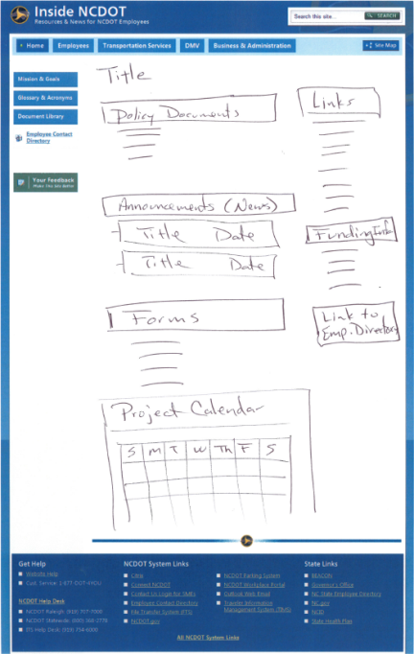
Plan Your Pages – Design and Layout
Put critical content at the top
Create a short but meaningful title
Consider ease of use
Group like data

Slide 20
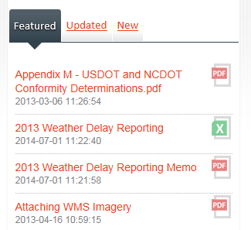
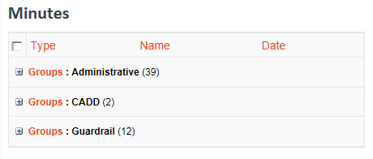
Plan Your Pages – Optimize Space
Use tabs
Combine short lists
Use a logical, uncluttered layout
If only dates are important, don’t display time
Group by column and use the collapsed view

Slide 21
When Do Page Changes Go Live?
Inside
Page changes are visible once a page is published
Connect team/project sites
Page changes are visible once a page is published
Unauthenticated (public) area of Connect
Page changes are made on a staging server so you do not work on the live website
Once a page is published, page changes are automatically copied to the production server at :42 after the hour
Page changes are then visible

Slide 22
Exercise 5: Pages
Go to the Designer Class home page
Click Exercises for the links you’ll need

