Slide 1
Agenda
Overview
What is SharePoint?
NCDOT Websites
Roles
Search
SharePoint Interface
SharePoint Changes
Items & Lists
Files & Libraries
SharePoint & Office
Help
Wrap Up

Slide 2
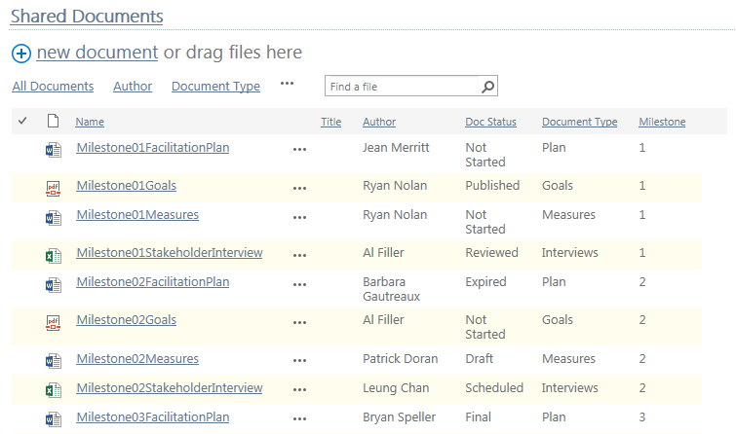
What is a Library?
A Library is a special type of list. Rather than data, a library contains files.

Slide 3
What is a Library?
A library is a place to create, collect, update and manage files. Files may be
PDFs
Office files – spreadsheets, documents, presentations
.zip files
Document sets
Images, audio and video
SharePoint does not allow you to store certain types of files, such as executables

Slide 4
Library Terminology
A library contains files
Each file has content and has properties
The terms files and documents may be used interchangeably
List terminology is occasionally used for libraries; that is, a file may be called an item and a library may be called a list

Slide 5
Common Libraries in Use at NCDOT
Assets – Store image, audio and video files
Document – Store files
Pages – Store publishing pages
Picture – Store pictures and slides

Slide 6
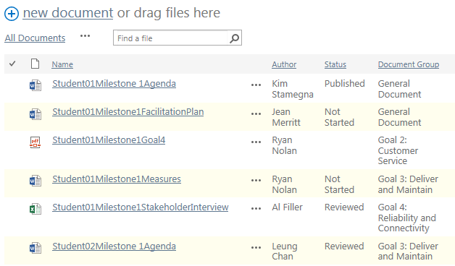
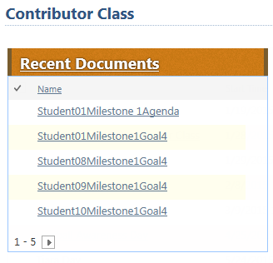
A Library May Look Different on a Page
Documents exist in the “source” list, but are often displayed on other pages

Slide 7
Let’s Learn How to…
Download a copy of a file from a library
Upload and check in a file
Upload and check in multiple files
Modify files
Edit, save and check in a file
Discard a checkout
Delete and restore a file
View and edit file properties
View version history
Restore an earlier version

Slide 8
When Do Changes to a File Go Live?
Inside
Immediately
Connect team/project sites
Immediately
Unauthenticated (public) area of Connect
Make changes on a staging server; changes are copied to a production server at :42 after the hour
There may be review or approval processes in your area

Slide 9
Demo of Files

Slide 10
The FILES Tab
Offers options to work with files in the library
Initially, only New options are available

Slide 11
The FILES Tab
When you select an individual file:
Other options become available

Slide 12
Check Out/Check In
This process prevents conflicting changes
When you check out a file, no one else can edit the file until you check it back in
You can see what files are checked out and to whom
When you check in a file, you can add comments to describe your changes

Slide 13
Check Out/Check In
If you do not want to save your changes, use Discard Checkout to avoid creating a version
Use the local (drafts) folder to avoid accessing the server every time you save

Slide 14
Versioning
Versioning tracks changes to files (when, who, what)
Files can have major (1.0, 2.0, ...) or major/minor (1.0, 1.1, 1.2, 2.0, ...) versions
Minor versions are drafts
You can view and restore earlier versions
You can add comments

Slide 15
Exercise 4 – Files
Go to the Contributor Class home page
Click Exercises for the links you’ll need

Slide 16
Considerations – File Names
File names cannot contain these special characters
Error message: “The file name is not valid”
Tilde | ~ | Braces | {} | Question mark | ?
Number sign | # | Backslash | \ | Slash | /
Percent | % | Colon | : | Pipe | |
Ampersand | & | Angle brackets | < > | Quotation mark | “
Asterisk | *

Slide 17
Considerations – File Names
Keep file names short and to the point
Replace Human Resources Staffing Plan - February 10 2015 – Revision 3.16 with Staffing-Plan and…
Use properties (metadata)
Department = Human Resources
Document type = Staffing Plan
Let SharePoint track dates and revisions

Slide 18
Considerations – File Names
Use dashes, not spaces.
Why? SharePoint replaces spaces with %20, creating longer URLs and reducing usability
Compare Staffing-Plan with Human%20Resources%20Staffing%20Plan%20-%20February%2010%202015%20–%20Revision%203.16

Slide 19
Considerations – File Titles
Titles are critical for good search results
Titles are included search results
Titles can (and should) be longer and more descriptive than file names
Titles can use spaces

Slide 20
Considerations – File Titles
If you copy a file, update its title
A title such as “Human Resources Staffing Plan” is good if you think users will search for Human Resources, staffing plan, or staffing
Users likely will not search for Revision 3.16 or February 10, 2015

Slide 21
Considerations – File Formats
Use PDF if no one should make changes – especially on unauthenticated (public) Connect
Use the source (Word, etc.) if changes are allowed
Use a SharePoint list instead of an Excel spreadsheet

Slide 22
Considerations – File Location
A file should only live in one library
Link to the file from other locations

Slide 23
New! Security Tags
Three security categories
Highly restricted is not permitted in SharePoint
Consult your Data Steward for help and clarification
Highly Restricted
Unrestricted
Restricted

Slide 24
New! Business Content Type Tags
~140 Business Content Types organized into 13 Genres
Example: The Correspondence genre contains 7 business content types – Invitations, Letters, Memos, etc.)
Consult your Data Steward for help and clarification

Slide 25
Why Is Content Tagging Important?
Your data is well understood
The right people access the right data
NCDOT adheres to legal mandates
You can consistently and easily find data
More information: https://inside.ncdot.gov/Teams/ncdotea/ Pages/ContentDataManagement-.aspx

Slide 26
Demo of Security and Content Tagging

Slide 27
Security and Content Tagging

Slide 28
Security and Content Tagging

Slide 29
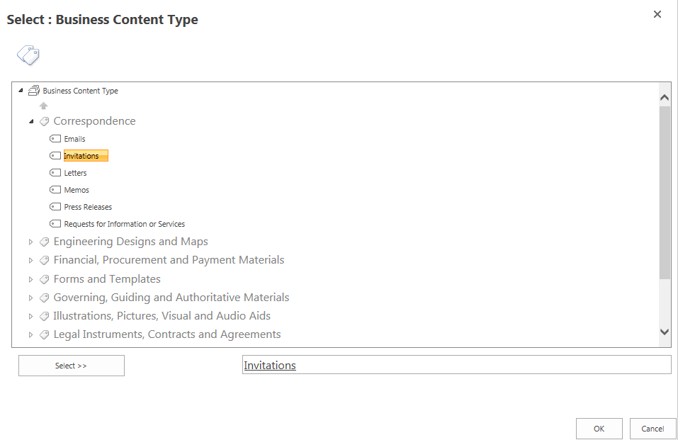
Content Tagging

Slide 30
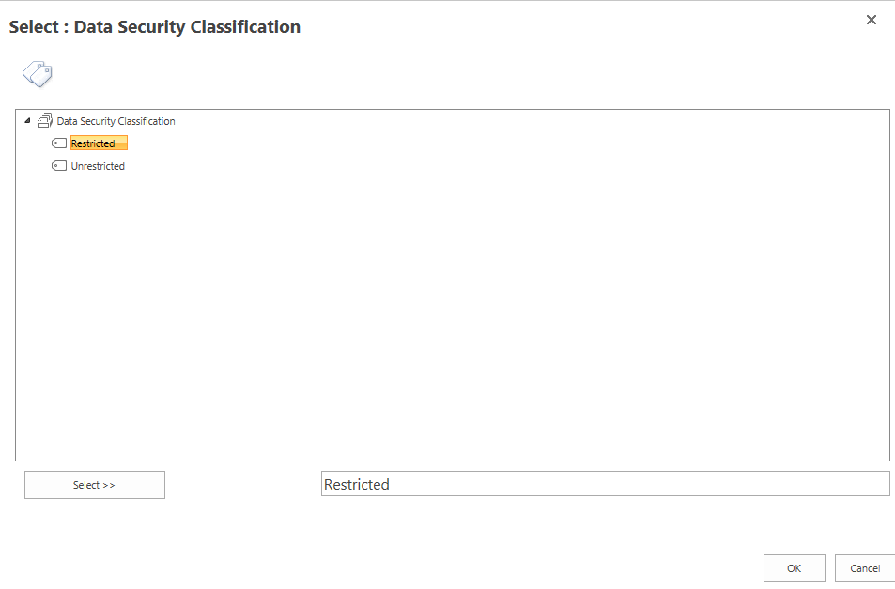
Security Tagging

Slide 31
Security and Content Tagging

Slide 32
Libraries
So far, we have worked with files in a library
We can also work with the library as a whole using the LIBRARY tab

Slide 33
Remember, a Library Is Actually a List
Many tasks for lists are the same for libraries
Sort and filter
Email a link
Set an alert
Switch views
Create a personal view
Use Quick Edit

Slide 34
Let’s Learn How to…
Search
Move files

Slide 35
When Do Changes to a Library Go Live?
Inside
Immediately
Connect team/project sites
Immediately
Unauthenticated (public) area of Connect
Make changes on a staging server; changes are copied to a production server at :42 after the hour
There may be review or approval processes in your area

Slide 36
Demo of Libraries

Slide 37
Library Views
For most libraries, the default view is All Documents
Just like lists…
Up to three views are listed
Click the ellipsis for additional views and options
A Designer creates all views except personal
Views depend upon item properties

Slide 38
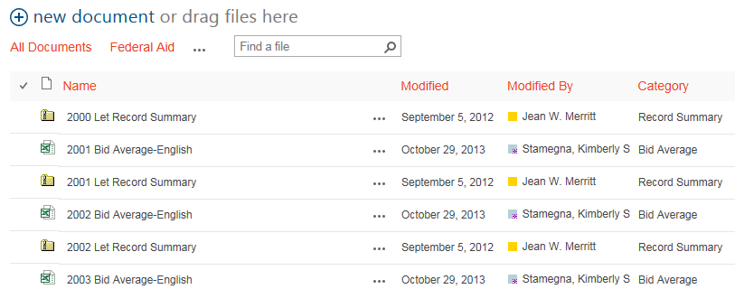
Example View: All Documents
The All Documents view contains 91 files

Slide 39
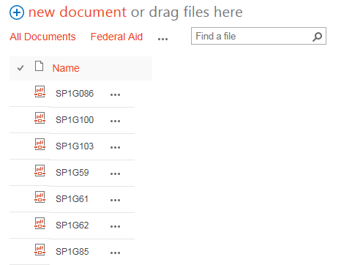
Example View: Federal Aid
The Federal Aid view displays the 19 files with a category of Federal Aid
The view hides most columns

Slide 40
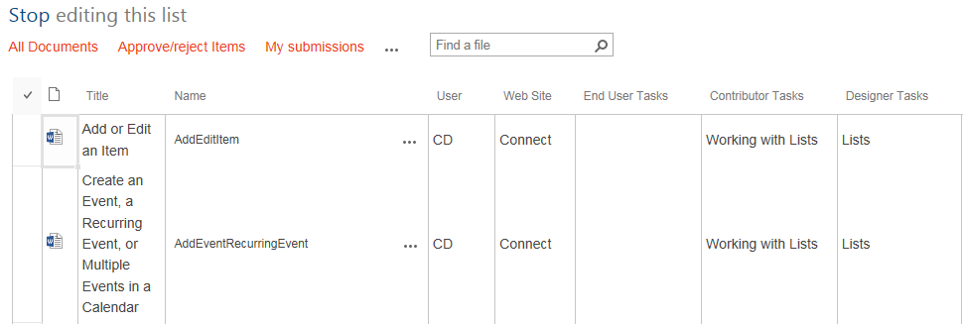
Example: Quick Edit
In a library, Quick Edit lets you edit properties of multiple files – but not add multiple files

Slide 41
Search a Library
Search within a library examines the titles, names and content of documents
Advantages
Do not go to the standard search results page
Do not get results from outside the library

Slide 42
Example: Search a Library
The TPB-CTP library contains 1121 files and you search for Orange County

Slide 43
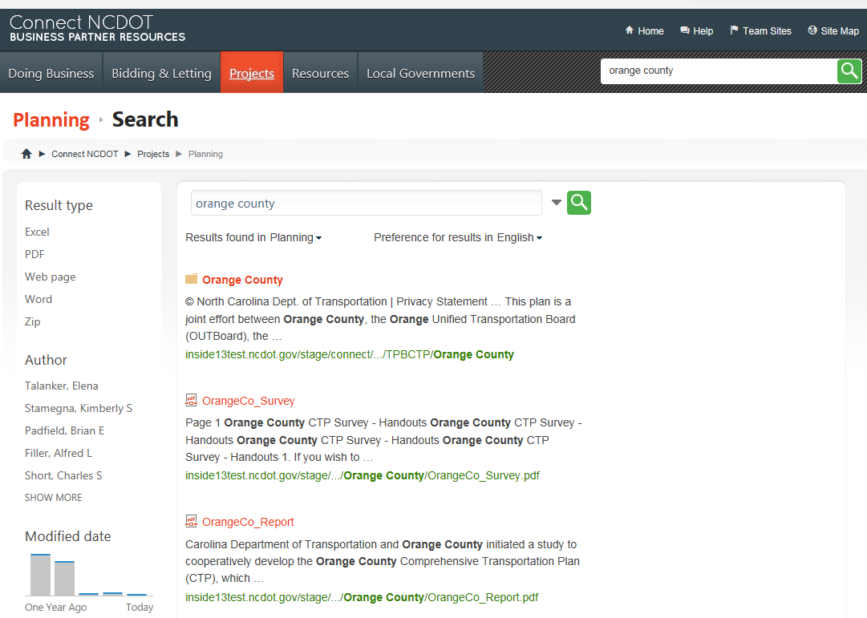
Example: Search a Library
Site search returns 217 results

Slide 44
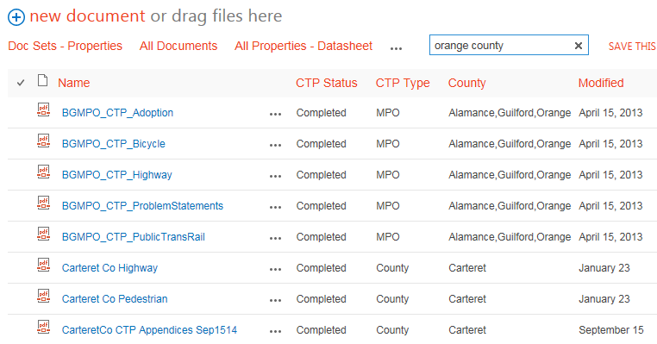
Example: Search a Library
Library search returns 62 results

Slide 45
Exercise 5 – Libraries
Go to the Contributor Class home page
Click Exercises for the links you’ll need

Slide 46
Considerations – Folders
You don’t need them as much as you think you do!
Instead, use
Properties (metadata)
Grouping

Slide 47
Folders Interfere with Usability
Folders are one-dimensional - there’s only one path through
If a Document Control staffer organizes files by status…
How do you find all documents by a particular author?
How do you find all documents that address a particular goal?

Slide 48
More Problems with Folders
Nested folders can quickly exceed the limit of 256 characters in a SharePoint URL
It is too easy to put the same file in different folders, introducing duplication and confusion
Sorting and filtering do not work across folders
You don’t know how many files are in a folder

Slide 49
Challenge
Can you make better use of metadata and reduce use of folders?

Slide 50
Demo of Folders

