Slide 1
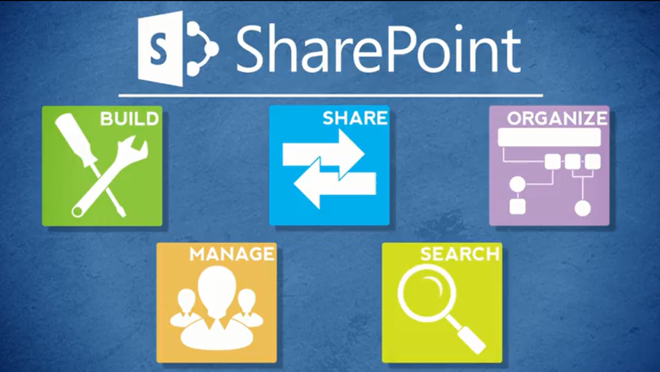
Agenda
Overview
Review
Roles
Lists
Libraries
Columns
Views
Pages
Web Parts
Navigation
Office
Wrap-Up

Slide 2
About Web Parts
Web parts are reusable “containers” that reside on web pages and interact with lists, libraries and other web parts
They add functionality to a web page and display content

Slide 3
Examples of Web Parts
Simple Tabs
Image Viewer
List View
Content Query

Slide 4
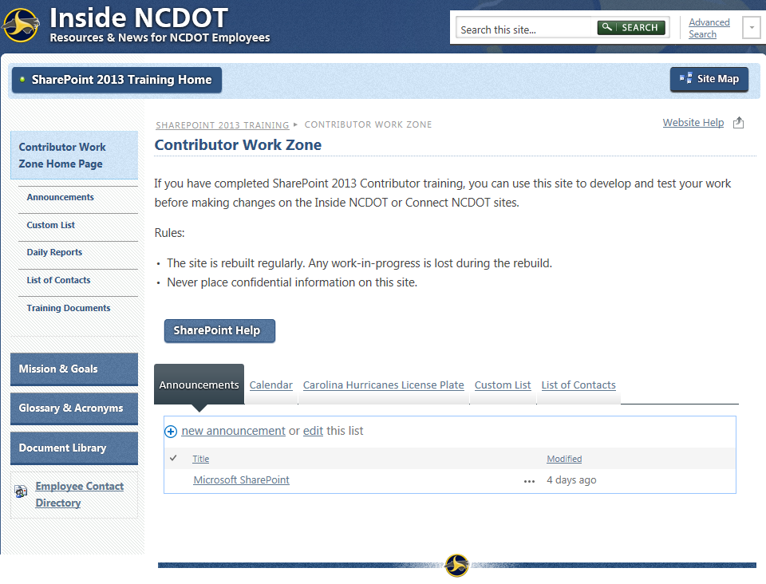
Simple Tabs Web Part
Create tabs to display a lot of information in a small amount of space
Each tab contains one web part

Slide 5
Image Viewer Web Part
Image is stored in the Asset library
Image is displayed on a page with the Image Viewer web part

Slide 6
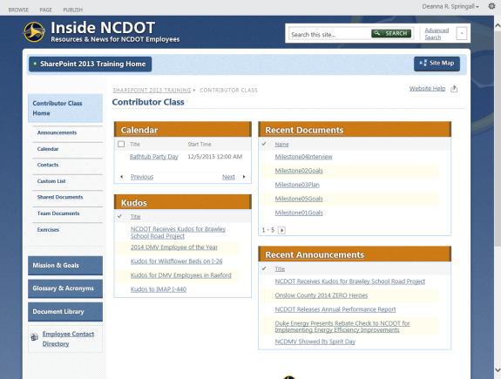
List View Web Part
Lists and libraries contain content
A page contains List View web parts
The List View web parts draw content from the list or library and display it on the web page

Slide 7
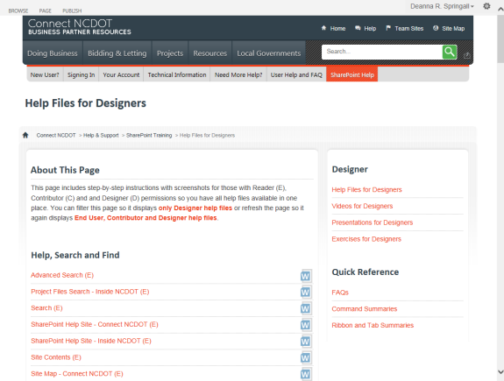
Content Query Web Part
Display results in a choice of styles
Display query results for lists and libraries that reside in the same site collection
Works within a site collection

Slide 8
Web Part Properties
All web parts have properties that can be edited
Some are common to all web parts
Appearance
Layout
Advanced
Some are specific to different web parts

Slide 9
Useful Properties: Appearance
Property | Description
Title | Text that appears in the title bar of the web part
Chrome State | Normal – The entire web part appears when the page loads Minimized – Only the title bar appears when the page loads
Chrome Type | None – Neither the title bar nor border are displayed Title and Border – Title bar and border are displayed (default) Title Only – Title bar is displayed Border Only – Border is displayed

Slide 10
Useful Properties: Layout
Property | Description
Hidden | Checked – Web part is hidden when the page loads. Hide a web part if it performs a function, but doesn’t need to be seen. Unchecked – Web part is visible when the page loads
Zone | Zone where the web part is located. Change the zone to move a web part to that zone.
Zone Index | Position of the web part in a zone. Change the zone index to move the web part within the zone.

Slide 11
Useful Properties: Advanced
Property | Description
Title URL | Destination URL if you want the web part title to be a link
Description | Tool Tip that appears when you hover over the web part title or icon

Slide 12
Let’s Learn How to…
Add and configure these web parts
Image Viewer
Simple Tabs
List View
Content Query

Slide 13
Image Viewer Web Part
Settings gear > Edit page
Add a Web Part > Media and Content category > Image Viewer web part > Add
Open the tool pane > Enter image URL in Image Link text box > Test Link
Configure additional properties
OK > Save, check in and publish page

Slide 14
Simple Tabs Web Part
All web parts that need tabs should be in the same web part zone. The top-to-bottom order of the web parts becomes the left-to-right order of the tabs.
Settings gear > Edit page
Add a Web Part > Miscellaneous category > Simple-Tabs-Web-Part > Add
Move Simple-Tabs-Web-Part below the web parts that need tabs
Save, check in and publish the page

Slide 15
List View Web Part
Settings gear > Edit page
Add a Web Part > Apps category > Select list > Add
The List View web part is automatically created
To change the default display, hover over web part title > Click down arrow > Edit Web Part
Change to another view or edit the current view
OK > Save, check in and publish the page

Slide 16
Web Part? App? List? Library?
What’s the difference between an app and a web part? They’re essentially the same
Both are available in the web part gallery
Both are added to pages in the same way
Both have custom properties
An app uses the List View web part in the background
What’s the difference between an app and a list or library?
It’s easiest to think of each list and library as an app

Slide 17
Content Query Web Part
Settings gear > Edit page
Add a Web Part > Content Rollup category > Content Query web part > Add
Open the tool pane
Enter the query
Configure additional properties
OK > Save, check in and publish the page

Slide 18
Manipulate Web Parts: Delete, Close, Hide
Delete
The web part is completely removed from the page
The default web part remains available in the web part gallery
Close
The web part and its configuration are stored in the Closed Parts category of the web part gallery for that page
The web part isn’t visible and doesn’t use system resources
The configured web part can be added back to the same page
Hide
The web part performs its function (such as adding tabs to a page), but is seen only when the page is in edit mode
The web part uses system resources like a visible web part

Slide 19
Manipulate Web Parts: Move, Export, Import
Move
Depending upon the type of page, web parts can be dragged and dropped from one part of a page to another
If drag and drop doesn’t work, use the Zone and Zone Index settings to move a web part to another zone on the page or to rearrange the web parts within a zone
Export
The web part and its configuration is saved as a .webpart file
The web part can be imported and used on other pages
This is not available for a List View web part
Import
A web part that was exported from one page can be re-used on another page

Slide 20
Let’s Learn How to…
Close, hide and delete a web part
Import, export and move a web part

Slide 21
Hide and Unhide a Web Part
Hide
Settings gear > Edit page
Hover over web part title > Click down arrow > Edit Web Part
In Layout section, check Hidden
OK > Save, check in and publish the page
Unhide
Settings gear > Edit page
Hover over web part title > Click down arrow > Edit Web Part
In Layout section, uncheck Hidden
OK > Save, check in and publish the page

Slide 22
Close and Restore a Web Part
Close
Settings gear > Edit page
Hover over web part title > Click down arrow > Close
OK > Save, check in and publish the page
Add a Closed Web Part
Settings gear > Edit page
Add a Web Part > Closed Parts category > Select closed web part > Add
Save, check in and publish the page

Slide 23
Delete a Web Part
Settings gear > Edit page
Hover over web part title > Click down arrow > Delete
OK > Save, check in and publish the page

Slide 24
Export and Import a Web Part
Export
Settings gear > Edit page
Hover over web part title > Click down arrow > Export > OK
If Export is not available, expand Advanced section and change Export Mode to Export all Data
Browse to download destination > Save
Import
Settings gear > Edit page
Add a Web Part > Upload a Web Part > Browse to and upload .webpart
Add a Web Part > Imported Web Parts category > Select the imported web part > Add
Save, check in and publish the page

Slide 25
Move a Web Part
Settings gear > Edit page
Drag web part to new location
OR
Hover over the title of the web part > Click down arrow > Edit Web Part
Expand the Layout section > Change Zone and/or Zone Index
OK > Save, check in and publish the page

Slide 26
Plan Your Web Parts
A web part does not have versions!
Changes to a web part overwrite previous content and settings
Store content in lists and libraries with versioning

Slide 27
Plan Your Web Parts
If you add a List View web part, you can use an existing view in the web part
Changes made to the view in the list or library later do not update the view in the web part
If you Edit the current view within the List View web part, that work is lost if you delete the web part
Changes made to a view within a web part do not update the view in the list or library

Slide 28
Plan Your Web Parts
Decide which is better in your situation
If you think a view is useful for many users, create it in the list or library
If you think a view is only useful within the web part, edit the view in the web part

Slide 29
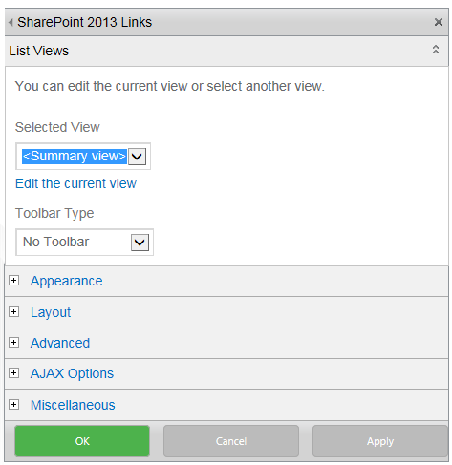
Plan Your Web Parts
Change the Toolbar Type to No Toolbar if you want to remove the options to add or edit items or files

Slide 30
Plan Your Web Parts
To sort a list or library in some order other than numeric or alphabetic (such as geographic)
See if there is a column for Order.
If not, add a column named Order and define the type of information as number
In the Order column, give a number (1, 2, 3) to each item to define its display order
In the web part, sort by the Order column

Slide 31
Gotchas
Changes may appear on pages, even if the pages were not published
Huh? A page contains web parts, but those web parts draw their content from lists and libraries
So, a change to a list or library may appear on a page, even though the page was not published

Slide 32
Gotchas – Example
A home page includes Recent Documents
When you add a new document to the library, Recent Documents is automatically updated
Why? When the home page loads, the web part that displays the Recent Documents queries the library to identify and display the newest documents
The page hasn’t changed since it simply contains the web part – it’s the display within the web part that’s changed
Remember, this is the concept of data-driven pages
So, a change can appear on a page although the page was not published

Slide 33
When Do Web Part Changes Go Live?
Inside
Immediately
Connect team/project sites
Immediately
Unauthenticated (public) area of Connect
Make changes on a staging server; changes are copied to a production server at :42 after the hour
There may be review or approval processes in your area

Slide 34
Exercise 6: Web Parts
Go to the Designer Class home page
Click Exercises for the links you’ll need

