Slide 1
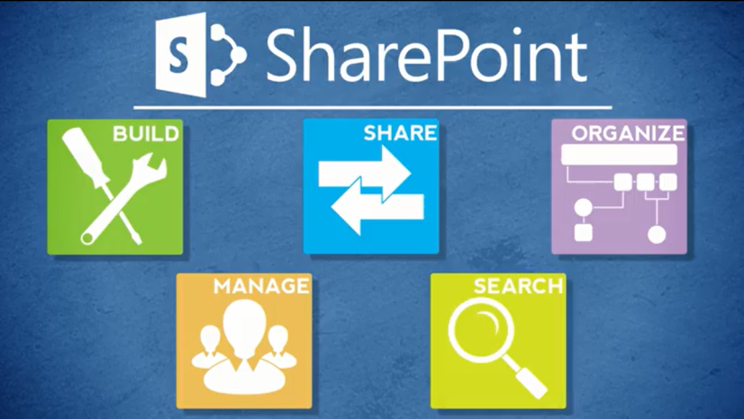
Agenda
Overview
Review
Roles
Lists
Libraries
Columns
Views
Pages
Web Parts
Navigation
Office
Wrap-Up

Slide 2
About Navigation
You can modify the Quick Launch navigation
Add or remove a list or library using List Settings or Library Settings
Edit and sort navigation using Site Settings

Slide 3
Add or Remove a List or Library
Under List Settings or Library Settings, there’s an option to display the list or library on Quick Launch
Inside NCDOT: No restrictions
Connect NCDOT: Option may be available on team and project sites

Slide 4
Edit and Sort Quick Launch Navigation
Under Site Settings, there are options to change Navigation Settings on Quick Launch
Inside NCDOT: Add, edit, rearrange and delete links and headings
Connect NCDOT: Add, edit, rearrange and delete links on team and project sites

Slide 5

Let’s Learn How to…
Add or remove list or library in Quick
Launch
Add heading or link in Quick Launch
Edit, move or delete heading or link
in Quick Launch

Slide 6
Add/Remove List/Library
LIST or LIBRARY tab > List or Library Settings > List name, description and navigation
Yes to add or No to remove
Save

Slide 7
Add Heading or Link
Settings gear > Site settings > Navigation
Sort manually for Structural Navigation: Sorting
In Structural Navigation: Editing and Sorting, select heading to position insert point
Enter title
Enter URL – or – browse to and Insert URL
OK > OK

Slide 8
Edit, Move or Delete Heading or Link
Settings gear > Site settings > Navigation
Sort manually for Structural Navigation: Sorting
In Structural Navigation: Editing and Sorting, select heading or link
To edit: Edit > Make changes > OK > OK
To move: Move Up or Move Down > OK > OK
To delete: Delete > OK

Slide 9
When Do Changes Go Live?
Inside
  Immediately after pages are published
Connect team/project sites
  Immediately after pages are published
Unauthenticated (public) area of Connect
  Changes are made on a staging server and are copied to a production server at :42 after the hour
There may be review or approval processes in your area

Slide 10

Exercise 7: Navigation
Go to the Designer Class home page
Click Exercises for the links you’ll need

