Slide 1
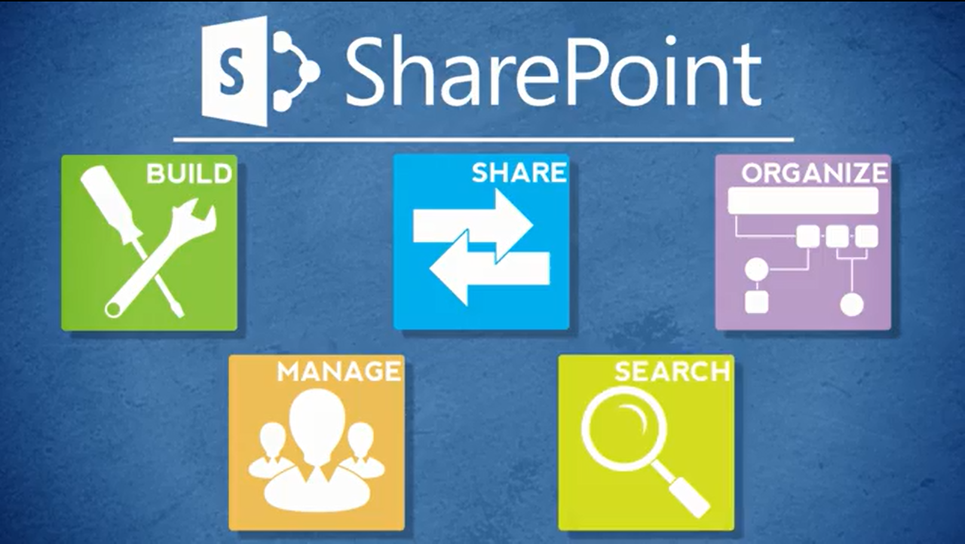
Agenda
Overview
What is SharePoint?
NCDOT Websites
Roles
Search
SharePoint Interface
SharePoint Changes
Items & Lists
Files & Libraries
SharePoint & Office
Help
Wrap Up

Slide 2


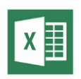
SharePoint and Office Applications
Outlook
Word
Excel
PowerPoint
Visio
OneNote
Access
InfoPath

Slide 3

What Can You Do within Office?
Open, check out, edit, save and
check in a SharePoint file
View document properties in
either the Document Information
Panel (DIP) or under File > Info
Edit properties of a SharePoint file
Manage versions of a SharePoint file

Slide 4
What Else Can You Do?
Export a SharePoint list to Excel
Overlay a SharePoint calendar on an
Outlook calendar
Connect a SharePoint library, contact list, task list, discussion board, and other lists to Outlook

Slide 5
When Do Changes to a File Go Live?
Inside
  Immediately
Connect team/project sites
  Immediately
Unauthenticated (public) area of Connect
  Make changes on a staging server; changes are copied to a production server at :42 after the hour
There may be review or approval processes in your area

Slide 6

Demo of SharePoint and Office

Slide 7
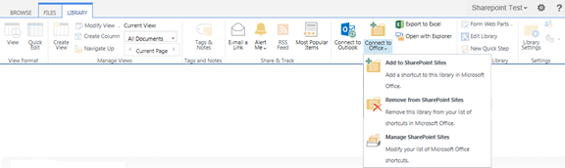
Connect to Office
Use Connect to Office to connect a SharePoint library with Office apps
Make this connection for each library

Slide 8
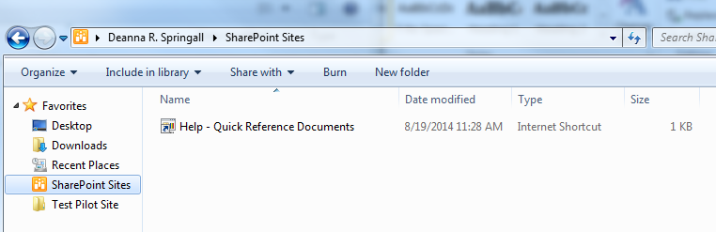
Connect to Office
The SharePoint library appears under SharePoint Sites in Favorites

Slide 9

Exercise 6 – SharePoint and Office
Go to the Contributor Class home page
Click Exercises for the links you’ll need

