Slide 1
Agenda
Overview
What is SharePoint?
NCDOT Websites
Roles
Search
SharePoint Interface
SharePoint Changes
Items & Lists
Files & Libraries
SharePoint & Office
Help
Wrap Up

Slide 2
SharePoint Help on Inside NCDOT
Link is below the Site Map and in the footer on every page
Currently goes to Help on Connect NCDOT

Slide 3
SharePoint Help on Connect NCDOT
Link will be available on the standard Help page
URL = https://connect.ncdot.gov/help/SharePoint-Training/

Slide 4
Demo of SharePoint Help

Slide 5
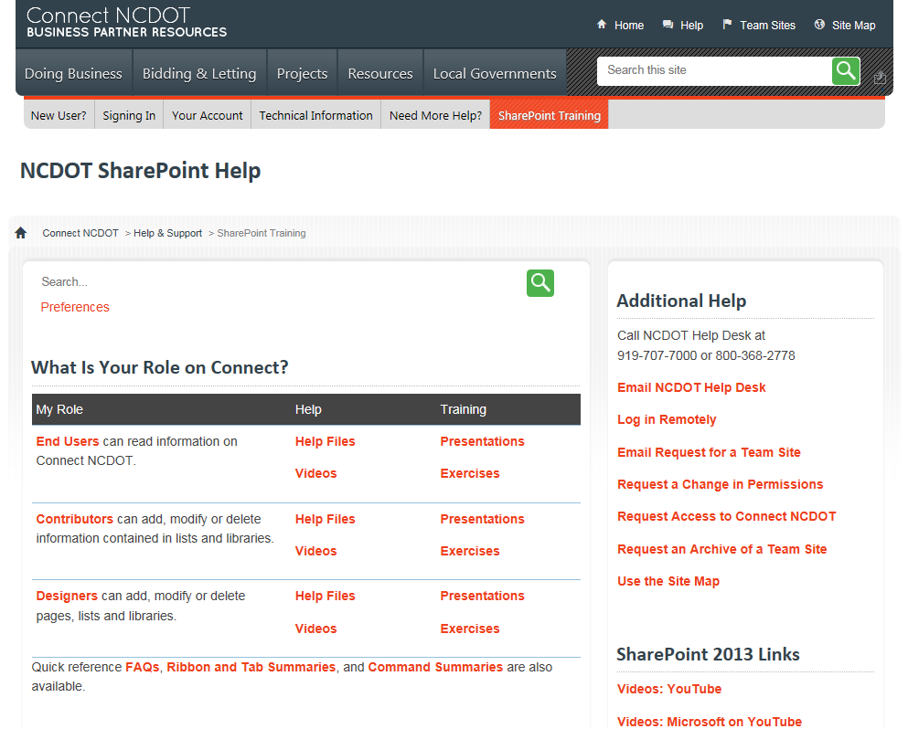
SharePoint Help: Browse by Role

Slide 6
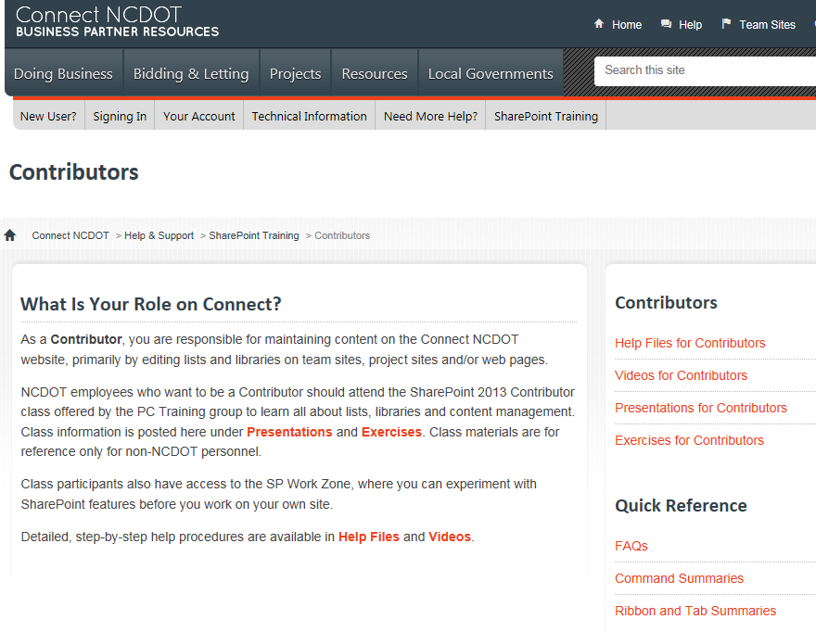
SharePoint Help: Browse by Role

Slide 7
SharePoint Help: Materials
By Role
Help files
Help videos
Exercises
Presentations
Quick Reference
FAQs
Ribbon and Tab Summaries
Command Summaries

Slide 8
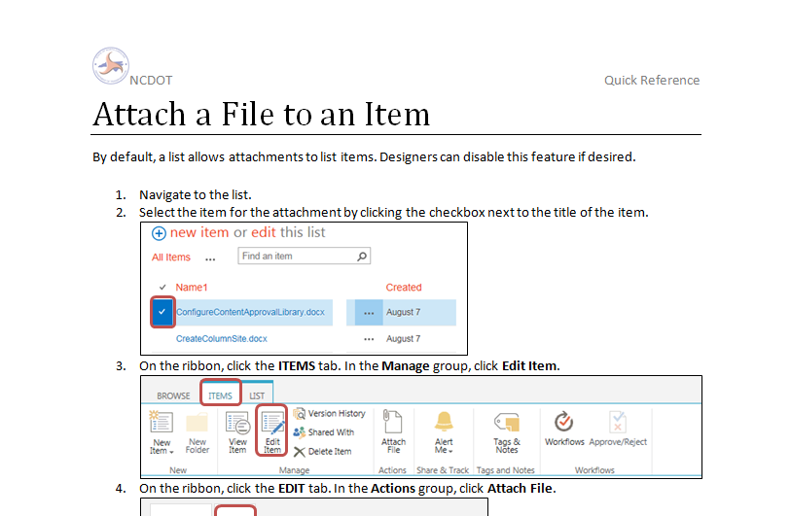
Sample Help File
Step-by-step instructions with screenshots

Slide 9
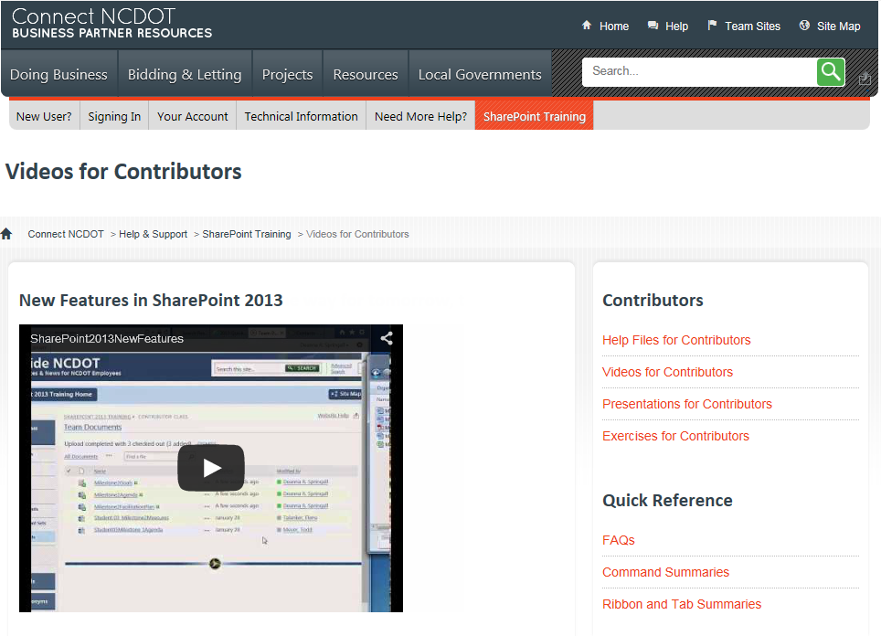
Sample Help Video

Slide 10
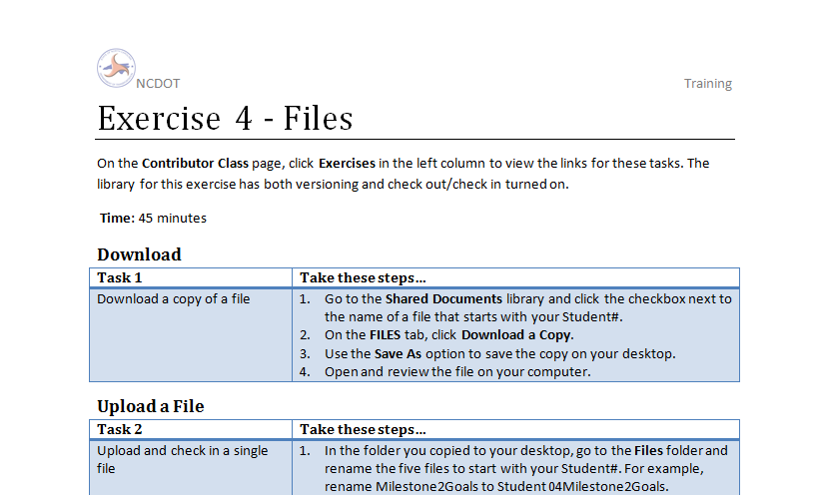
Sample Training Exercise
Step-by-step instructions for lab exercises

Slide 11
Sample Training Presentation
Lecture content for class

Slide 12
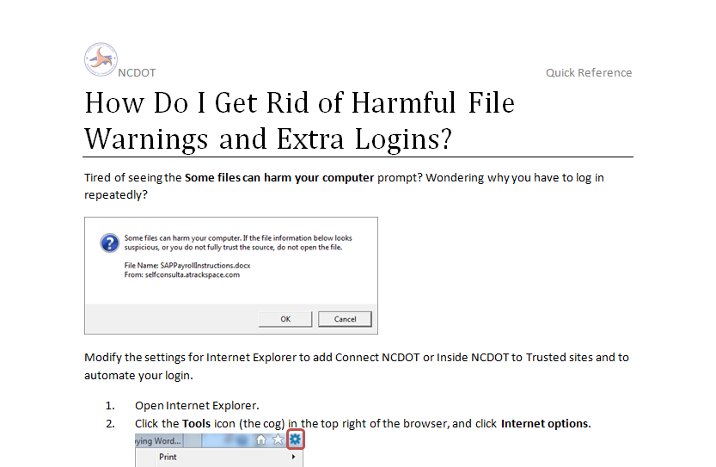
Sample FAQ
Common questions and troubleshooting tips

Slide 13
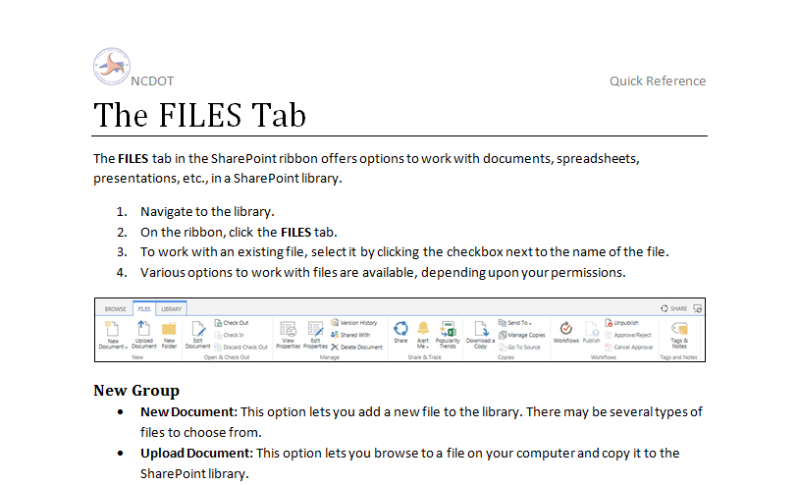
Sample Ribbon and Tab Summary
Quick reference for tabs and ribbons

Slide 14
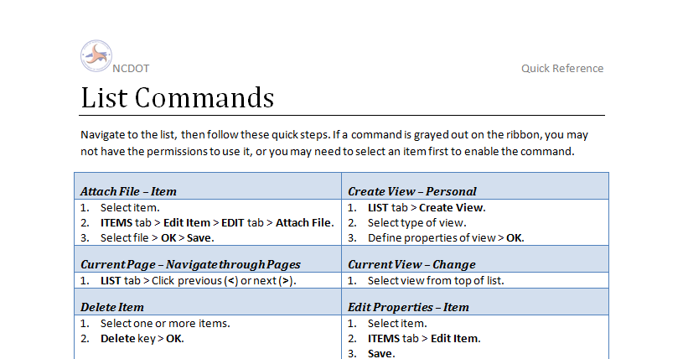
Sample Command Summary
Quick command reference – a very condensed version of the Help File

