Slide 1
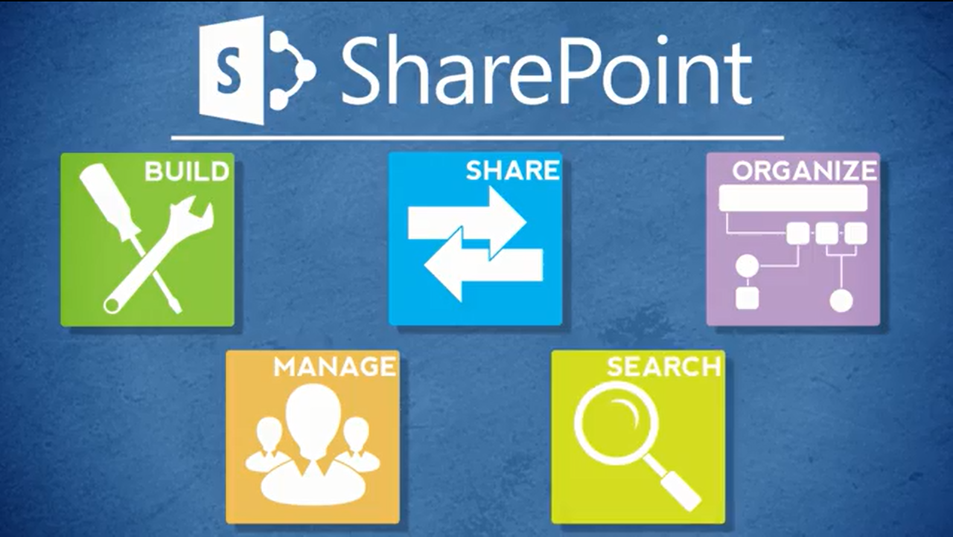
Agenda
Overview
What is SharePoint?
NCDOT Websites
Roles
Search
SharePoint Interface
SharePoint Changes
Items & Lists
Files & Libraries
SharePoint & Office
Help
Wrap Up

Slide 2
Wrap-Up of Goals
You are comfortable with the Contributor tasks covered in this class
You understand the division of labor between a SharePoint Contributor and a SharePoint Designer
You know where to find resources

Slide 3
Resources for Contributors
SharePoint Help Site
SharePoint Work Zone
Others: Designer, Business Owner, Web Services
Tab Owners (for Inside)
  Home – Amanda Perry
  Employee – Daphne Wright
  Transportation Services – Robbie McKeithan
  DMV – Jerry Higgins
  Business & Administration – Ehren Meister

Slide 4

The SharePoint Work Zone
It is part of the training environment
It is an area where you can practice
It is open to NCDOT Contributors
It can be seen by all NCDOT, but not by the public
  Do NOT leave important information or work-in-progress
  in the work zone or training environment – it may be
  refreshed at any time!
  Do NOT place confidential information in the work zone or
  the training environment!

Slide 5
Other SharePoint Classes
If you take SharePoint training elsewhere, you may learn about features and capabilities you don’t see at NCDOT
NCDOT does not support or implement all SharePoint 2013 features

Slide 6
Features Not Supported by Web Services
Please do not use these SharePoint features
Folders in lists
Manage copies
Collaboration
  Share
  Follow
  Tags & Notes

Slide 7
Features Not Implemented at NCDOT
Office Web Apps
Co-authoring
Sync
One Drive
Promoted links
Wiki
Site mailbox
InfoPath
Social
  About Me
  Personal sites & pages
  Organizational chart
  Microblogs
  News feed

Slide 8

Course Evaluation
Go to BEACON
(link in footer of Inside NCDOT)
Log in with your workstation
credentials
Click the Learning tab and
click Submit
If prompted, click Yes to allow
Go to My Training & Transcript
Locate this class
Click the button to the right that says Evaluation
(You may have to hover over the button and select Evaluation from the drop-down)

Slide 9
Thank You!
Please….
Complete the course evaluation in the Learning Center to get credit for the class
Delete all files or folders you placed on the desktop
Log off the Learning Center, BEACON and your computer
Tidy up your work area

