Slide 1
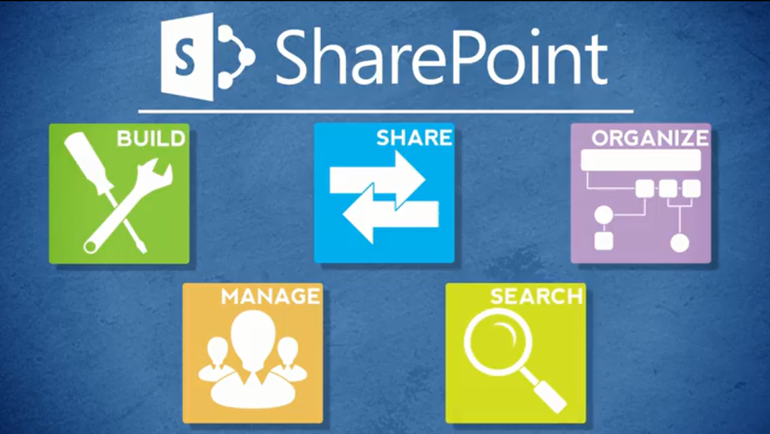
Agenda
Overview
Review
Roles
Lists
Libraries
Columns
Views
Pages
Web Parts
Navigation
Office
Wrap-Up

Slide 2
Wrap-Up of Goals
You are comfortable with the Designer tasks covered in this class
You understand the division of labor between a SharePoint Designer and the Web Services team
You know where to find resources

Slide 3
Resources for Designers
SharePoint Help site
SharePoint Work Zone for Designers
Writing for the web
Contributor, Business Owner, Data Steward, Web Services
Tab Owners (for Inside)
Home – Amanda Perry
Employee – Daphne Wright
Transportation Services – Robbie McKeithan
DMV – Jerry Higgins
Business & Administration – Ehren Meister

Slide 4
Resources: SharePoint Work Zone for Designers
It is part of the training environment
It is an area where you can practice
It is open to NCDOT Designers
It can be seen by all NCDOT, but not by the public
Do NOT leave important information or work-in-progress in the work zone or training environment – it may be refreshed at any time!
Do NOT place confidential information in the work zone or the training environment!

Slide 5
Resources: Writing for the Web
Web users typically scan for information and only read 20-30% of content.
Be concise
Use the words your users use
Break your content into small chunks
Use white space to make a page easier to scan
Put the most important content at the top
Use pronouns (you, we) to create friendly content
Use active voice, short sentences and short paragraphs
Use numbered and bulleted lists
Use clear headlines and subheads
Use images, diagrams and multimedia
Source: usability.gov and plainlanguage.gov

Slide 6
Resources: Writing for the Web
How to Write for the Web
9 Simple Tips for Writing Persuasive Web Content
Web Writing Style Guide
Writing for the Web (Rutgers)
Writing for the Web (NYU)
Break Grammar Rules on Websites for Clarity
Really Break Grammar Rules on Websites: Part Two

Slide 7
Resources: Web Services
Open a Help Desk ticket for help with
Creation, configuration and management of sites and site collections
Permissions
Content types (both SharePoint and business)
Content organizer
Workflows
Search configuration
Troubleshooting

Slide 8
Other SharePoint Classes
If you take SharePoint training elsewhere, you may learn about features and capabilities you don’t see at NCDOT
NCDOT does not support or implement all SharePoint 2013 features

Slide 9
Features Not Supported by Web Services
Blogs
Metadata navigation
Dialogs
Audiences
Folders in lists
Personal web parts
Manage copies
Non-publishing pages
SharePoint and Visio, Access, or OneNote
Collaboration
Share
Follow
Tags & Notes

Slide 10
Features Not Implemented at NCDOT
Office Web Apps
Co-authoring
Sync
One Drive
Top navigation (editing)
Promoted links
Wiki
Site mailbox
Search center
PerformancePoint
Project
App Store
InfoPath
Social
About Me
Personal sites & pages
Organizational chart
Yammer
Microblogs
Tags & Notes
News feed

Slide 11
Course Evaluation
Go to BEACON (link in footer of Inside NCDOT)
Log in with your workstation credentials
Click the LMS & NCVIP tab and click Submit
If prompted, click Yes to allow
Go to My Training & Transcript
Locate this class
Click the button to the right that says Evaluation (You may have to hover over the button and select Evaluation from the drop-down)

Slide 12
Thank You!
Please…
Complete the course evaluation in the Learning Center to get credit for the class
Delete all files or folders you placed on the desktop
Log off the Learning Center, BEACON and your computer
Tidy up your work area

