Slide 1

NCDOT – Integrated Project Delivery
ACEC NCDOT Transportation Delivery Subcommittee
2.4.21

Slide 2

Outline
Integrated Project Delivery
What IPD is
What the IPD Team is Working on
Project Delivery Network
Project Management
Quality Management
Upcoming Training
Staying Connected

Slide 3

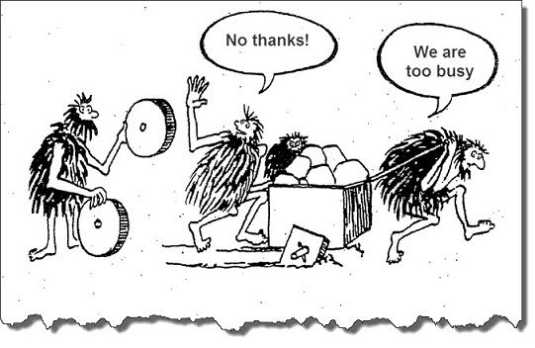
What is IPD?
Integrated Project Delivery
Streamlined, more efficient process
Notes:
NCDOT’s project delivery vision is to build a culture where we promise what we are going to do and deliver what we promise. To bring NCDOT’s project delivery vision to life, DOT began the Integrated Project Delivery effort . It consists of streamlining processes to be transparent, repeatable and accountable to enable teams to consistently deliver projects effectively and efficiently.

Slide 4

Team-based culture
Integrated Project Delivery
Integrated
Share Ideas
Innovation
Common Goal
High Engagement
Together We Achieve More
Notes:
Don’t wait to be instructed

Slide 5
What are IPD Teams Working On?
Integrated Project Delivery
Detailed PDN Training
Standard Scopes of Work
Data Governance
Alt. Delivery PDN
MS Project Schedule Training
CDE Flowchart
Project Mgmt. Guide
Errors & Omissions Guide
PDN – versions 1.1 and 2.0
Quality Mgmt. Guide
Financial Guidance Doc.
Change Mgmt. Process
Kitchen Sink/PDN Scope Assistance
Risk Mgmt. Guide
Division LET Guidance
Roadway Design Manual
Utilities Process Improvement
ROW Process Improvement
Merger Process Refinements
Cost Estimating Process
Notes:
Blue – IPD team leading and currently working on
Orange – upcoming IPD tasks
Maroon – IPD not leading but coordinating with
We are in the process of developing a chart that shows all the products IPD is working on and the associated DOT and Consultant contact for each
Detailed PDN Training – 2 elearning modules (How to Navigate the PDN & Differences b/w the existing delivery process and the PDN & the transition process) Module 1 → expected to be out by early Feb. Module 2 → end of Feb.
MS Project Schedule Training – How to use the schedule everyday to effectively manage projects 1 training with 2 tracks – Create/Develop & Analyze/Manage. E-learning → expected available by end of Feb.
PDN Versions 1.1 & 2.0 – Version 1.1 → Main update will be congestion mgmt. activities with some possible line movements at the end of Stage 1. anticipated roll out March/April.
Version 2.0 → Updating entire PDN, anticipated roll out in June.
Kitchen Sink/PDN Scope Assistance - Provide guidance that bridges the gap between the roles in the PDN process that do not exist in the kitchen sink. Anticipated available at end Feb.
Merger Process Refinements – wrapping this out, will roll out this Spring. Beginning to develop training for this and have meeting with FHWA and DOT to finalize.
Standards Scopes of Work - Decreased Ambiguity, Increased Productivity, Consistency in roles, and expectations across Divisions, Central Office, Consultant Firms to successfully deliver what was expected. Have just finished collecting existing scopes of work and will begin developing a standardized format and diving into what currently exists. Desire is to align them with the PDN and make them easy to customize to projects. Anticipated to be completed by the end of March/Early April.
CDE Role & Responsibility Doc/Flowchart – Clarify the role and responsibility of the CDE (or designee) throughout stage 1 & how coordination from Stage 1 and 2 occur. Anticipate roll out end of March
Quality Mgmt. Guide - Minimize long review periods & streamline the process while delivering high quality projects. Eliminate the many hard-core gates/formal review processes & have DOT focus on higher-level transportation needs. Anticipated roll out is end of Feb.
Rick Mgmt. Guide - Early identification and continuous management of risks reduces negative impacts, promotes timely decision making, and improves our success in meeting project objectives and delivering what we promised. Anticipated roll out is end of Feb.
Division LET Guidance – wrapping up the updates to this document. PM’s will be reviewing this at the end of January and then it is anticipated to be roll out in February
Financial Guidance Doc. - Aggregate all the financial guidance that is currently dispersed in various areas throughout the Department. Guidance is for Internal Project Managers and consists of various topics ranging from establishing PE funding to looking at scopes of work, monthly projections. This will be a reference document to the PM Guide. Anticipate available early March.
*Project Mgmt Guide - To gain consistency in the role and responsibility Project Managers have in delivering projects. This will help them successfully lead teams to deliver quality projects on time and on budget. (Conducting an orchestra). This will be a companion document to the PDN – it will look similar but be for PM’s. Roll out is anticipated for June.
Data Governance: Develop a one stop shop/ landing page for manuals & policies, Documents organized and easy to find, Less time spent looking for most recent update, Reduce potential of folks mistakenly using old standard, Manuals, Policies
Easy to find, organized. Roll out next year.
Utilities Process Improvement - Address challenges and issues related to utilities and how they relate to design process, align with PDN. Roll out next year.
ROW Process Improvement - Address challenges and issues related the ROW process, identify opportunities to streamline, align with PDN. Roll out next year.

Slide 6
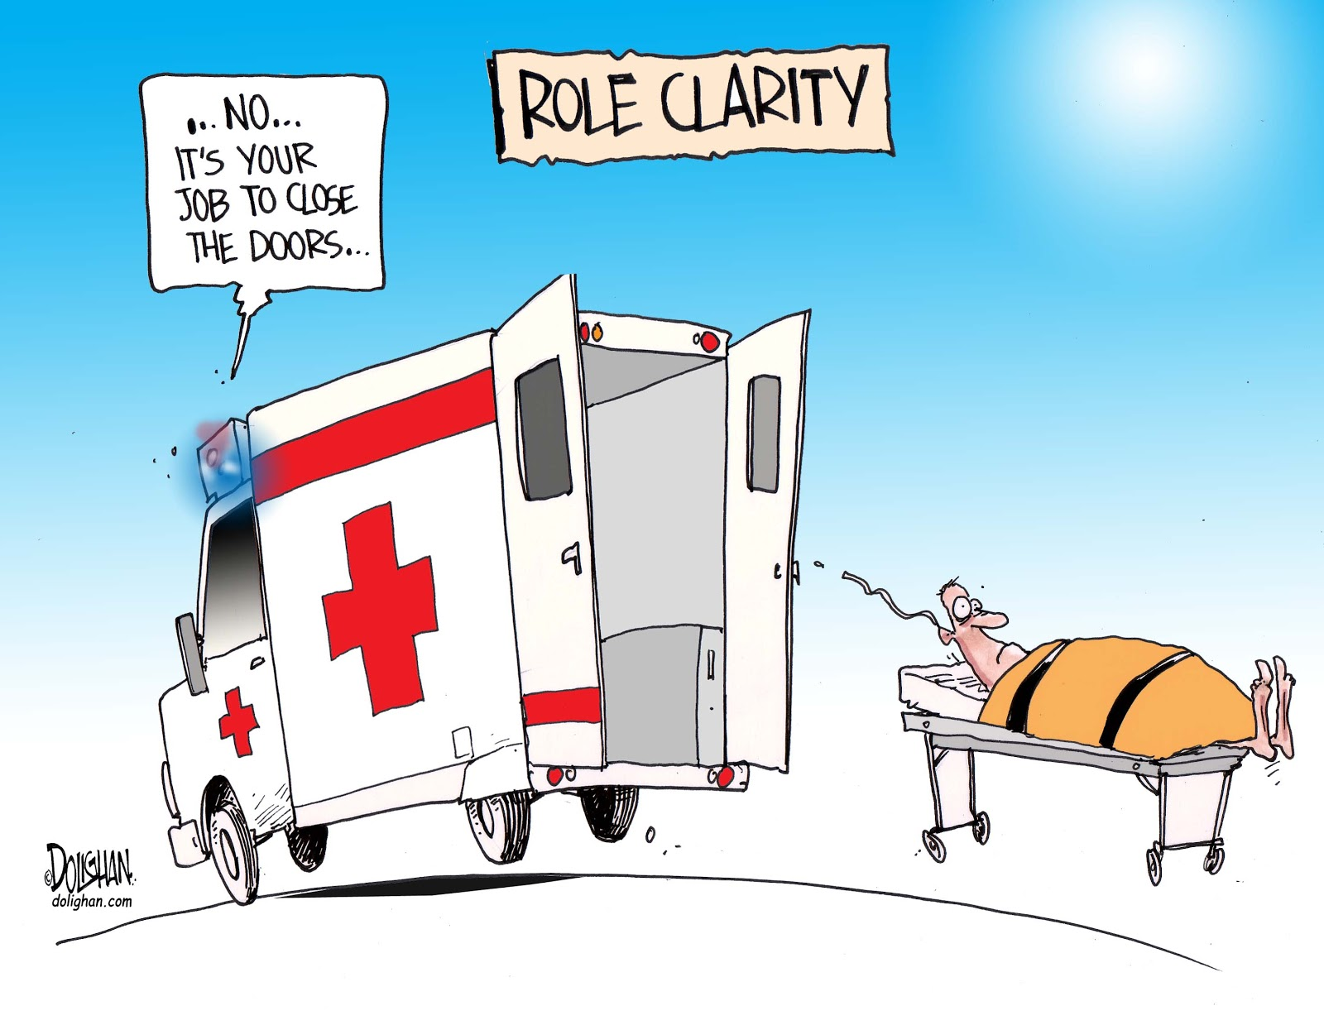
The Project Delivery Network (PDN)
Integrated Project Delivery
Well-defined,
transparent process
Streamlined Activities
Has clearly defined:
Milestones
Deliverables
Roles
Notes:
The PDN is a process document designed to provide individuals with a well-defined, transparent process that clearly delineates milestones, deliverables, and roles. It defines key project deliverables and major activities to build a schedule in MS Project for Project Managers and the project team to track progress and proactively address obstacles.
It was developed to alleviate the pain points and handoff loops in the existing project delivery process. It also streamlines and integrates some disciplines earlier, like pavement design, to help streamline the project delivery process and promote a more efficient workflow.

Slide 7
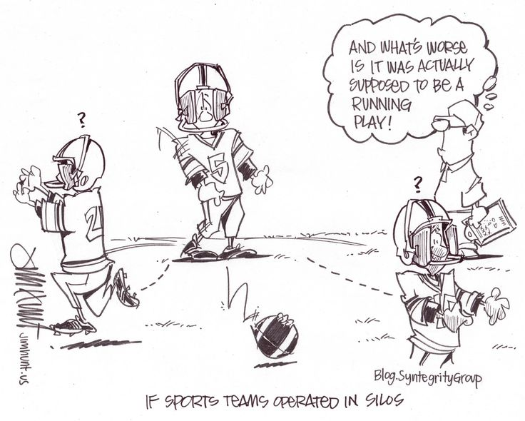
The Project Delivery Network (PDN)
Integrated Project Delivery
Benefits:
Encourages team collaboration
Eliminate silos
Team Members → on same page
Efficient delivery of projects & meet stakeholder's expectations
Notes:
The PDN highlights opportunities to be more collaborative and eliminate silos, enabling us to consistently and reliably deliver on our promises to our public stakeholders. It also helps you to engage the team at the right time to work as one to efficiently deliver quality projects that meet our stakeholders’ expectations, all while staying on time and on budget

Slide 8
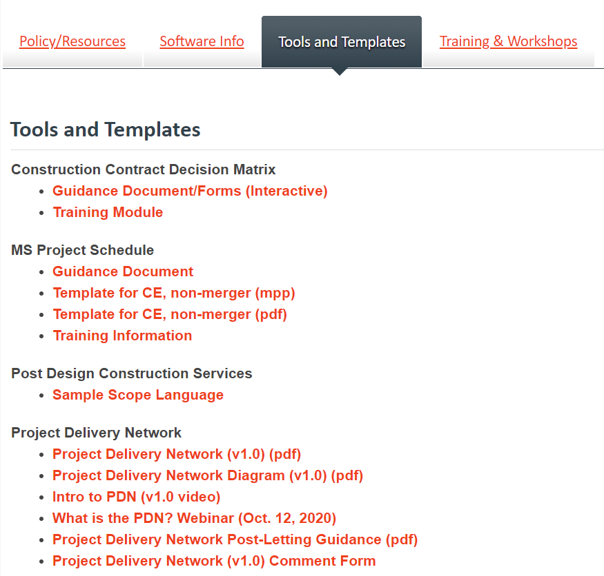
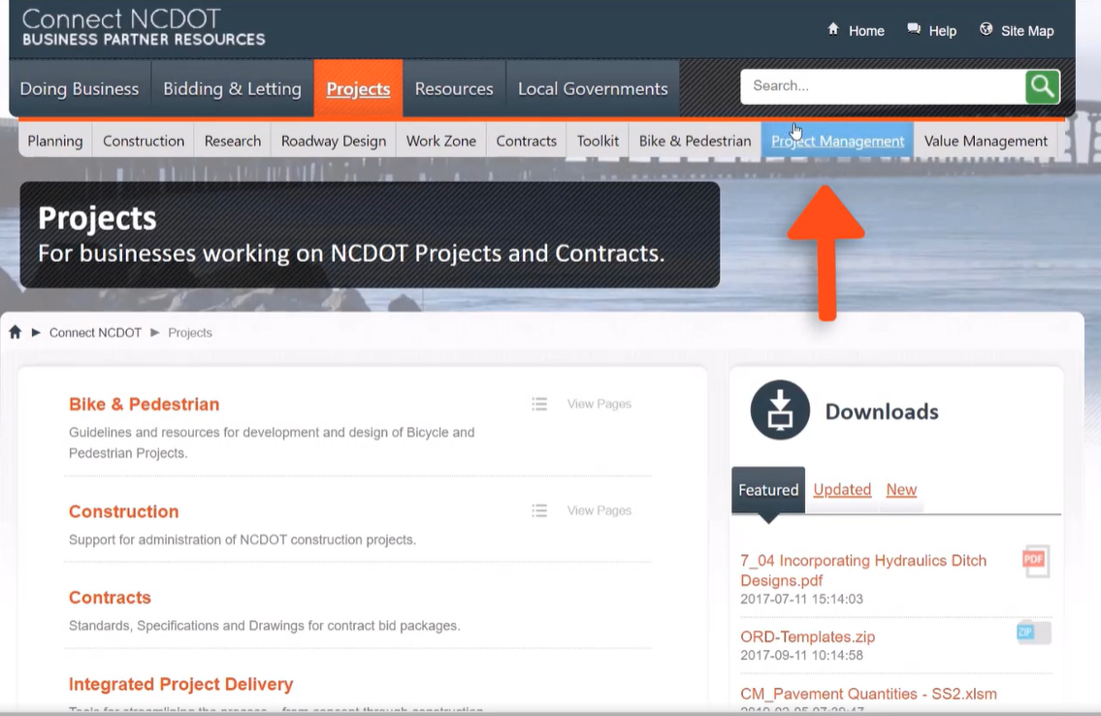
Where is the PDN?
Integrated Project Delivery
Notes:
Project Management Site, scroll down, click on “tools and Templates”, scroll down to Project Delivery Network.

Slide 9
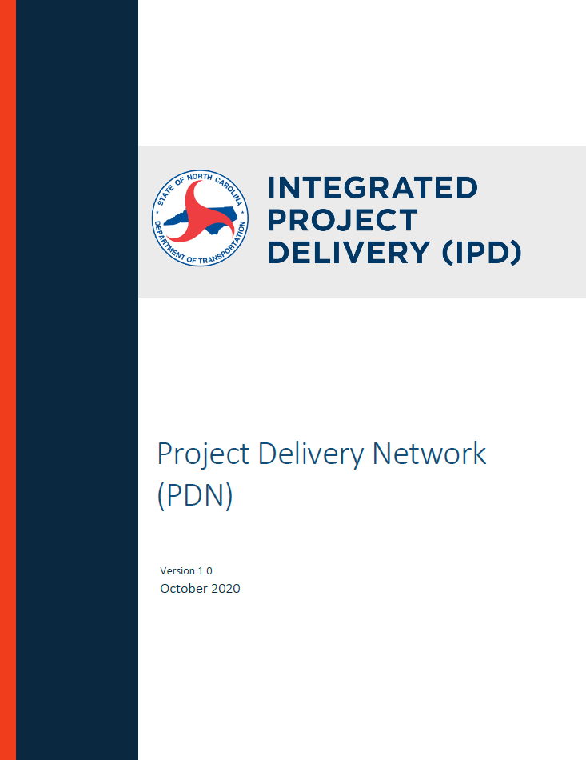
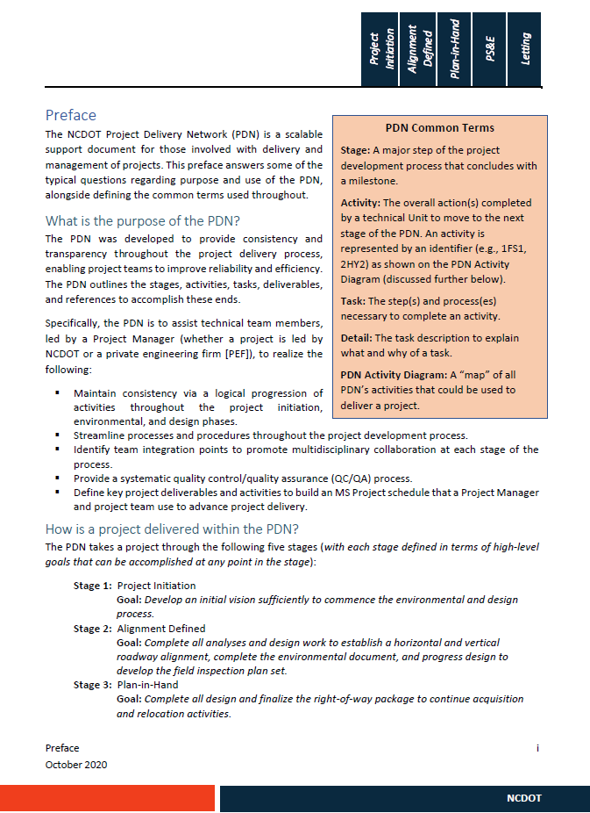
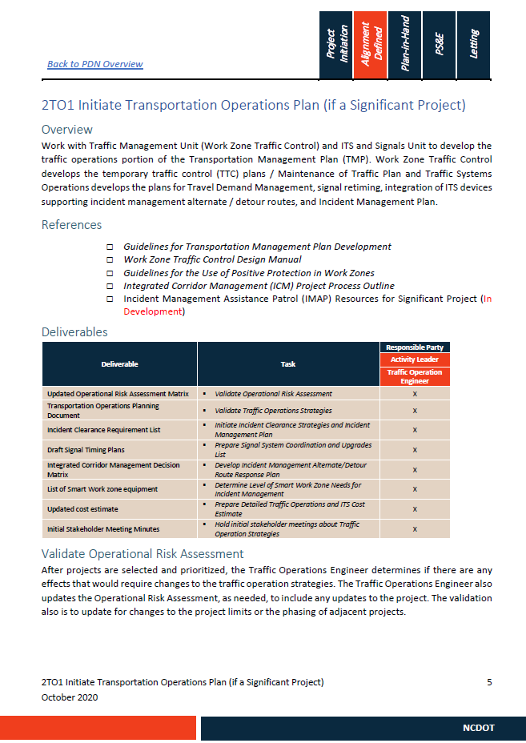
Project Delivery Network
Integrated Project Delivery
Notes:
The PDN is a large process document (over 200 pages) but is broken down into stages, activities, tasks, deliverables and roles within each discipline. There is a 4-page intro/preface describing how the PDN is set up.
Like a choose your own adventure books – where you only read the pages in the story that are in the path that you choose to take. You don’t read all the pages from front to back.

Slide 10
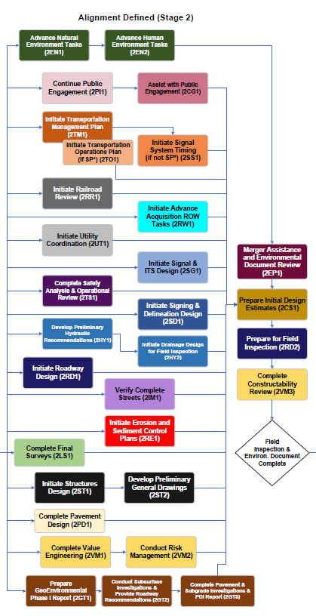
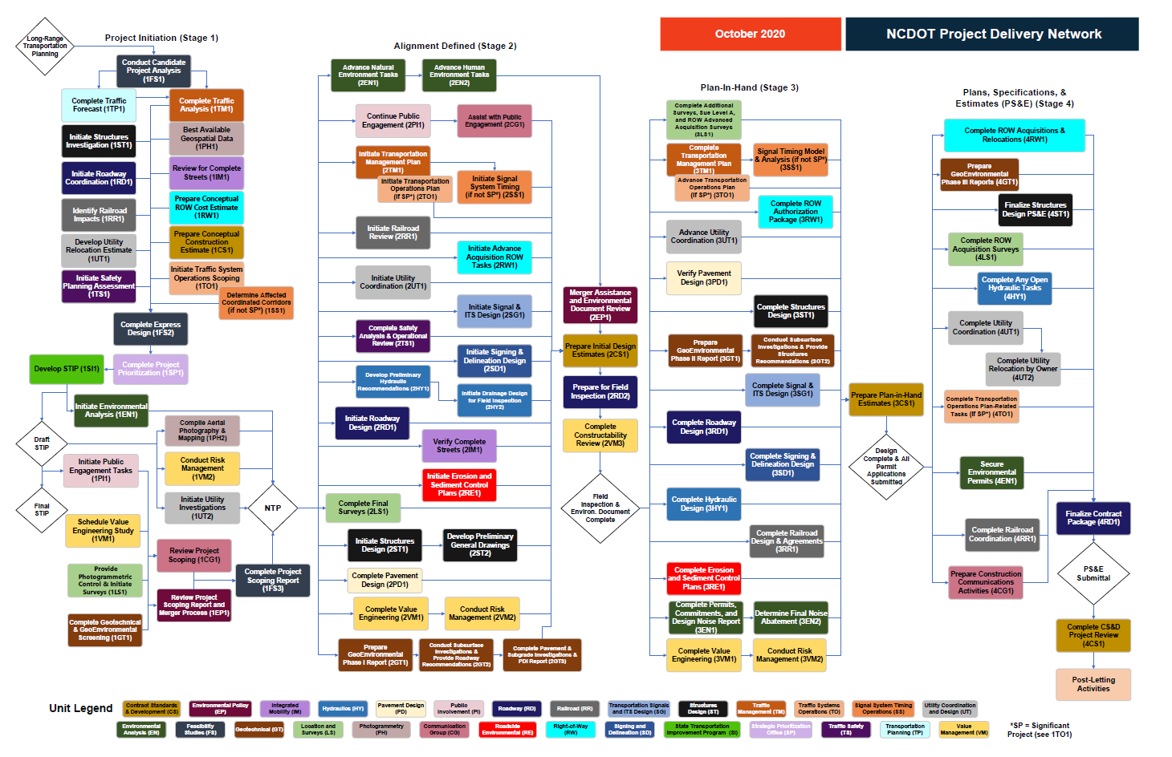
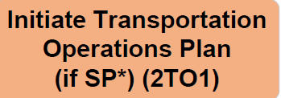
Integrated Project Delivery
Notes:
The Network Activity Diagram provides a summary of all major activities and milestones you may need to complete during each stage to efficiently deliver your project. This diagram serves as a roadmap for delivering projects and can be customized to meet the requirements and complexity of each unique project. The activities are not laid out chronologically but are grouped by discipline. As such, the network requires collaboration, led by the Project Manager, to determine what activities apply and to define the logical relationships and order of activities for a specific project.
The first stage, Project Initiation, is listed on the left, followed by Stages 2, 3, and 4 as you move further to the right. Each stage is defined in terms of the high-level goal it achieves upon completion and consists of multiple activities that are organized and identified by Discipline. The boxes in the network diagram represent an activity that needs to be completed prior to the end of the stage. An activity is the overall action that needs to be completed for a technical unit to move on to the next stage of the PDN. Each activity is color coded based on the discipline responsible for leading the activity. The PDN is customizable to allow teams to identify and select the necessary activities to drive a project forward.
WHY NOT USING 30, 60 AND 90 ANYMORE: There was continued confusion with the headings of 30%/60%/90% in the PDN The intent of the percentages was to represent a phase rather than a time. It has been suggested that we no longer list the percentages and just keep the headings of Alignment Defined, Plan in Hand (PIH), and Plans, Specifications & Estimate(PS&E) with the PDN.
The PDN is an interactive tool, clicking on any activity box takes you directly to that activity’s documentation.

Slide 11
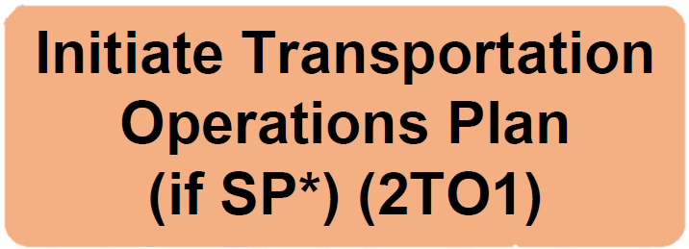
Integrated Project Delivery
STAGE
DISCIPLINE
ORDER
Notes:
In addition to the color coding, you can use the activity identifiers to learn more about who is responsible for leading the activity, which stage it happens in, and which activity it is within the stage and discipline track. These Activity Identifier can also be used for tracking purposes in MS Project.
For 2TO1 This means Stage 2 – Alignment Defined
Traffic Operations is the discipline, and this is the 1st activity for Traffic Ops in Stage 2.

Slide 12
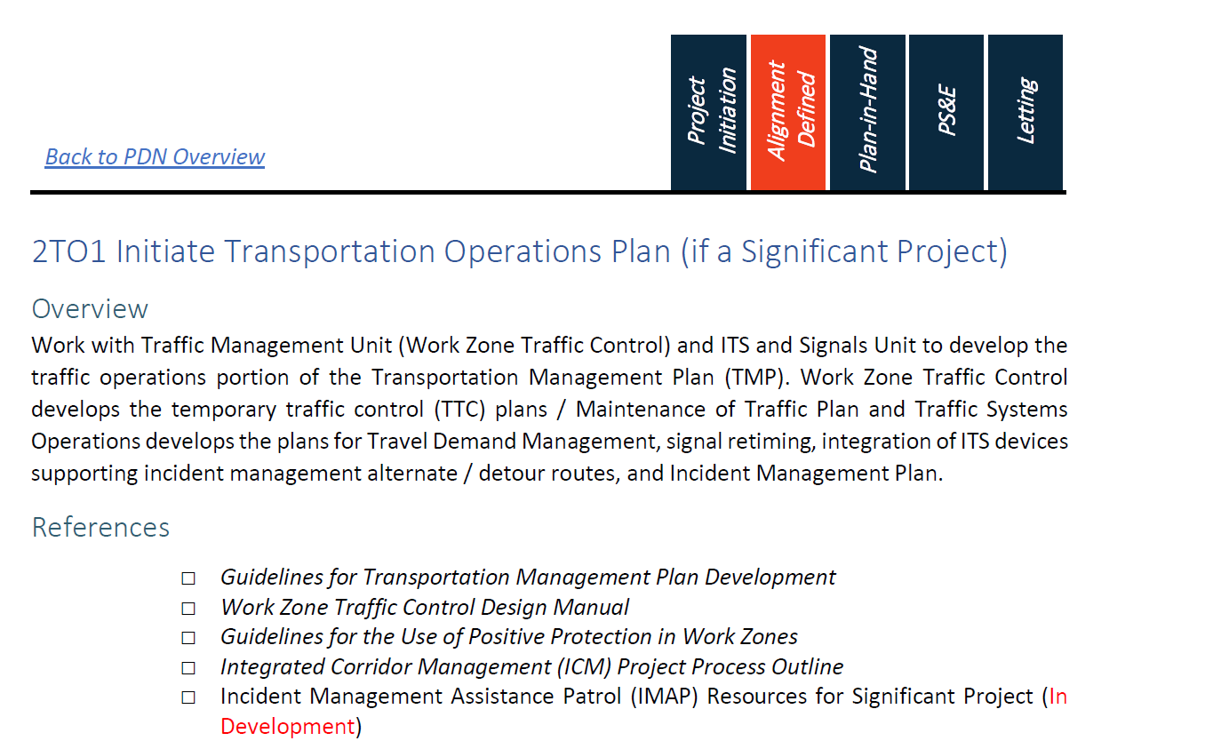
Integrated Project Delivery
Notes:
To return to the network diagram, there is a “back to the PDN overview” header at the top of any section that takes the user back to the diagram
Following the identifier and activity name, there is an Overview describing the overall objective of the activity and why it needs to be completed
Below that is a list of associated References that the user could refer while completing any of the tasks and deliverables that are part of this activity.

Slide 13
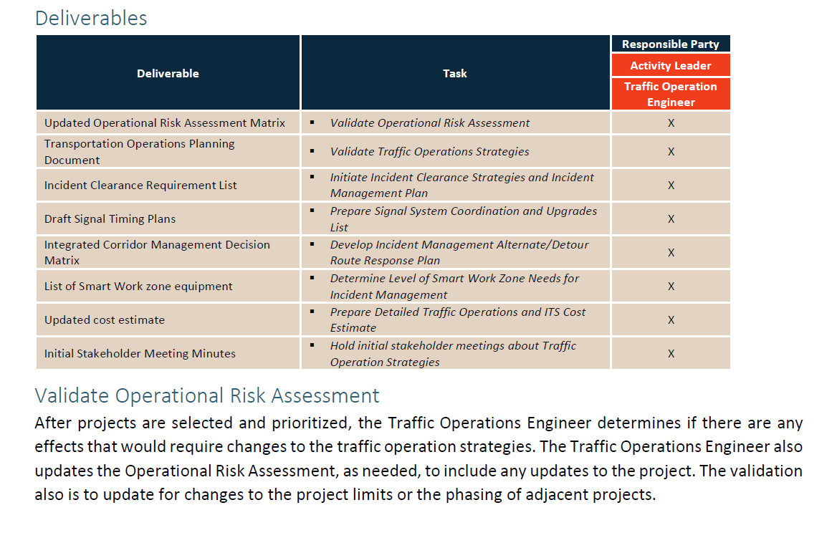
Integrated Project Delivery
Notes:
Below the References is a table of Deliverables, and a series of tasks or steps to complete each activity.
The Deliverables Table identifies all the deliverables, associated task(s), and the responsible party(ies) for each task(s) that may be needed to complete this activity. The listed order of deliverables and tasks is not necessarily the chronological order for completion.
The Activity Leader is the member of the project team responsible for ensuring that the task is completed successfully, and the Additional Support is anyone other than the Activity Leader who has a responsibility for the task. The table is not intended to list all team members involved, and the Activity Leader may delegate the completion of specific tasks to other team members.
Below this table are the each of the tasks described in more detail.

Slide 14
PDN
Transition
Integrated Project Delivery
Current Stage
PDN Stage
Have not reached notice to proceed
Stage 1, Project Initiation
NTP
Enviro. Doc not Complete
Stage 2, Alignment Defined
Environmental Doc. Complete
Right-of-Way Plans not Complete
Stage 3, Plan-in-Hand
ROW Plans Complete
Continue to follow existing process with current scope & schedule
Notes:
What should folks do if they don't have any projects using IPD yet?

Slide 15
PDN – Next Steps
Integrated Project Delivery
March / April
Roll out Version 1.1 – update to Congestion Mgmt. (TM)
Early Feb.
Re-Engage Disciplines
End of March
June
Roll out Version 2.0
Disciplines submit updates
Notes:
What to expect – coming up

Slide 16
Integrated Organization
Integrated Project Delivery
Discipline Managers
Discipline
Roadway
Survey
Environ.
ROW
Utilities
Structures
Project 1
Downward –
Discipline Technical Direction
Project 1
Project Manager(s)
Project 2
Horizontal -
Project Direction and Integration
Project 3
Notes:
Establishing the Project Manager Role and transitioning to a Matrix Organization with the technical units will result with increased communication and collaboration with team members and internal and external stakeholders throughout the life of the project.
1) It is critical that the project discipline team members communicate with each other in the development of the designs and plan set/documents
The PM is responsible for communications out to stakeholders and within the department outside of the team to anticipate and reduce impacts to the overall project. And to ensure that quality checks are occurring, and that the direction of the overall project is delivered as committed to.

Slide 17
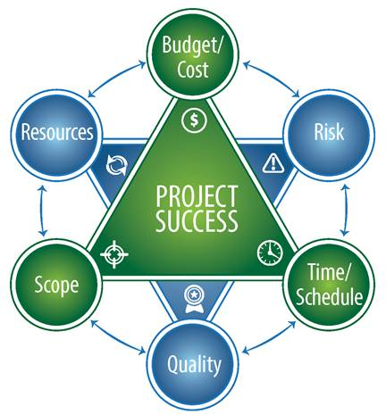
Project Manager Roles and Responsibilities
Integrated Project Delivery
NCDOT Project Manager Roles and Responsibilities
  Project Champion
  Project Accountability
  Project Performance
  Project Leadership
Notes:
Defined PM roles and responsibilities: Centered around Scope, Schedule, Budget, Quality, Risk
project champion, provide vision, leadership,
Defined team member responsibilities
PM instills team accountability, (Project Definition Document – project team contract)

Slide 18
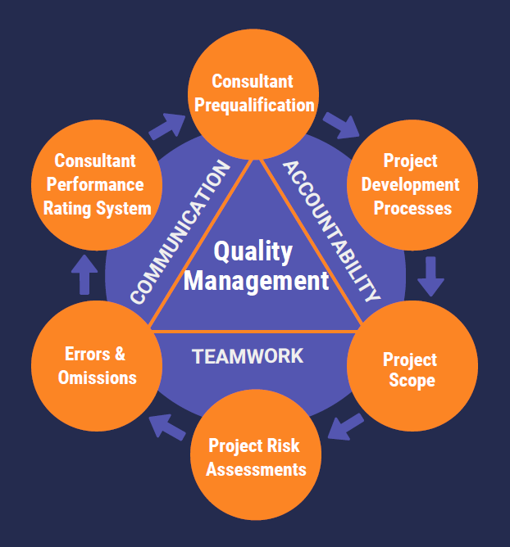
Quality Management
Integrated Project Delivery

Slide 19
Quality Management
Integrated Project Delivery
Quality Assurance
QA make sure QC items taken care of
Quality Control
Process of identifying and correcting deficiencies and errors in calculations, plansets, reports, etc…
Ensures the correct policies, standards are used, and high-risk items are addressed
Notes:
Purpose of Quality Mgmt. Minimize long review periods & streamline the process while delivering high quality projects. Eliminate the many hard-core gates/formal review processes & have DOT focus on higher-level transportation needs.
Quality control (QC) – consultants / professional engineering firms or DOT (for internal projects)
QA - DOT

Slide 20
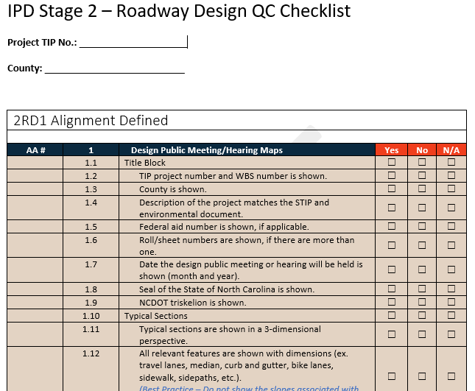
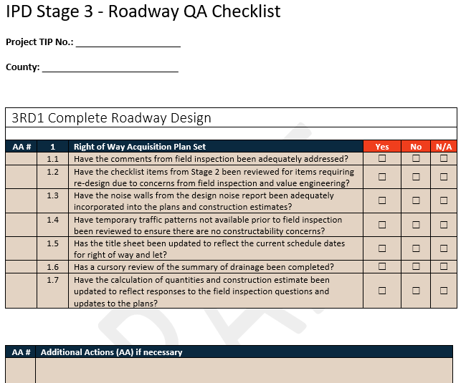
Quality Control & Assurance Checklists
Integrated Project Delivery
Notes:
Purpose of Quality Mgmt. Minimize long review periods & streamline the process while delivering high quality projects. Eliminate the many hard-core gates/formal review processes & have DOT focus on higher-level transportation needs.

Slide 21

Integrated Project Delivery
Upcoming Training
  More detailed PDN Training
      How to Navigate the PDN
      Differences between existing process and the PDN & how to transition projects
  Microsoft Project Schedule
  Project Management
  Quality Management
  Risk Management
Notes:
How to Navigate the PDN – available at the end of the month.
Differences between existing process and the PDN – FEB.
PDN training is available to everyone to take – geared towards everyone who will use the PDN
MS Project – available end of Feb. – available to everyone – geared to technical leads and Project Managers both internal and external
Project Management – for project managers – still determining if this will be internal only or both internal and external
Quality Mgmt. – All involved in delivering projects. Will likely be for internal and external folks. Format is still being discussed.
Risk Mgmt. – Everyone involved in delivering projects. Format and internal/external audience are still being discussed.

Slide 22
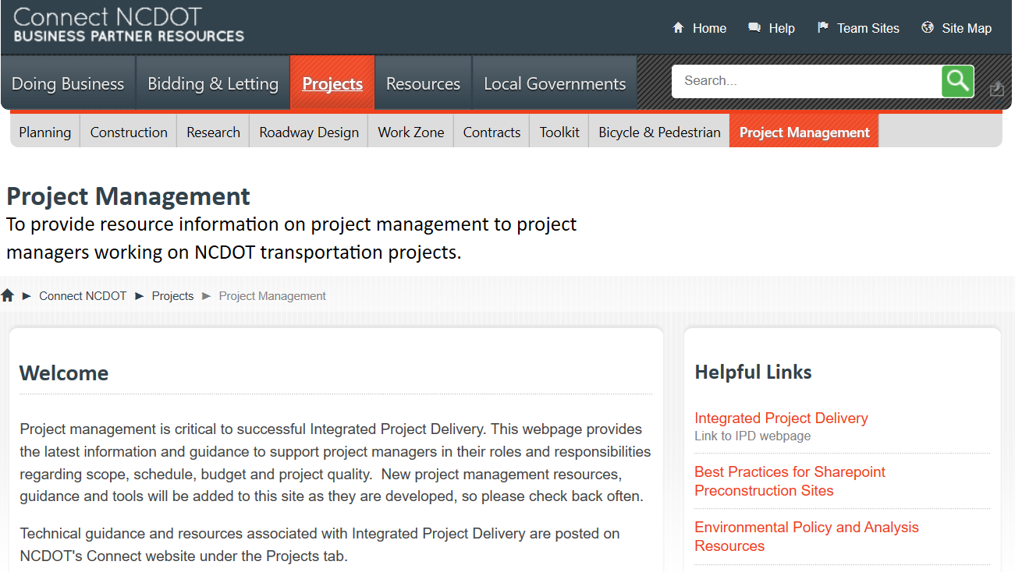

Integrated Project Delivery
Resources
Project Management Connect Site
Notes:
Project Management Site – contains tools and resources for Project Managers to use and will be updated regularly with guidance, training opportunities, etc. so make sure you check back often!
There is a contact us if you have ideas and there is also a link to IPD webpage

Slide 23

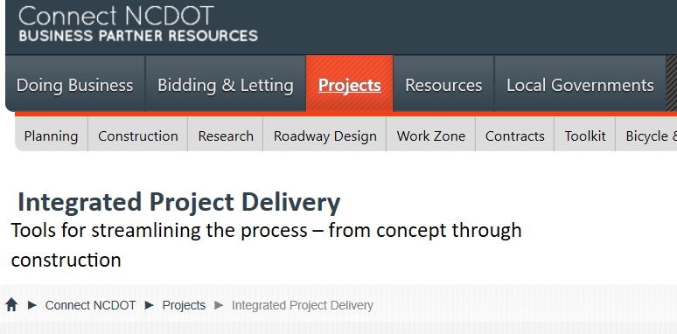
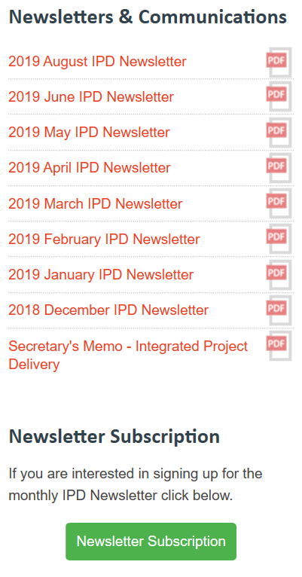
Integrated Project Delivery
Stay Connected
Subscribe to the IPD Newsletter!
Go to IPD Connect Site…
Notes:
The IPD Connect Site contains all the latest information about IPD, including contact information, upcoming training opportunities, highlights from workshops and the Newsletters.
Be sure to subscribe to the IPD newsletter to receive updates on new tools, resources, and training opportunities available.
This is available on the IPD Connect site, on the right-hand side under “Newsletters Subscription”

Slide 24
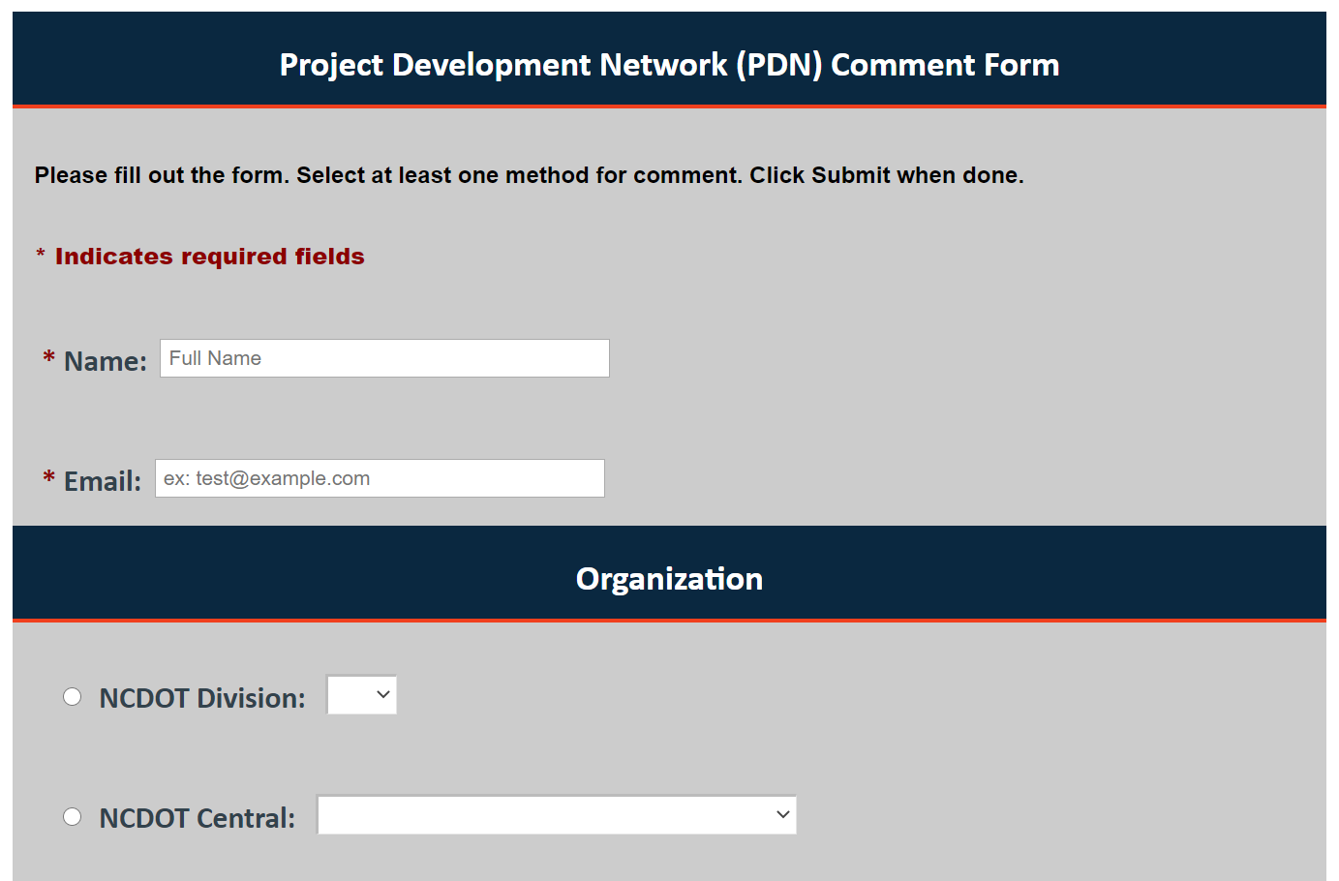
Comments Form
Integrated Project Delivery
Located on the IPD site
Notes:
Show how this works!

Slide 25

Integrated Project Delivery
Questions or Feedback?
Paul Steinman
psteinman@HNTB.com
Katrina Feltes
kfeltes@hntb.com

