Slide 1







































NCDOT Project Manager Training
Copy/paste any of the icons below into your presentation. Please change color to white if using them on a dark background.
Jennifer Evans, PE
September 13, 2023

Slide 2
Other slide variations are available. Select Insert above and choose “new slide” to see all the options.
Progress To Date
Late 2022 - Regular Executive Leadership Team meetings started
  Worked to identify goals and core curriculum for the training
February 2023 - Leadership Team started conversations with Knowesis
May 2023 – Presented PM Training vision at Preconstruction Workshop
June 2023 – NCDOT under contract with Three Oaks/Knowesis Team

Slide 3
Other slide variations are available. Select Insert above and choose “new slide” to see all the options.
Vision for NCDOT PM Training
Grow Project Managers through Technical and Soft Skill Training
  Empower PMs to Build and Lead Productive Teams
  Develop Confidence and Critical Thinking Skills
  Introduce Conflict Resolution and Negotiation Techniques
Focus on Current NCDOT Project Managers with Potential Evolution to Others
Leverage a Combination of On-Line and In-Person Training Methods to be Effective and Efficient
Utilize Cohorts of 20-25 PMs for Three 2-Day Workshops to develop relationships and peer exchange opportunities

Slide 4
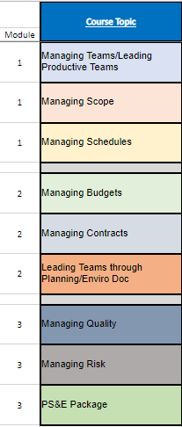
Other slide variations are available. Select Insert above and choose “new slide” to see all the options.

Slide 5
Other slide variations are available. Select Insert above and choose “new slide” to see all the options.
Current Events
Since July 2023
  Assembled NCDOT and PEF Expert Teams
  Developed Program Schedule
  Focused on Developing Materials for First Cohort
    Draft Agenda
    Draft Course Content Summary/Lesson Plans
  Kicked off Subject Matter Expert Focus Groups
  Performed 30 Minute Interviews with selected PMs
  Sent out Needs Assessment to all NCDOT PMs
  Sent out request to Divisions and Units to capture accurate PM training attendee list
  Identified Pilot cohort attendees

Slide 6
Other slide variations are available. Select Insert above and choose “new slide” to see all the options.
What’s to come:
More communications and meeting invites from the Knowesis team
Training opportunities to start before the end of the year
Manage your schedule so that you can come to training focused with an open attitude, be willing to share ideas, listen and learn!

Slide 7
Other slide variations are available. Select Insert above and choose “new slide” to see all the options.
A special thanks go to the following people that are working together to make this happen:
Katrina Feltes, PE, Wendee Smith, PE, Terry Canales, PE Derrick Weaver, PE, Glenda Gibson, PE, Matt Clarke, PE
The NCDOT PM Leadership Committee
NCDOT PM SMEs and the Three Oaks/Knowesis Team

