Slide 1
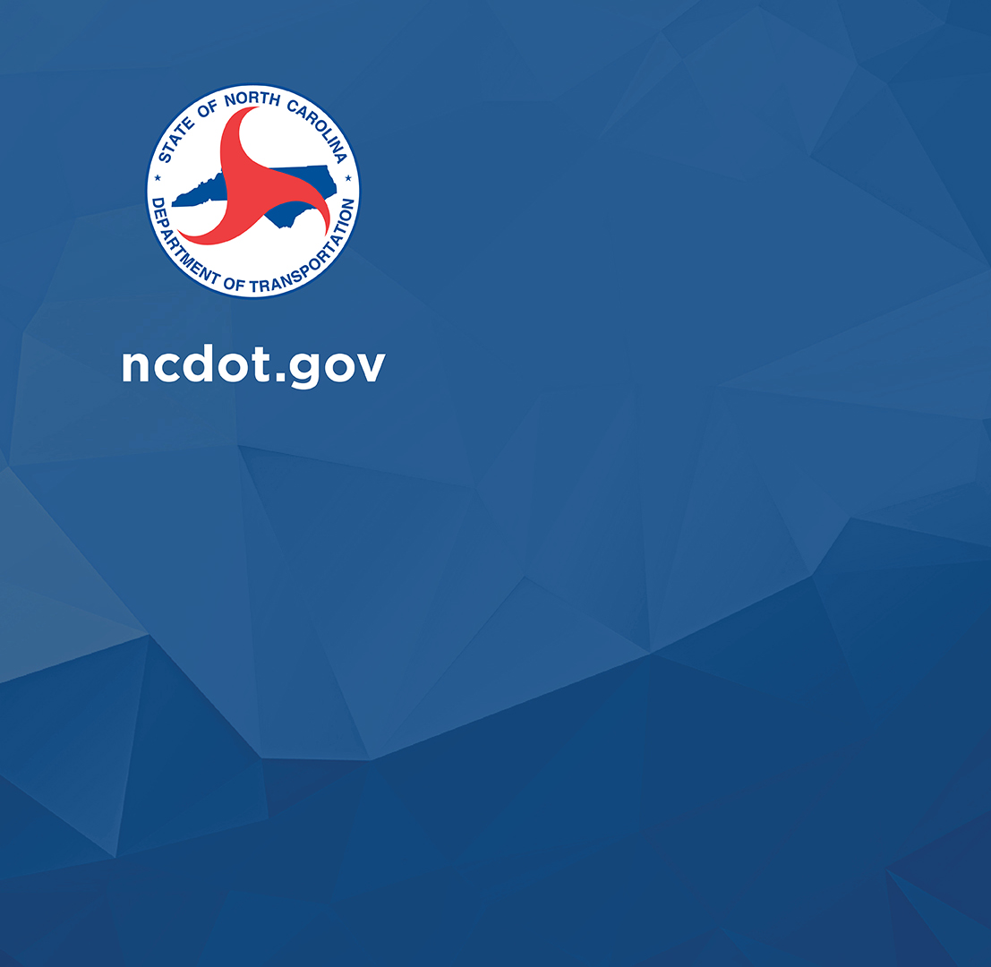
FERC Conveyance Permitting

Slide 2
What is FERC?
The Federal Energy Regulatory Commission is an independent agency that regulates the transmission and wholesale sale of electricity and natural gas in interstate commerce and regulates the transportation of oil by pipeline in interstate commerce.
FERC also authorizes interstate natural gas pipelines, natural gas storage projects, liquefied natural gas terminals, and non-federal hydropower projects.
FERC does NOT regulate Federal hydropower facilities (e.g., those owned and operated by the Tennessee Valley Authority, the United States Army Corps of Engineers, the Bureau of Land Management, or other federal agencies)

Slide 3
How does FERC regulate these facilities?
A FERC license is required to construct, operate, and maintain a non-federal hydroelectric project.
A Hydropower Project Owner is an entity that holds a FERC license for one or more hydropower facilities.
A project boundary is an administrative marker that encloses the lands that are necessary for the operation and maintenance of a project and for other purposes (e.g., shoreline control, protection of environmental resources, recreation).

Slide 4
How do Project Owners regulate these facilities?
Project Owners are authorized by their FERC license to permit small-scale changes to their projects without prior FERC approval.
Some changes require FERC-issued amendments to the existing licenses or exemptions.
Both of these examples are referred to as a Conveyance Permit.
NCDOT never receives a permit from the FERC.

Slide 5
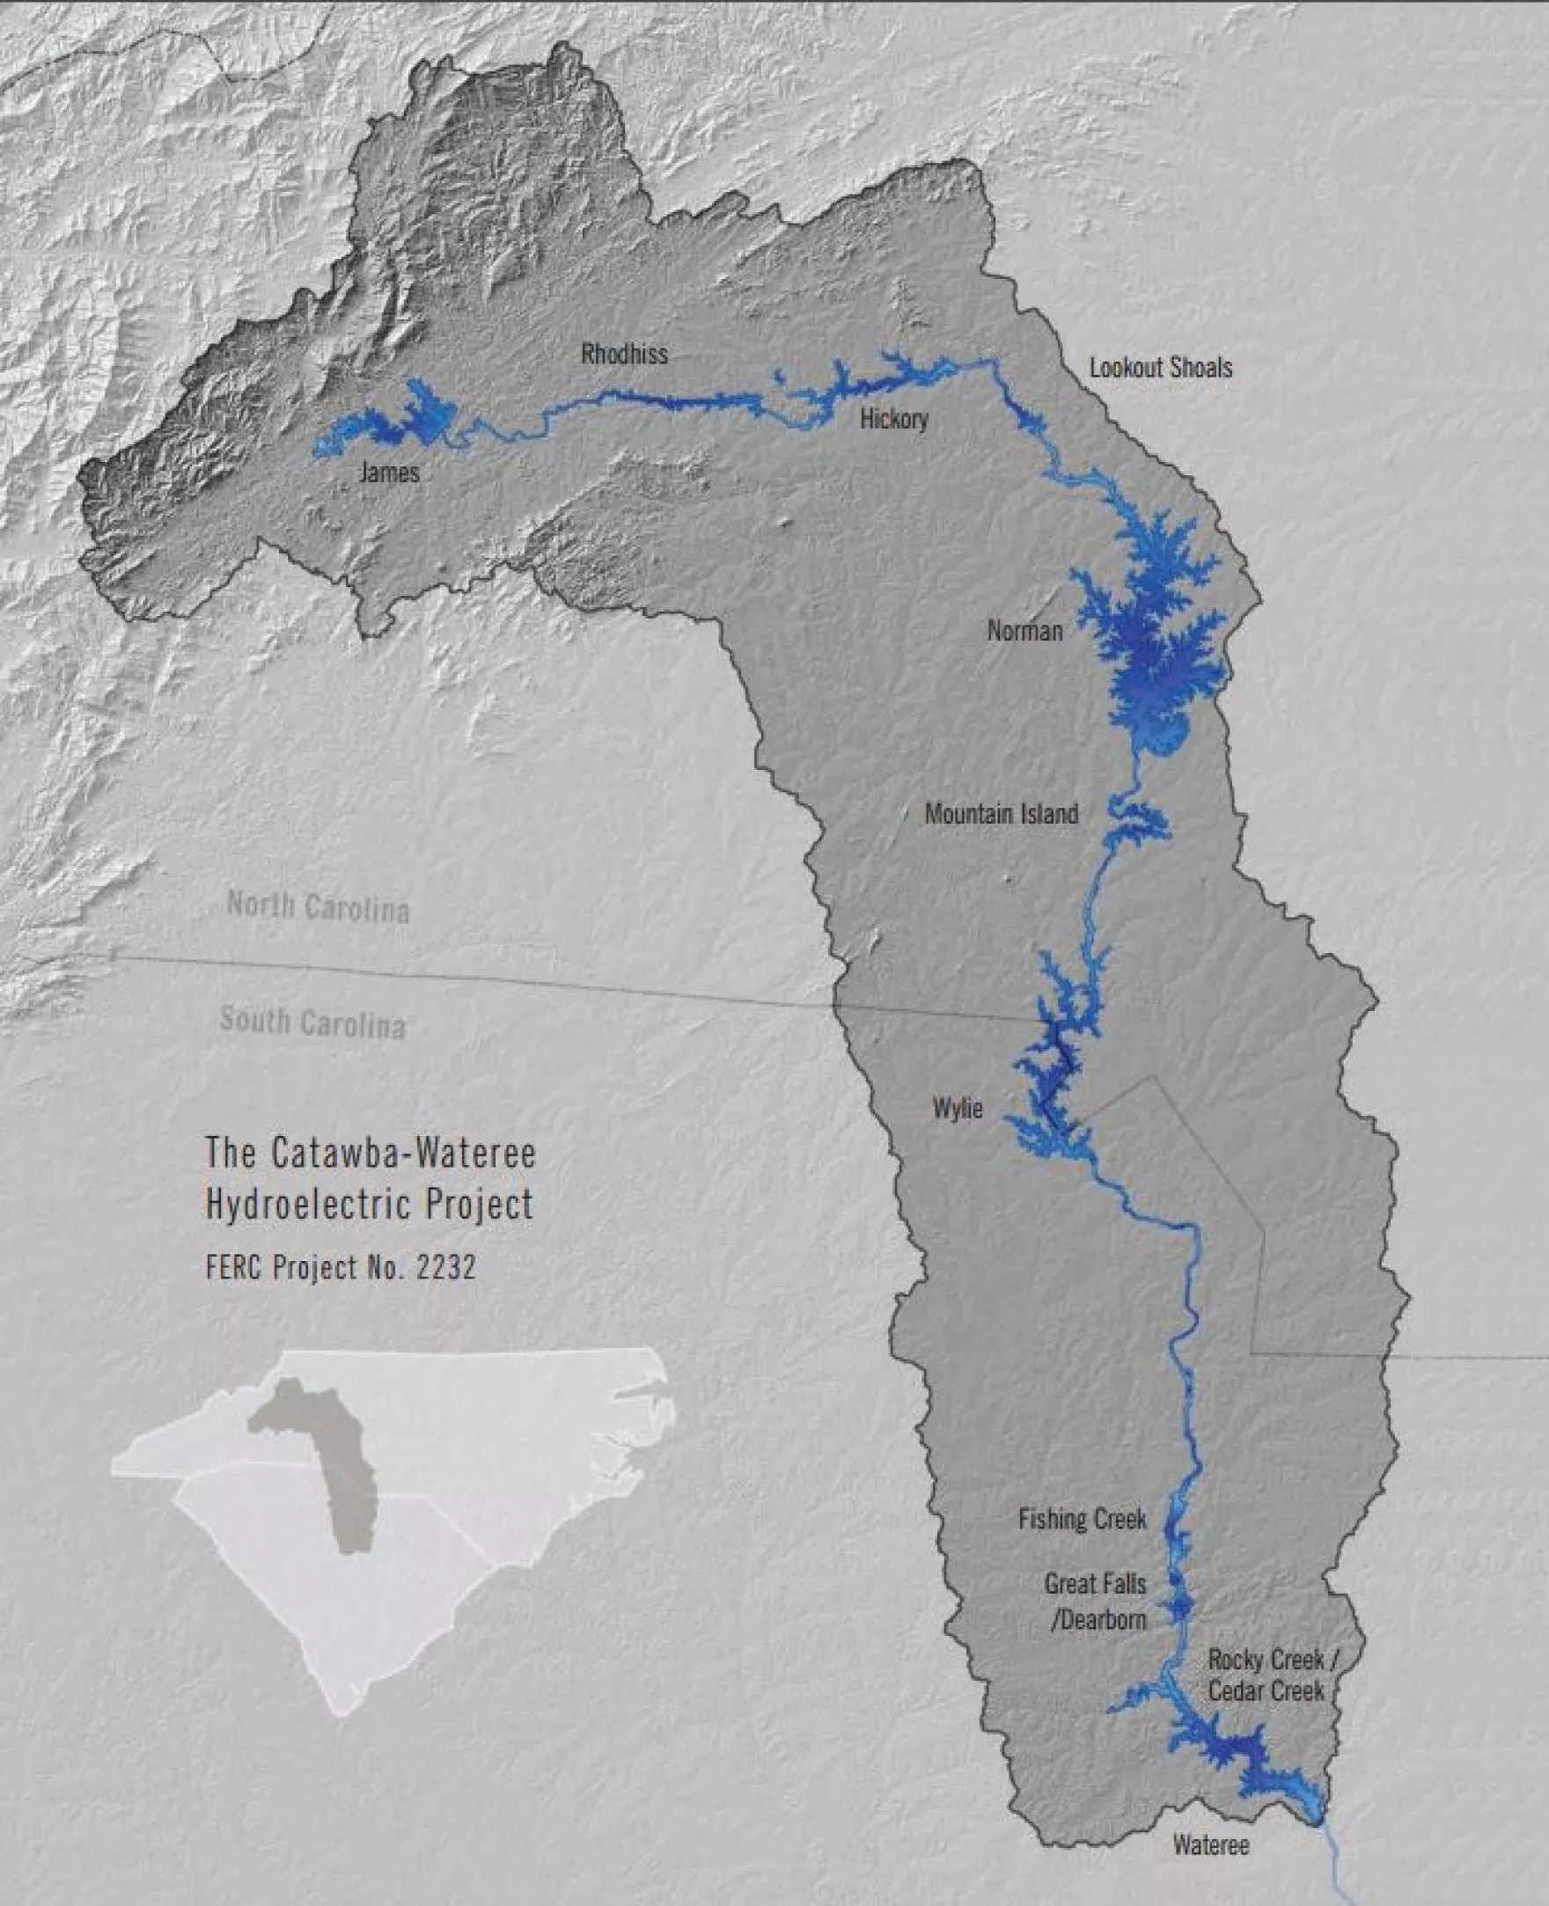
Example:
Duke Energy is Licensed by FERC to operate and maintain these hydroelectric facilities in the Catawba-Wateree Basin.

Slide 6
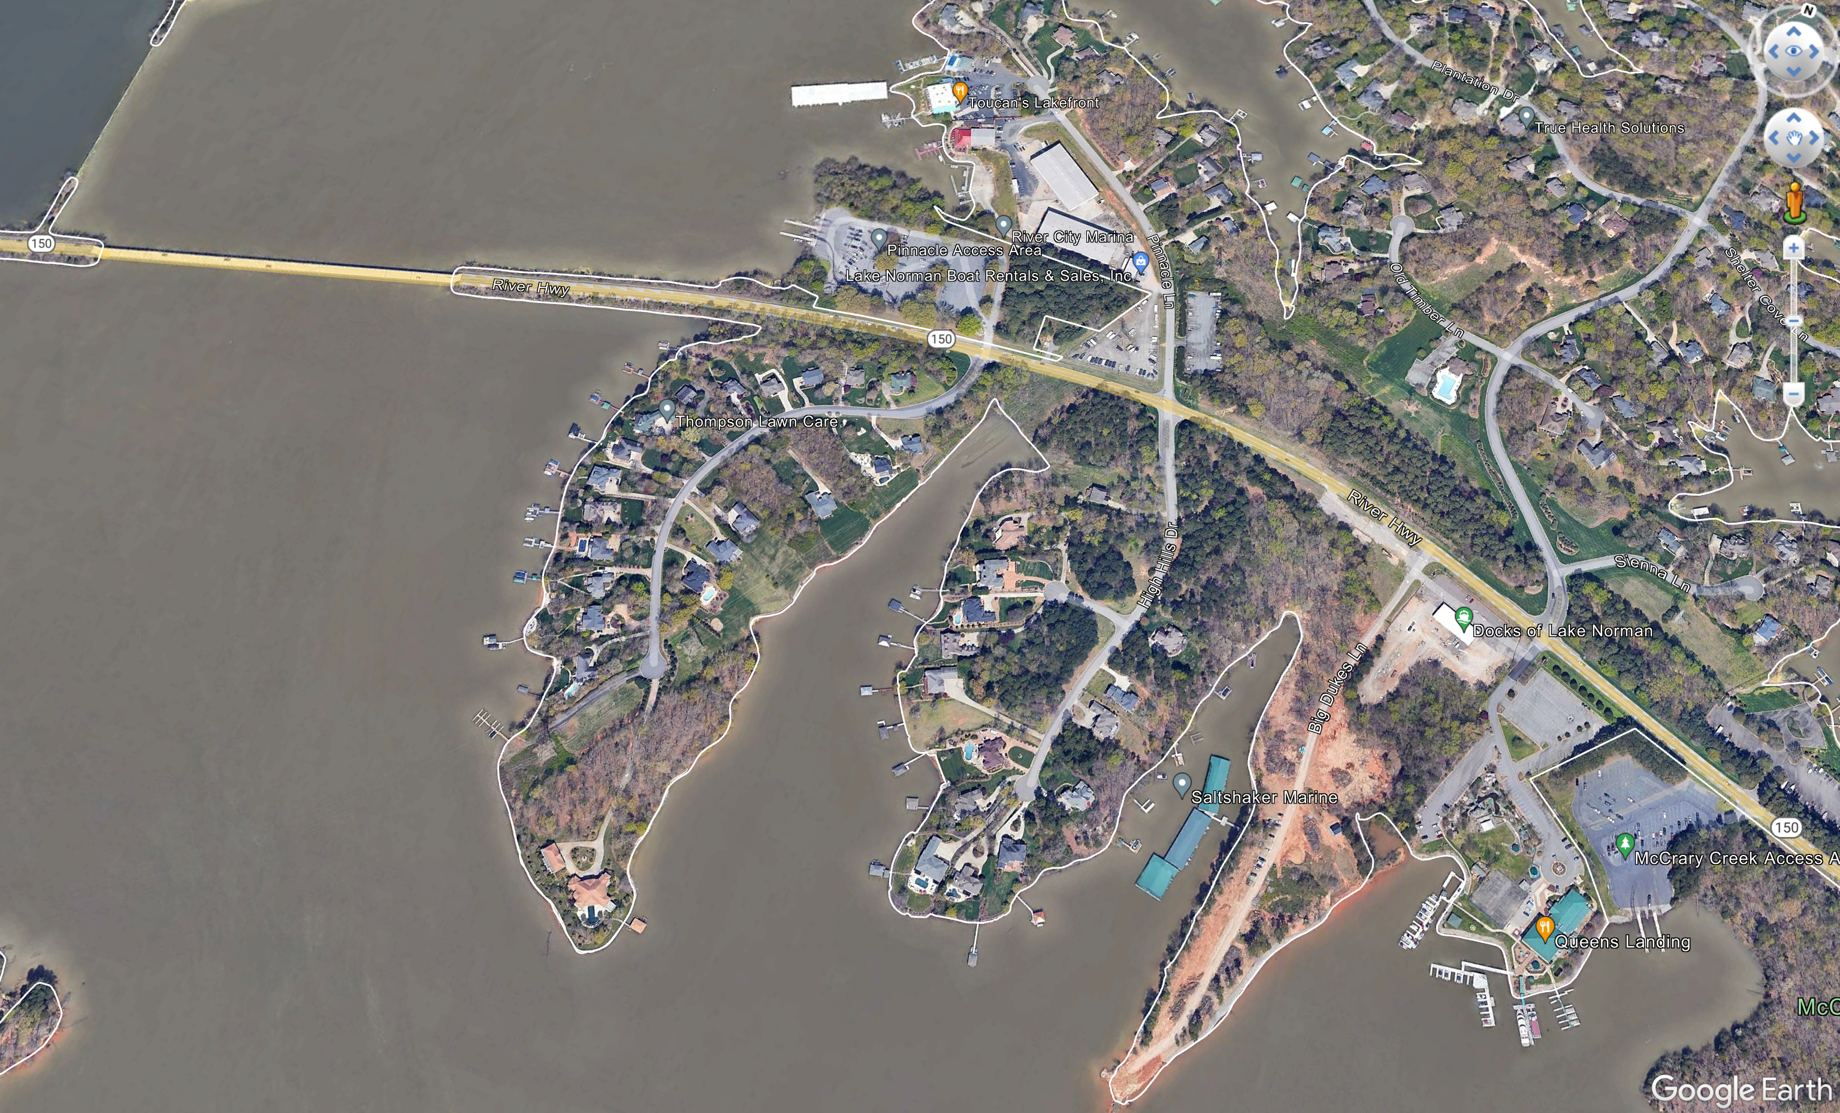

Slide 7
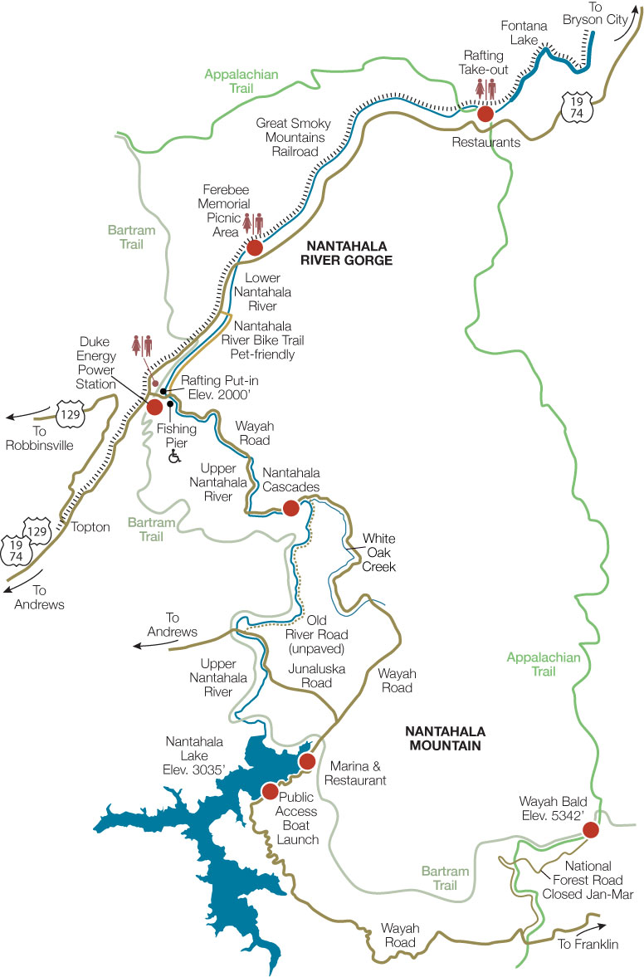

Slide 8
So what’s the big deal?
Project Owners determine their requirements for applicants to apply for a Conveyance Permit.
Duke considers NCDOT projects with other lake user applicants.
All other state and federal approvals are a prerequisite for a Conveyance Application.
Application requires Final Design.
Lengthy application and review times. 60-day re-do loops common.

Slide 9
What do I need to do?
Screen project though ATLAS. If you’re near a FERC dot, contact ECAP for further review.
If you will have impacts within a FERC Project Boundary:
  Based on project type, other permits, ECAP may bring on additional coordination once an alternative is chosen.
  Adjust the project schedule for an early acquisition of permits. Final design may be required up to 2 years prior to let.

