Slide 1
NCDOT CONNECT WorkSpace
Oak Thammavong
July 24, 2019

Slide 2
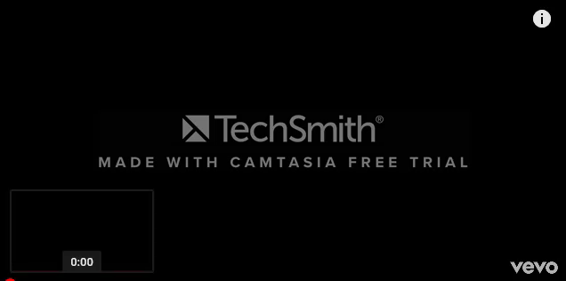
NCDOT CONNECT WorkSpace

Slide 3
ORD Quarterly Updates
NCDOT CONNECT WorkSpace
Major Release in Q1 and Q3
Minor Release in Q2 and Q4
WorkSpace must be tested with new version
WorkSpace must be “upgraded” with new civil data/file format change to be compatible with production version
Everyone must be on the same ORD version and Workspace!

Slide 4
Bentley Delivered WorkSpace
NCDOT CONNECT WorkSpace
Mirror image used to create the NCDOT CONNECT WorkSpace
Compared and synchronized with every ORD update
Retrofit and use “out-of-box” settings as much as possible; e.g. civil cells, 3D custom line styles, etc.
Some fundamental differences; One vs. Separate Workspaces, AASHTO vs. DOT Sup Prefs, Geom vs. CL, Imperial vs. English!
“One day we will use the Bentley delivered WorkSpace.” – But not anytime soon.

Slide 5
Standalone CONNECT WorkSpace
NCDOT CONNECT WorkSpace
Not ProjectWise Managed WorkSpace
Separate from SS2 and SS4 V8 Workspaces
Can be installed on local drive or on shared server
Can include other DOTs including Bentley
Imperial English Only – No Metric

Slide 6
WorkSpace Installation Sequence
NCDOT CONNECT WorkSpace
Set Windows Environment Variables (2)
Install UpdateConnectWs App
Update CONNECT WorkSpace
Replace "WorkSpaceSetup.cfg"
NCDOT_ORD_SetupUtility.cmd (optional)
Download NCDOT ORD Training Worksets (optional)

Slide 7
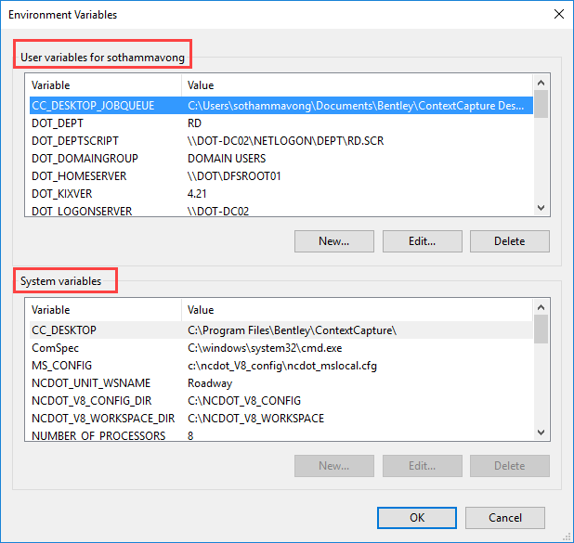
Windows Environment Variables
NCDOT CONNECT WorkSpace
System Level – Admin
  Default
  Admin Rights
  Image/Deployment Package
User Level
  Override System Level
  Switch Between Workspaces

Slide 8
Windows Environment Variables
NCDOT CONNECT WorkSpace
ORD_CONNECT_WORKSPACE_DIR
  C:\MICROSTATION_CONNECT_WORKSPACE
  Needed by the UpdateConnectWs App
  Redirect WorkSpace “Configuration” folder location
  Rename Workspace “Configuration” folder path
  Examples: C:\WKSP, S:\CoR\WS, W:\StantecCONNECT

Slide 9
Windows Environment Variables
NCDOT CONNECT WorkSpace
ORD_ORGANIZATION-CIVIL
  NCDOT
  Define “Organization-Civil” (DOT) WorkSpace folder
  Examples: NCDOT, VDOT, SCDOT, Raleigh, Bentley

Slide 10
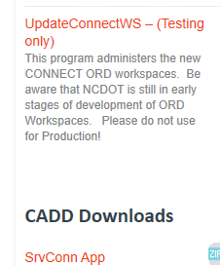

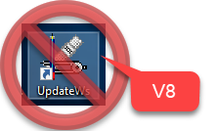
UpdateConnectWs App
NCDOT CONNECT WorkSpace
https://connect.ncdot.gov/resources/CADD/Applications/UpdateConnectWs/UpdateConnectWs.application

Slide 11
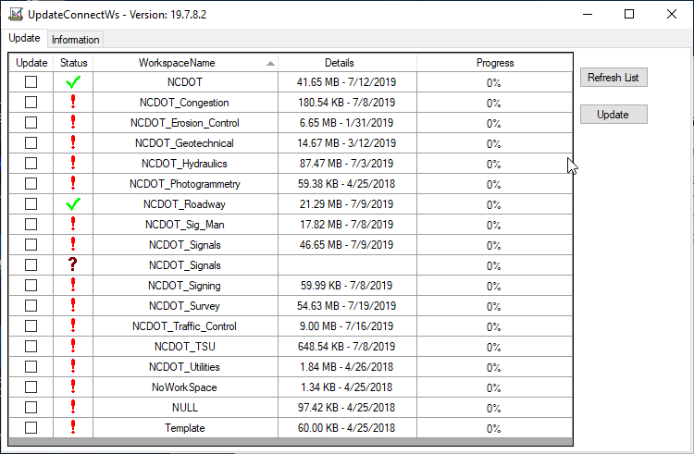
Update NCDOT CONNECT WorkSpace
NCDOT CONNECT WorkSpace
NCDOT (Required), NCDOT_Roadway (Recommended)

Slide 12
WorkSpaceSetup.cfg
NCDOT CONNECT WorkSpace
Rename (view hidden files and folders enabled)-
C:\ProgramData\Bentley\OpenRoads Designer CE\Configuration\WorkSpaceSetup.cfg_default
Copy from:
C:\MICROSTATION_CONNECT_WORKSPACE\Configuration\Organization-Civil\NCDOT\Workspace ReadMe\ WorkSpaceSetup.cfg

Slide 13
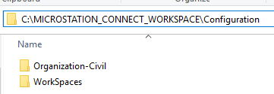
WorkSpaceSetup.cfg
NCDOT CONNECT WorkSpace
WorkSpace Structure (Configuration & Standards folder)
  Organization-Civil – NCDOT, SCDOT, Bentley
  WorkSpaces – NCDOT_Roadway, VDOT_Hydraulics
  WorkSet (project) – B-1234, R-6543, Quick Start
.CFG and Standards in the same folder
WorkSet can be different

Slide 14
WorkSpaceSetup.cfg
NCDOT CONNECT WorkSpace
MY_CIVIL_ORGANIZATION_ROOT = $(ORD_CONNECT_WORKSPACE_DIR)\Configuration\Organization-Civil\
MY_WORKSPACES_LOCATION = $(ORD_CONNECT_WORKSPACE_DIR)\Configuration\WorkSpaces\$(ORD_ORGANIZATION-CIVIL)\
# MY_WORKSET_LOCATION = //MyNetwork/MyWorkSpaces/

Slide 15
WorkSpaceSetup.cfg
NCDOT CONNECT WorkSpace
MY_CIVIL_ORGANIZATION_ROOT
  Define Location of “Organization-Civil” .CFG file, e.g. NCDOT.CFG
  .CFG defines location of “Organization-Civil” Standards folder
  CIVIL_ORGANIZATION_STANDARDS = $(CIVIL_ORGANIZATION_ROOT)$(CIVIL_ORGANIZATION_NAME)/
  C:\MICROSTATION_CONNECT_WORKSPACE\Configuration\Organization-Civil\NCDOT\

Slide 16
WorkSpaceSetup.cfg
NCDOT CONNECT WorkSpace
MY_WORKSPACES_LOCATION (available to select)
  _USTN_WORKSPACESROOT
  _USTN_WORKSPACEROOT
  _USTN_WORKSPACESTANDARDS=
    $(_USTN_WORKSPACEROOT)Standards/
.CFG loads Organization-Civil and WorkSpace Standards

Slide 17
WorkSpaceSetup.cfg
NCDOT CONNECT WorkSpace
# MY_WORKSET_LOCATION
  If not defined or does not exist then default under WorkSpace
C:\MICROSTATION_CONNECT_WORKSPACE\Configuration\WorkSpaces\NCDOT\NCDOT_Roadway\WorkSets
Location of WorkSet .CFGs and .DGNWSs
.DGNWS – rsc dgn file containing project info and sheet index
.CFG – points to project CADD dgn files and Standards location

Slide 18
Opening a DGN File
Loading of Standards
NCDOT CONNECT WorkSpace
Not selectable
load
load
Select
WorkSpace
Organization-Civil
Standards
WorkSpace
Standards
load
Select
WorkSet
WorkSet
Standards
File Open

Slide 19

Organization-Civil
NCDOT “Umbrella” Standards
NCDOT CONNECT WorkSpace
NCDOT as an Organization-Civil is not selectable
By selecting the WorkSpace the .CFG loads the Organization-Civil Standards
All WorkSpaces load the Organization-Civil Standards

Slide 20
How to Include other DOT’s WorkSpaces
NCDOT CONNECT WorkSpace
Separate Organization WorkSpaces Folders:
Redefine the Environment Variable
Desktop Icon Shortcut Switches
Combined Common Configuration Folder (put all Workspaces in a common USTN_WORKSPACESROOT folder)

Slide 21
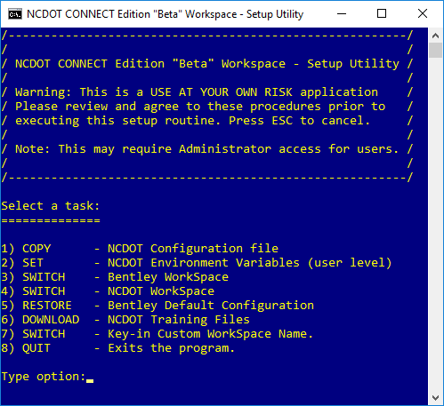
NCDOT_ORD_SetupUtility.cmd
NCDOT CONNECT WorkSpace
C:\MICROSTATION_CONNECT_WORKSPACE\Configuration\Organization-Civil\NCDOT\Workspace ReadMe\

Slide 22
Explicit Configuration Variables
DGNLIB with Keyword in File Name
NCDOT CONNECT WorkSpace
Default: MS_DGNLIBLIST (\*.dgnlib)
MS_DGNLIBLIST_LEVELS (*Level*.dgnlib)
MS_DGNLIBLIST_TEXTSTYLES (*Text Style*.dgnlib)
MS_DGNLIBLIST_TEXTFAVORITES (*Text Favorite*.dgnlib)
MS_DGNLIBLIST_DIMENSIONSTYLES (*Dimension Style*.dgnlib)
CIVIL_CONTENTMANAGEMENTDGNLIBLIST (*Feature*.dgnlib)

Slide 23
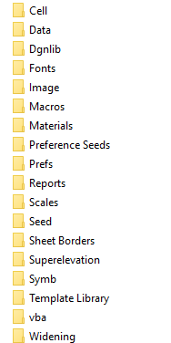
Standards Folder Structure
Organization-Civil, WorkSpace, WorkSet
NCDOT CONNECT WorkSpace

Slide 24
WorkSpace Standards Folders
NCDOT CONNECT WorkSpace
Cell – 2D and 3D Cell Libraries
Data – NCDOT.CTB
Dgnlib – (see next slide)
Fonts - ncdotFont.rsc (font11, font23, etc.)
Macro/VBA
Preference Seeds – UserPrefsSeed
Scale – units.def
Seed – 2D/3D Design Seed
Seed > Sheets – 2D Drawing/Sheet Seed
Sheet Borders – Plan, Profile, XS Sheet Borders (.dgn and .cel)
Superelevation – 2011/2018 Superelevation Rule Files (.XML)
Symb – Custom LineStyle Resource (V8 project scale)
Template Library - (see next slide)

Slide 25
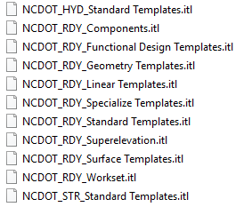
Roadway Template Libraries
NCDOT CONNECT WorkSpace

Slide 26
DGN Library (Dgnlib)
NCDOT CONNECT WorkSpace
Civil Cells - 2D/3D
Design Standards – AASHTO 2011
Display Styles – Wireframe, Illustration, etc.
Feature Definitions – (see next slide)
GUI – Custom Tool boxes and Ribbon Tabs
ItemTypePlus – Used by Asset Manager for Automated Quantities
Levels – Some levels are stored in the feature definitions dgnlib
Line Styles – Custom Line Styles for ORD (annotation scale)
Sheet Seeds – Drawing Seeds for plan, Profile, and XS sheet named boundary, annotation group, and sheet creation
Text* - Text Styles and Text Favorites
  * Exist only in Roadway. Text Styles and Text Favorites exist in the feature definition library everywhere else.

Slide 27
Feature Definition DGNLIB
NCDOT CONNECT WorkSpace
TYPE
Linear
Surface
Point
Alignment
Terrain
Superelevation
Linear Template
Surface Template
Mesh
Trace Slope
Aquaplaning
Sight Visibility
Pad
Survey
Driveway
Sidewalk
Parking Row
Limits of Disturbance
Building Footprint
Grading Con. Area
Node
Conduit
Drainage Area
Element
Template
Feature
Symbologies
Feature Definition
Level
Color
Line Style
Weight
Symbology Override
Class
Priority
Transparency
Cell
Material
2D Plan View
2D Profile View
2D XS View
3D Model View
Plan
Profile
Dynamic XS
3D
Annotation Group
Linear Symbology
Profile Symbology
Surface Symbology
Item Type
Volume Option

Slide 28
Annotation Group
NCDOT CONNECT WorkSpace
Drawing, Linear, Point
Label elements and features for plan profile XS sheets
Grid lines are drawing annotation definitions (not cell)
Stored in DGNLIB (update from library next release)
Use element templates, text styles, text favorites

Slide 29
Annotation Group
Linear vs, Drawing
NCDOT CONNECT WorkSpace
In Plan View, Linear will label the horizontal alignment tick marks, cardinal stations, PI, Curve Data, etc.
When creating sheets, annotation takes place in the Drawing model, such as label the match lines and placing the north arrows.

Slide 30
Text Favorites
NCDOT CONNECT WorkSpace
“Ad-hoc” attributes for:
Civil Plan Elements, e.g. HAL
Civil Profile Elements, e.g. VAL
Civil XS Element, e.g. Segment Slope
Microstation Element Properties, e.g. Level Name
Microstation File Properties, e.g. Project Number (.dgnws)
Used in conjunction with Element Templates and Text Favorites

Slide 31
My Two WorkSpace Tech Favorites
NCDOT CONNECT WorkSpace
Steve Atkinson – WorkSpace Guru
    NCDIT CADD Services
    scatkinson@ncdot.gov
    919-707-7034
Jason Johnson (JJ)– Consultant WorkSpace Mastermind
    Kimley-Horn (Raleigh)
    Jason.Johnson@kimley-horn.com

Slide 32



Roadway Design Dynamic Duo
NCDOT CONNECT WorkSpace

Slide 33

NCDOT CONNECT WorkSpace

Slide 34
Post Conference Initiative
NCDOT CONNECT WorkSpace
Form an ORD CONNECT WorkSpace focus workgroup with inputs from our PEFs and Bentley
Reduce dependencies on environment variables
No edits to WorkSpaceSetup.cfg (untouched)
Seamless integration with Bentley and other DOT workspaces
Rebuild from the ground up for ease of use

Slide 35
NCDOT CONNECT WorkSpace
WORKSPACE CONFIGURATION FOCUS GROUP
Roadway Support
Oak
Thammavong
Bentley
Steve
Atkinson
Jason
Johnson
NCDIT
CADD Services
PEF Community
NCDOT 2019 WorkSpace Revitalize Initiative

