Slide 1
Strategic Transportation Corridors
Corridor D: U.S. 321
Kusondra King, NCDOT
August 2020

Slide 2
Agenda
Strategic Transportation Corridors: Corridor D
Data Collection Review
Corridor Analysis Review
Preliminary Corridor Vision
Stakeholder Involvement

Slide 3
Timeline
Strategic Transportation Corridors: Corridor D
Start of Study | Spring 2018
Steering Committee Meeting | Spring 2018
MPO/RPO Presentations | Summer 2018
Data Collection | Fall/Winter 2019
Steering Committee Meeting | Spring 2020
Public Survey | Spring 2020
Steering Committee Meeting | Summer 2020
Draft Vision | Early Summer 2020
MPO/RPO Presentations | July- September 2020
State Resource Agencies Feedback | August 2020
Final Vision Plan | Winter 2020

Slide 4
U.S. 321 - Facilities Inventory
Strategic Transportation Corridors: Corridor D
Highway assets inventory
  Approximately 106 miles along highway corridor
  Federally designated truck route from S.C. state line to I-85 in Gastonia and from I-40 in Hickory to US 64 in Lenoir
Bridges inventory
  67 bridges along highway corridor
  3 structurally deficient; 12 functionally obsolete
  All documents are available:
  https://connect.ncdot.gov/projects/planning/Pages/STC-Master-Plans-Bundle-2.aspx
Notes:
Facilities inventory data was collected along the US 321 corridor using NCDOT GIS layers and shapefiles.
-highway corridor divided into logical breaks based on travel lanes, functional class, and access control
-US 321 corridor has full & partial access control in different sections
-Has freeway, principal arterial, & minor arterial classification in different sections
-at-grade railroad crossing inventory includes at-grade crossings of cross streets immediately adjacent to the main corridor
-the larger rail network includes 396 miles of active track and 5 rail facilities across all Corridor US 321 counties
-structurally deficient = bridge is in relatively poor condition or has insufficient load carrying capacity
-functionally obsolete = bridge is narrow, has inadequate clearances or other geometric issues, and can no longer service today’s traffic
-bridge must be 10 years and a highway bridge and cannot be classified as both categories
RPOs – High Country RPO, Isothermal RPO
MPOs – Gaston-Cleveland-Lincoln MPO, Greater Hickory MPO

Slide 5
U.S. 321 - Transportation Plan Recommendations
Strategic Transportation Corridors: Corridor D
Compiled transportation plans and recommended projects along the corridor from:
  Statewide Transportation Improvement Program (STIP): 18 projects
  Comprehensive Transportation Plans (CTPs): 4 CTPs
  Metropolitan Transportation Plans (MTPs): 2 MTPs
  Feasibility Studies (FS): 3 within the past 10 years
  Traffic Forecasts (TF): 12 with the past 5 years
Most of corridor recommended to be classified as expressway
  South of Gastonia recommended to be classified as boulevard
  Gastonia to Hickory recommended to be classified as freeway
Notes:
-18 current STIP projects
-3 identified FS (within 10 years)
-12 identified forecasts (within 5 years)
-CTPs – Avery Co, Watauga Co, Greater Hickory MPO, GCL MPO
-MTPs – Greater Hickory MPO, GCL MPO

Slide 6
Public Survey
Strategic Transportation Corridors: Corridor D
Survey Dates: April 6, 2020 to June 6, 2020
Advertised via email, website, and newsletters
Views 609 | Participants 253 | Responses 3,734 | Comments 44
Full Survey Results available:
https://connect.ncdot.gov/projects/planning/STC%20Documents/US%20321%20public%20survey%20results.pdf
Notes:
8 percent responded in the boone area

Slide 7
U.S. 321 – Public Survey Results
Strategic Transportation Corridors: Corridor D
From the Hickory to Boone, what changes would you like to see on U.S. 321 in the next 20 years?

Slide 8
U.S. 321 – Public Survey Results
Strategic Transportation Corridors: Corridor D
From Hickory to Boone, do you support the preliminary vision of an expressway (access at interchanges for major cross streets and at-grade intersections at minor cross streets, speed limit 45 to 60 mph, no traffic signals)?
181 respondents
Notes:
81% at a minimum agree

Slide 9
U.S. 321 – Public Survey Results
Strategic Transportation Corridors: Corridor D
From Boone to the Tennessee state line, what changes would you like to see on U.S. 321 in the next 20 years?

Slide 10
U.S. 321 – Public Survey Results
Strategic Transportation Corridors: Corridor D
From Boone to Tennessee state line, do you support the preliminary vision of an expressway (access at interchanges for major cross streets and at-grade intersections at minor cross streets, speed limit 45 to 60 mph, no traffic signals)?
168 respondents
Notes:
74% at a minimum agree

Slide 11
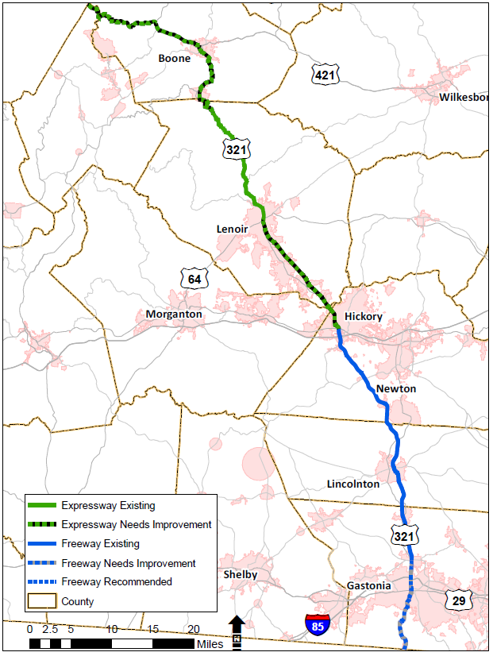
U.S. 321 – Recommended Vision
Strategic Transportation Corridors: Corridor D
Freeway: South Carolina state line to U.S. 70 in Hickory
Expressway: U.S. 70 in Hickory to Tennessee the Tennessee state line
Notes:
Important to note the 40-mile buffer existing for this corridor. Also, as bypasses are open to traffic of US 321, the STC could be moved (ie Boone Bypass and Gastonia west freeway bypass)

Slide 12
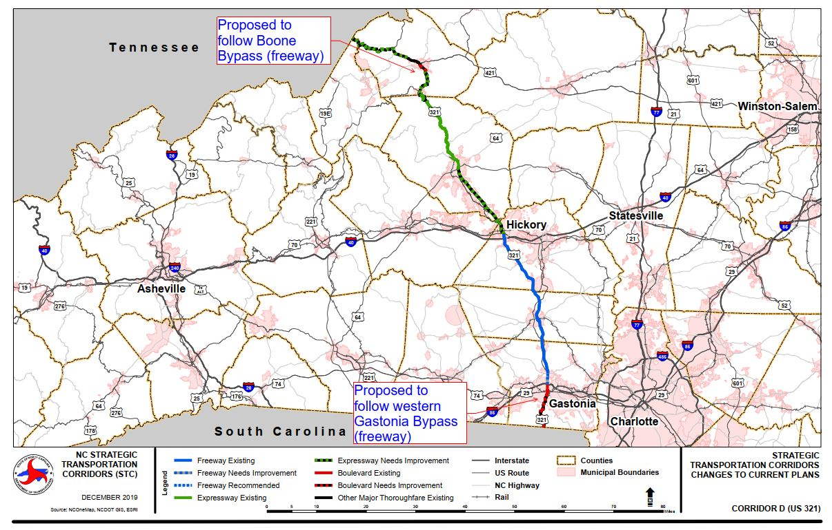
Strategic Transportation Corridors: Corridor D

Slide 13
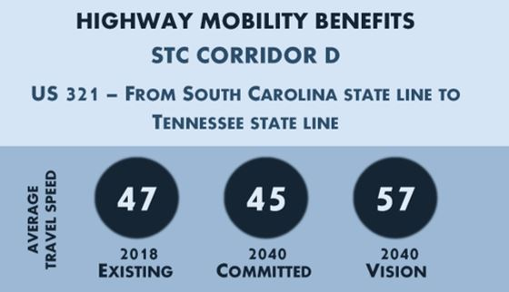
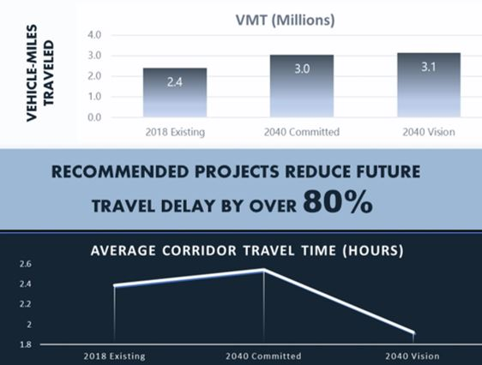
U.S. 321 - Mobility Analysis
Strategic Transportation Corridors: Corridor D
Increases the average corridor travel speed by 12mph
Notes:
The recommended vision increases the average corridor travel speed by 12mph in 2040.
The average corridor travel delay is reduced by 80%.

Slide 14
U.S. 321 – Identified for Further Study
Strategic Transportation Corridors: Corridor D
Expressway improvements northwest of Boone and the connection at the Tennessee state line
Boone Bypass
Expressway Improvements between Boone and Blowing Rock
Traffic Signal Time Study in Blowing Rock
Multimodal connections
Resiliency Assessment
Notes:
The CTP/MTP recommendations in Gastonia show a freeway bypass on the west side that will need to be evaluated further.

Slide 15
Next Steps
Strategic Transportation Corridors: Corridor D
Turnpike Authority
AASHTO Application
SPOT Methodology
Request to revise Corridor U once a new bypass is open to traffic
Additional Public Involvement
Notes:
Or possible feasibility study if one has not been done on the boone bypass

Slide 16
Strategic Transportation Corridors: Corridor
Corridor D
Questions?

Slide 17
Contact Information
U.S. 321 and U.S. 74 Strategic Transportation Corridors
Nastasha Earle-Young, NCDOT Project Manager
nbearle-young@ncdot.gov
919-707-0931
Tyler Bray, Atkins Project Manager
tyler.bray@atkinsglobal.com
919-431-5274

