Slide 1
Anson County Comprehensive Transportation Plan (CTP)
Dominique Boyd, Roger Castillo
October 20, 2022

Slide 2
Socio-economic Data
Anson County CTP
Year | Population | Employment
2019 | 21,999 | 10,192
2050 | 25,409 | 12,704
0.5 Employment/Population ratio

Slide 3
Anson County CTP
SURVEY RESULTS
Who responded to the survey?
294 Responses
~1.3% of the county population
Notes:
https://demo.metroquestsurvey.com/sc5k5j

Slide 4
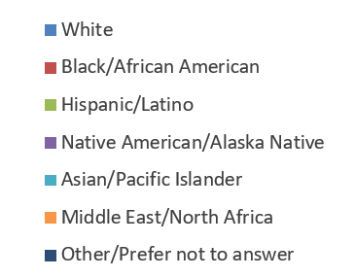
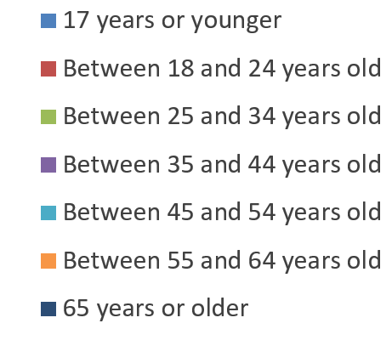
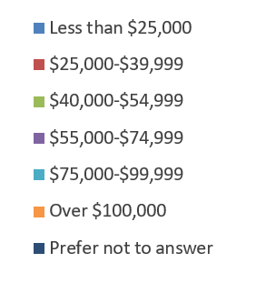
Anson County CTP
Demographics
Age
Ethnicity
(0 %)
(0 %)
(0 %)
Annual Household Income
Notes:
https://demo.metroquestsurvey.com/sc5k5j

Slide 5
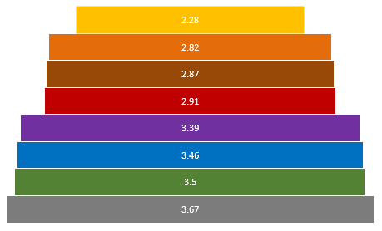
Anson County CTP
PRIORITY RANKING
Category
Ranking Average
# of times in top 5
Safety
Modern Roads
Growth/Development
Shorter Travel Times
Public or Private Transit
Accessibility
Walking/Biking
Driveway Access
233
220
213
156
101
192
109
64
Comments Summary (Total 18):
General – More aesthetics and electrical charging stations
Modern Roads - Less Potholes
Accessibility – Better traffic control for first responder access
Safety – Top concern
Shorter Travel Times – Charlotte through traffic is not good
Walking/Biking – More outdoor options
Growth/Development – More jobs
Notes:
https://demo.metroquestsurvey.com/sc5k5j

Slide 6
Anson County CTP
What do you think?
GENERAL QUESTIONS
Average Rating:
3.01
Average Rating:
3.72
Comments Summary (68)
Unsafe rural roads
Potholes
Lack of sidewalks, lighting and road markings
Beach Traffic Congestion*
Beach and truck traffic at the same time is an issue
74 summer traffic was mentioned multiple times
Ansonville traffic
Weekend and holiday traffic on 74
Too much truck traffic in Wadesboro
Some truck turns are hazardous
Need bypass
Average Rating:
2.29
Average Rating:
2.82
Notes:
https://demo.metroquestsurvey.com/sc5k5j

Slide 7
Anson County CTP
What do you think?
ROADWAY
Comments Summary (13)
Improvements yes, but not at the expense of endangered/threatened habitats or species
Road widenings especially on major roads like 74 and 52
Widening yes, not adding new roads
Don’t widen 74 through Wadesboro
Maysville Road is dangerous due to truck traffic
Do not want bypass
Average Rating:
4.27
Average Rating:
3.05
Average Rating:
4.05
Average Rating:
4.15
Notes:
https://demo.metroquestsurvey.com/sc5k5j

Slide 8
Anson County CTP
What do you think?
PUBLIC TRANSPORTATION
Comments Summary (24)
No knowledge or usage of public transportation
Do not expand ACTS service and cause further burden on County finances
To benefit handicapped and elderly
Service does not reach rural areas
Expand ACTS to veterans and arranging trips to health campuses
Average Rating:
1.71
Average Rating:
2.89
Average Rating:
2.94
Notes:
https://demo.metroquestsurvey.com/sc5k5j

Slide 9
Anson County CTP
What do you think?
BICYCLING
Comments Summary (17)
Only more bike lanes if other road safety is upgraded first
Bike lanes need to be off public roadways
Would like to see more paved roads with bike lanes
See many bikers riding on roads due to no bike lanes and it is dangerous
If it was safe, I would ride a bike again
Feel like the general public would not utilize the service of more bike accommodations
I don’t ride bikes
Average Rating:
3.00
Average Rating:
3.44
Average Rating:
2.97
Notes:
https://demo.metroquestsurvey.com/sc5k5j

Slide 10
Anson County CTP
What do you think?
PEDESTRIAN
Comments Summary (13)
Keep them mowed
Sidewalks can be upgraded
Poor conditions
Sidewalks are a high priority in impoverish areas
Safe, green spaces with eco-safety option lighting
More for towns, not rural areas
There are already sidewalks
Average Rating:
3.87
Average Rating:
2.28
Average Rating:
3.50
Notes:
https://demo.metroquestsurvey.com/sc5k5j

Slide 11





Anson County CTP
Map Markers
# of markers for each mode
269
58
56
70
47
For a map containing all the comments:
https://www.google.com/maps/d/u/0/edit?mid=117gEiNMUeGyBruPgYBwaRmV-lTr51ao&usp=sharing
Notes:
https://demo.metroquestsurvey.com/sc5k5j

Slide 12
Anson County CTP
Map Markers
Roadway (269 Markers – 133 comments)
Map Marker Breakdown
127- Traffic Congestion
31 – Narrow Lanes
15 – Poor Signal Timing
13 – Crash Problem
11 – Confusing Traffic Pattern
7 – Limited Sight Distance
65- Other
Comment Summary
US 74
Many comments on Traffic Congestion
  Most comments among cities
Beach and holiday traffic is high
Truck Traffic is High
Certain intersections are dangerous or congested
  Horne-Town Rd
  Poplar Hill Church Rd
  Anson High School Rd
  N Greene St
  Camden St
Limited Sight Distance among certain intersections
  US 52
  Horne-Town Rd
Other
Green St has congestion and poor signal timing
Need Bypass around Wadesboro
Crash Problem at Ansonville-Polkton Rd and NC 742N
Narrow lanes and potholes on local roads
Narrow lanes on NC 145
Notes:
https://demo.metroquestsurvey.com/sc5k5j

Slide 13
Anson County CTP
Map Markers
Public Transportation (58 Markers – 15 comments)
Map Marker Breakdown
29- Transit Stop Needed
4 – Park and Ride Lot Needed
1 – Bus Shelter Needed
24 – Other
Comment Summary
Access to college for people with limited options
Better access to appointments for elderly and those without vehicles
More availability
Would like to have Public Transportation between Anson and Union County
Do not expand ACTS
Transit stops in Polkton, Lilesville and Morven
Notes:
https://demo.metroquestsurvey.com/sc5k5j

Slide 14
Anson County CTP
Map Markers
Bicycle (56 Markers – 15 comments)
Map Marker Breakdown
35- Bike Lane Needed
10 – Greenway Needed
1 – Bike Rack Needed
10 – Other
Comment Summary
Bike lanes through 74
Improve downtown bike routes
Bike lanes to access park
Add bike racks downtown
Greenway near the school and hospital near Anson High School
Bike lane on Upper White Store Rd
Bike lanes/greenway near Pee-Dee National Wildlife Refuge
Notes:
https://demo.metroquestsurvey.com/sc5k5j

Slide 15
Anson County CTP
Map Markers
Pedestrian (70 Markers – 120 comments)
Map Marker Breakdown
27- Sidewalk Needed
12 – Crosswalk Needed
10 – Greenway Needed
21 – Other
Comment Summary
Additional sidewalks and greenways in the Town of Wadesboro
Improved crosswalks throughout 74
Dangerous traffic and crossing on 74
Overpass on the highway on Salisbury Street (74)
People crossing near McDonalds and Bojangles
Sidewalks from Food Lion to Peaches and Cream
Sidewalk on Camden Rd
Notes:
https://demo.metroquestsurvey.com/sc5k5j

Slide 16
Anson County CTP
Map Markers
Other Issues (47 Markers – 44 comments)
Comment Summary
Cars and Trucks running red lights on 74
Too many log trucks coming through town
Traffic issues on 74
Dangerous intersection on Greenwood Ln near Wendy’s
Landscape and houses are eye sore along 74
Parking on S Green St
Accidents at the US 74 intersection with US 52
Trash and litter on US 74
Speed limit on Parson Grove Church Rd
Alignment of intersection at US 74 and Camden St
Problem intersection at Horne-Towne Rd and 74
Plan NC wildflowers throughout 74
Notes:
https://demo.metroquestsurvey.com/sc5k5j

Slide 17
Contacts
Anson County CTP
NCDOT Transportation Planning Division (TPD)
  Dominique Boyd, dlboyd1@ncdot.gov, (919)-707-0932 (Project Manager)
  Roger Castillo, ricastillo@ncdot.gov, (919) 707-0942 (Project Engineer)
Rocky River Rural Planning Organization (RPO)
  Lee Snuggs, lsnuggs@rockyriverrpo.org, (704) 986-3871

Slide 18

QUESTIONS

