Slide 1
Anson County Comprehensive Transportation Plan (CTP)
Dominique Boyd, Roger Castillo
June 16, 2022

Slide 2
Vision Statement
Anson County CTP
This statement should capture the community’s vision for how the transportation system should function in the future.
Written in present tense
Describe the best outcome achievable
Does not specify timeframe or provide numeric measures
Helps build a picture for the community

Slide 3
Vision Statement Breakdown
Anson County CTP
Produce and maintain a Comprehensive Transportation Plan to preserve and promote the quality of life and economic development of Anson County and all its municipalities that includes roadway systems, rail, transit, and sidewalks. This will be accomplished by providing an accessible, integrated, efficient, and safe transportation system.
Current Themes
Economic Development
Multimodal
Accessibility
Safety
Efficiency/Travel Time Reliability
Other Common Themes
Rural/Urban Character
Mobility
Environmental
Sustainable
Advocating Healthy Lifestyle
Natural Beauty
Adapting to technology
Connectivity
Accommodating users

Slide 4
Goals and Objectives
Anson County CTP
Goals - General, Separates the Vision statement into themes
Objectives - Specific, Action oriented, Measurable, Reasonable
Multimodal - Provide a transportation system that accommodates for all modes of transportation.
Provide Bicycle and pedestrian accommodations on facilities that connect key destinations
Provide more opportunities more transit options to medical centers
Safety – Provide a safe transportation system
Reduce crashes along major intersections
Promote safe driving behaviors by providing speed controlling tools
Accessibility – Provide a transportation system accessible to all users.
Improve signage for residents and visitors
Provide safe access to transit facilities
Economic Development – Provide a transportation system to supports economic development
Improve mobility along x corridor to allow access for future businesses
Support tourism by implementing more scenic roadways

Slide 5
Recap Questions
Anson County CTP
What is most important for the community for the future of Anson County in terms of transportation?
What problems do you feel like should be addressed throughout this plan?
What transportation improvements should be made and through what methods?
Any innovations to plan for in the future?

Slide 6
Goals and Objectives Survey
Anson County CTP
Used to refine and improve the Vision, Goals and Objectives
Identify community concerns
Feedback specific to local transportation systems
DRAFT Anson CTP Survey
https://demo.metroquestsurvey.com/sc5k5j

Slide 7
Recap Questions
Anson County CTP
How can the Draft Survey be improved?
What kind of questions specific to Anson County could help identify the community’s outlook?

Slide 8
Title VI Maps
Anson County CTP
The NCDOT is committed to ensuring that no person – on the grounds of race, color, national origin, limited English proficiency, income status, sex, age or disability – is excluded from participating in, denied the benefits of or otherwise subjected to discrimination under any NCDOT program or activity.
These maps will help us while making recommendations.
These maps will assist in locating areas where we may need additional outreach.

Slide 9
Survey Distribution Methods
Anson County CTP
We want to reach out to as many people as possible. Examples of methods to increase outreach:
Libraries
Transit Buses
Local Shops
Community Centers
Schools
Local Newspaper
Social Media
Churches

Slide 10
Recap Questions
Anson County CTP
Does the data in these maps represent what you of the county well?
What additional outreach methods can be used based on what you have learned from these maps?

Slide 11
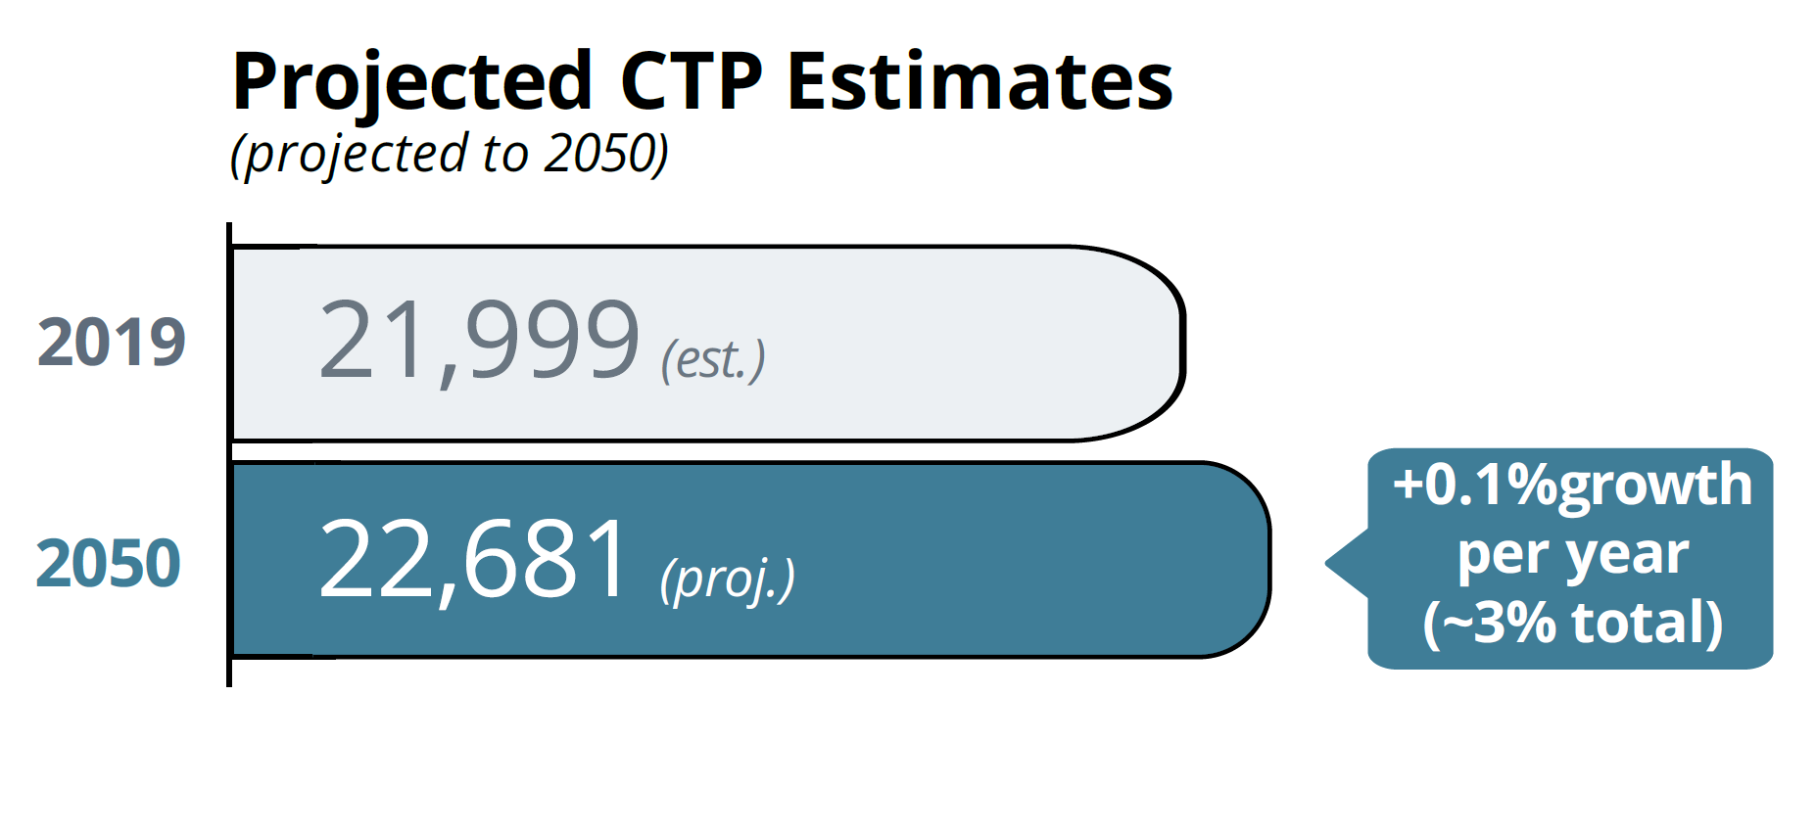
Anson County Trends
Anson County CTP
Anson County Population Projections
Anson County Employment
Year | Labor Force | Employed | Unemployed | Unemployment Rate (%)
2000 | 11,019 | 10,437 | 582 | 5.3
2005 | 10,656 | 9,811 | 845 | 7.9
2010 | 11,217 | 9,649 | 1,568 | 14.0
2015 | 10,817 | 10,119 | 698 | 6.5
2019 | 10,626 | 10,192 | 434 | 4.1
https://www.bls.gov/lau/#tables
U.S. Bureau of Labor Statistics
https://www.osbm.nc.gov/facts-figures/population-demographics/state-demographer/countystate-population-projections
*Projections by the North Carolina OSBM

Slide 12
Recap Questions
Anson County CTP
How do you see your county growing? Thoughts on shown trends?
Where are people from the county traveling to?
Where are people from outside the county traveling from?
What if any new development is planned?
What are high trafficked areas? (Changes due to tourism, seasons, or events?)

Slide 13
Contacts
Anson County CTP
NCDOT Transportation Planning Division (TPD)
Dominique Boyd, dlboyd1@ncdot.gov, (919)-707-0932 (Project Manager)
Roger Castillo, ricastillo@ncdot.gov, (919) 707-0942 (Project Engineer)
Rocky River Rural Planning Organization (RPO)
Lee Snuggs, lsnuggs@rockyriverrpo.org, (704) 986-3871

Slide 14
QUESTIONS

