Slide 1
Anson County Comprehensive Transportation Plan (CTP)
Dominique Boyd, Roger Castillo
August 18, 2022

Slide 2
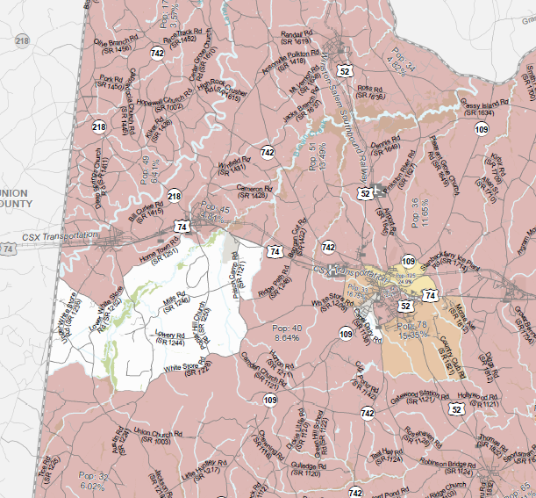
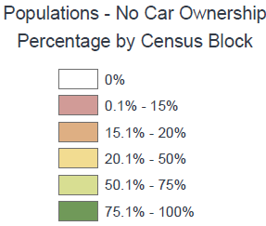
Title VI Question
Anson County CTP

Slide 3
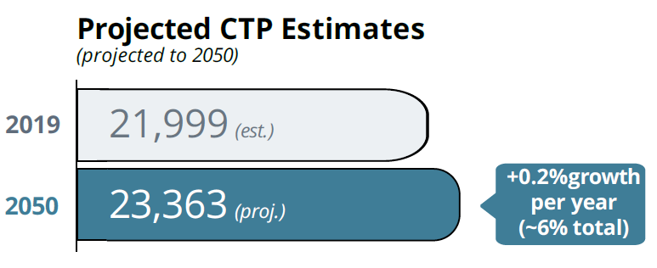
Socio-economic Data
Anson County CTP
Year | Population | Employment
2019 | 21,999 | 10,192
2050 | 23,363 | 10,824
0.463 Employment/Population ratio

Slide 4

Survey is now LIVE!!
Anson County CTP
Will run until September 30th
Available in English and Spanish
Paper versions available
metroquestsurvey.com/AnsonCTP
Notes:
https://demo.metroquestsurvey.com/sc5k5j

Slide 5

Existing Bicycle/Pedestrian
Facilities
Anson County CTP
Bicycle Facilities include:
  Bicycle Lanes
  Separated Bike Facilities
  Greenways/Multiuse Paths
  5-foot paved shoulders (Bike Accommodation)
Pedestrian Facilities Include
  Sidewalks
  Greenways/Multiuse Paths

Slide 6
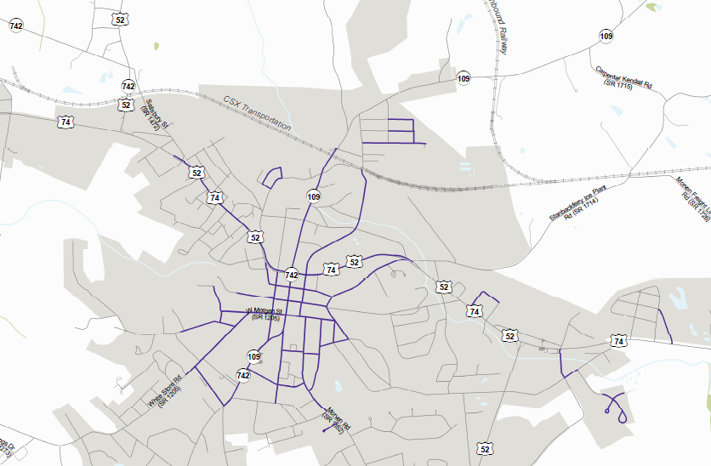
Existing Pedestrian (Wadesboro)
Anson County CTP

Slide 7
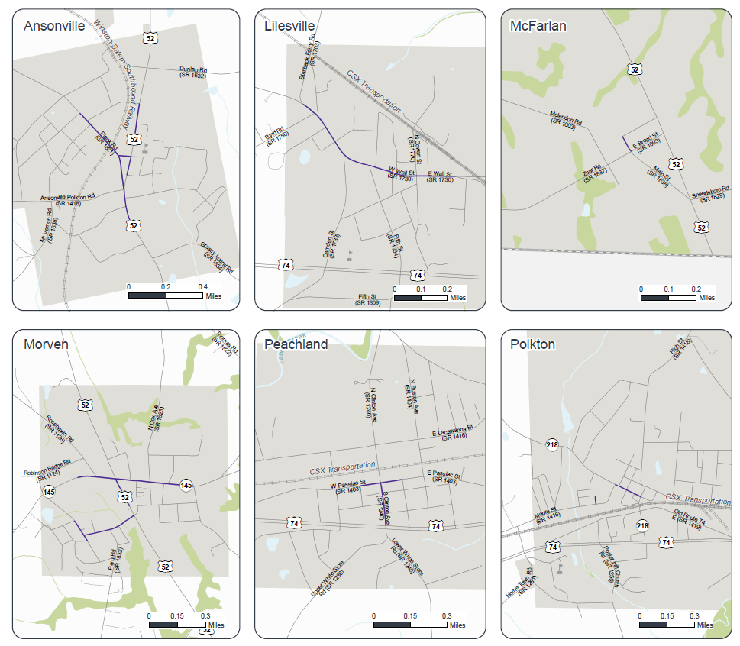
Existing Pedestrian (Continued)
Anson County CTP

Slide 8
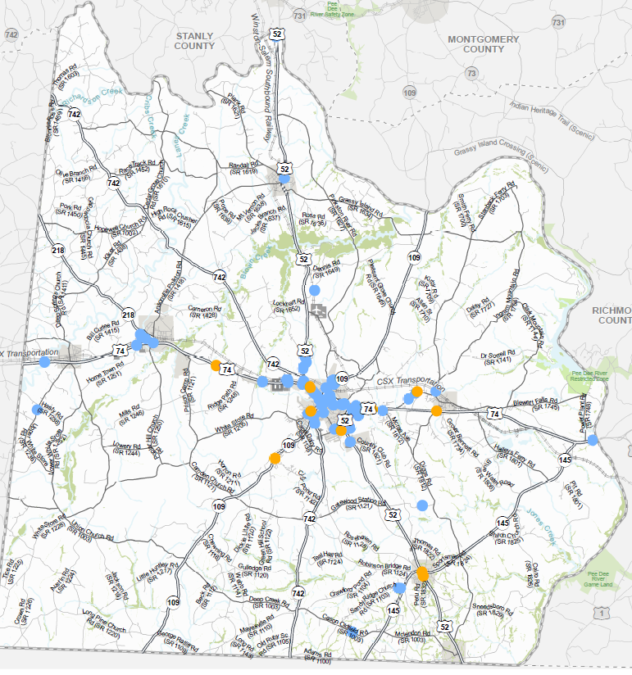
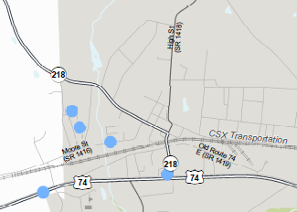
Bike and Pedestrian Crashes
Anson County CTP
Polkton
Bicycle Crash
Pedestrian Crash
2007-2019

Slide 9
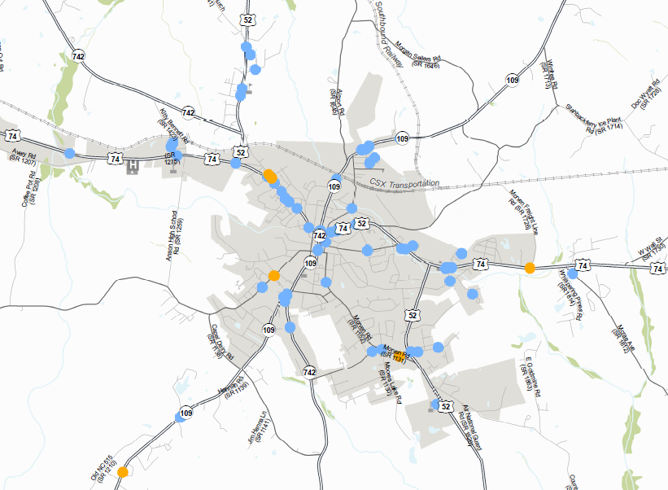
Bike and Pedestrian Crashes
Anson County CTP
Wadesboro

Slide 10
Bicycle and Pedestrian Destinations
Anson County CTP
Destinations will help us establish connections.
Destinations such as schools, colleges, and government complexes are important.
Do you know of any other specific locations that people would like to travel to?
  Community centers
  Parks and recreational facilities
  Popular businesses
  Health Centers

Slide 11
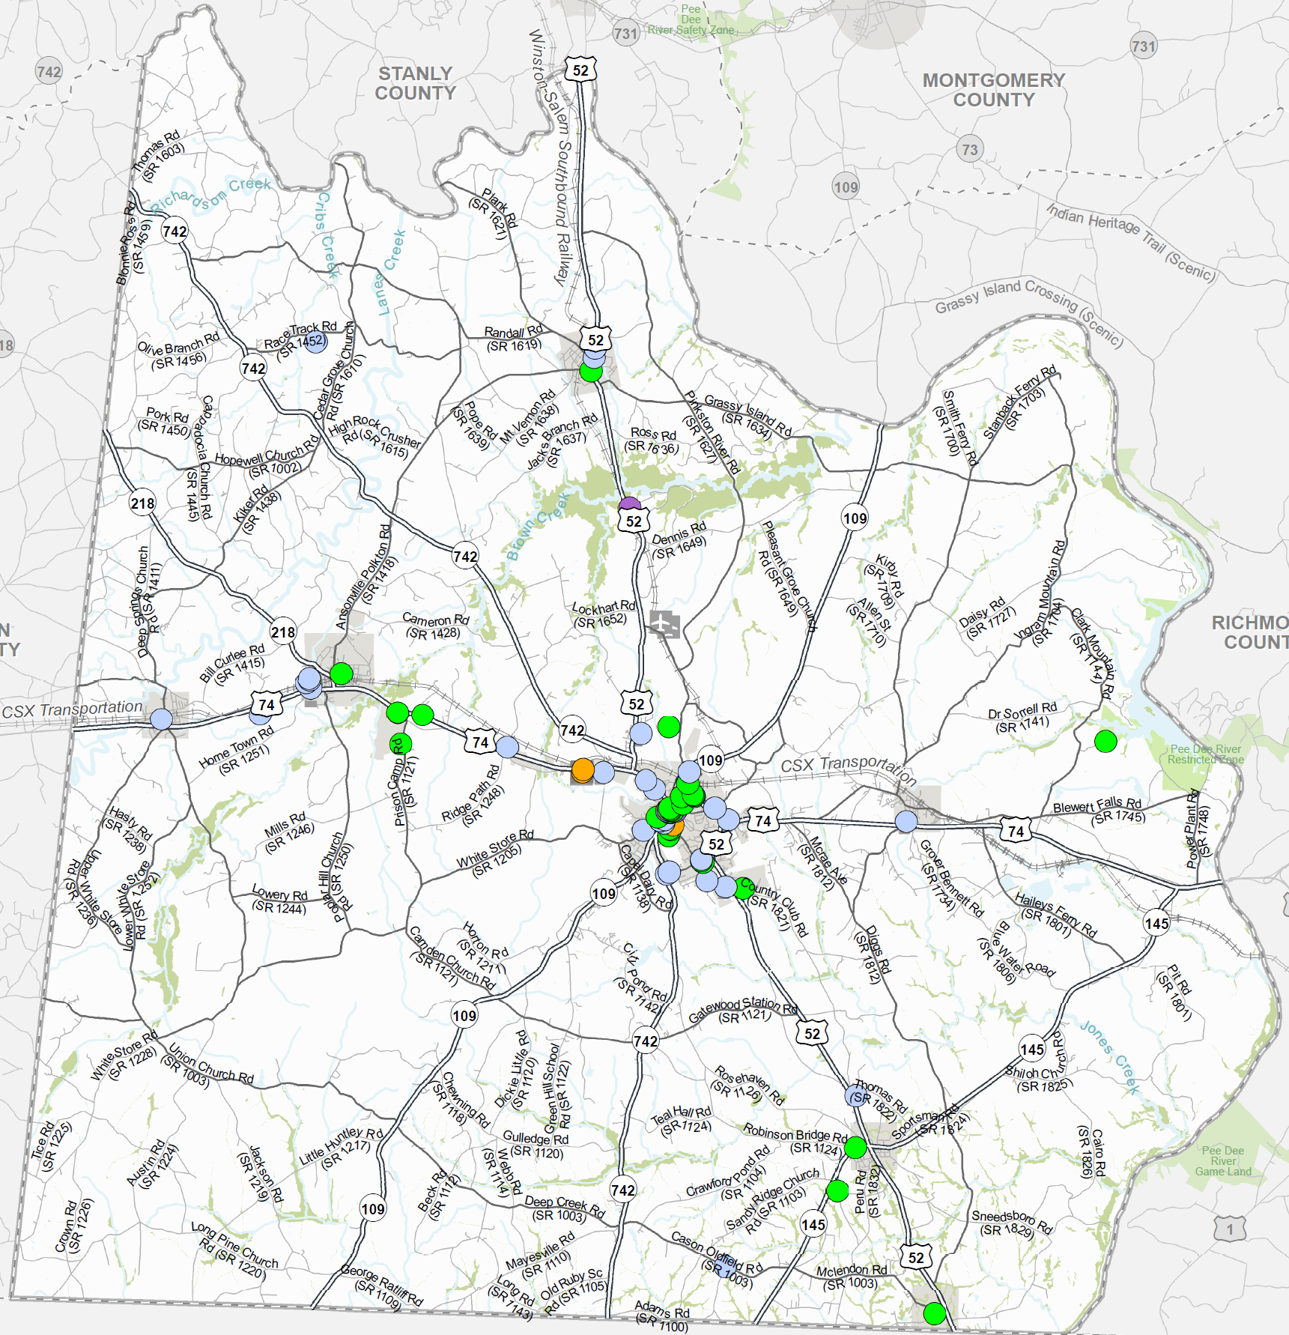
Draft
Destinations
Anson County CTP
Schools/Colleges/Daycares
Government Office
Medical Facility
Museum
Library

Slide 12
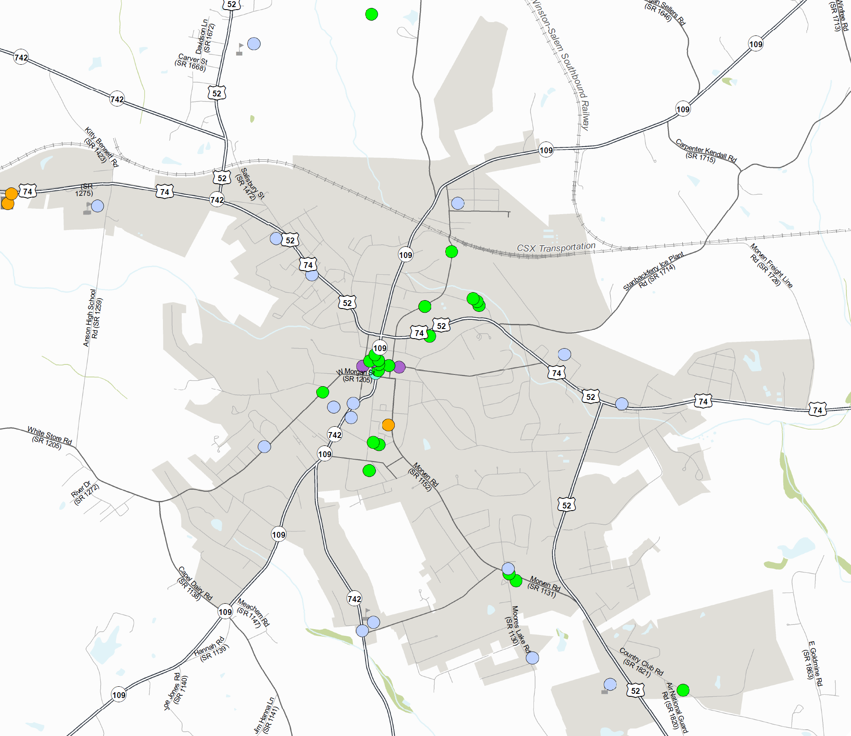
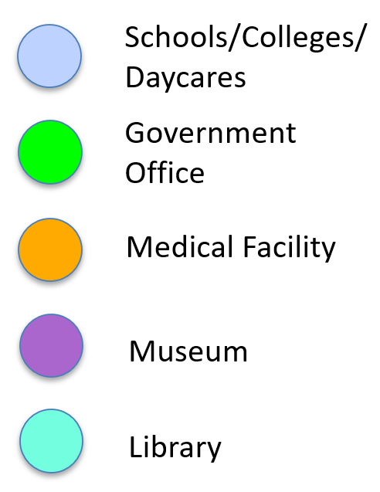
Draft
Destinations
Anson County CTP
Wadesboro

Slide 13
Contacts
Anson County CTP
NCDOT Transportation Planning Division (TPD)
  Dominique Boyd, dlboyd1@ncdot.gov, (919)-707-0932 (Project Manager)
  Roger Castillo, ricastillo@ncdot.gov, (919) 707-0942 (Project Engineer)
Rocky River Rural Planning Organization (RPO)
  Lee Snuggs, lsnuggs@rockyriverrpo.org, (704) 986-3871

Slide 14

QUESTIONS

