Slide 1
Node 3
Partial MUT #1
ϕ1
ϕ2
←
↶
3
2
1
Node 1
ϕ1
ϕ2
ϕ3
Node 2
⤵
⤵
⤵
←
←
⤴
ϕ1
ϕ2
ϕ4
ϕ5
ϕ6
↶
←
⤴
←
⤵
←
⤵
⤵
Notes:
Redirect L&T

Slide 2
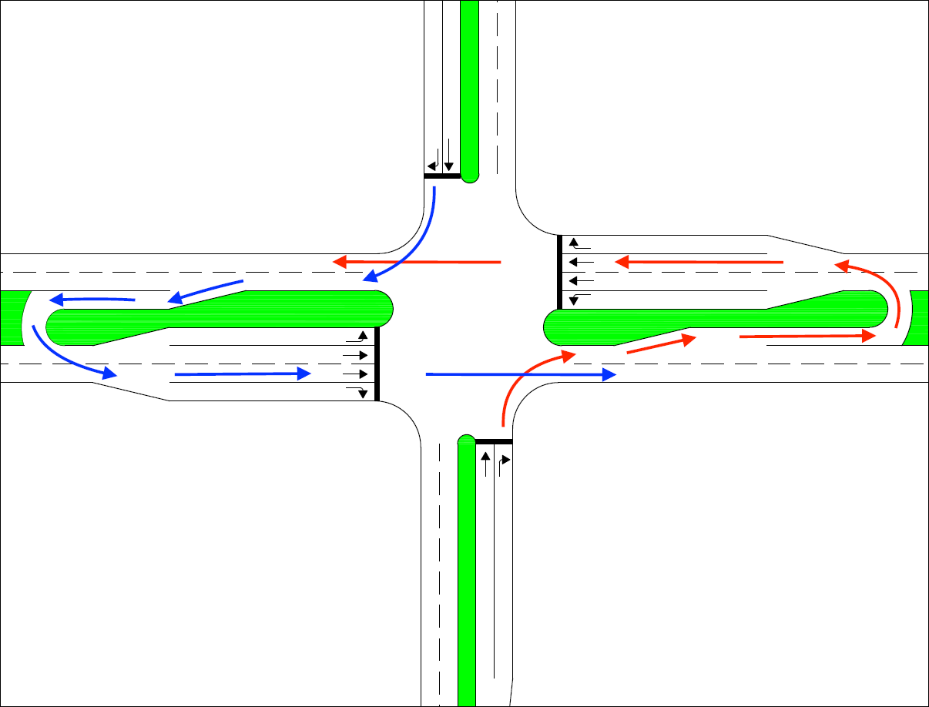
Node 3
Partial MUT #2
ϕ1
ϕ2
←
↶
3
2
1
Node 1
ϕ1
ϕ2
ϕ3
Node 2
⤴
⤵
⤵
←
←
⤵
ϕ1
ϕ2
ϕ4
ϕ5
ϕ6
↶
⤵
⤵
←
←
←
⤴
⤵
Notes:
Partial MUT #2

Slide 3
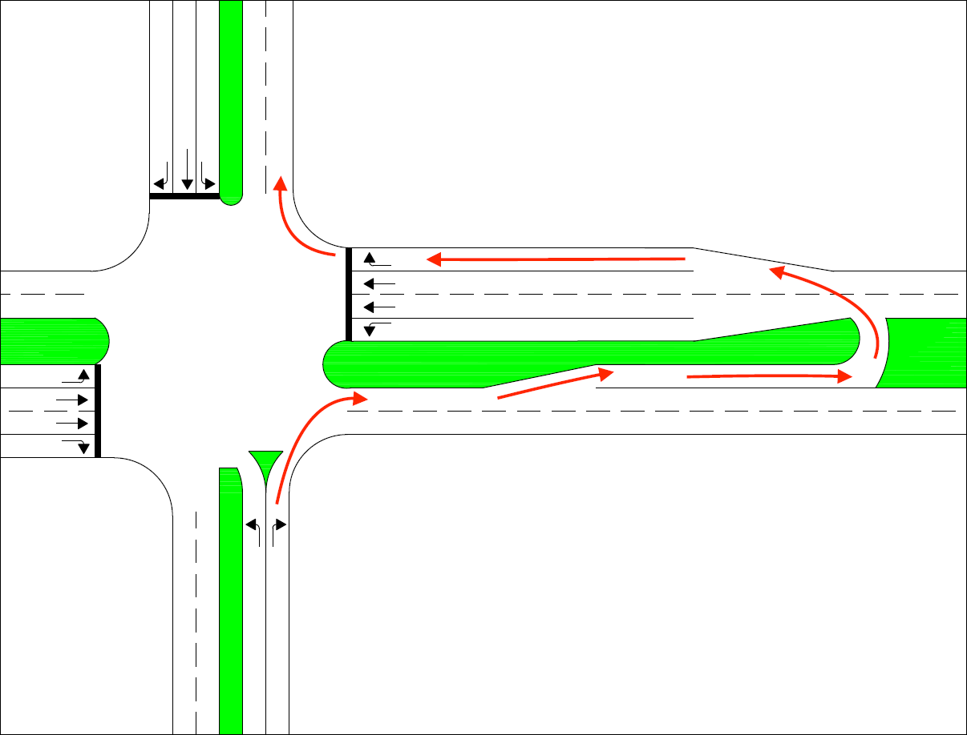
Node 2
Seven-Phase
ϕ1
ϕ2
←
↶
2
1
Node 1
ϕ1
ϕ2
ϕ3
ϕ4
⤴
⤵
⤴
⤵
←
⤵
←
⤵
ϕ5
ϕ6
ϕ7
ϕ8
←
⤵
⤵
⤵
⤵
⤴
⤵
⤴
Notes:
Seven Phase

Slide 4
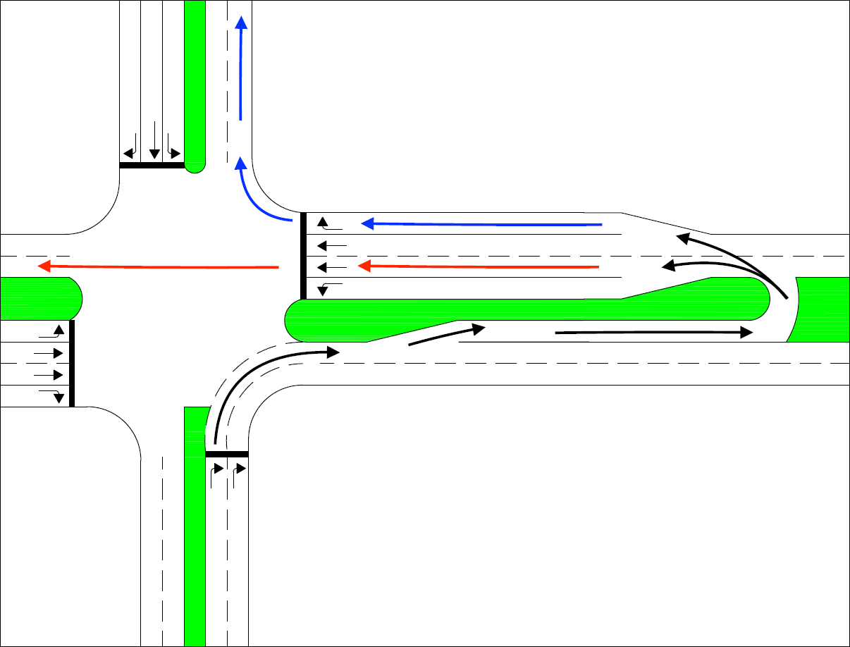
Node 2
Redirect L&T
ϕ1
ϕ2
←
↶
2
1
Node 1
ϕ1
ϕ2
ϕ3
ϕ4
⤵
⤵
⤵
←
←
←
⤵
⤴
ϕ5
ϕ6
ϕ7
ϕ8
⤴
⤴
⤵
⤵
⤵
←
←
⤵
Notes:
Redirect L&T

Slide 5
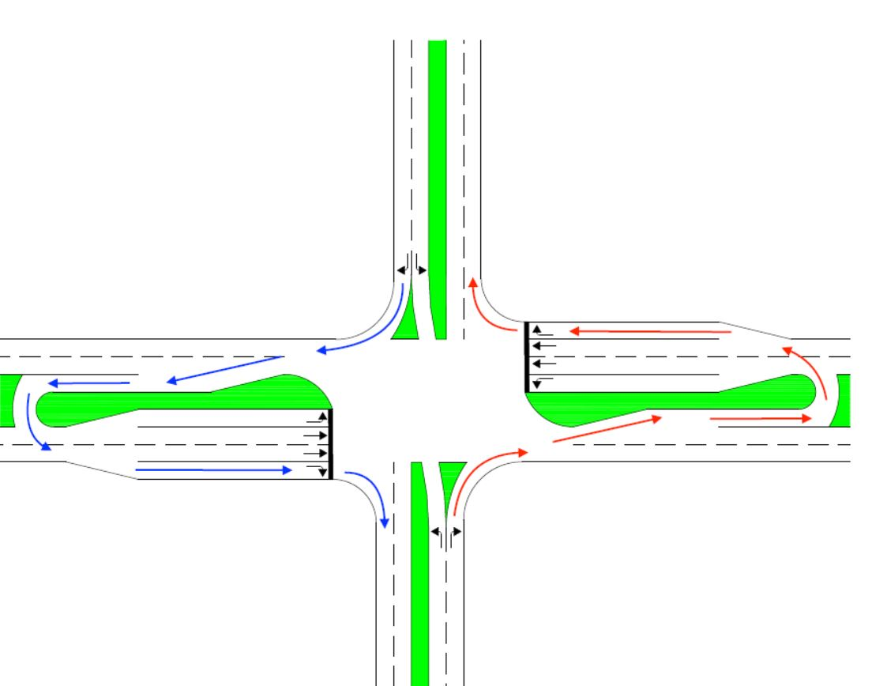
Node 1
ϕ1
ϕ2
ϕ3
Thru-Cut
←
⤴
⤴
⤵
⤵
⤵
ϕ4
ϕ5
ϕ6
⤵
⤵
←
⤴
⤵
⤴
3
2
1
Node 2
Node 3
ϕ1
ϕ2
ϕ1
ϕ2
←
↶
←
↶
Notes:
Redirect L&T

Slide 6
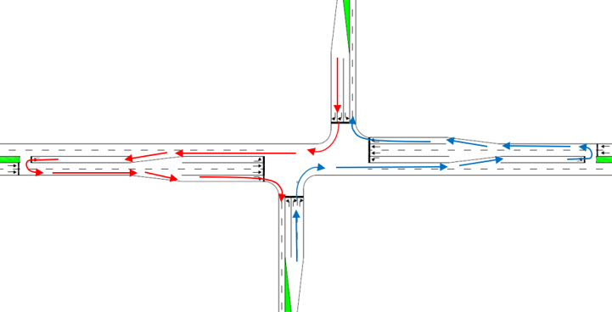
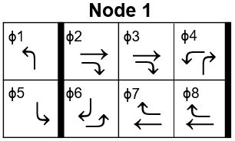
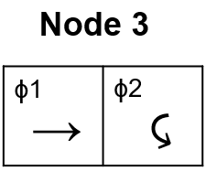
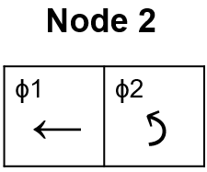
Offset Thru-cut
Offset Thru-cut
Offset Thru-cut
2
3
1
Notes:
Seven Phase

Slide 7
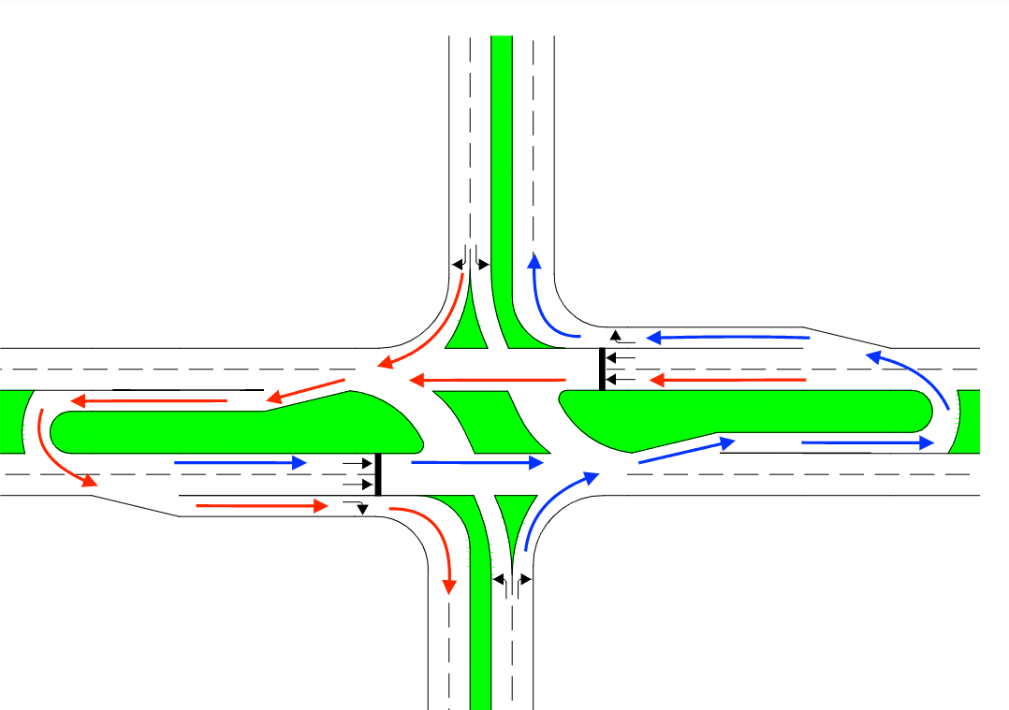
Node 1
ϕ1
ϕ2
ϕ3
Reverse RCI
←
⤵
⤴
⤵
⤵
⤵
ϕ4
ϕ5
ϕ6
←
⤵
⤵
⤵
⤵
⤴
3
2
1
Node 2
Node 3
ϕ1
ϕ2
ϕ1
ϕ2
↶
←
↶
←
Notes:
Redirect L&T

Slide 8
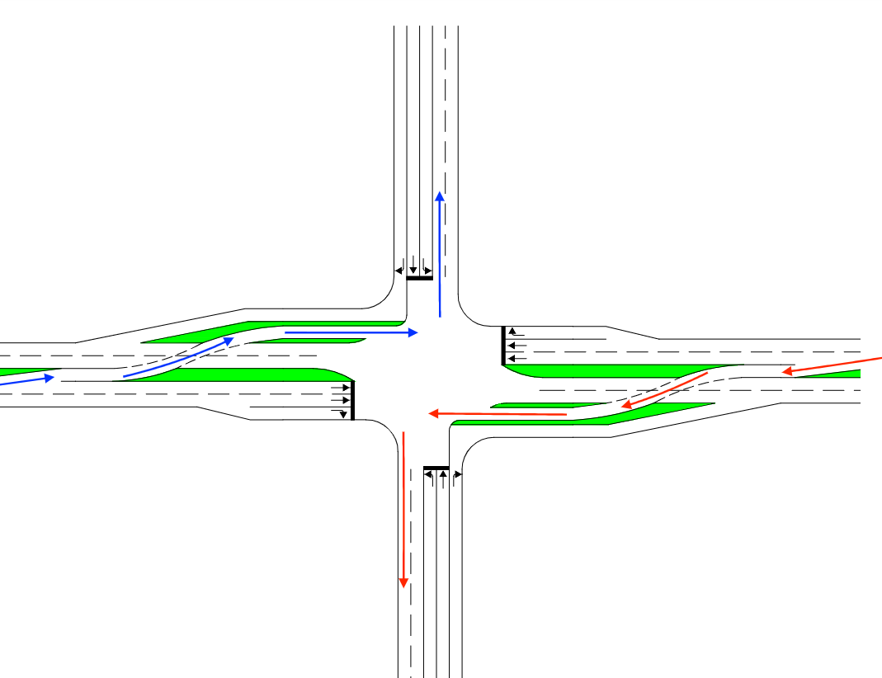
Node 1
Partial CFI
ϕ2
ϕ4
ϕ3
⤴
←
⤵
⤵
⤵
⤴
←
⤵
ϕ6
ϕ8
ϕ7
←
←
⤵
⤵
⤴
⤵
⤵
⤴
3
2
1
Node 3
Node 2
ϕ6
ϕ5
ϕ2
ϕ1
←
←
←
←
←
←
Notes:
Redirect L&T

Slide 9
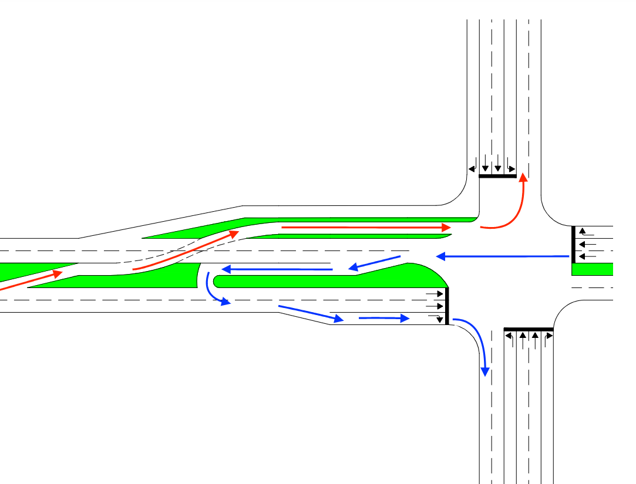
CFI/MUT Combo
Node 3
ϕ1
ϕ2
←
←
←
3
1
2
Node 2
Node 1
ϕ1
ϕ2
↶
ϕ1
ϕ2
ϕ3
←
⤵
←
⤵
←
⤵
⤴
⤵
⤵
ϕ4
ϕ5
ϕ6
⤴
←
⤵
←
⤵
⤴
Notes:
Redirect L&T

Slide 10
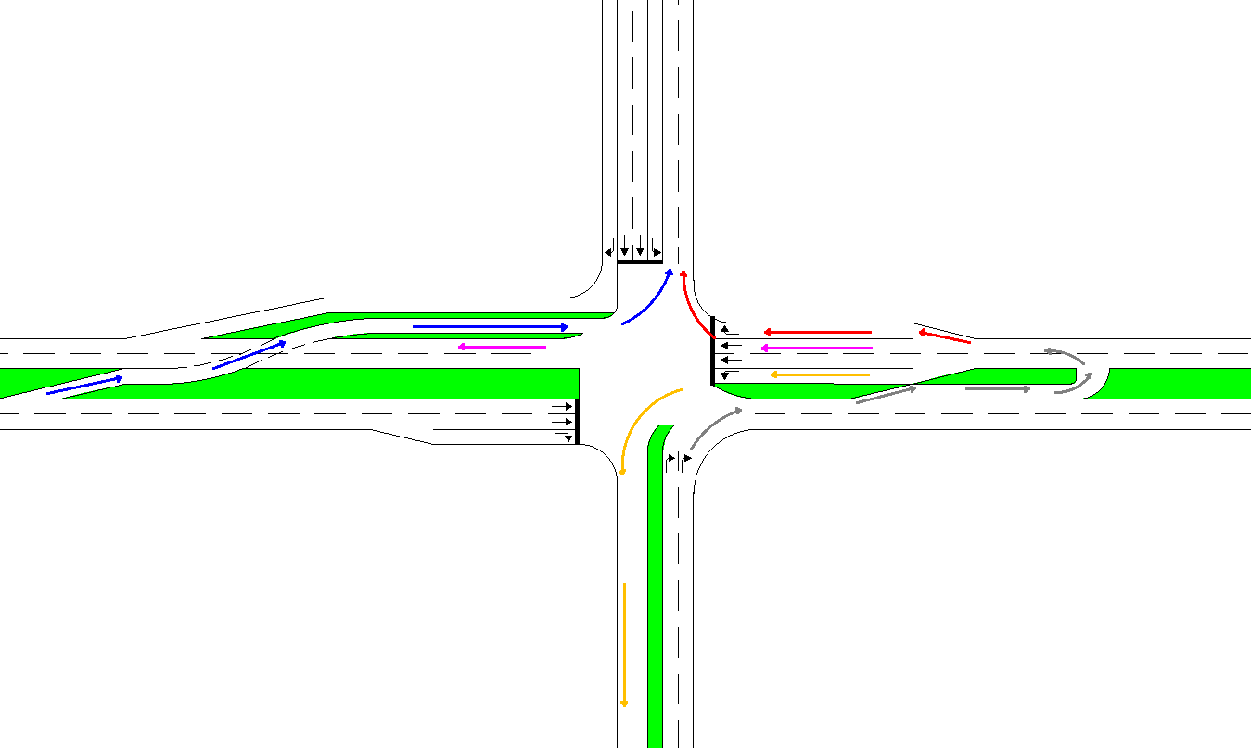
Redirect 2L&T
Node 2
ϕ1
ϕ2
←
↶
3
2
1
Node 3
ϕ1
ϕ2
Node 1
←
←
ϕ1
ϕ2
ϕ3
←
⤵
←
⤵
←
⤵
⤵
⤴
ϕ4
ϕ5
ϕ6
⤴
⤴
←
⤵
←
⤵
⤴
Notes:
Redirect L&T

