Slide 1
Strategic Transportation Corridors
Raleigh, NC
June 11, 2015
Notes:
Good afternoon, my name is Kerry Morrow and I am the Statewide Plan Engineer and Project Manager for the Strategic Highway Corridors.

Slide 2
PRESENTATION objective
To give an overview on the newly adopted Strategic Transportation Corridors.
2
Notes:
Adopted by the Board of Transportation on March 4, 2015.

Slide 3
What are strategic Transportation corridors?

Slide 4
What are strategic transportation corridors?
The backbone of the state’s transportation system, a critical network of multimodal corridors that:
Move high volumes of freight and intercity travel within the state
Form our primary links to interstate and international markets
Link critical centers of economic activity and our international air and sea ports
Cornerstone of NCDOT’s updated NC Transportation Network
An update of Strategic Highway Corridors
Notes:
The Strategic Transportation Corridors (or STCs) are a critical network of multimodal corridors within NC that:
-move high volumes of freight and intercity travel
-form key links to interstate and international markets
-allow us to access our major economic activity centers and our air and sea ports
They serve as the cornerstone of our updated NC Transportation Network
They are an update of SHC (which I’m sure you all are quite familiar with)

Slide 5
Why update shc?
To respond to 2040 Plan directive
To consider multimodal opportunities
To create a data-driven corridor identification basis
To focus on high-priority corridors
SHCs - “A set of existing highways vital to moving people and goods
within and just outside North Carolina”
Notes:
Directive from the BOT a few years ago when they adopted the 2040 Plan.
SHC was highway-intensive, while STC emphasizes inclusion of non-highway modes as well.
Move toward a more data-driven approach to identifying our strategic corridors
Place an emphasis on our high-priority corridors.
**One difference that I’d also like to point out is that unlike SHC, STC does NOT specify a facility types or cross sections.

Slide 6
Strategic corridor
vision & goals

Slide 7
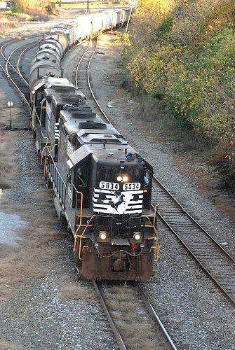
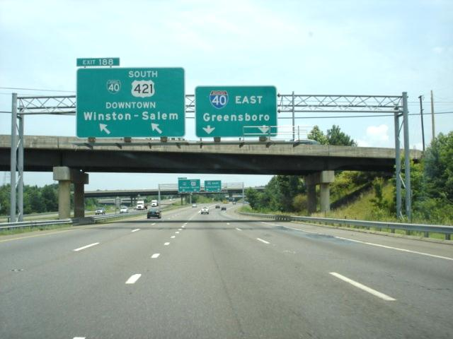
Strategic Corridors vision & Goals
[MMB1]Propose to remove this incomplete listing of identification criteria from Vision/Goals, and use it as intro to expanded corridor criteria development section.
Strategic Corridors framework defines:
Vision
Corridor goals
Provide system connectivity
Provide reliable, higher-speed mobility
Promote economic prosperity
Notes:
We established a Vision and Goals that guided us through the process of identifying the corridors.
The corridor goals of System Connectivity, Mobility and Economic Prosperity drove the criteria by which corridors were defined and selected for inclusion in the network.

Slide 8
Strategic Corridors vision & Goals
[MMB1]Propose to remove this incomplete listing of identification criteria from Vision/Goals, and use it as intro to expanded corridor criteria development section.
STC Vision and Goals Strategic Corridors Vision: to provide North Carolina with a network of high-priority, multimodal transportation corridors and facilities that connect statewide and regional activity centers, to enhance economic development, promote highly-reliable, efficient mobility and connectivity, and support good decision-making.
Strategic Corridors framework defines:
Vision
Corridor goals
Provide system connectivity
Provide reliable, higher-speed mobility
Promote economic prosperity

Slide 9
Strategic Corridors vision & Goals
[MMB1]Propose to remove this incomplete listing of identification criteria from Vision/Goals, and use it as intro to expanded corridor criteria development section.
STC Vision and Goals Strategic Corridor Goals: System connectivity: Provide essential links as part of defined Interstate highway, defense, and freight networks for movement of people and goods. Mobility: Facilitate significant movements of people and goods across the state. Economic prosperity: invest NC’s transportation resources to maximize economic opportunity.
Strategic Corridors framework defines:
Vision
Corridor goals
Provide system connectivity
Provide reliable, higher-speed mobility
Promote economic prosperity

Slide 10
Strategic Corridors identification

Slide 11
STC Identification
Objective: Apply STC objectives and criteria to define a network of strategic corridors
Process:
Define criteria reflecting STC Goals
Apply criteria to identify candidate corridor elements
Identify corridors:
Prepare composite map
Review coverage
Propose end-to-end candidate corridors
Notes:
We set some criteria that served as the basis for selecting the STCs, which I’ll talk more about on the next few slides.
We then applied that criteria to our transportation system to identify corridors.
**It’s worth noting that we did NOT start with SHCs and whittle it down (a common misconception), we started from scratch.**

Slide 12
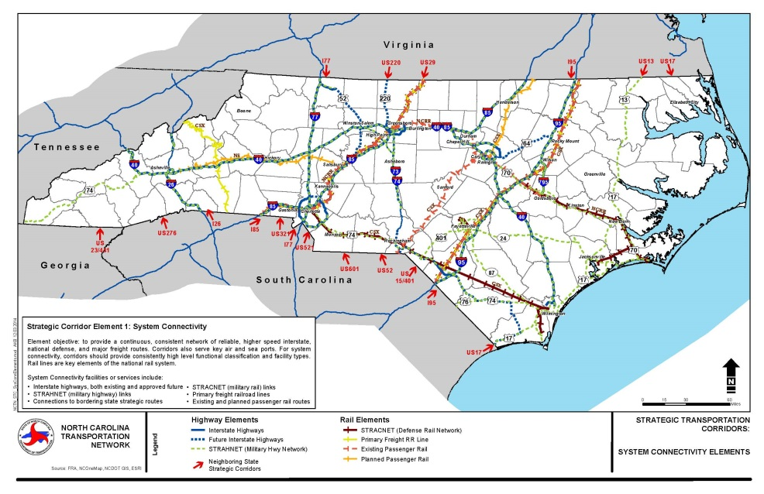
System Connectivity Objective
Objective
Provide a continuous, consistent network of reliable, higher speed interstate, defense, and major freight routes. For system connectivity, identified statewide corridors should provide functional classification and facility type consistent with those attributes; corridors should have high capacity consistent with speed and reliability objectives.
12
Notes:
For the objective of System Connectivity, we focused on reliable, high speed interstate, defense and freight routes. So, we were really looking at corridors that are part of a national system of transportation routes.

Slide 13
System Connectivity
13
Notes:
Interstate
Future Interstate
STRAHNET
STRACNET
Primary Rail Freight
Passenger Rail

Slide 14
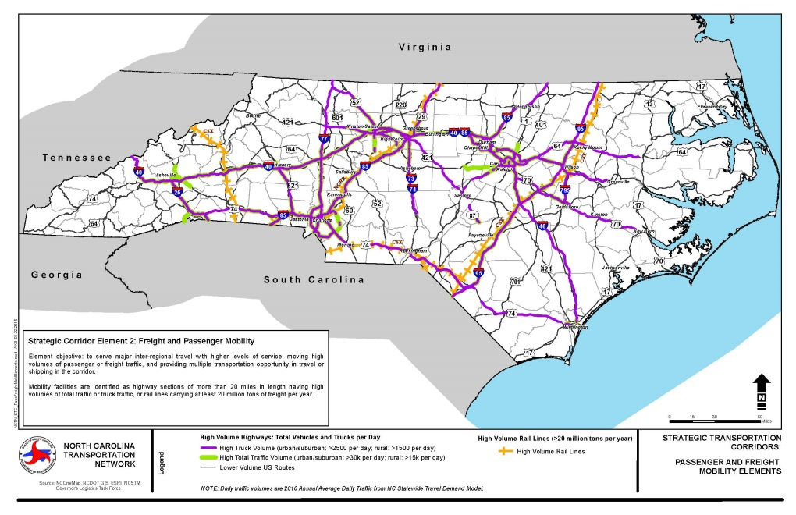
mobility Objective
Objective
Serve longer-distance and/or major commuter travel with high levels of service, moving higher volumes of existing passenger or freight traffic, and provide multiple transportation modes or routes for the opportunity of choice and flexibility in travel or shipping in the corridor.
14
Notes:
The mobility objective focuses on routes that serve longer distance travel, moving higher volumes of passenger and freight traffic.

Slide 15
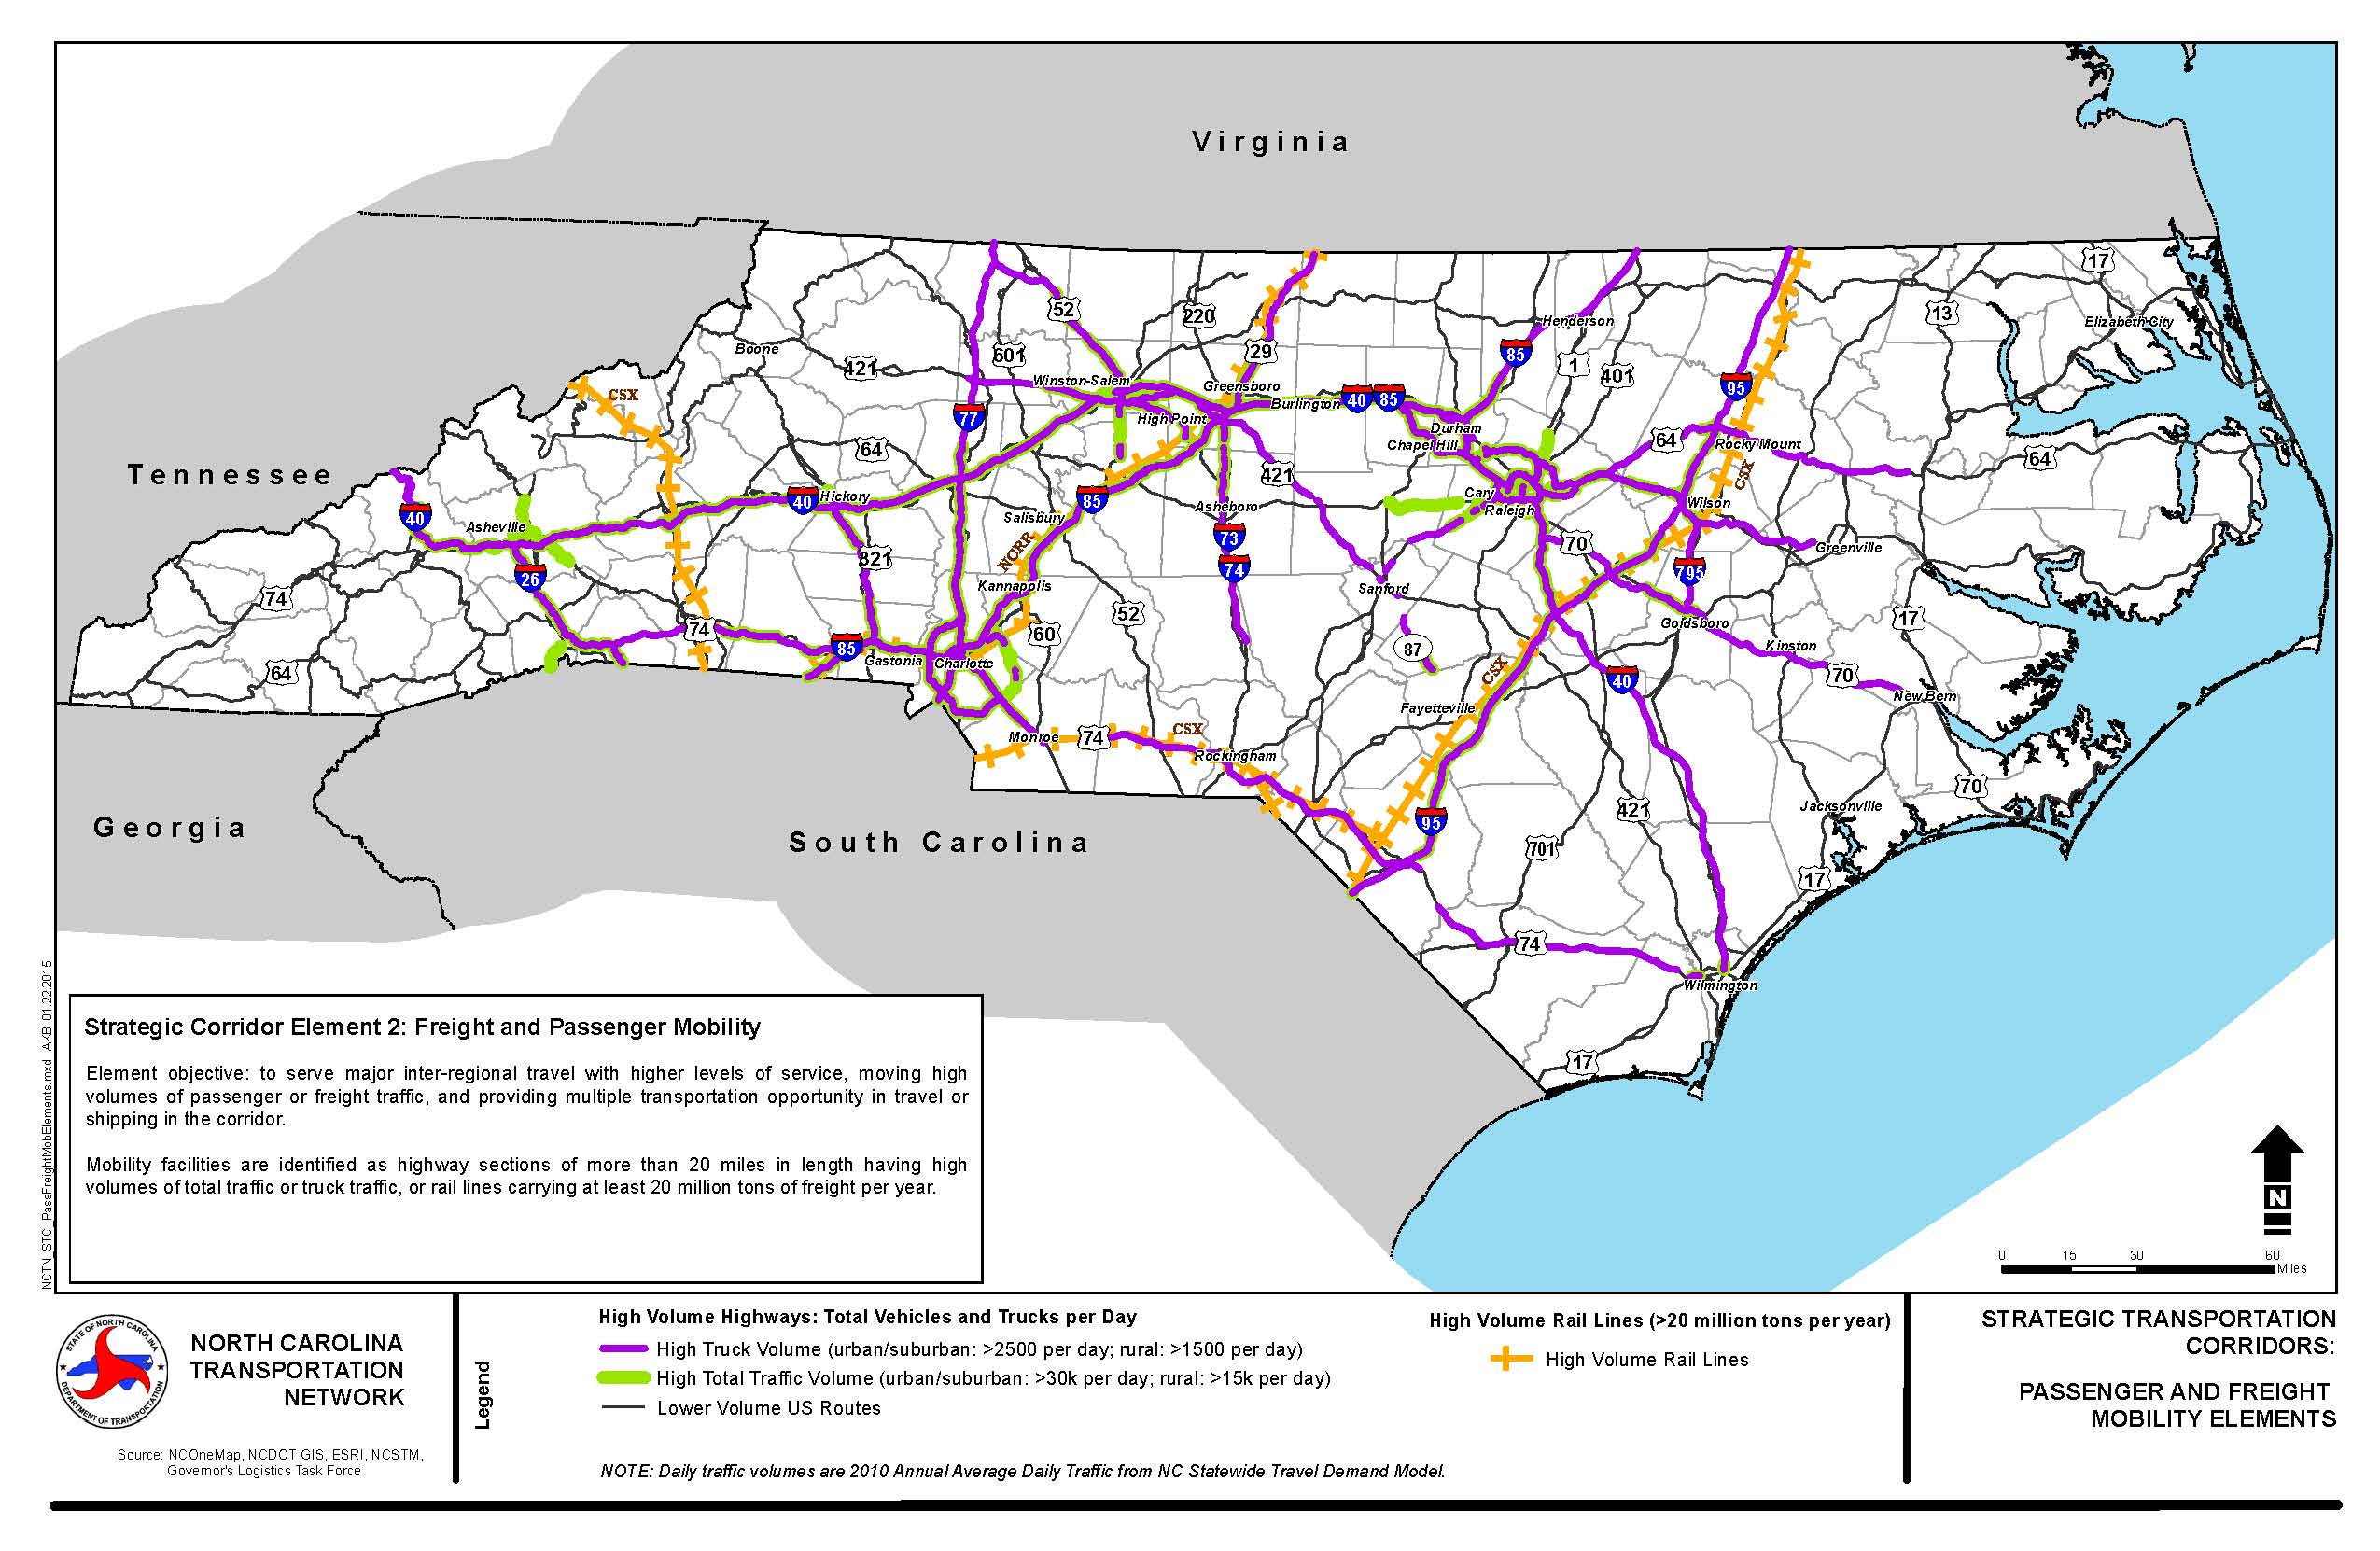
Mobility
15
Notes:
So, here we're really looking at the higher volume routes (read out legend).

Slide 16
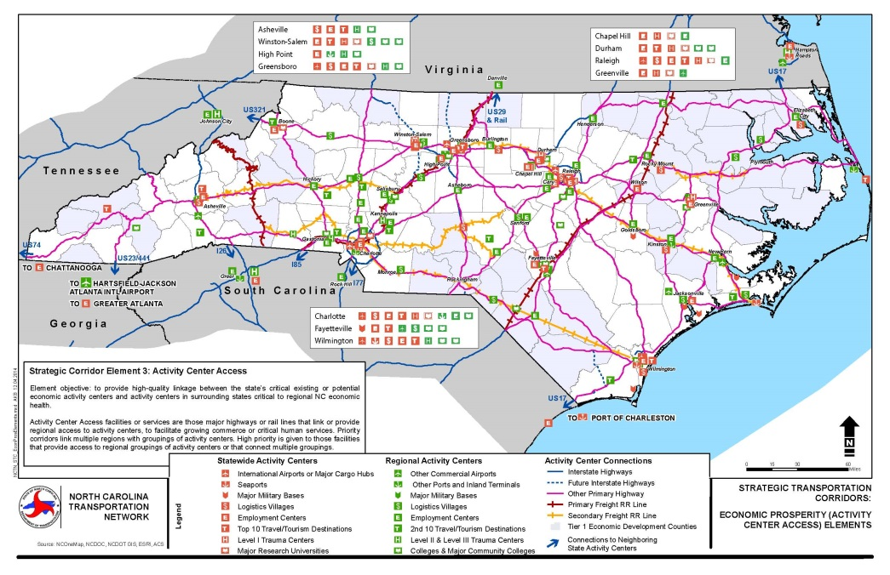
Economic prosperity Objective
Objective
Provide high-quality access between and within the state’s Prosperity Zones and activity center clusters, and from nearby economic activity centers in surrounding states that are critical to regional NC economic health.
16
Notes:
The economic prosperity objective focuses on access to clusters of economic activity, connecting those within NC as well as ones just beyond our borders (such as Hampton Roads, VA).

Slide 17
Activity Center Access
Notes:
We went in and identified activity centers across the state and focused on routes that link clusters of these activity centers.
(point out red-statewide and green-regional icons on map)

Slide 18
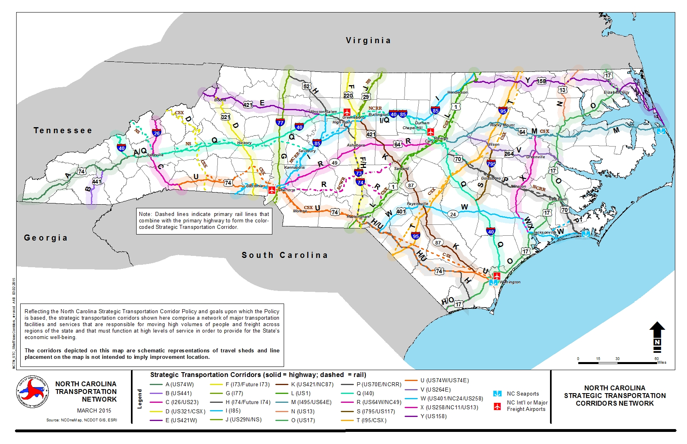
STC Network

Slide 19
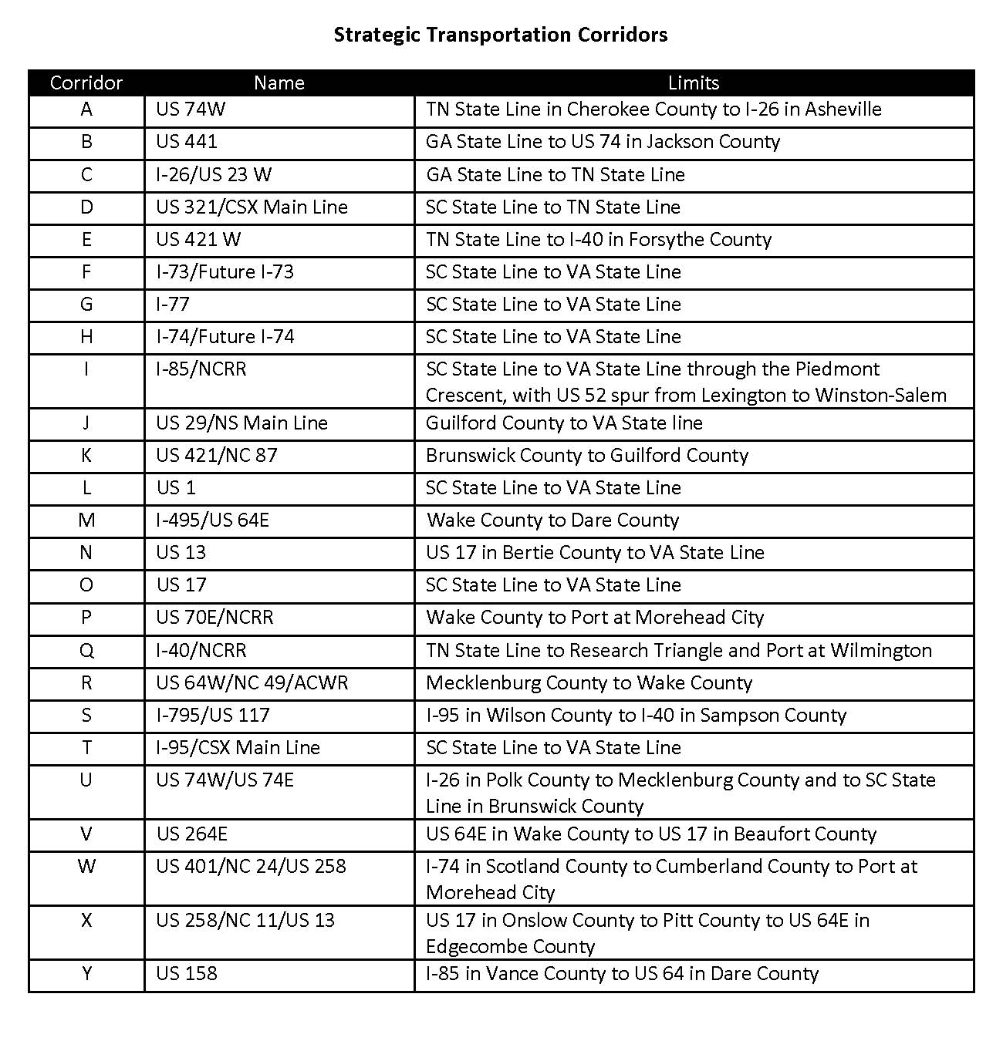
STC Summary
25 corridors of varying length
Responding to regional and statewide issues and opportunities
All regions of state
Varying lengths reflecting travel markets

Slide 20
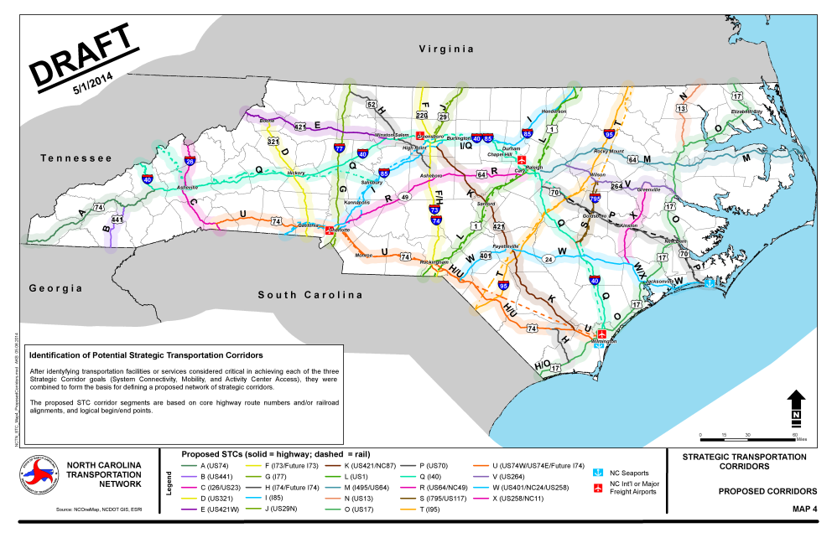
Stakeholder engagement summary
On-going coordination with MPOs, RPOs, and key stakeholders
Two rounds of public review
7 regional workshops & statewide webinar
60-day policy comment period – electronic process
20

Slide 21
HOW WILL STCs BE USED?
STCs are a planning tool, supporting multiple NCDOT activities:
Comprehensive Transportation Plans, by defining corridors with the highest levels of statewide interest
Project development, by providing system-level input to Purpose & Need
Access management, by establishing corridors needing high levels of access control
Notes:
By working with stakeholders, NCDOT is:
Defining the role of NC’s transportation system elements in providing mobility and land access, within a consistent modal framework (NCTN)
Identifying a network of strategic multimodal corridors that link significant activity centers, serve as critical corridors for statewide goods and person movement, and ensure system continuity (STCs)
Tools can support Comprehensive Transportation Plans, project development, access management, and design standards.

Slide 22
STC Policy and NEPA
Preserve and support prior project development decisions based on SHC (including environmental studies, purpose and need, alternative screening, etc.)
STC does not replace, modify or negate ongoing or prior project development decisions that reference SHC policy. Those decisions remain valid and are incorporated into STC by reference.

Slide 23
Thank you.
Further Questions?
Kerry Morrow, NCDOT kmorrow@ncdot.gov

