Slide 1
WELCOME
N.C. DEPARTMENT OF TRANSPORTATION
MATERIALS AND TESTS UNIT
FIELD CONCRETE CERTIFICATION SCHOOL

Slide 2
Materials & Tests Contacts
Jim Sawyer, Field Services Engineer
919-329-4170
Assistance call:
Phone 919-329-4240
Email concretetrng@ncdot.gov
Materials and Tests Unit on the Web
https://apps.dot.state.nc.us/dot/directory/authenticated/UnitPage.aspx?id=2824
Notes:
2

Slide 3
Concrete Field Technician School
Requirements for Certification
ACI Field Testing Technician Level I
Written Test (closed book)
Field Performance Tests
NCDOT Field Testing Technician
On-Line Test
Class Quiz (open book)
Chase Indicator Test (Performance – Field Test)
Requirements MUST be completed in ONE year.

Slide 4
FREQUENTLY ASKED QUESTIONS

Slide 5
Certifications
Q1)
My ACI Certification is good for another year, but my NCDOT Field Technician certification expired this year. May I continue to test concrete?
A1)
No. The technician is not allowed to sample and test concrete until the certificate is renewed.
Must have both ACI and NCDOT.

Slide 6
Paperwork
Q2) What paperwork is required on the materials?
A2) The plant is responsible for and must supply copies of certifications for all cement, fly ash, slag, fine, and coarse aggregates, all admixtures, and the water source.

Slide 7
Paperwork
Q3) What forms are sent by a Plant to the Project?
A3) The plant sends a MT250 with the first and last load each day. The plant sends a MT903 with every load.

Slide 8
INTRODUCTION TO PORTLAND CEMENT CONCRETE

Slide 9
Class Goals?
To get NCDOT Certified.
To get ACI Certified.
To learn the basics of concrete.

Slide 10
WHAT IS CONCRETE?
Concrete is a manufactured product.
Subject to variations in Quality due to varying raw materials and of the mixing process.
Quality Control is our job, without “QC” concrete is: -UNPREDICTABLE -UNREGULATED -WITHOUT VALUE AS A BUILDING MATERIAL

Slide 11
PORTLAND CEMENT CONCRETE
CONCRETE CONSISTS OF:
Portland Cement
Fine Aggregate
Coarse Aggregate
Water -
Admixtures
Air Agents
Retarders

Slide 12
CONCRETE INGREDIENTS
CEMENT - The bonding agent.
FINE AGGREGATE - Gives the mix workability.
COARSE AGGREGATE - Filler material, aids in strengthening the concrete mix.
Water - Causes chemical reaction in the concrete mix by reacting with the cement - Hydration.
AIR AGENT - Used to entrain air in concrete.
RETARDER - Used to slow setting time.

Slide 13
Components of Concrete
Concrete is made up of two components:
Aggregates & Paste
Notes:
13

Slide 14
AGGREGATES
Classified into two groups:
Fine or Sand
Coarse or Stone
Notes:
14

Slide 15
PASTE: Cement, Water and Entrained Air
Constitute 20 to 40 Percent of the total volume of the mix.
The quality of the concrete is dependent upon the quality of the paste, which in turn, is dependent upon:
1. The ratio of water to the cement content used
(W/C Ratio)
2. Extent of curing

Slide 16
Components of Concrete
“General Proportions”
Aggregate (Coarse and Fine) 60-80%
Paste (Cement, Water, Entrained Air) 20-40%
“Common” Mix Design Percentages
Cement 11%
Water 17%
Air (entrained) 6% optimal (can range from 4.5 – 7.5%)
Coarse Aggregate 39%
Fine Aggregate 27%

Slide 17
Components of Concrete
Mortar – a mixture of cement paste and fine aggregate

Slide 18
HYDRATION
The chemical reaction between water and cement.
WATER + CEMENT = HYDRATION
When HYDRATION stops -- strength gain stops!
Concrete needs moisture so hydration can continue--this is why curing is so important!
Notes:
18

Slide 19
Desirable Properties of Concrete
Durability - Ability of hardened concrete to resist deterioration caused by weathering.
Workability - Ease of placing, handling, and finishing.
Weather Resistant - Resistance to deterioration caused by freeze-thaw cycles.
Erosion Resistant - Resistance to deterioration caused by waterflow, traffic, & wind blasting.
Chemical Resistant - Resistance to deterioration caused by de-icing salts, salt water, & sulfate salts.
Notes:
19

Slide 20
Desirable Properties of Concrete
Water Tightness - Resistance to water infiltration.
Strong - Ability to with-stand all the elements, and meet the structural requirements.
Economical - Concrete must be able to be produced and sold for a profit $$$.
Notes:
20
This is about achieving results, not micro-managing.
Be specific in our expectations and mutually commit ourselves to get the desired results.

Slide 21
Ingredients In Concrete
CEMENT -The bonding agent used in a concrete mix.
Five Types of Cement
Type I
Type II
Type III
Type IV
Type V

Slide 22
Type I
General Purpose Cement.
Used when the special properties of the other types are not required.
Type II
Less Heat, at a slower rate
Usually generates less heat, at a slower rate than type I or the general-purpose cement.
Notes:
22
When we are empowered to make our own decision and act for ourselves, we take a more personal interest in our work and achieve benefits for both ourselves and the Unit.

Slide 23
Type III
High Early Strength due to high fineness and amount of tricalcium silicate
Richer mixes with a higher cement content of Type I or Type II, may be used to gain early strength instead of using Type III.
Notes:
23
When we are empowered to make our own decision and act for ourselves, we take a more personal interest in our work and achieve benefits for both ourselves and the Unit.

Slide 24
Type IV
Used in mass concrete structures.
Type V
Used in concrete exposed to severe sulfate action.
Used mostly in the western parts of the United States.
Notes:
24
When we are empowered to make our own decision and act for ourselves, we take a more personal interest in our work and achieve benefits for both ourselves and the Unit.

Slide 25
Properties of Portland Cement
1. Fineness
As cement fineness increases, the rate of reaction increases and strength development is accelerated.
2. Setting Time
The time that it takes a cement paste to begin hardening.
Notes:
25
We are going to enter into a contract improve our work.
To do this there are 6 areas we must address

Slide 26
Properties of Portland Cement (cont.)
3. False Set - A significant loss of plasticity shortly after the concrete is mixed, without the evolution of much heat.
Further mixing without additional water can typically restore plasticity.
Most common cause, heating of the cement during the grinding process.
Notes:
26
We are going to enter into a contract improve our work.
To do this there are 6 areas we must address

Slide 27
Properties of Portland Cement (cont.)
4. Heat of Hydration
The heat generated when cement and water react.
The amount of heat is based on the chemical composition of the cement.
The rate of heating is affected by
1. Fineness
2. Temp of curing
3. Chemical Composition

Slide 28
Properties of Portland Cement (cont.)
5. Quick Set / Flash Set
Occurs when cement is insufficiently retarded.
Initial setting time is less than one hour at normal temperature.
6. Specific Gravity
Portland Cement is 3.15
Notes:
28
When we are empowered to make our own decision and act for ourselves, we take a more personal interest in our work and achieve benefits for both ourselves and the Unit.

Slide 29
Shipping and Storage
Most cement is shipped in bulk.
Rail, Truck, Barge
Measured in Hundredweight: HWT
Available in bags.
94 pound bag is industry standard
Must be kept DRY!

Slide 30
Initial Set
The concrete paste gradually loses plasticity.
The point when concrete starts to lose fluidity and shows the first signs of stiffening.
Usually 2 to 4 hours after the cement comes in contact with water.

Slide 31
Final Set
The point when concrete has lost fluidity and shows consistency of a stiff mass without appreciable strength, usually 5 to 8 hours after cement contacts water.
Strength gain takes place after the concrete reaches final setting.

Slide 32
Fly Ash
A by-product of the burning of coal in power plants.
Fly ash particles are typically spherical.
The chemical composition is determined by: Type of Coal and the Burning Process
Ideal fly ash has high fineness and low carbon content.
Notes:
32
When we are empowered to make our own decision and act for ourselves, we take a more personal interest in our work and achieve benefits for both ourselves and the Unit.

Slide 33
Pozzolans
A material which possesses little or no cementitious value but which will, in finely divided form and in the presence of water and cement, react chemically like a cement.
Fly ash is a commonly used type of Pozzolan.
Notes:
33
When we are empowered to make our own decision and act for ourselves, we take a more personal interest in our work and achieve benefits for both ourselves and the Unit.

Slide 34
Benefits of Pozzolans
Fresh Concrete
Reduce water requirements
Increase workability
Notes:
34
When we are empowered to make our own decision and act for ourselves, we take a more personal interest in our work and achieve benefits for both ourselves and the Unit.

Slide 35
Benefits of Pozzolans
Hardened Concrete
Postpone strength gain
Reduce drying shrinkage
Improve water tightness
Improve resistance to sulfates in soils and water.
To inhibit and reduce alkali-aggregate reaction.
Reduce heat of hydration of massive members.
Notes:
35
When we are empowered to make our own decision and act for ourselves, we take a more personal interest in our work and achieve benefits for both ourselves and the Unit.

Slide 36
Mixing Water
In general, use water that is suitable to drink. (No more acidic than 4.5 and no more basic than 8.5 on the pH scale)
Water is added during batching:
Volumetrically
By weight
To convert volume to weight:
1 gallon of water = 8.33 pounds
32.0 gallons of water x 8.33 = 267 pounds of water

Slide 37
Aggregates
Two types:
Fine
Coarse
Comprise 60-80 % of the concrete mix.
Well-graded aggregate blend with low void content is desired for efficient use of paste.

Slide 38
Characteristics of Aggregates
1. Resistance to Freezing and Thawing
(important in structures subjected to weathering)
Related to its: Porosity, Absorption, and Pour Structure.
Sodium Sulfate Soundness Test
2. Abrasion Resistance--is the ability to withstand loads without excessive wear or deterioration of all types of structures.
Los Angeles Abrasion Test
3. Chemical Stability: Important to strength and durability of all types of structures.
Notes:
38
When we are empowered to make our own decision and act for ourselves, we take a more personal interest in our work and achieve benefits for both ourselves and the Unit.

Slide 39
Characteristics of Aggregates (cont.)
Aggregates must not be reactive with cement alkalies.
Reaction may cause:
Abnormal Expansion
Map-cracking of concrete
4. Particle Shape and Surface Texture - (Important to the workability of fresh concrete.)
Rough textures or flat and elongated require more water than round or cubical aggregates.
5. Grading - (Important to the workability of fresh concrete) The grading, or particle size distribution of an aggregate is determined by a sieve analysis.
Notes:
39
When we are empowered to make our own decision and act for ourselves, we take a more personal interest in our work and achieve benefits for both ourselves and the Unit.

Slide 40
6. Specific Gravity - is the ratio of its weight to the weight of an equal volume of water at a given temperature
Characteristics of Aggregates (cont.)
7. Absorption & Surface Moisture - moisture conditions of aggregates: Oven Dry, Air Dry, Saturated Surface Dry, and Wet with Free Moisture.
8. Dry-Rodded Unit Wt. - is the weight of one cubic foot of dry coarse aggregate that is compacted by rodding in a standard container in three equal layers.
For any one aggregate the dry-rodded unit wt. Varies with size and gradation.
Notes:
40
When we are empowered to make our own decision and act for ourselves, we take a more personal interest in our work and achieve benefits for both ourselves and the Unit.

Slide 41
Admixtures
All materials other than cement, water, and aggregates that are added to concrete.

Slide 42
NCDOT Common Admixtures
Air-entraining admixtures
Retarding admixtures
Water-reducing admixtures
Pozzolans (Fly Ash)
Super Plasticizers
All admixtures must be on the Approved List!

Slide 43
AIR-ENTRAINING ADMIXTURES
Most Commonly Used Admixture
This admixture is introduced into the batch of concrete with water, and after mixing occurs, microscopic air bubbles are created and are distributed through-out the load.
The purpose of the microscopic bubbles is to allow water within the concrete to flow into reservoirs and undergo freeze - thaw cycles without damage to the concrete. This is known as DURABILITY.
Notes:
43
When we are empowered to make our own decision and act for ourselves, we take a more personal interest in our work and achieve benefits for both ourselves and the Unit.

Slide 44
Effects of Entrained Air
Durability (Freeze Thaw Resistance) is improved.
Workability is improved
Strength is reduced. Strength reduction can be minimized because the improved workability allows for a lower water-cement ratio.

Slide 45
Factors Affecting Air Content
Coarse Aggregate Gradation: For aggregate sizes smaller than ¼” the air content increases sharply because of increase in mortar volume.
Fine Aggregate Content: Increase in fine aggregate causes an increase in air content with a given amount of air entraining agent.
Cement: Increase in cement content decreases air content

Slide 46
Factors Affecting Air Content (cont.)
Slump: The air content increases up to 7”, and decreases with further increases in slump.
Temperature: Less air is entrained as the temperature of the concrete increases.
The amount of air specified in air entrained concrete depends on the type structure and the extent of exposure to harsh conditions.

Slide 47
RETARDING ADMIXTURES
Used to delay the setting time of concrete.
To offset the accelerating effect of hot weather on the setting of concrete
To provide time for difficult placing or finishing in large concrete pours (bridge decks, piers, etc.).

Slide 48
WATER-REDUCING ADMIXTURES
Used to reduce the quantity of mixing water required to produce concrete of a given consistency.

Slide 49
Accelerating Admixtures
Used to reduce the accelerate the setting time and the strength development of concrete.
NCDOT Specifications do not allow the use of an accelerator except when approved by the Engineer.

Slide 50
Superplasticizer Admixtures
These admixtures are high range water reducers that can reduce water demand up to 20%.
Effects and Uses of “Supers”
Used for pumped or tremied mixes.
Lower water-cement ratio
Increase flowability
Used for precast production

Slide 51
Alkali Silica Reactivity
Alkali Silica Reactivity is a chemical reaction that deteriorates hardened concrete. The reaction occurs when alkali rich fluid present in concrete react with siliceous minerals in aggregate.
The product of this reaction is a gel that may absorb water and increase in volume over time.
The alkali-silicate gel does not always cause damage to the concrete; however the gels can absorb large quantities of water.

Slide 52
Alkali-Silica Reactivity
The absorption of large quantities of water generate pressure that ruptures the aggregate particles and causes cracking.
Reactions usually become visible in five to ten years after placement of concrete.
Reactive aggregates, alkalis, and water must be present for reaction to occur. If any of the three are missing the reaction will not occur.

Slide 53
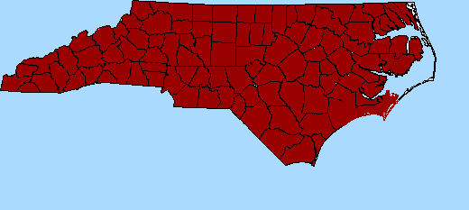
STANDARD SPECIFICATIONS FOR
ROADS AND STRUCTURES
Page 41

Slide 54
NCDOT STANDARD SPECIFICATIONS
This presentation will cover the following sections:
Section 420 - Concrete Structures
Section 1000 - Portland Cement Concrete Production and Delivery

Slide 55
NCDOT STANDARD SPECIFICATIONS
Section 420: CONCRETE STRUCTURES

Slide 56
420-4 Placing Concrete
TEMPERATURE OF THE CONCRETE:
Temperature of the concrete can neither exceed 95⁰F nor fall less than 50⁰F
EXCEPTION: Temperature for bridge decks and drill shafts shall range from 50⁰ TO 90⁰ F
Confine concrete dropped more than 5 feet
Thoroughly wet existing concrete for a minimum of 2 hours before placing additional concrete

Slide 57
420-4 Placing Concrete
Pg 52
If concrete is found to be porous, cracked, plastered or otherwise defective:
Repair, remove, or replace in whole or in part as directed and at no additional cost to the department

Slide 58
420-5 Pumping Concrete
Permitted only when approved:
DO NOT USE PUMPING EQUIPMENT WHICH CONTAINS ANY ALUMINUM OR ALUMINUM ALLOY.
WASTE ALL GROUT USED TO LUBRICATE THE INNER SURFACES OF THE CONDUIT SYSTEM.
TAKE SAMPLES OF CONRETE FOR TEST PURPOSES FROM THE DISCHARGE END OF THE CONDUIT SYSTEM!!!!

Slide 59
420-6 Slump Tests
DETERMINED IN ACCORDANCE WITH AASHTO T119.
If a slump exceeds the maximum specified limit, a separate sample is immediately obtained from the same truckload and slump test is performed again
If the average of the 2 tests exceeds specified maximum slump:
The truck is to be rejected

Slide 60
420-7 Cold Weather
I. TAKE PRECAUTIONS
(a) Usually 35º F. lowest air temp.
(b) Concrete Temp. Minimum 50º F.
(c) Temp. of heated concrete is 55-80°F.
(d) Aggregates or water not heated to a temperature higher than 150ºF.

Slide 61
420-7 Cold Weather
Protect all concrete by means of heated enclosures or by insulation whenever any of the following occur:
The concrete is placed when the air temperature is below 35°F.
The air temperature at the location of the freshly placed concrete is below 35°F and the concrete has not yet attained an age of 72 hours or an age of 48 hours when using high-early concrete. If the mix contains fly ash or slag the concrete must be protected for 7 days.

Slide 62
420-7 (B) Heated Enclosures
Immediately enclose Portland cement concrete that is placed when the air temperature is below 35°F, and Portland cement concrete that has not yet attained an age of 72 hours before the air temperature falls below 35°F, with a housing consisting of canvas or other approved material.

Slide 63
Heated Enclosures
Maintain the air surrounding the concrete at a temperature of not less than 50°F nor more than 90°F for the remainder of the 72 hour period.
For high early strength concrete, the time requirement is reduced from 72 hours to 48 hours.

Slide 64
420-7 (C) Insulation
When using insulation for cold weather protection, batch concrete for sections 12” or less in thickness as follows:
Use Type III portland cement without any increase in cement content, or use Type 1 or II portland cement with the cement content increased to 1.80 barrels per cubic yard.

Slide 65
Insulation
When the mix includes fly ash, use 572 lbs per cubic yard of cement and a minimum of 172 lbs per cubic yard of fly ash.
When the mix includes ground granulated blast furnace slag, use a mix containing 465 lbs per cubic yard of cement and 250 lbs per cubic yard of ground granulated blast furnace slag.

Slide 66
Insulation (cont.)
Should the air under the insulation fall below 50°F during the protection period, immediately cover the concrete with canvas and framework and apply heat uniformly at a rate such that the air surrounding the concrete is not less than 50°F for the remainder of the protection period.

Slide 67
420-14 BRIDGE DECKS
DO NOT place bridge deck concrete until the engineer is satisfied that adequate personnel and equipment are present to deliver, place, spread, finish, and cure the concrete within the scheduled time

Slide 68
Bridge Deck Placing
Place concrete in the deck when the concrete temperature at the time of placement is not less than 50°F, nor more than 90°F, except where other temperatures are required by Article 420-7.
Place concrete at a minimum rate of 35 cubic yards per hour.

Slide 69
420-14 (B) Finishing
Unless otherwise specified or permitted, use mechanically operated longitudinal or transverse screeds for finishing bridge deck concrete.
Do not use vibratory screeds unless specifically approved.
Use readily adjustable screeds with sufficient rigidity and width to strike-off the concrete surface at the required grade.

Slide 70
Finishing
During the screening operation, keep an adequate supply of concrete ahead of the screed and maintain a slight excess in front of the screed.
Operate the screed to obtain a uniform finish over the entire bridge deck.
Use a minimum of 2 approved work bridges to provide access for the purpose of finishing, testing, straightedging, fogging, and any other operations requiring access to the bridge deck.

Slide 71
Finishing
Provide on site fogging equipment which is capable of applying water to the concrete in the form of a fine mist in sufficient quantity to curb the effects of rapid evaporation of mixing water resulting from wind, high temperature, or low humidity, or a combination of these factors.
Do not apply the moisture from the nozzle under pressure directly upon the concrete and do not allow it to accumulate on the surface in a quantity sufficient to cause a flow.

Slide 72
Finishing
Unless otherwise indicated on the plans, groove bridge decks. Produce grooves that are perpendicular to the centerline of the bridge.
Continuously remove all slurry or other residue resulting from the grooving operation from the bridge deck by vacuum pick-up or other approved methods.

Slide 73
420-14 (C) Inspection
After the deck concrete is in place for a minimum of 2 days, test the concrete for soundness and bonding of the metal stay-in-place forms by sounding with a hammer as directed.
For a minimum of 50% of the individual form panels, as selected by the Engineer, hammer test over the entire area of the panel.
In areas of doubtful soundness, remove the forms for visual inspection after the pour attains a minimum compressive strength of 2400 psi.

Slide 74
Inspection
As soon as the forms are removed, allow the Engineer to examine for cavities, honeycombing and other defects.
If irregularities are found, and in the opinion of the Engineer these irregularities do not justify rejection of the work, repair the concrete as directed.
Remove and repair all unsatisfactory concrete as directed.

Slide 75
420-15 Curing Concrete
Unless otherwise specified in the contract, use of membrane curing compounds on the bridge deck is not permitted unless permitted in conjunction with the polyethylene sheeting method or on concrete which is to receive epoxy protective coating in accordance with 420-18.
Notes:
75

Slide 76
Curing Concrete
Curing temperature is defined as the atmospheric temperature taken in the shade away from artificial heat, with the exception that it is the temperature surrounding the concrete where the concrete is protected in accordance with Article 420-7.
Notes:
76

Slide 77
Curing Concrete
A curing day is defined as any consecutive 24-hour period, beginning when the manipulation of each separate mass is complete, during which the air temperature adjacent to the mass does not fall below 40°F.
After placing the concrete, cure it for a period of 7 full curing days.
Notes:
77

Slide 78
Curing Concrete
Take all reasonable precautions to prevent plastic shrinkage cracking of the concrete, including the provision of wind screens, fogging, application of an approved temporary liquid moisture barrier, or the early application of temporary wet coverings to minimize moisture loss.
Notes:
78

Slide 79
Curing Methods-Water
Keep the concrete continuously wet by the application of water for a minimum period of 7 curing days after placing the concrete.
DO NOT apply the moisture from a nozzle under pressure directly upon the concrete and do not allow it to accumulate on the concrete in a quantity sufficient to cause a flow or wash the surface.

Slide 80
Membrane Curing Compound
Use clear curing compound to which a fugitive dye is added for color contrast on bridge superstructures and substructures, and on retaining walls.
Apply the curing compound after the surface finishing is complete, and immediately after the free surface moisture disappears.

Slide 81
Membrane Curing Compound
Apply curing compound at a rate of coverage recommended by manufacturer or as directed, but not less than 1 gallon per 150 sq ft of surface area.
Protect the concrete surfaces to which the compound is applied from abrasion or other damage that results in perforation of the membrane film for 7 curing days after placing the concrete.
Notes:
81

Slide 82
Polyethylene Sheeting
Use sheeting which provides a complete continuous cover of the entire surface.
Lap the sheets a minimum of 12” and securely weigh down or cement together in such a manner as to provide a waterproof joint.

Slide 83
Forms In Place
If electing to leave forms in place for a part of the curing period and using one of the other methods of curing for the remainder of the curing period, keep the concrete surfaces wet during transition between curing methods.

Slide 84
420-16 Removal of Forms and Falsework
Do not remove forms and falsework for the portions listed in Table 420-1 until the concrete attains the compressive strength shown.
Bridge Deck Slabs- 3,000 psi
Top and Wall of Box Culvert – 2,400 psi
Notes:
84

Slide 85
Removal of Forms
Remove forms for parapets, walls less than 10 feet in height, curb faces on bridge superstructure, and vertical loads that do not carry loads, any time after 3 hours if the concrete is set sufficiently to permit form removal without damage to the member.
Do not remove forms used for insulation before the expiration of the minimum protective period.

Slide 86
420-20 Placing Load on Structure Members
Do not place beams or girders on concrete substructures until the concrete in the substructure develops a minimum compressive strength of 2,400 psi.
Do not place vehicles or construction equipment on a BRIDGE DECK until the deck concrete develops the minimum specified 28 day compressive strength and attains an age of at least 14 curing days.

Slide 87
Placing Load on Structure Members
Construction equipment is allowed on bridge APPROACH SLABS after the slab concrete develops a compressive strength of at least 3,000 psi and attains an age of at least 7 curing days.
Do not abruptly start or stop concrete trucks on bridge deck.
Do not mix concrete in the truck while on the deck.

Slide 88
NCDOT STANDARD SPECIFICATIONS
Division 10: Materials, Section 1000

Slide 89
1000-1 Description
Mixes for all portland cement concrete covered by this section shall be designed by a Certified Concrete Mix Design Technician.
When concrete being placed in one pour is furnished by more than one concrete plant, use the same mix for all concrete, including sources of cement, sand, stone, pozzolan, and admixture.

Slide 90
1000-4(A) Composition and Design
Submit mix designs in terms of saturated surface dry weights on M&T Form 312U at least 35 days prior to proposed use.
Adjust batch proportions to compensate for surface moisture contained in the aggregates at the time of batching.
Notes:
90

Slide 91
Composition and Design
Changes in the saturated surface dry mix proportions will not be permitted unless revised mix designs have been submitted to the Engineer and approved.
The Engineer will review the mix design for compliance with the Specifications and notify the contractor as to its acceptability.

Slide 92
1000-4(B) Air Entrainment
Add an air entraining agent at the time of mixing to produce an air content in the freshly mixed concrete of 6.0 percent plus or minus 1.5 percent when tested at the job site.
Air entrainment may be added at the job site when permitted by the Engineer.

Slide 93
1000-4(B)Strength of Concrete
The compressive strength of the concrete will be considered the average compressive strength test results of two 6” x 12” cylinders, or two 4” x 8” cylinders if the aggregate size is not larger than 57 or 57M
The average compressive strength of the concrete test cylinders must meet or exceed the minimum strength specified in Table 1000-1.

Slide 94
1000-4(D)Temperature Requirements
The concrete temperature at the time of placing in the forms shall not be less than 50°F nor more than 95°F except where other temperatures are required by Articles 420-8, 420-9 and 420-15.

Slide 95
Temperature Requirements
Do not place concrete without permission when the air temperature measured at the location of the concrete operation in the shade away from artificial heat is below 35°F.

Slide 96
Temperature Requirements
When such permission is granted, uniformly heat the aggregates and/or water to a temperature not higher than 150°F.
Do not place heated concrete in the forms if the temperature is less than 55°F or more than 80°F.

Slide 97
1000-4(E)Elapsed Time for Placing Concrete
Regulate delivery so that the maximum interval between the placing of batches at the work site does not exceed 20 minutes.
Place concrete before the time between adding the mixing water to the mix and placing the concrete in the forms does not exceed that set forth in Table 1000-2.

Slide 98
1000-4(F)Use of Set Retarding Admixtures
Use an approved set retarding admixture in all concrete placed in the superstructure of bridges such that the concrete will remain workable until the entire operation of placing and finishing, including corrective measures, if necessary, has been completed.

Slide 99
1000-4(H) Use of Calcium Chloride
Calcium chloride may be used as a set accelerating agent where permitted by the Engineer.
Do not use calcium chloride where steel reinforcement, metal conduit, or other metals will be in contact with the concrete.
Provide cold weather protection for concrete containing calcium chloride in the same manner as is provided for concrete without calcium chloride.

Slide 100
1000-4(I) Use of Fly Ash
Fly ash may be substituted for portland cement in all classes of concrete at a rate not to exceed 20% by weight of the required cement noted in Table 1000-1.
Substitute at least 1.2 pounds of fly ash per pound of cement replaced.
Use the table located in 1000-4(I) to determine the maximum allowable water-cementitous ratio for the classes of concrete listed.

Slide 101
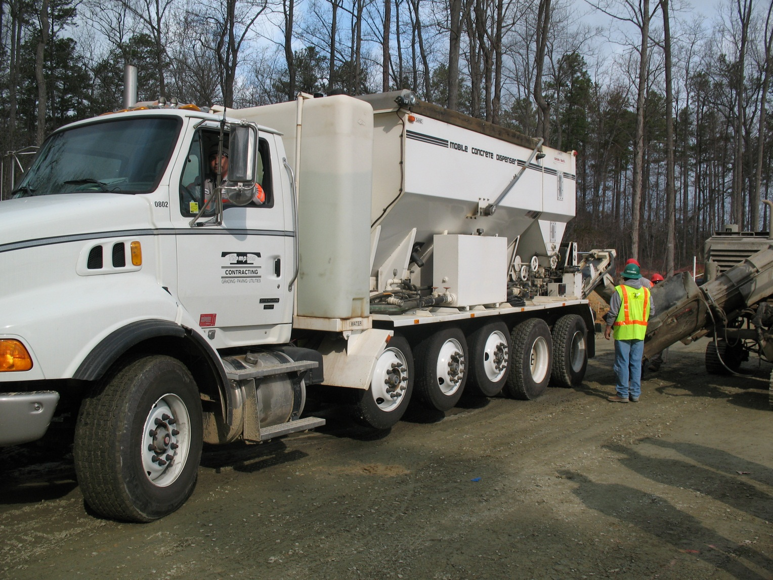
1000-8 Latex Modified Concrete

Slide 102
1000-8(A) Materials
Do not use Type III cement.
Do not allow the temperature of latex emulsion admixture to fall below 35°F at any time or exceed 85°F after delivery to the project.
The minimum 7 day compressive strength is 3,000 psi.
Measure the slump 4 to 5 minutes after discharge from the mixer.

Slide 103
1000-8(B) Equipment
Use a self propelled mixer that is capable of carrying sufficient unmixed dry, bulk cement, sand, coarse aggregate, latex modifier, and water to produce at least 6 cy of concrete on site.
Use a mixer that is capable of positive measurement of cement introduced in the mix.

Slide 104
Equipment
Use a recording meter that is visible at all times and equipped with a ticket printout to indicate the quantity of cement.
Calibrate the mixers to accurately proportion the specified mix.
Prior to placing latex modified concrete, perform calibration and yield tests under the Engineer’s supervision in accordance with the Department’s written instruction.

Slide 105
Equipment
Perform the calibration and yield tests using the material to be used on the project.
Recalibrate the mixer after any major maintenance operation on the mixer, anytime the source of materials changes, or as directed.
Use a mixer that controls the flow of water and latex emulsion with a calibrated flowmeter coordinated with both the cement and aggregate feeding mechanisms and the mixer.

Slide 106
Equipment
Calibrate the mixer to automatically proportion and blend all components of the indicated composition on a continuous or intermittent basis as the finishing operation requires.

Slide 107
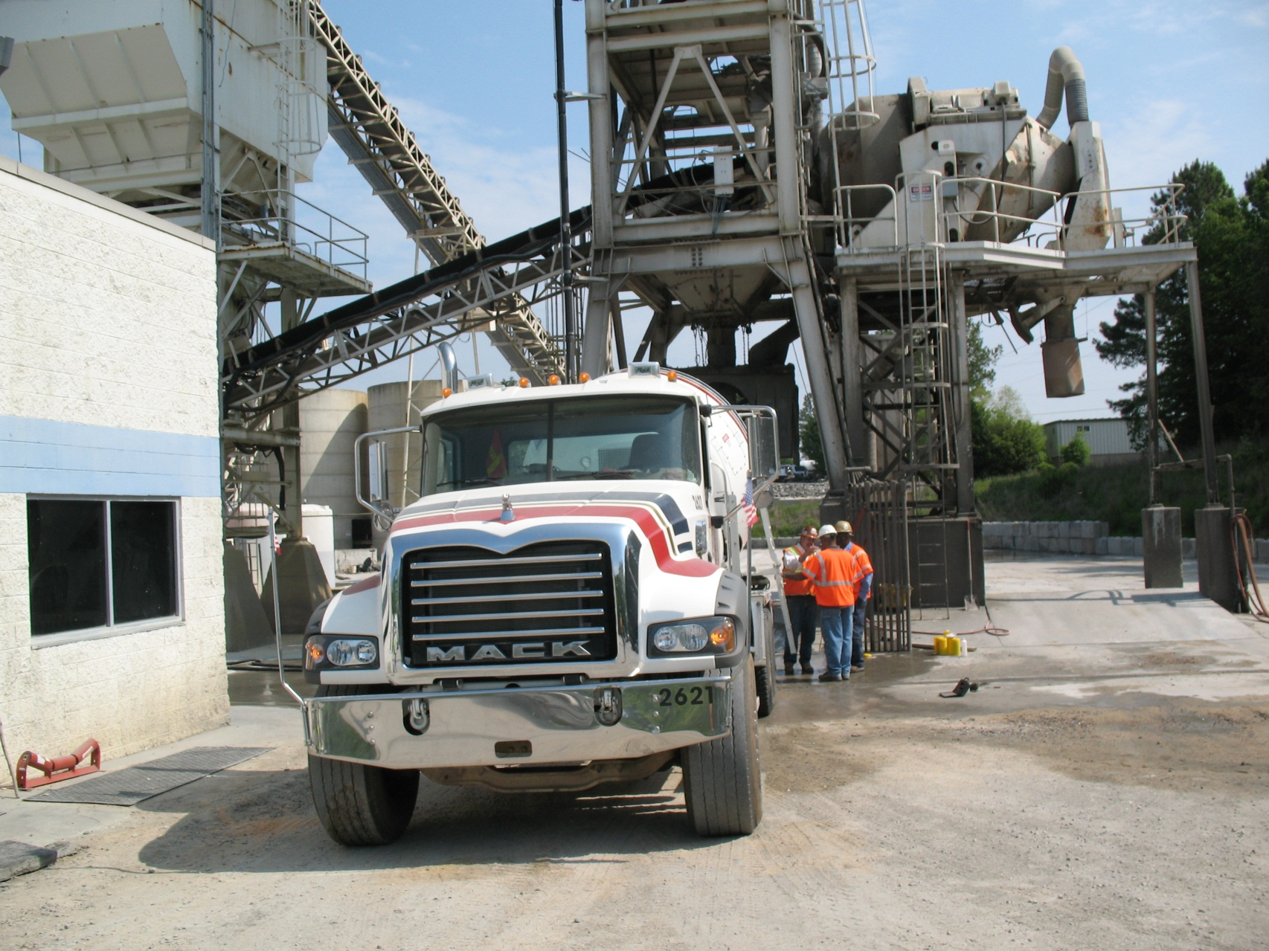
1000-11 Mixers and Agitators

Slide 108
1000-11(B) Mixer Capacity
Do not load truck mixers with concrete with more than 63% of the gross volume of the drum.
Use at least 20% of the rated mixing capacity as the minimum quantity of concrete permitted to be mixed or agitated in any mixer.

Slide 109
1000-11(C) Agitator Capacity
Load the agitator to not exceed 80 percent of the gross drum volume and have it be capable of maintaining the concrete in a thoroughly mixed and uniform mass and discharging the concrete with a satisfactory degree of uniformity.

Slide 110
1000-12(B)Mixing Time for Central Mixers
Where mixer performance tests are not made, use a minimum mixing time of 90 seconds.
The minimum mixing time for an individual mixer with a mixer performance test is 50 seconds.

Slide 111
1000-12(C) Truck Mixers and Agitators
When a truck mixer is used for complete mixing, mix each batch of concrete for at least 70 revolutions of the drum or the blades at the rate of rotation designated by the equipment manufacturer for mixing.
If additional water is necessary to produce the necessary slump, rotate the drum 25 revolutions at mixing speed.

Slide 112
1000-12(D) Delivery
Use a ticket system for recording the transportation of batches from the proportioning plant to the site of the work.
Issue the tickets to the truck operator at the proportioning plant for each load and have them signed by the plant inspector.
Have each ticket show the time batching was completed.
Deliver the tickets to the inspector at the site of the work.

Slide 113
Hot Weather Concrete
Placing concrete in hot weather requires good planning. High temperature accelerates the hardening of concrete.
Potential detrimental effects of hot weather on concrete include increased water demand, difficulty in control of entrained air, accelerated set, and lower strength.

Slide 114
Hot Weather Concrete
High air temperature can result in very unfavorable concrete placing conditions when combined with low humidity, and/or high winds.
This is true in situations where concrete is placed in elements having large exposed surface areas as in the case of exposed concrete slabs.

Slide 115
Hot Weather Concrete
Examples of materials and materials that complicate hot weather operations are
Use of Type III Cement
Use of Concrete with Higher Cement Contents
Use of Larger Size Mixers
Use of Pumping Equipment
Larger Concrete Pours

Slide 116
Planning for Hot Weather
In hot weather conditions mixing water can rapidly evaporate from the concrete mixture during transportation with a corresponding loss of workability.
If water is added to the mix at the job site, the water/cement ratio could be increased beyond its original design, resulting in decrease of compressive strength.

Slide 117
Planning for Hot Weather
In hot weather concrete, the amount of water loss to evaporation depends on temperature of air and concrete, wind, and type of components in the mix.
Additional water is needed to maintain the required slump. The W/C ratio is increased and the strength weakened.

Slide 118
Planning for Hot Weather
Minimize the potential detrimental effects of hot weather by decreasing the temperature of the concrete mix.
Keep the concrete components as cool as possible.
The component easiest and most practical to cool is water.

Slide 119
Planning for Hot Weather
Water can be cooled down by the use of chillers or the concrete mix can be cooled by the use of ice.
Ice used as a cooling agent in concrete must be crushed or flaked.
Substitution of ice for water must be done on a pound per pound basis.

Slide 120
ICE - ADDED TO MIXERS
Use Crushed or Flaked Ice
Use Pound For Pound of Mixing Water
Must be completely melted before concrete is discharged from the mixer.

Slide 121
ETHICS
North Carolina Department of Transportation

Slide 122
Ethics
Ethics is defined as a set of rules or standards governing the conduct of a person or the members of a profession.
Employees of the NCDOT are expected to conduct themselves in a manner that prevents all forms of impropriety.

Slide 123
NCDOT Ethics Policy
Members of the board, officers, and employees of the Department of Transportation shall ensure that an atmosphere of ethical behavior is promoted and maintained at all times.

Slide 124
Definitions
Conflict of Interest
Arises when an employee’s private interest, usually of a personal, financial or economic nature, conflicts or creates the appearance of a conflict with the employee’s public duties and responsibilities.
Gifts
Anything of value given without compensation.

Slide 125
Definitions
Favor
Any opportunity, service, accommodation, use of facility, or other benefit made available for less than fair market or normal value given in exchange for being influenced in the discharge of one’s duties and responsibilities.

Slide 126
Conflict of Interests
No employee shall use or attempt to use his or her position with the NCDOT to secure unwarranted privileges.
No employee authorized to draft, negotiate, administer, accept or approve any contract on behalf of the State shall have directly or indirectly any financial interest in such a contract.

Slide 127
Business Opportunities
No employee or member of his/her immediate family shall accept any business or professional opportunity when such person knows that the opportunity is being afforded to them with the intent to influence the performance of the employee’s official duties.

Slide 128
Use of Information
No employee shall use, disclose, or allow the use of official information which was obtained through his or her official duties and which has not been made available to the general public, for the purpose of furthering the private interest or personal profit of any business entity or person, including the employee.

Slide 129
Gifts and Favors
No employee should knowingly ask, accept, demand, or agree to receive anything of value in return for being influenced in the discharge of the employee’s duties and responsibilities.

Slide 130
Enforcement and Compliance
Failure to comply with the policy will be grounds for disciplinary action up to and including dismissal.
Conflicts of interest or unethical behavior that defrauds the Department, vendor, contractor, or supplier may also be violations of criminal law and may result in criminal prosecution.

Slide 131
FALSIFICATION

Slide 132
North Carolina State Law
Any person who knowingly falsifies any inspection report or test report required by the Department of Transportation in connection with the construction of highways shall be guilty of a Class H felony.

Slide 133
NC State Law
Any person who directs a subordinate under his direct or indirect supervision to falsify an inspection report or test report required by the Department of Transportation in connection with the construction of highways shall be guilty of a Class H Felony.

Slide 134
NC State Law
Punishment for Class H Felony can result in 10 years in jail, up to $10,000.00 in fines, or both.

Slide 135
Federal Law
Falsification can lead to a $10,000.00 fine, or 5 years prison, or both.

Slide 136
NCDOT/ M&T POLICIES

Slide 137
March 2, 2004
Determining Air Content of Fresh Concrete Containing Marine Limestone and Lightweight Aggregates
Page 28

Slide 138
Lightweight Aggregate
ppp
All concrete mixes produced using lightweight aggregates, including marine limestone, must be tested using the volumetric method or by “rollometer.” (AASHTO T 196 / ASTM C 173)
Pg 29

Slide 139
February 15, 2010
Making, Storing, and Transporting Concrete Cylinders
Page 30

Slide 140
Casting Concrete Cylinders
A person who is currently certified as a Field Concrete Technician must make all concrete test cylinders.
Select and prepare a proper site for preparing the molds and making the test specimens.
Select a representative sample of concrete and remix it before making the cylinders.

Slide 141
Casting Concrete Cylinders (cont.)
The initial curing of cylinders should be in some type of curing box.
Protect cylinders from vibration and other disturbances for the first 24 hours. Keep them in a moist condition at temps between 60-80°F.

Slide 142
Initial Curing, Transportation
Cure the cylinders until they are delivered to the lab.
Deliver the cylinders to the lab no later than 3 days (72 hours).
Do not allow the cylinders to roll or fall while transporting them to the lab.

Slide 143
Improperly Made Cylinders
Concrete cylinders that do not conform to requirements of AASHTO T-23 will be marked as failing compressive strength requirements.
An investigation will be conducted by M&T to determine cause of deficiency.

Slide 144
Improperly Made Cylinders (cont.)
If the investigation reveals the technician was deficient in the making, curing, handling, or transportation of the cylinders in excess of three times, concrete certification will be removed.

Slide 145
August 8, 2002
Minimum Sampling for Incidental and Structural Concrete
Page 34

Slide 146
Class A, AA Concrete
Placement Operation is defined as the process of pouring plastic concrete in a structure, pavement, or incidental item. Each item is considered to be a placement operation. Items range from bridge decks to pave ditches.

Slide 147
Class A, AA Concrete
Pg 38
Test | Load | Volume | Other
Slump | First Load | Each 30 cy (Randomly) | Cylinders Made
Air Content (Pressure) | First Load | Each 30 cy (Randomly) | Cylinders Made
Temperature | First Load | N/R | Cylinders Made
Specimens | Each Placement Operation | Each 100 cy (Randomly) | N/A
Unit Weight | N/R | N/R | N/R
Air Content (Chace) | Every Load | N/R | N/R

Slide 148
Class B Concrete
Pg 39
Test | Load | Volume | Other
Slump | First Load | Each 30 cy (Randomly) | Cylinders Made
Air Content (Pressure) | First Load | Each 30 cy (Randomly) | Cylinders Made
Temperature | First Load | N/R | Cylinders Made
Specimens |  | Minimum of one per mix, up to 100 cy cumulative, then each 100 cy (Randomly) | N/A
Unit Weight | N/R | N/R | N/R
Air Content (Chase) | Every Load | N/R | N/R

Slide 149
Lightweight Concrete
Pg 40
Test | Load | Volume | Other
Slump | First Load | Each 30 cy (Randomly) | Cylinders Made
Air Content (Volumetric) | First Load | Each 30 cy (Randomly) | Cylinders Made
Temperature | First Load | N/R | Cylinders Made
Specimens | Each Placement Operation | Each 100 cy (Randomly) | N/A
Unit Weight | First Load | N/R | Cylinders Made
Air Content (Chace) | Every Load | N/R | N/R

Slide 150
Drill Pier Concrete
Pg 41
Test | Load | Volume | Other
Slump | Each Load | NR | NR
Air Content (Pressure) | Optional | NR | NR
Temperature | Each Load | N/R | N/R
Specimens | Each Load | N/R | N/R
Unit Weight | Optional | N/R | N/R
Air Content (Chace) | Every Load ≤ 7.5 % | N/R | N/R

Slide 151
January 2, 2002
Policy for Adding Air Entraining Agent in Ready Mix Concrete at the Job Site
This policy has been added to the 2006 specifications (1000-4B)
Page 42

Slide 152
Adding Air Entraining
Air may be added on the project if the following conditions are met:
The mixture is the same brand and type as that originally introduced at the concrete plant unless otherwise permitted by the Engineer.

Slide 153
Adding Air
Pg 42
The admixture is measured into a bucket containing one gallon of water.
The mixture is directed as far back in the drum as possible.
The max. w/c ratio is not exceeded.
The concrete is mixed 30 revolutions.

Slide 154
Adding Air
Pg 42
A record is kept by project personnel of the brand, type, and quantity of admixture and water added.
This policy applies only to trucks already on the jobsite or in route to the jobsite.

Slide 155
Adding Air
Pg 42
Air entraining agent may be added twice per truck on the job site.
The intent of this policy is to allow for small adjustments at the start up of batching operations.

Slide 156
Adding Air
Pg 42
The policy does not relieve the producer from the responsibility of producing good quality concrete on a consistent basis.

Slide 157
January 2, 2002
Mix Design Numbering Scheme
Page 45

Slide 158
1782VO03081BCE
Pg 45
178 – The Ready Mix Plant’s Certification Number
2 – Concrete Class (AA)
V – Vibrated and Air-entrained
O – Without Pozzolan
03081BC – Producer’s Mix Number
E – English
Mix Design Codes are on pg 115

Slide 159
November 15, 2001
Submittal and Acceptance of Concrete Mix Designs
Page 48

Slide 160
Concrete Mix Design Submittals
Pg 48
The Physical Testing Engineer is responsible for acceptance of concrete mix designs for all construction and maintenance projects.
Mix designs for structural concrete shall be submitted to the Engineer 35 days before proposed use.

Slide 161
Concrete Mix Design Submittals
Pg 48
Acceptance of a concrete mix design is a twofold process.
Step one is entry of the mix design into the database. Concrete producers must submit directly to the Physical Testing Engineer each mix design on M&T Form 312U.

Slide 162
Concrete Mix Design Submittals
Step two is assignment of a database mix design to a specific project, or in the case of precast and prestress mixes, assignment is to a specific manufacturing plant for specific items.
The contractor must complete and sign Form 312U and submit it to the Resident or Maintenance Engineer.
Pg 48

Slide 163
Concrete Mix Design Submittals
The Resident Engineer submits the form to the physical Testing Engineer.
The Physical Testing Engineer reviews the mix for compliance with project specifications. The mix is then assigned to the project.
Pg 48

Slide 164
FIELD TEST PRESENTATIONS AND DEMONSTRATION
Notes:
164

Slide 165
FIELD TEST
Temperature of Freshly Mixed Concrete
Sampling Freshly Mixed Concrete
Slump
Unit Weight
Air Content by Pressure Method
Air Content by Volumetric Method
Test Specimens
Chace Indicator
Notes:
165

Slide 166
TEMPERATURE FOR FRESHLY MIXED CONCRETE
Notes:
166

Slide 167
TEMPERATURE
Run test on first load and whenever cylinders are made.
Use a calibrated thermometer.
Calibrate annually, or when questionable.
Insert probe into sample a minimum of 3 inches, for a minimum of 2 minutes but no longer than 5. The probe shall be surrounded by at least 3 inches of concrete in all directions.
Record temperature to the nearest 1⁰F.
Notes:
167

Slide 168
TEMPERATURE (CONT.)
2006 Specs. - incidental and structural concrete 50⁰ – 95⁰F for all, except for bridge decks and drill piers temperature is 50⁰ - 90⁰F. Cold weather specifications applies when one component is heated and the concrete temperature range will be 55⁰- 80⁰F.
Complete the temperature test within 5 minutes after obtaining sample.

Slide 169
SAMPLING FRESHLY MIXED CONCRETE
ACI Concrete Field Testing Technician Book Pg 16
Notes:
169

Slide 170
Sampling Info
Concrete arrives at the jobsite and inspector checks that the batch ticket for project number and class of concrete match up with mix design, admixtures, time batching completed, amount of allowable water that can be added at the jobsite, etc.
Obtain the sample by passing the receptacle through the entire discharge stream or divert the stream completely into a sampling container.
After all allowable water is added; the inspector then samples the concrete and must begin the acceptance tests for slump, air, and temperature within 5 minutes. If the slump appears to be within specifications, then a Chace indicator test is performed. If the slump looks high, then measure it first. A thermometer can be inserted into the sample as soon as it is remixed.
Test specimens are to be made within 15 minutes after obtaining the sample.
Notes:
170

Slide 171
SLUMP TEST FOR FRESHLY MIXED CONCRETE
ACI Concrete Field Testing Technician Book Pg 23
Notes:
171

Slide 172
SLUMP
Perform test on first load, and a random load per 30 yd³ (cubic yards), and when cylinders are made.
Add all water before test is performed.
Begin test within 5 minutes after obtaining sample.
Test is to be completed in 2.5 minutes.
Record to nearest 1/4 inch.
Slump measures consistency.
Notes:
172

Slide 173
SLUMP
Notes:
173

Slide 174
DENSITY FOR FRESHLY MIXED CONCRETE
ACI Concrete Field Testing Technician Book Pg 33
Notes:
174

Slide 175
DENSITY
Perform test on first load and whenever cylinders are made.
Perform test on lightweight concrete.
Record weight to the nearest 0.01 pound.
Final answer must be recorded in pounds per cubic feet (pcf or lbs/cf ).
This test can be performed on standard concrete to determine yield and air content.
Notes:
175

Slide 176
DENSITY FORMULA
The formula used to calculate the unit weight is :
(Wt. Concrete and Bucket) - Wt. Bucket empty
Volume of Bucket
EXAMPLE:
Wt. of empty bucket = 23.20 lbs
Wt. of concrete and bucket = 94.80 lbs
Volume of bucket = 0.51 cu. ft.
94.80 - 23.20 lbs = 140.39 lb/cu ft
0.51 cu. ft.
.
Notes:
176

Slide 177
EXAMPLE #2
Wt. of empty bucket = 19.84 lbs
Wt. of concrete & bucket = 92.26 lbs
Volume of bucket = 0.49cu.ft
SOLUTION:
92.26 - 19.84 lbs = 147.80 pcf 0.49 cu ft
NOT IN BOOK
Notes:
177

Slide 178
CALCULATE YIELD
Yield: The volume of concrete produced from a mixture of known quantities of the component materials. Total all materials batched in pounds.
Determine the field unit weight.
Divide the total weight batched by the field unit weight.
Pg 90
Yield = Total Wt. Batched
Field Density x 27
Notes:
178

Slide 179
YIELD EXAMPLE
Given the following weights, determine the yield.
Cement 564 lbs
Stone 1948 lbs
Sand 1100 lbs
Water 34.5 gals
Field Density 144.20 p.c.f.
Notes:
179

Slide 180
SOLUTION
Add all materials in pounds.
564 + 1948 + 1100 + (34.5 X 8.33) = 3899 lbs.
Divide total weight by field density.
Yield = 3899 lbs. = 27.03 cf 144.20 pcf
27.03/27 = 1.0 cy
Yield = 1.0 Cu. Yd.
Notes:
180

Slide 181
CALCULATE AIR CONTENT
The formula for calculating % air is:
% Air = T - W X 100
T
T = Theoretical Density of concrete computed on an airfree basis.
W = Density of concrete.
Notes:
181

Slide 182
AIR
Theoretical Density = 159.65pcf
Density (W) = 149.20 pcf
What is the % air content?
% Air = 159.65 - 149.20 X 100
159.65
% Air = 6.5%
Pg 92
Notes:
182

Slide 183
AIR CONTENT
Run test on first load and a random load per 30 cubic yards (yd³⁾, when cylinders are made.
Air Specifications 4.5 -7.5%
Type B meter was used in the Concrete Field Tech course
An aggregate correction factor is subtracted.
Begin the air test within 5 minutes after obtaining the sample.
Notes:
183

Slide 184
VOLUMETRIC AIR METHOD
Perform test on the first load, and a random load per 30 cubic yards (yd³), and when cylinders are made.
Must be performed when using lightweight concrete.
Record air content to the nearest quarter percent (0.25%).
Air specifications - 4.5% to 7.5%.
Do not fill past the “zero” mark.
Notes:
184

Slide 185
CYLINDER INFO.
Obtain a representative sample from the middle of the load by passing the receptacle through the entire discharge stream or divert the stream completely into the receptacle.
The minimum size sample obtained shall be one cubic foot.
Transport the sample to the location at which the cylinders are to be made. It should be away from the movement of heavy equipment and other sources of vibration.
Notes:
185

Slide 186
CYLINDER INFO.
Air, slump, and temperature tests must be run before cylinders are molded.
The process of making the cylinders should begin no later than 15 minutes after obtaining the sample.
One sample will consist of 2 cylinders.
Make the cylinders simultaneously following the procedure described in AASHTO T23.
Notes:
186

Slide 187
CYLINDER INFO.
The air temperature surrounding the stored cylinders shall be 60-80 0F.
Maintain the cylinders in the field at a temperature of 60-80 0F. This is done in hot weather by shading, placing a wet covering over them, burying them in damp sand, immersing them in water, sealing them in a plastic bag with water in it, etc. In cold weather, place the cylinders in an insulated or heated curing box.
Notes:
187

Slide 188
CYLINDER INFO.
A sample card shall be filled out and shall be submitted along with the cylinders.
Transport the cylinders to the laboratory within 72 hours after they are made. Protect the cylinders from jarring during transport.
Remove the molds at the lab and write the project no., sample no, and the date made on each cylinder.
One set of 2 cylinders shall be made on each load of concrete placed in the drilled shaft.
Notes:
188

Slide 189
CHACE INDICATOR
1. What part of the concrete mix is used to perform a Chace test?
Mortar
2. How often is a Chace test performed?
On EVERY load
3. The Chace stem reading is recorded to the nearest?
1/4 %
4. The top line on the glass indicator represents what percent air?
0% air
5. The stem reading is read from the bottom mark up?
False, from the top down
Notes:
189

Slide 190
CHACE INDICATOR (cont.)
6. What is the specified range for air content in concrete class AA, A, and B?
6.0% + 1.5 (4.5 - 7.5)
7. What is the purpose for rodding the mixture, and how many times do you rod?
To allow any entrapped air to escape and look for any large particles, rod 10-15 times
Notes:
190

Slide 191
CHACE EXAMPLE
Indicator reading 3.25
Chace Calibration 2.2
Mortar Content 16.75
Notes:
191

Slide 192
Table 1
Mortar Content | Chace # 2.2
17 | 1.39
3.25 x 1.39 = 4.5

Slide 193
Table 2
Air Content 4.5 | Curve Correction 0.4
3.25 x 1.39 = 4.5 + 0.4
= 4.9% Air

Slide 194
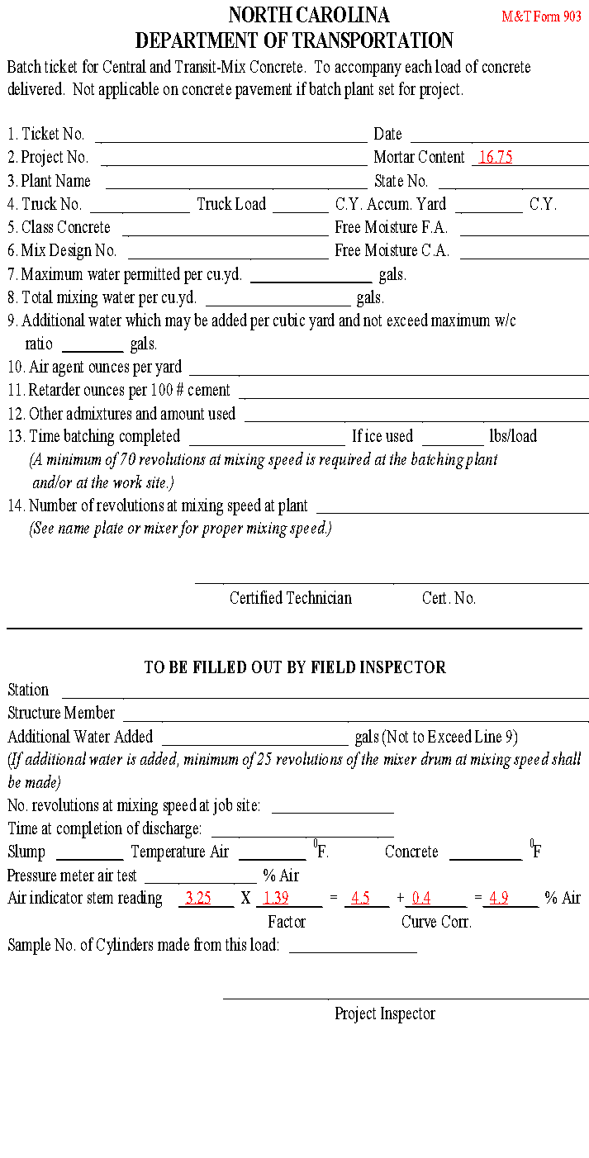
Notes:
194

Slide 195
Notes for Table Use
When using Table 1, round the Mortar Content to the whole number.
To get the Curve Correction using Table 2, round the Mortar Corrected Air Content to the closest half.

Slide 196
CHACE PROBLEM # 1
Mortar Content = 16.37
Chace Indicator Cal. = 1.8
Stem Reading = 3.75
SOLUTION:
3.75 X 1.07 = 4.0 + 0.3 = 4.3%
Pg 224
Notes:
196

Slide 197
NCDOT FORMS
M&T 903 Batch Ticket
NCDOT 312U
M&T Form 250
Sample Card

Slide 198
M&T 903 Form
Pg 60
The M&T 903 batch ticket serves two important functions;
Communication
Documentation
The 903 form is filled out for all incidental and structural concrete sent to a NCDOT project
On page 62, step by step instructions are listed for filling out the M&T 903 batch ticket.
The certified plant batcher fills out the top portion of the ticket based on what is batched.

Slide 199
M&T Form 903 (cont.)
Pg 63
An approved mix design is required before the batcher can batch and send concrete to a NCDOT project.
Upon the arrival of the concrete to the project, the certified field technician receives the M&T 903 batch ticket. The inspector then completes the bottom half of the ticket.
Station – the station number where the concrete is being placed.
Structure Member – is the type of use for the concrete, bridge deck, footing, curb and gutter, etc

Slide 200
M&T Form 903 (cont.)
Additional Water Added – is any water added to the load after the mixing process is complete. This amount should not exceed the amount shown on Line 9 of the batch ticket
Number Revolutions at Mixing Speed at Job Site – for additional mixing on job site if needed.
Time at Completion of Discharge
Slump, Temperature of the Air, and Temperature of the Concrete
Pressure Meter Air Test
Chace Air Indicator
Cylinders – Sample Number of the cylinders

Slide 201
NCDOT FORM 312U
A approved mix design assigned to a project must be used to batch concrete for the project.
A properly assigned mix design will have the project, or contract number, and the signature of the Physical Testing Engineer.
Pg 64

Slide 202
M&T Form 250
Pg 66
The M&T Form 250 is completed by the plant and provided to the Resident Engineer.
The Form 250 provides additional information about the moisture adjustments made by the batcher on the mix design during batching.
The form should be sent with the first and last load of concrete sent to the project each day.

Slide 203
Sample Card
Pg 67
The sample card is completed by the certified field concrete technician when delivering samples to a state lab for testing.
A HiCams number should be assigned and written on the card.
The card should be filled in completely as possible.
For compressive strength cylinders, it is important to fill in the Concrete Mix design used on the project.

