Slide 1
NCDOT RFID Application and Reader
Zachary Leonard

Slide 2
Topics
How to use new NCDOT RFID Application
Connecting Device to Scanner
Scanning tags
Sending tags via email
Adjusting scanner settings

Slide 3
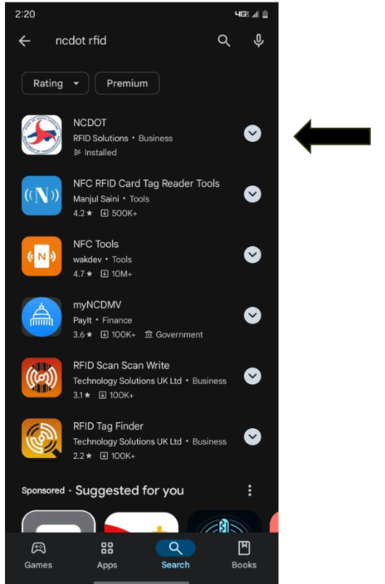
Installation of RFID Application
1. Download the NCDOT RFID (RFID Solutions)

Slide 4
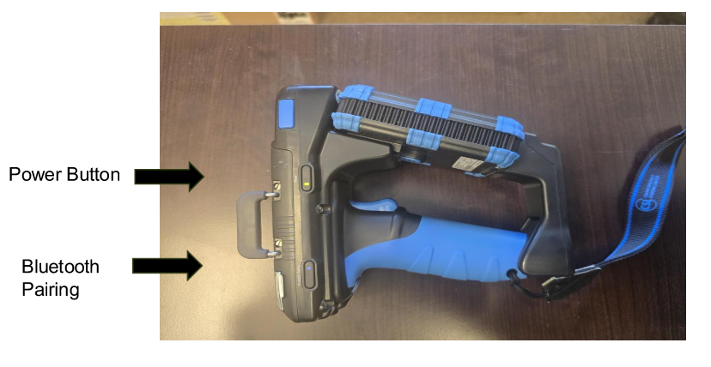
Connecting Device to RFID Reader
Always ensure that the device’s location service and Bluetooth are enabled when using the RFID app
Hold the power button down for three seconds and release to see a green light next to the power button
Ensure the blue light is flashing next to the Bluetooth Pairing button located on the reader

Slide 5
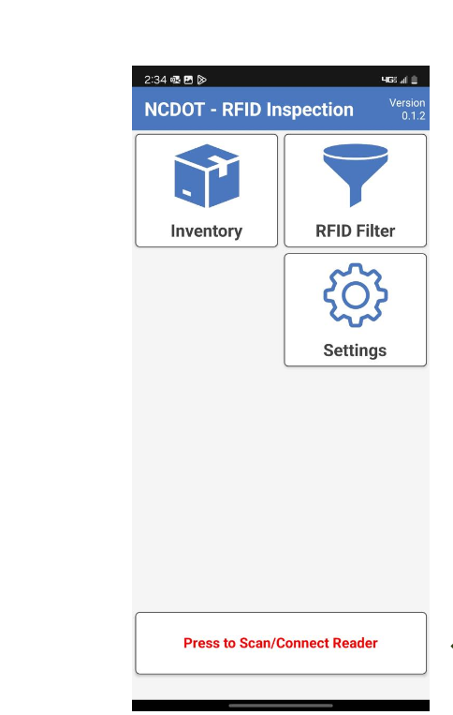
Device Connection
Select “Press to Scan/Connect Reader” highlighted in red to connect your device
Remember to have location services and Bluetooth turned on

Slide 6
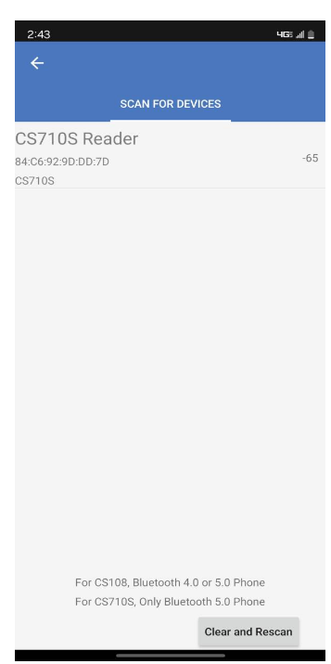
Device Connection
Select your reader from the list of devices
This step is always required when the device is powered back on

Slide 7
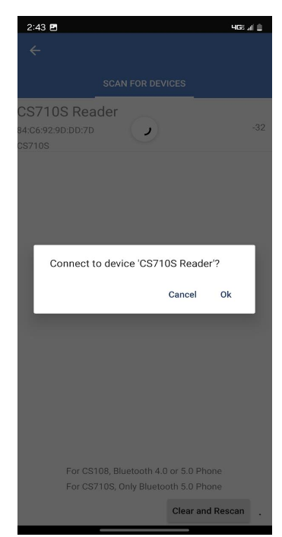
Device Connection
Select “Ok” which will finish connection of the device

Slide 8
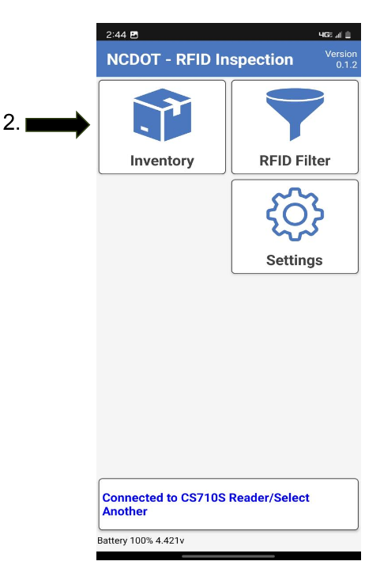
Device Connection
The original box at the bottom should now be blue which means the device is ready for use
Click “Inventory” to start the scanning process.
1.

Slide 9
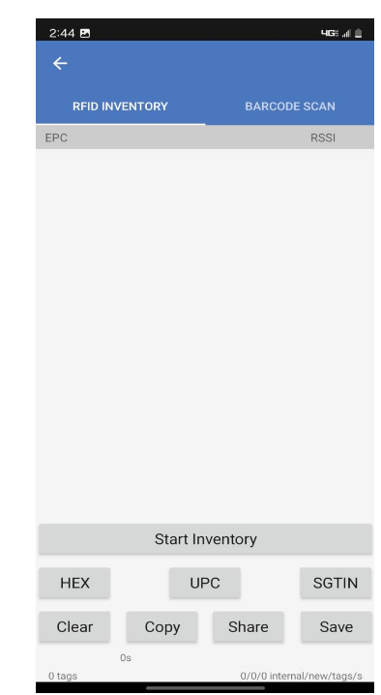
Scanning Tags
Press “Start Inventory” to start the scanning process. Then press “Stop Inventory” to stop the scanning process
The other method is to hold the trigger on the RFID Reader and release until all the tags have been captured.

Slide 10
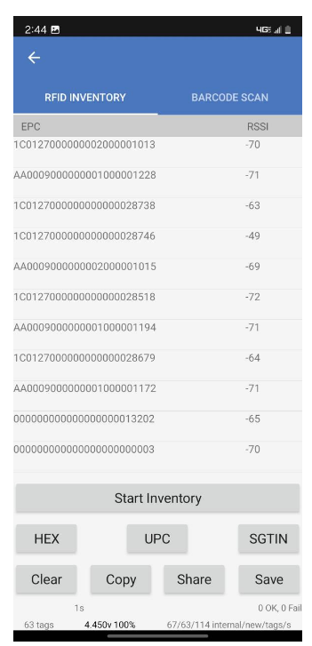
Scanning Tags
Once you have completed scanning, all the tags that were captured will appear on the screen
The number of tags scanned will appear at the bottom left of the screen so you can verify that all tags have been captured.

Slide 11
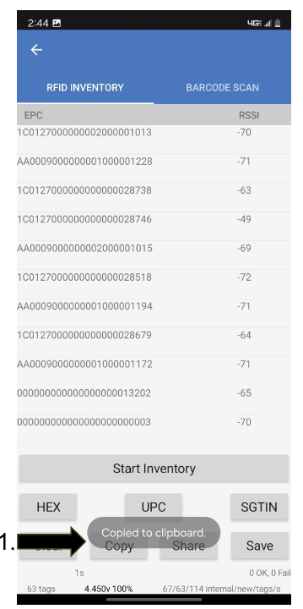
Scanning Tags
Next click the “Copy” button to save the tags to the device’s clipboard which will give a message “Copied to clipboard”
This will allow you to paste the tags into HiCams, Sharepoint, email, etc.

Slide 12
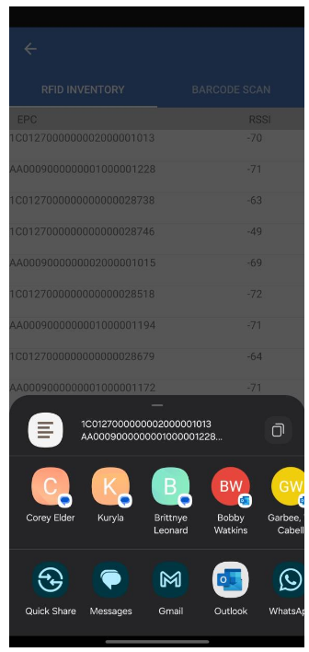
Sending Tags via Email
To send tags via email click the “Share” button next to the “Copy” button which will bring up several options to share the tags
The tags will automatically carry over to the selected method of sharing

Slide 13
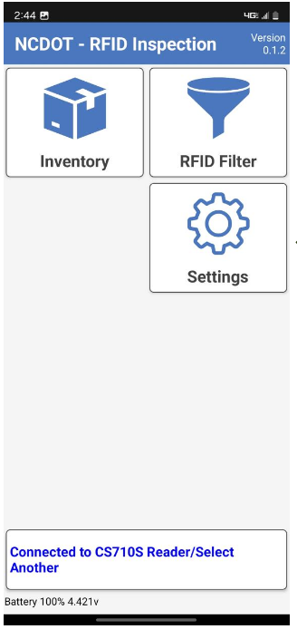
Adjusting Scanner Settings
To adjust the scanner’s range, return to the main menu and select the “Settings” button

Slide 14
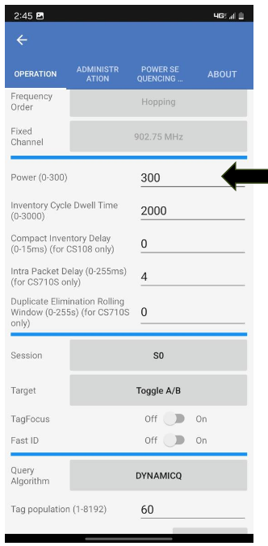
Adjust Scanner Settings
Adjust the power level to the desired level. Some adjustments may need to be made to get the best range.
This option is changed if some material is too close and you do not want extra tags to be scanned

Slide 15
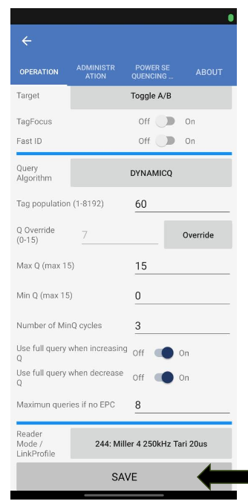
Adjusting Scanner Settings
Each time the power is adjusted you must scroll to the bottom of this page and select “Save” for the adjustments to take place
You should hear a quick beep indicating the changes have been saved

Slide 16
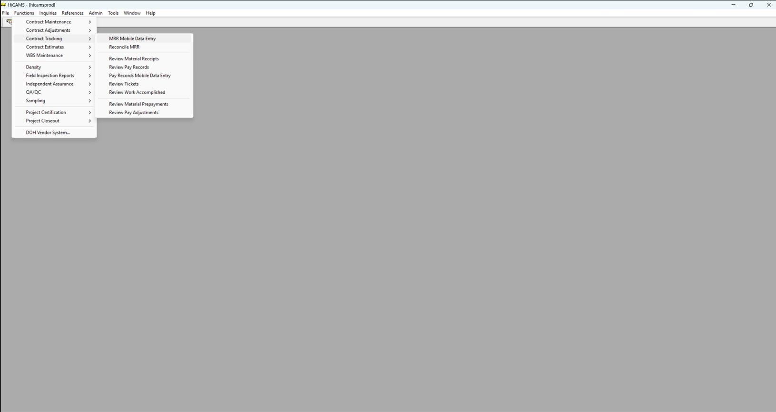
Receiving in HiCAMS
Select Mobile MRR
from List

Slide 17
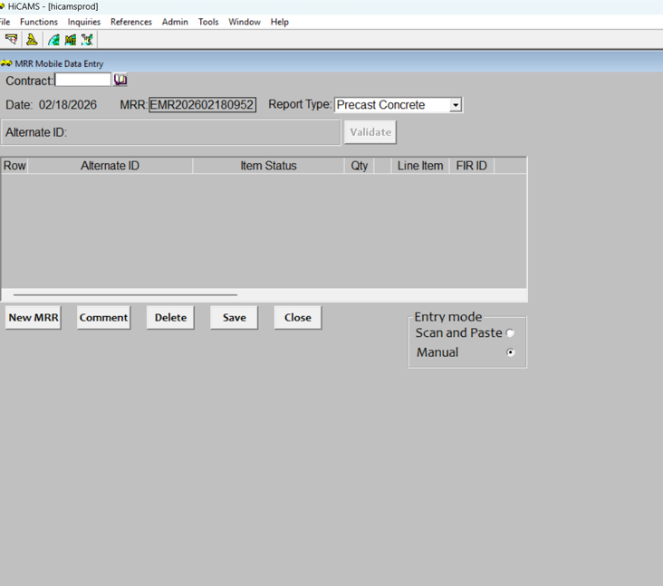
Receiving in HiCAMS cont.
Add contract number

Slide 18
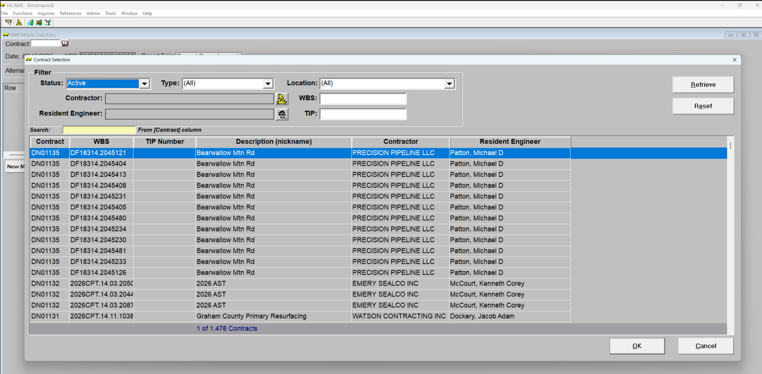
Receiving in HiCAMS cont.
Choose your contract and press OK

Slide 19
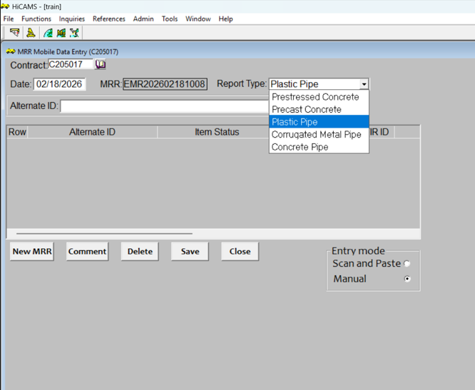
Receiving in HiCAMS cont.
Choose report type from list

Slide 20
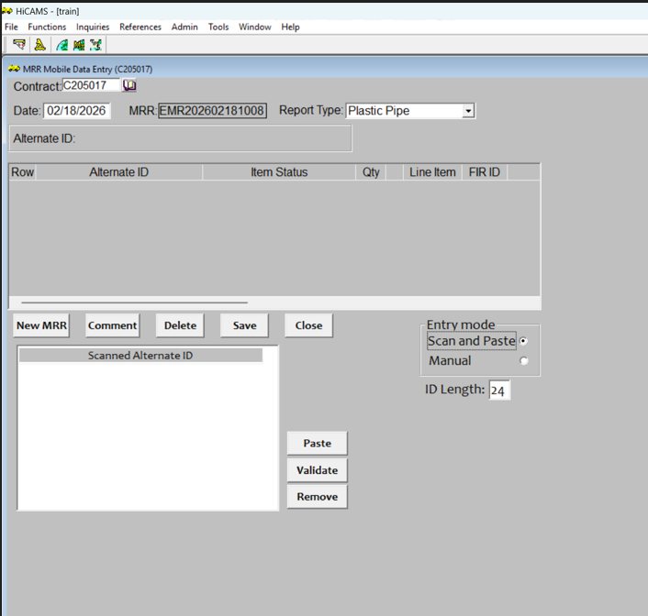
Receiving in HiCAMS cont.
Click Scan and Paste

Slide 21
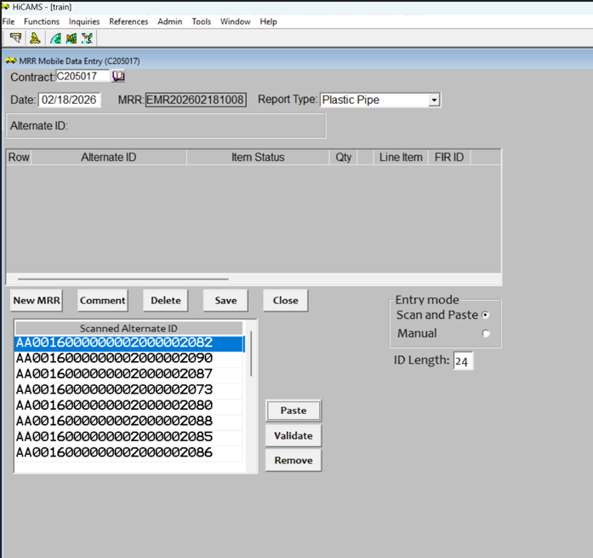
Receiving in HiCAMS cont.
Click Paste

Slide 22
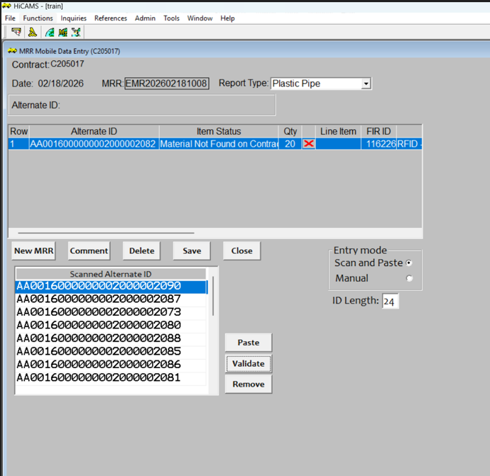
Receiving in HiCAMS cont.
Click Validate to check each Alt ID

Slide 23
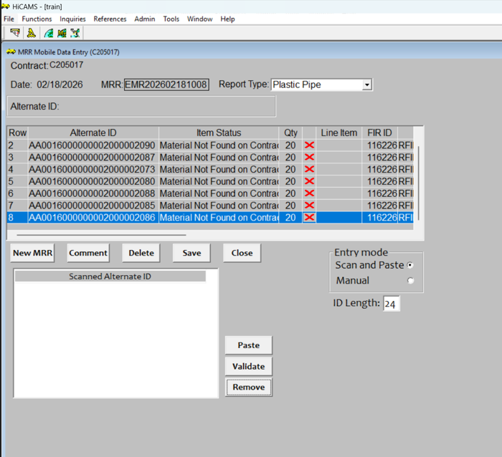
Receiving in HiCAMS cont.
Once all are Validated click New MRR

Slide 24


Zach Leonard
Bobby Watkins
zkleonard@ncdot.gov
ext-bwwatkins@ncdot.gov
919-218-4950
910-900-0573

