Slide 1
Integrated Mobility Division Transit Systems Call
February 9, 2022

Slide 2
AGENDA
Grant opportunities
Grant administration updates
Other Updates and Reminders
Questions

Slide 3
New Grant Opportunities
Notes:
Melanie Henderson – North Carolina Department of Environmental Quality, Environmental Engineer, Mobile Source Compliance Branch, Division of Air Quality – Sharing an overview of Phase 2 of the Volkswagen Settlement Funds grant opportunity
Annamae Giles – Clinical Assistant Professor, UNC Chapel Hill School of Social Work – sharing an overview of a funding opportunity for the Building Capacity for Home & Community Based Services Through Collective Impact program.

Slide 4
Finance Updates and Reminders
Notes:
Myra

Slide 5
Grant Administration & Procurement Updates
Notes:
Pam

Slide 6
Recent Grant Administration Updates
New Regional Grant Specialists for Mountains and Coastal Plains
Anne Galamb, Coastal Plains
Brandi Claybrooks, Mountains
FY22 2nd call for projects under review
Regional Grant Specialist’s ongoing outreach for follow-up.
5307 Transition Updates
Monthly FTA/NCDOT Meetings
RLS recently completed most individual meetings in January. If you have not had your meeting yet, please reach out to Rich Garrity.
Website: https://connect.ncdot.gov/business/Transit/Pages/5307-Transition.aspx
Notes:
Pam

Slide 7
New! Monthly ROAP Reporting Smartsheet Update
ROAP SmartSheet adjustments continue to be refined to enable specific transfer information and to capture sub-allocated funds and trips.
Instructions for submitting the monthly ROAP report will be included on the SmartSheet form.
The catch-up reporting for July – December 2021 can be done in one report, using the month of December
The final adjustments and verbiage will be reviewed this week and then the SmartSheet will be released with adjusted due dates to allow enough time for reporting.
*Anticipated release for later this week (Week of Feb 7)
Notes:
Carolyn

Slide 8
Procurement Updates
Raised Roof Van/LTV Contract Status Update
As of 10/5/21, the previous NCDOT-specific contract for LTVs has expired
Currently finalizing the bid posting for an NCDOT-specific contract for LTVs and Raised Roof Vans
Bid is undergoing final revisions and should be submitted to NC Division of Purchase and Contract before end of January
Contract awards should take place in Q2 of 2022
Reasons for delay of new contract:
Addition of specifications related to electric vehicle options
Lack of current pricing from Ford regarding chassis
Notes:
Chris

Slide 9
Compliance Updates and Reminders

Slide 10
NCDOT Integrated Mobility Division Training Standards
Annual Training and Reporting Requirements – Feb 3, 2022
Topic Areas
ADA
Bloodborne Pathogen*
Defensive Driving
Emergency Procedures for Vehicle Operators
Health Insurance Portability and Accountability Act (HIPAA)
Ride Checks
Illegal Drug Use and Alcohol Misuse
Notes:
Kelly

Slide 11
NCDOT Integrated Mobility Division Training Standards
Changes from previous standards:
Addition of HIPAA
Quarterly Reporting system is changing – July 2022
Recommendation: Develop a reliable, consistent method of tracking refresher training (Excel, Driver file checklist etc..)
Required: Document all training in employee file to include at minimum employee name, training subject, date of training, instructor name/organization, length of training
Notes:
Kelly

Slide 12
IMD Business Guide
Updating the IMD Business Guide: A Two-Phased Approach
Deliver Immediate Changes as Quickly as Possible Including Process and Procedure Updates – January 2022
Update the IMD Business Guide to Include Future Changes in a More User-Friendly, Searchable Tool – Mid 2022
Develop Long Term Support Strategy for Updates and Revisions to the IMD Business Guide
Notes:
Jimmy

Slide 13
IMD Business Guide
Where Are We In This Process?
What Has Been Accomplished? – Phase I
Standard Language Revisions & Updates – Unit Names, Contacts, Verbiage, etc.
Process & Procedure Change Updates – Includes Revised & New Processes/ Procedures
Formatting Updates to the Existing PDF
What Will Be Accomplished? – Phase II
Develop a New Format for the IMD Business Guide – Includes Searchable Format
Anticipated Processes & Procedures – Includes New Processes/Procedures
Implement an Update Strategy – Timely Updates/Revisions to the IMD Business Guide
Notes:
Jimmy

Slide 14
IMD Business Guide
Major Changes in the 2022 IMD Business Guide:
Section | Name | Change Description
EX-00 | Communication with NCDOT IMD | IMD Staff Assignments: Updated to current regional area model for support.
EX-102 | Project Budgeting | Cost Allocation/Indirect Cost Plan: Must be approved by the governing board of the Transportation Agency.
EX-203 | Asset Management | SSP/PR Visit Review: Updated requirements.
EX-301 | Procurements | Piggybacking: Updated requirements and links.
EX-302 | Reimbursements | DBE Payments; Updated requirements for DBE payments.
EX-401 | Vehicle Replacement | Support/Service Vehicles: Clarified mileage requirements for useful life.
EX-404 | Vehicle Procurement | Vehicle Ordering: Clarification on ordering vehicles prior to agreement execution is clarified.
Notes:
Jimmy

Slide 15
IMD Business Guide
Major Changes in the 2022 IMD Business Guide:
Section | Name | Change Description
EX-405 | New Vehicle Arrival and Road Readiness | Delivery, Inspection and Acceptance: Rolling Stock inspection forms must be submitted to IMD within 24 hours of receipt.
EX-407 | Vehicle Maintenance and Control | Vehicle Preventive Maintenance: Clarifies the IMD Safety & Education Section's role for PM compliance. Lift Inspection, testing and preventive maintenance: Clarifies the IMD Safety & Education Section's role for PM compliance. Camera Inspection and Preventive Maintenance: Clarifies maintenance requirements for cameras. Key Control: Added requirements for a Key Control policy.
EX-408 | Disposition of Vehicles | Disposition Changes: Clarifies disposition of a different vehicle other than the one replacing. Notification to IMD of Sale: Clarifies requirements for sale of vehicle and IMD notification.
Notes:
Jimmy

Slide 16
IMD Business Guide
Major Changes in the 2022 IMD Business Guide:
Section | Name | Change Description
EX-502 | Operation of Transit Services | Passenger Mixing and Required policies: Clarified allowable passenger mixing and required policies.
EX-701 | Training | Minimum Training Standards for Operators: Updated to reference new policy mandating Minimum Training Standards and remove the training toolkit reference.
EX-901 | Reporting | Charter Reports & Incident/Accident Reports: Updates reporting requirements to SmartSheet.
EX-1201 | Title VI – Limited English Proficiency– Environmental Justice | Complaint Procedures & Plan Approval: Require submission to IMD for compliance.
EX-1203 | Disadvantaged Business Enterprise | Good Faith Effort: Clarification of a good faith effort. Predicting DBE Use: Clarified required procedure for anticipated DBE use and approval by IMD. DBE Reporting & Payments: Clarified DBE reporting requirement and reporting of DBE payments to NCDOT.
Notes:
Jimmy

Slide 17
IMD Business Guide
Major Changes in the 2022 IMD Business Guide:
Section | Name | Change Description
EX-1401 | Oversight & Monitoring | Facility Condition Review: Clarification that further facility inspection may be required.
EX-2102 | Actual Duties and Responsibilities of the Transit Manager (Director) | This section was revised to include any revised submission requirements, approvals, examples and best practices for duties and reporting.
EX-3003 | Strategic Transportation Investments (STI) Law | Prioritization: Updated language in regard to the latest prioritization round.
EX-3004 | STIP Amendments and FHWA Flexing | STIP Revisions: General clarification of the types of STIP revisions. Flexing Federal Funds: Clarification on flexing funds procedure.
401-1 Attachment | Community Transportation Program Disposition Policy Guidelines & Accident/ Incident Report for Personal Property | New format for Policy. Notification to IMD of Sale: Clarification of process for the disposition/sale of assets.
Notes:
Jimmy

Slide 18
Program Income
Definition: FTA recognizes program income to be gross income (minus the cost of generating program income) earned by the recipient that is directly generated by a supported activity, or earned only as a result of federal funds during a period of performance
Examples of Program Income:
Income from fees for services performed, such as fees collected for servicing tickets for Greyhound.
Income from the use or rental of real or personal property
Rent received from leasing a portion of a facility that is owned by the transit agency
Income from leasing vehicle(s) to another transit system
Income from the sale of advertising from local businesses concessions
Income from the sale of commodities, such as profits from vending machines on property like a transfer station
Notes:
Beth/Ryan

Slide 19
Program Income
Activities that are NOT considered program income:
Interest accrued on grant funds
Refunds, credits, discounts, rebates earned on items purchased with federal funds
Farebox revenues must be deducted from eligible operating expenses before applying for Operating Assistance
Sale of federally-funded assets, such as vehicles, real property or equipment. This process is laid out in FTA Circular 5010 (Award Mgmt Circular)
Notes:
Beth/Ryan

Slide 20
Program Income Guidance
Reporting: Quarterly Reporting
IMD sends a spreadsheet specific to each program for the recording of program income
Utilizing Program Income:
Any income generated must be spent on eligible transit capital and/or operating expenses for that program
References:
Section 5311 Circular (FTA C 9040.1G)
Award Management Requirements (FTA C 5010.1E)
Notes:
Beth/Ryan

Slide 21
Program Income Generated from Emergency Relief Funds
Must Reserve, Track, and Use Properly
Transit agencies have two options when program income is generated from CARES funding:
Deduct program income from eligible expenses when submitting claims (similar to fares).
Reserve and track program income and utilize in the future as match to FTA funds or for eligible transit expenses.
Next Steps
Smartsheet survey will be sent out (2/14) to systems to inquire how they are tracking and utilizing program income generated from CARES
Beth Gay, Compliance Officer, will lead oversight of the submittals
Future actions could include required quarterly reporting, a programmatic review by IMD, and targeted document review during proficiency reviews.
Notes:
Beth/Ryan

Slide 22
Other Updates & Reminders

Slide 23
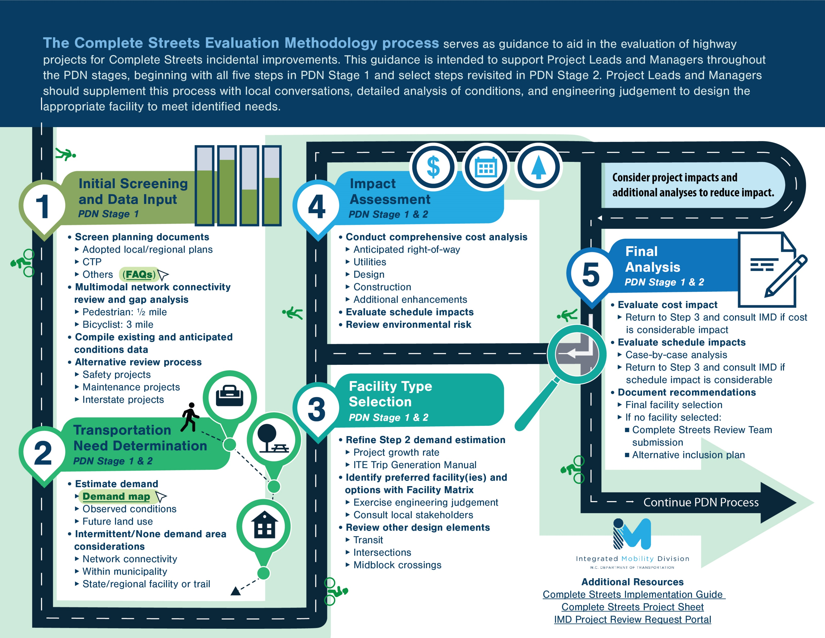
Notes:
Joe Overview

Slide 24
Methodology Update Process to Date
Summer
2021
Develop methodology
CTT review
Fall
2021
Revised facility selection tools
Winter
2021
MPO, RPO, TPD feedback
Incorporated updates
Winter
2022
Summer
2022→
Spring
2022
Finalize and post guidance
Continue trainings
Monitor implementation
Division feedback
CTT review
Updated related guidance
Begin trainings
Initiate work groups
Monitor implementation
Gather data
Gather data
Identify V2 updates
CTT review
Notes:
Joe

Slide 25
Guidance Release
January release of CS guidance and supporting materials to Connect NCDOT:
Evaluation Methodology (new)
Overview Presentation and Video (new)
Implementation Guide (updated)
FAQs (updated)
Project Sheet (updated)
Guidance release paired with online training sessions (for eligible parties)
Track implementation and identify needed process improvements
Notes:
Joe

Slide 26
Complete Streets Training Dates
Wednesday Feb 16th 1:00 – 2:30pm
Thursday Feb 17th 10:00 – 11:30am
Tuesday Feb 22nd 10:00 – 11:30am
Wednesday Feb 23rd 10:00 – 11:30am
Friday Feb 25th 10:00 – 11:30am
Sign up for your preferred date here:
NCDOT Complete Streets

Slide 27
State Management Plan
February – RLS (consultant) making final SMP updates based on public feedback and direction from IMD
February – submit final SMP to FTA
February – share final SMP with transit agencies
Notes:
Ryan

Slide 28
Mobi Awards
2022 MOBI Awards
January-Feb
Nomination
Window
Jan 10-Feb 10
APPLY TODAY
March-April
Finalists Announcement & Event Registration
High profile panel of judges will select the winners
Winners announced at awards luncheon
May 4
MOBI AWARDS
Luncheon
Projects to include two or more modes (bike/ped, aviation, transit, rail, ferry, roadway)
Construction/Implementation has been completed in the past five-year. Previous applicants still eligible, will need to re-submit.
Hosted by the NC Department of Transportation in partnership with NC GO, NC Triangle Chapter of WTS, and ITRE.
Notes:
Ryan – deadline extended to tomorrow, February 10

Slide 29
Proficiency Reviews/SSP Reviews 2022
2020 Proficiency Reviews took 1.5 years to complete due to COVID-19, so we are working on catching up.
Typically, we handle 15-20 reviews a year. In 2022, we have 63 total reviews - 22 PRs, 9 PR/SSP Pilots, 16 SSPs and 16 Advanced Desk Reviews.
We are working towards combing the SSP and PR into a collaborative review that will be more efficient and less administratively burdensome on both the system and IMD. As much of the reviews as possible will be handled virtually and electronically. 9 Systems will pilot this approach this year.
Notes:
Blair

Slide 30
Proficiency Reviews/SSP Reviews 2022
This year’s reviews will be conducted within the next 2-6 months.
We have 5 Consultant Teams that will be splitting the reviews up: KFH Group, RLS, WSP, HDR and AECOM.
If you are scheduled for a review in 2022, you will be notified by IMD in the next few weeks.
The assigned consultant will then contact you to determine reviews dates and will send you the documentation needed to prepare for the review.
Notes:
Blair

Slide 31
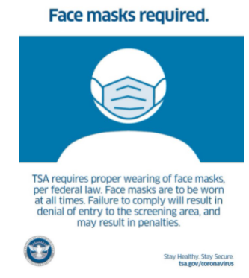
TSA Mask Mandate
The Transportation Security Administration (TSA) is extending the face mask requirement for individuals across all transportation networks throughout the United States, including at airports, onboard commercial aircraft, on over-the-road buses, and on commuter bus and rail systems March 18, 2022.
COVID-19 Response Reporting
Federal Transit Administration (FTA) launched an online application to collect information from recipients and subrecipients on the impacts of COVID-19. The FTA will use information submitted through the application to inform FTA actions in support of the transit industry’s COVID-19 recovery efforts and implementation of the Federal mask requirement for public transportation. Information on the program can be accessed at this link: https://www.transit.dot.gov/COVID-19Data
As of Dec 7, 2021, this requirement was continued indefinitely.
Notes:
Blair

Slide 32
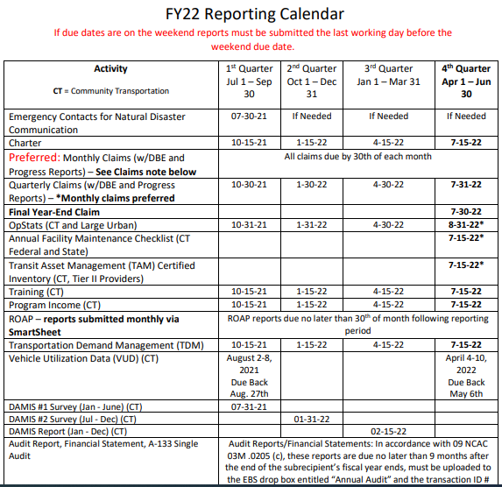
https://connect.ncdot.gov/business/Transit/Documents/NCDOT%20IMD%20FY22%20Calendar.pdf
Notes:
Blair

Slide 33
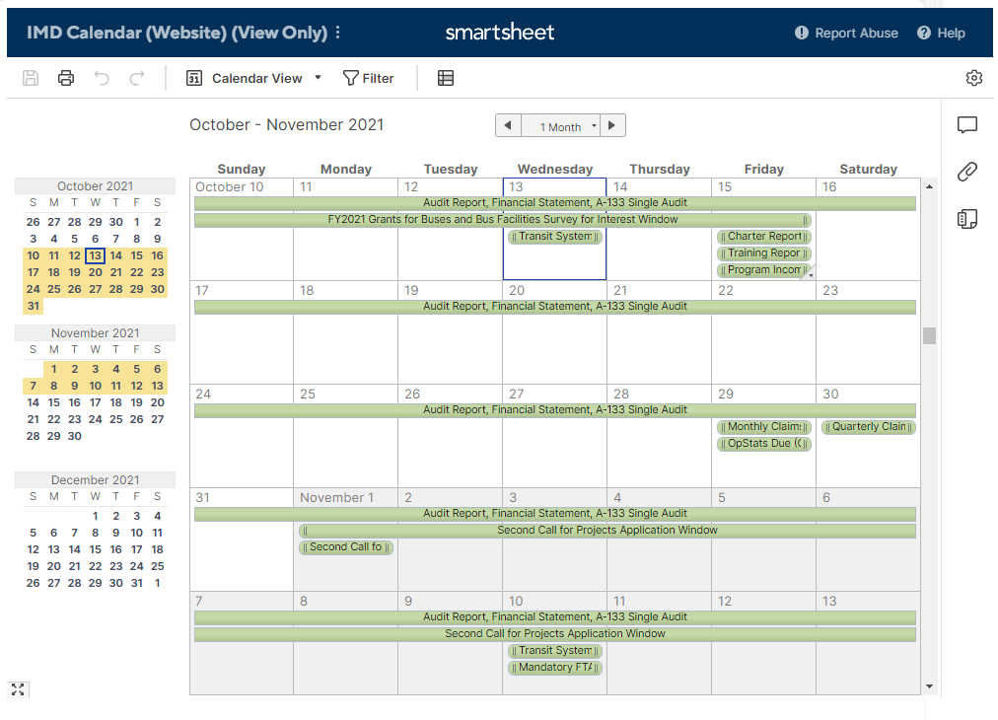
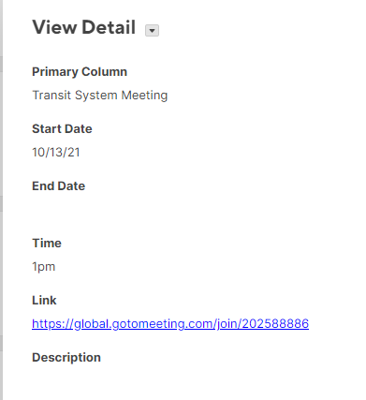
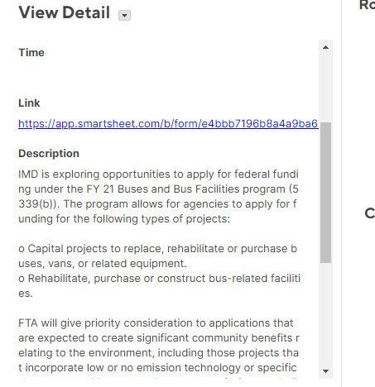
Transit Communication Hub
Notes:
Blair

Slide 34
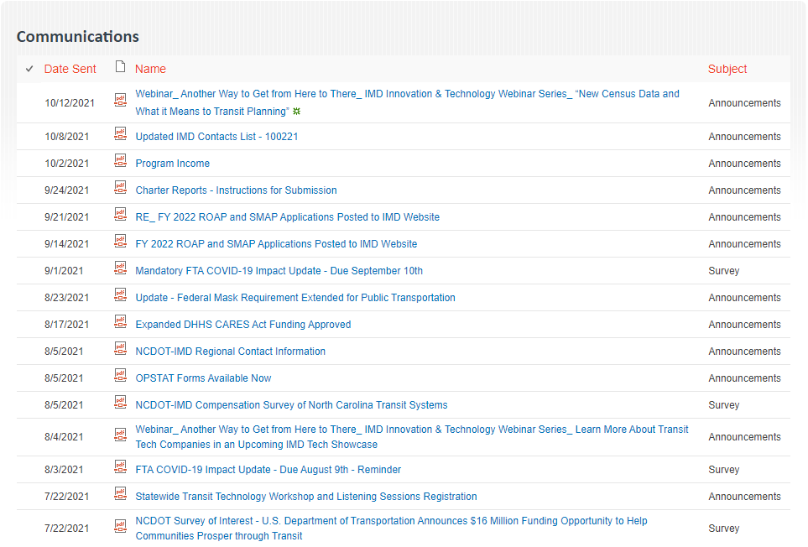
Transit Communication Hub
Notes:
Blair

Slide 35
Notes:
David Rhew

Slide 36
QUESTIONS
Previous slides, recordings and FAQs:
https://connect.ncdot.gov/business/Transit/Pages/Transit-Meeting-Resources.aspx

