Slide 1
Mobile Data Entry for RFID
RFID MRR
NCDOT Materials and Tests Unit

Slide 2
Welcome

Slide 3
WELCOME

Slide 4
Introduction
The final link in the RFID program is the receiving of the project onto the project site.
The producer has entered the quality control and initial production information into the RFID, mostly through the Idencia program.
Idencia is the conduit through which date is transmitted from the producer, and transmitted to HiCAMS.
The NCDOT, through the Materials and Tests technicians, inspect the product pieces to ensure quality control. Materials and Tests also utilizes the Idencia software to transmit test results to HiCAMS.
HiCAMS uses the information transmitted from Idencia to create the Field Inspection Report (FIR). Information transmitted is a combination of the producer’s initial QC process, and the M&T technicians QA inspection.
The project inspector receives the product based on the RFID. If the RFID is in the HiCAMS, the producer’s info and the M&T technicians info has been confirmed and meets specification.
The product is then accepted on the project.

Slide 5
NCDOT Electronic Asset Tracking
Mftr 1
Mftr 2
Mftr 3
HiCAMS
Idencia Data Server
DOT
DOT
DOT

Slide 6
The Acceptance Process

Slide 7
HiCams Entry Mobile App

Slide 8
Access the HiCAMS Mobile App
Log into Citrix using the Apple Ipad tablet
Log into HiCAMS
Go to Contract Tracking in HiCAMS
Next go to MRR Data Entry
Information entered on the RFID tags is accessed by scanning the RFID with a reader app.

Slide 9
MRR Data Screen

Slide 10
Tablet View

Slide 11
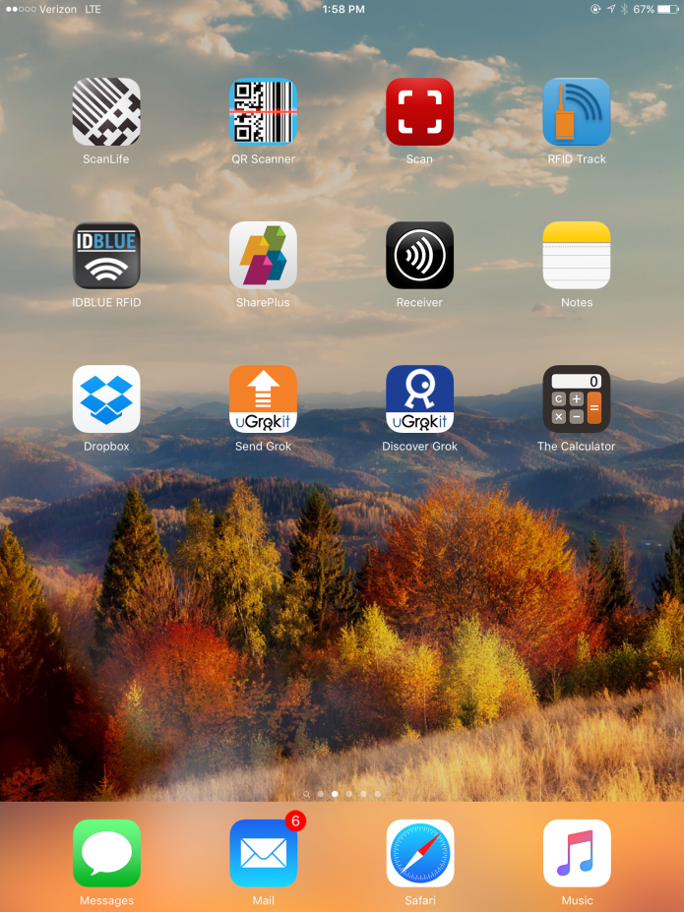
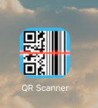
A RFID or a barcode scanner will need to be downloaded and installed on the Ipad.
The app will be used to read the number on the RFID tag.
Once read by the scanner, the number is copied into the HiCAMS MRR application.

Slide 12
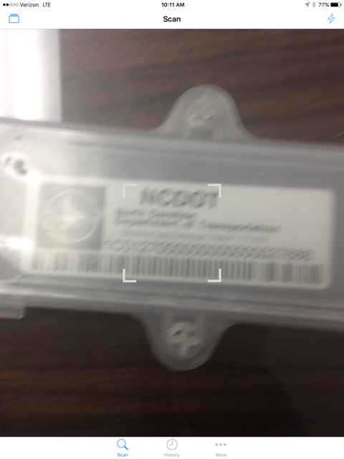
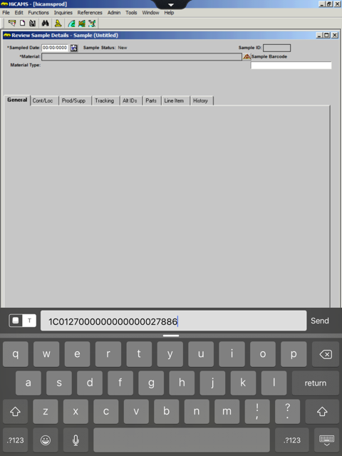
Scanning Process
After opening HiCAMS and selecting MRR, open the selected Scan app
Scan the RFID using the Ipad
Once the tag is recognized by the Ipad, select Copy

Slide 13
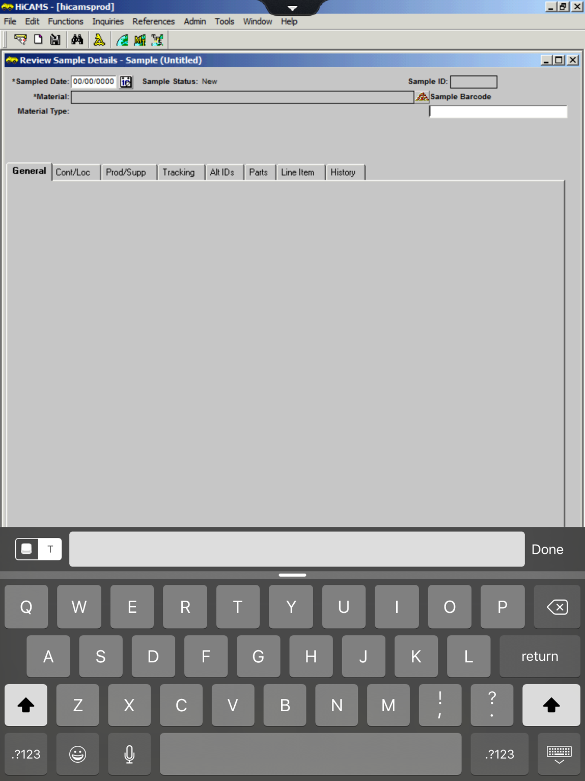
To copy number into the MRR app, first click on the T to open the dialog box.

Slide 14
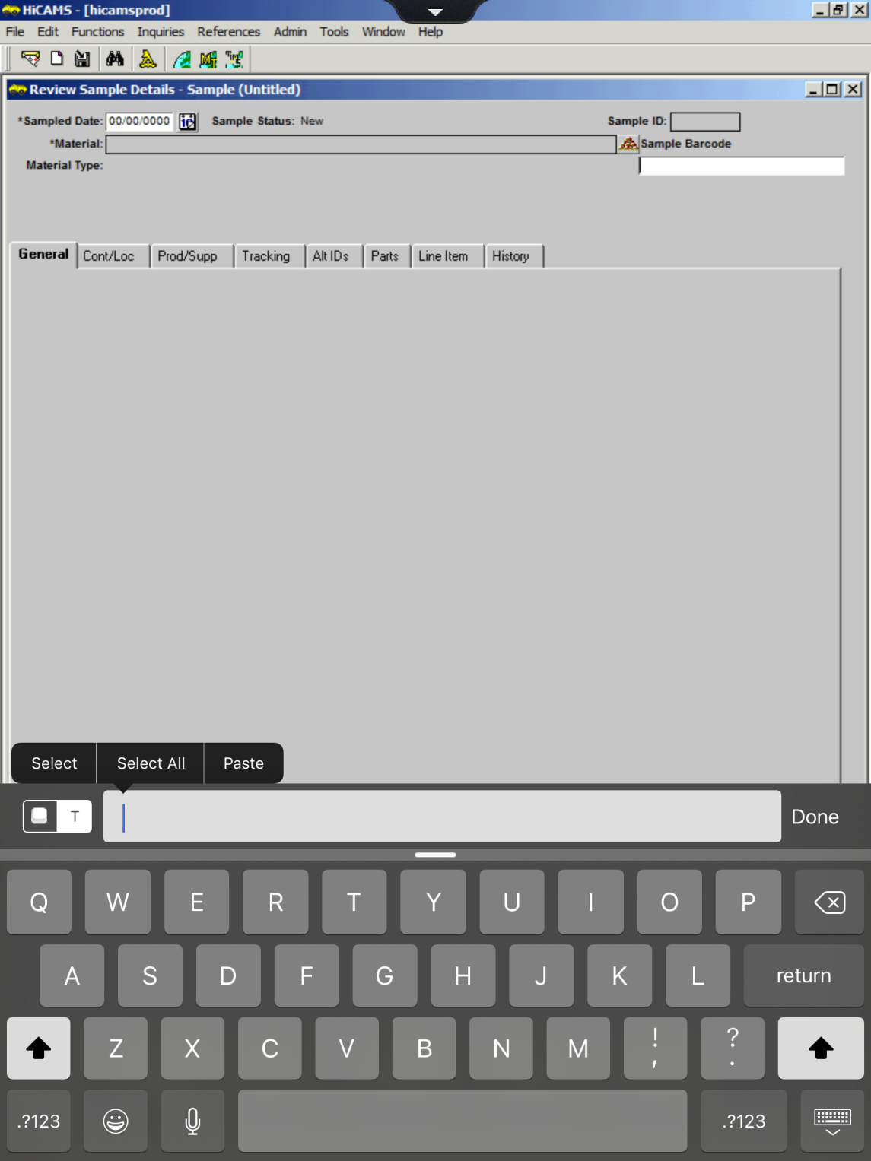
Hold finger on dialogue box until the Paste menu opens.

Slide 15
Click paste to get the scanned number in the dialogue box. Click Send to copy the number into the Alternate ID field.

Slide 17
Field Inspection Report (FIR) example

Slide 18
Validation for MRR
After the RFID number is entered, the MRR first checks to ensure the precast piece is on the CBOM.
If the precast piece is on the CBOM, and listed on a FIR, it will be added to the MRR

Slide 19
MRR

Slide 20
MRR
This item has to be dealt with.

Slide 21
MRR Reconcilation
If a piece is marked as invalid on the MRR, it is sent to the Reconcile screen for further action.
The reconcile screen is located just below the MRR screen on the Contract Tracking tab.
The screen allows further investigation to ensure the piece does not actually belong on the project.
In conjunction with the Reconcile screen, NCDOT Precast Lookup site is also used to verify the status of the precast item.
The address for the Precast Lookup site is https://apps.ncdot.gov/vendor/approvedproducts/PrecastLookup.aspx
After attempting to reconcile, and looking on the Precast Lookup site, the MRR is saved.
The items on the Reconcile window remain their until resolved.

Slide 22
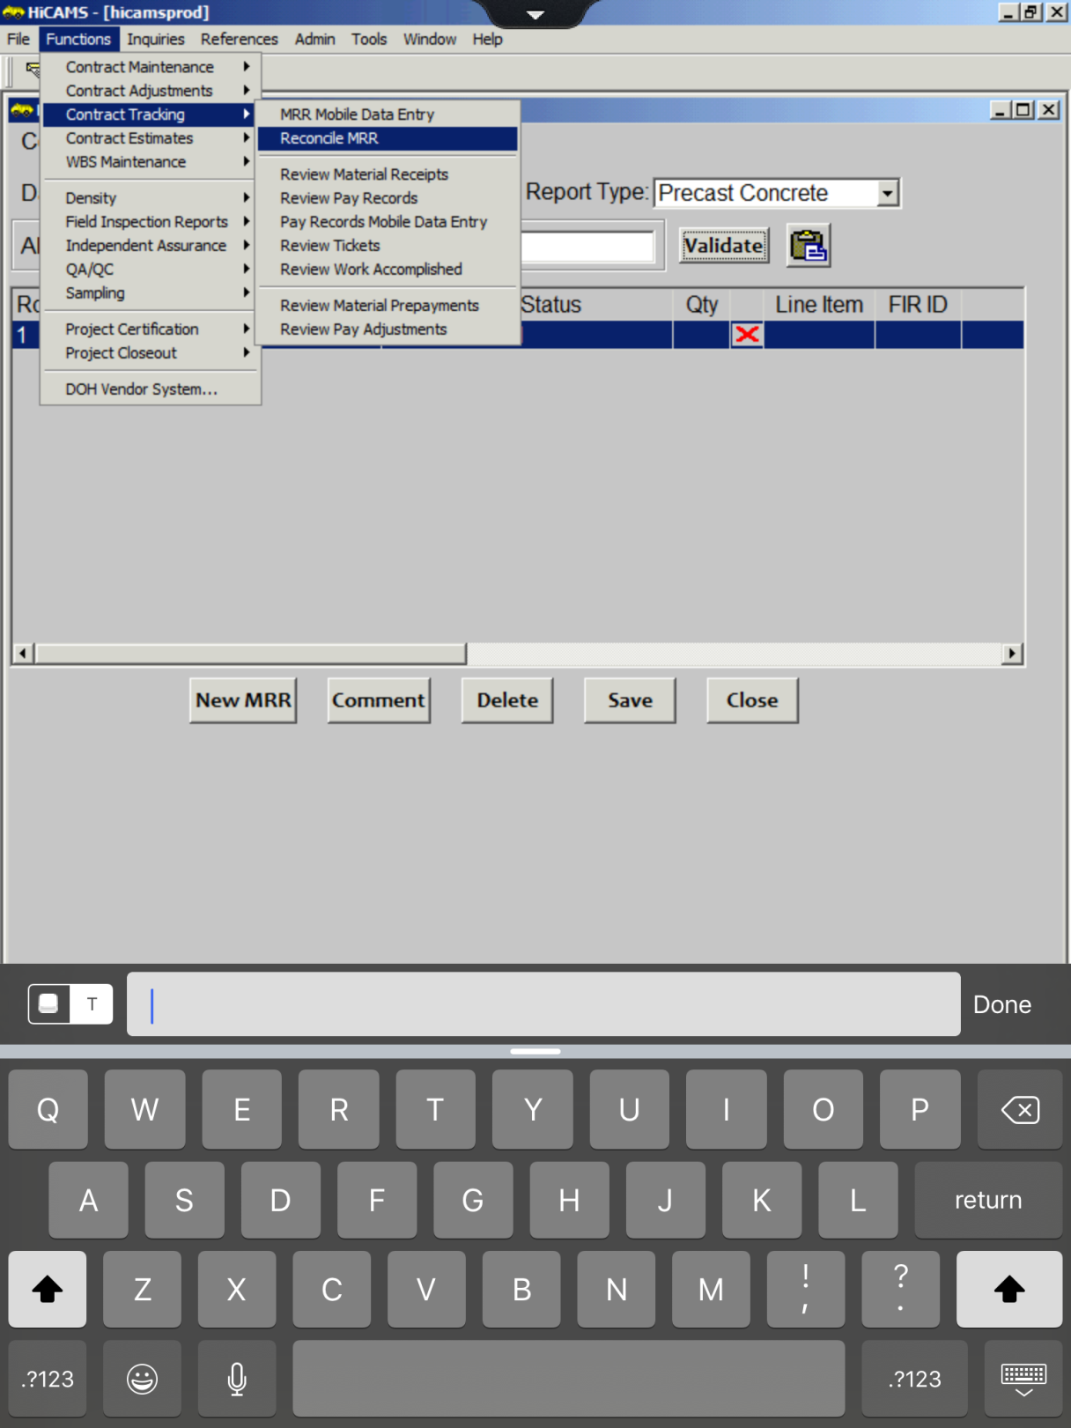
Pull up the Reconcile Screen

Slide 23
Reconcile MRR Screen

Slide 24
Reconcile Screen

Slide 25
NCDOT Precast Lookup

Slide 26
NCDOT Precast Lookup Page

Slide 27
NCDOT Precast Lookup Page-Tag Found

Slide 29
FIR Showing Pieces Received

Slide 30
QUESTIONS

